Slide 1
2023.04.18
Malicious Code Analysis
Fangtian Zhong
CSCI 491
Gianforte School of Computing
Norm Asbjornson College of Engineering

Slide 2
Overview
Arithmetic Instructions
Loops
01
04
Logical Instructions
Variables
02
05
Conditions
03

Slide 3

Arithmetic Instructions
Part One
01

Slide 4

The INC Instruction
The INC instruction is used for incrementing an operand by one. It works on a single operand that can be either in a register or in memory.
The INC instruction has the following syntax −
INC destination
The operand destination could be an 8-bit, 16-bit, 32-bit, or 64-bit operand.
Example
INC RBX ; Increments 64-bit register
INC DL ; Increments 8-bit register
INC [count] ; Increments the count variable

Slide 5
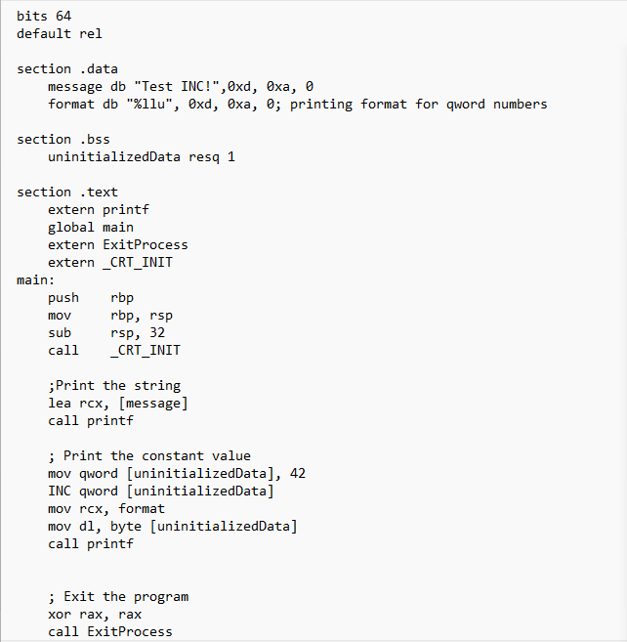
Example: INC

Slide 6
The DEC Instruction
The DEC instruction is used for decrementing an operand by one. It works on a single operand that can be either in a register or in memory.
The DEC instruction has the following syntax −
DEC destination
The operand destination could be an 8-bit, 16-bit, 32-bit or 64-bit operand.

Slide 7
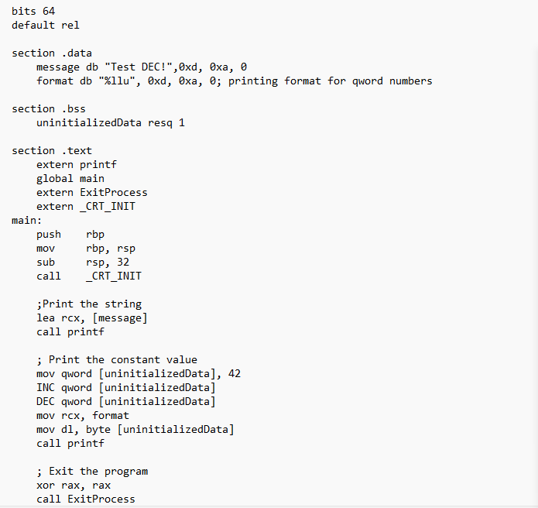
Example: DEC

Slide 8

The ADD and SUB Instructions
The ADD and SUB instructions are used for performing simple addition/subtraction of binary data in byte, word and doubleword size, i.e., for adding or subtracting 8-bit, 16-bit, 32-bit or 64-bit operands, respectively.
The ADD and SUB instructions have the following syntax −
ADD/SUB destination, source
The ADD/SUB instruction can take place between −
Register to register
Memory to register
Register to memory
Register to constant data
Memory to constant data

Slide 9
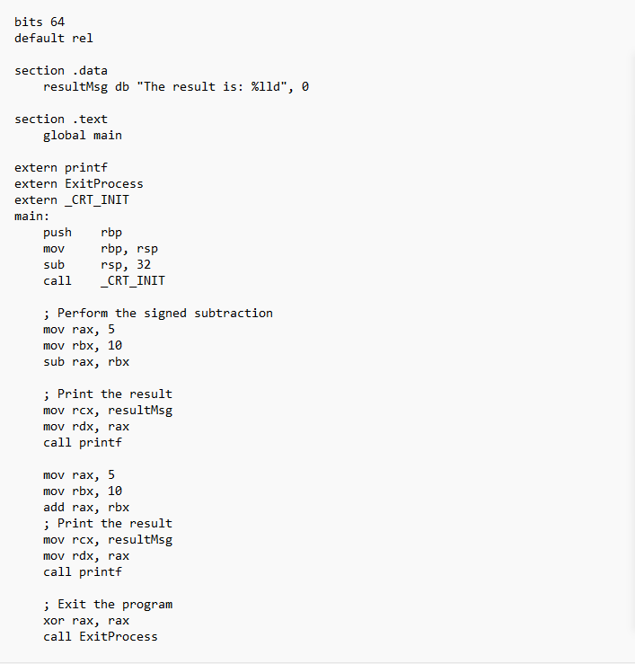
Examples

Slide 10
The MUL/IMUL Instruction
There are two instructions for multiplying binary data. The MUL (Multiply) instruction handles unsigned data and the IMUL (Integer Multiply) handles signed data. Both instructions affect the Carry and Overflow flag.
The syntax for the MUL/IMUL instructions is as follows −
MUL/IMUL multiplier
Multiplicand in both cases will be in an accumulator, depending upon the size of the multiplicand and the multiplier and the generated product is also stored in two registers depending upon the size of the operands.

Slide 11

Different Cases
When two bytes are multiplied −
The multiplicand is in the AL register, and the multiplier is a byte in the memory or in another register. The product is in AX. High-order 8 bits of the product is stored in AH and the low-order 8 bits are stored in AL.

Slide 12

Different Cases
When two one-word values are multiplied −
The multiplicand should be in the AX register, and the multiplier is a word in memory or another register. For example, for an instruction like MUL DX, you must store the multiplier in DX and the multiplicand in AX.
The resultant product is a doubleword, which will need two registers. The high-order (leftmost) portion gets stored in DX and the lower-order (rightmost) portion gets stored in AX.

Slide 13

Different Cases
When two doubleword values are multiplied, the multiplicand should be in EAX and the multiplier is a doubleword value stored in memory or in another register. The product generated is stored in the EDX:EAX registers, i.e., the high order 32 bits gets stored in the EDX register and the low order 32-bits are stored in the EAX register.

Slide 14
Different Cases
When two qword values are multiplied, the multiplicand should be in RAX and the multiplier is a qword value stored in memory or in another register. The product generated is stored in the RDX:RAX registers, i.e., the high order 64 bits gets stored in the RDX register and the low order 64 bits are stored in the RAX register.
EAX X 64 bit Source = RDX RAX

Slide 15
Examples
MOV AL, 10
MOV DL, 25
MUL DL
...
MOV DL, 0FFH ; DL= -1
MOV AL, 0BEH ; AL = -66
IMUL DL

Slide 16
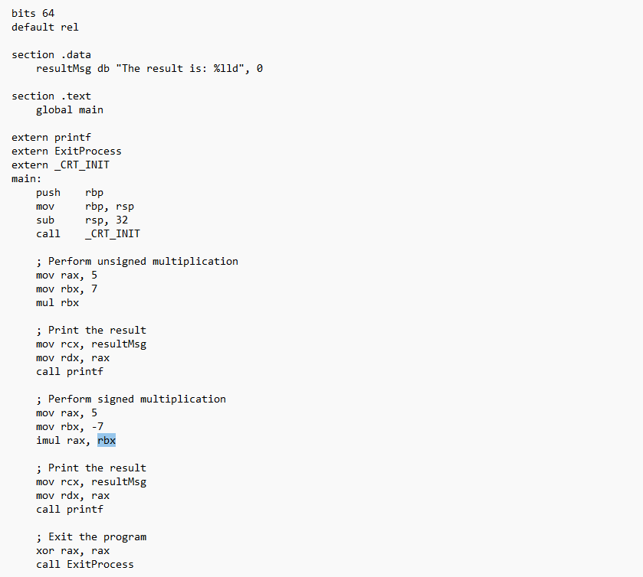
Examples

Slide 17
The DIV/IDIV Instructions
The division operation generates two elements - a quotient and a remainder. In case of multiplication, overflow does not occur because double-length registers are used to keep the product. However, in case of division, overflow may occur. The processor generates an interrupt if overflow occurs.
The DIV (Divide) instruction is used for unsigned data and the IDIV (Integer Divide) is used for signed data.
The format for the DIV/IDIV instruction −
DIV/IDIV divisor

Slide 18
The DIV/IDIV Instructions
The dividend is in an accumulator. Both the instructions can work with 8-bit, 16-bit, 32-bit, or 64 bit operands. The operation affects all six status flags. Following section explains four cases of division with different operand size −

Slide 19
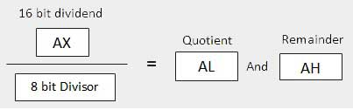
Different Cases
When the divisor is 1 byte −
The dividend is assumed to be in the AX register (16 bits). After division, the quotient goes to the AL register and the remainder goes to the AH register.

Slide 20
Different Cases
When the divisor is 1 word −
The dividend is assumed to be 32 bits long and in the EAX registers. After division, the 16-bit quotient goes to the AX register and the 16-bit remainder goes to the DX register.
EAX/16 bit Divisor = Quotient (AX) And Reminder (DX)

Slide 21
Different Cases
When the divisor is doubleword −
The dividend is assumed to be 64 bits long and in the RAX registers. After division, the 32-bit quotient goes to the EAX register and the 32-bit remainder goes to the EDX register.
RAX/32 bit Divisor = Quotient (EAX) And Remainder (EDX)

Slide 22
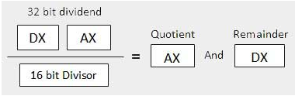
Different Cases
When the divisor is qword −
The dividend is assumed to be 128 bits long and in the RAX registers. The high-order 64 bits are in RDX and the low-order 64 bits are in RAX. After division, the 64-bit quotient goes to the RAX register and the 64-bit remainder goes to the RDX register.
Notes:
Change it accordingly

Slide 23
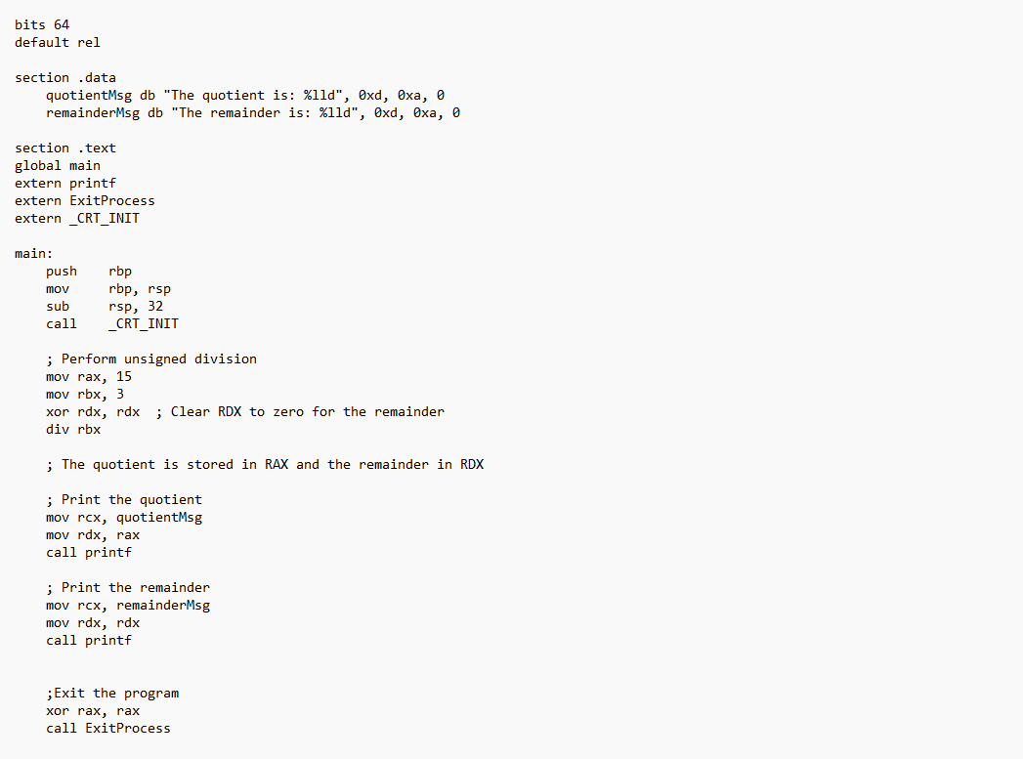
Examples
Notes:
Change it accordingly

Slide 24
Examples
Notes:
Change it accordingly

Slide 25
Part Two
Logical Instructions
02

Slide 26
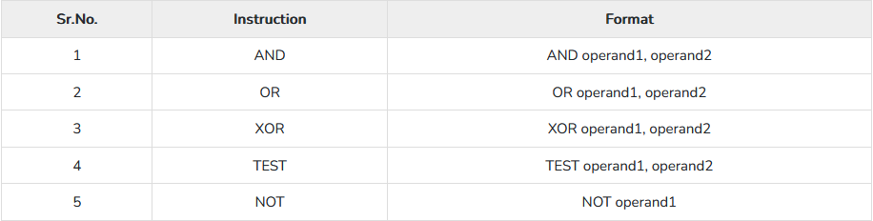
Logical Instructions
The processor instruction set provides the instructions AND, OR, XOR, TEST, and NOT Boolean logic, which tests, sets, and clears the bits according to the need of the program.
The format for these instructions −
The first operand in all the cases could be either in register or in memory. The second operand could be either in
register/memory or an immediate (constant) value. However, memory-to-memory operations are not possible.
These instructions compare or match bits of the operands and set the CF, OF, PF, SF and ZF flags.

Slide 27

The AND Instruction
The AND instruction is used for supporting logical expressions by performing bitwise AND operation. The bitwise AND operation returns 1, if the matching bits from both the operands are 1, otherwise it returns 0. For example −
The AND operation can be used for clearing one or more bits. For example, say the BL register contains 0011 1010. If you
need to clear the high-order bits to zero, you AND it with 0FH.
AND BL, 0FH ; This sets BL to 0000 1010

Slide 28
The AND Instruction
Let's take up another example. If you want to check whether a given number is odd or even, a simple test would be to
check the least significant bit of the number. If this is 1, the number is odd, else the number is even.
Assuming the number is in AL register, we can write −

Slide 29
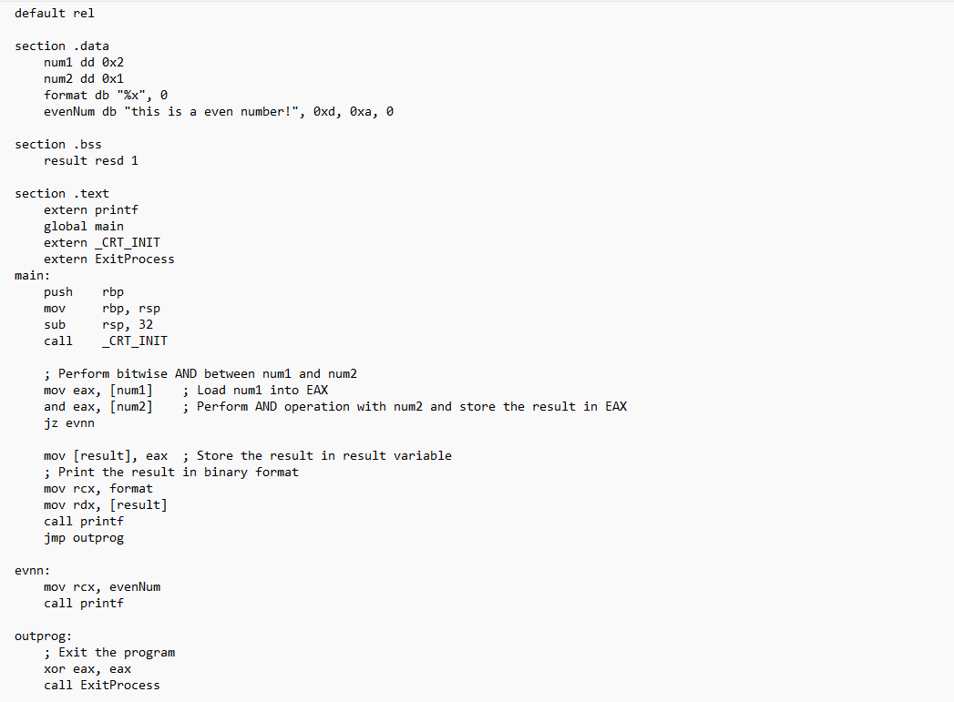
Examples

Slide 30

The OR Instruction
The OR instruction is used for supporting logical expression by performing bitwise OR operation. The bitwise OR
operator returns 1, if the matching bits from either or both operands are one. It returns 0, if both the bits are zero.
For example,
The OR operation can be used for setting one or more bits. For example, let us assume the AL register contains
0011 1010, you need to set the four low-order bits, you can OR it with a value 0000 1111, i.e., FH.

Slide 31
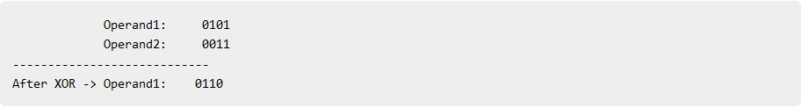
The XOR Instruction
The XOR instruction implements the bitwise XOR operation. The XOR operation sets the resultant bit to 1, if and only
if the bits from the operands are different. If the bits from the operands are same (both 0 or both 1), the resultant bit
is cleared to 0.
For example,
XORing an operand with itself changes the operand to 0. This is used to clear a register.

Slide 32
The TEST Instruction
The TEST instruction works same as the AND operation, but unlike AND instruction, it does not change the first operand.
So, if we need to check whether a number in a register is even or odd, we can also do this using the TEST instruction
without changing the original number.

Slide 33
The NOT Instruction
The NOT instruction implements the bitwise NOT operation. NOT operation reverses the bits in an operand. The
operand could be either in a register or in the memory.
For example,

Slide 34
Part Three
Conditions
03

Slide 35
Condition Execution
Conditional execution in assembly language is accomplished by several looping and branching instructions. These
instructions can change the flow of control in a program. Conditional execution is observed in two scenarios −
Unconditional jump
This is performed by the JMP instruction. Conditional execution often involves a transfer of control to the address of an
instruction that does not follow the currently executing instruction. Transfer of control may be forward, to execute a
new set of instructions or backward, to re-execute the same steps.
Conditional jump
This is performed by a set of jump instructions j<condition> depending upon the condition. The conditional instructions
transfer the control by breaking the sequential flow and they do it by changing the offset value in IP.

Slide 36
CMP Instruction
The CMP instruction compares two operands. It is generally used in conditional execution. This instruction basically
subtracts one operand from the other for comparing whether the operands are equal or not. It does not disturb the
destination or source operands. It is used along with the conditional jump instruction for decision making.
Syntax
CMP destination, source
CMP compares two numeric data fields. The destination operand could be either in register or in memory. The source
operand could be a constant (immediate) data, register or memory.
Example
CMP RAX, 00 ; Compare the DX value with zero
JE L7 ; If yes, then jump to label L7
.
.
L7: ...

Slide 37
CMP Instruction
CMP is often used for comparing whether a counter value has reached the number of times a loop needs to be run.
Consider the following typical condition −
Example
INC RDX
CMP RDX, 10 ; Compares whether the counter has reached 10
JLE LP1 ; If it is less than or equal to 10, then jump to LP1

Slide 38
Unconditional Jump
As mentioned earlier, this is performed by the JMP instruction. Conditional execution often involves a transfer of control to the address of an instruction that does not follow the currently executing instruction. Transfer of control may be forward, to execute a new set of instructions or backward, to re-execute the same steps.
The JMP instruction provides a label name where the flow of control is transferred immediately. The syntax of the JMP instruction is −
JMP label

Slide 39
Examples

Slide 40
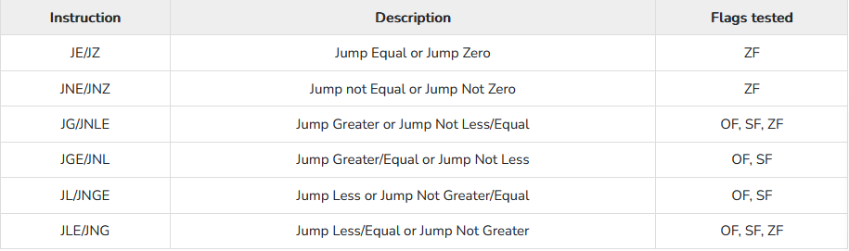
Conditional Jump
If some specified condition is satisfied in conditional jump, the control flow is transferred to a target instruction. There are numerous conditional jump instructions depending upon the condition and data.
Following are the conditional jump instructions used on signed data used for arithmetic operations −

Slide 41
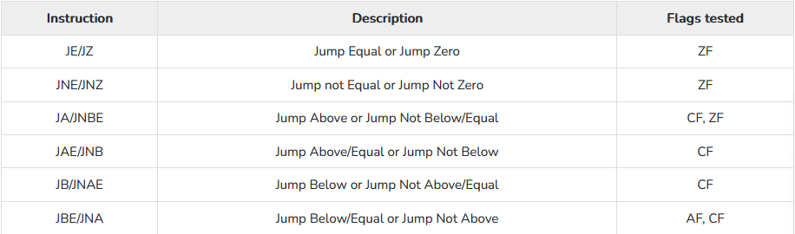
Conditional Jump
Following are the conditional jump instructions used on unsigned data used for logical operations −

Slide 42
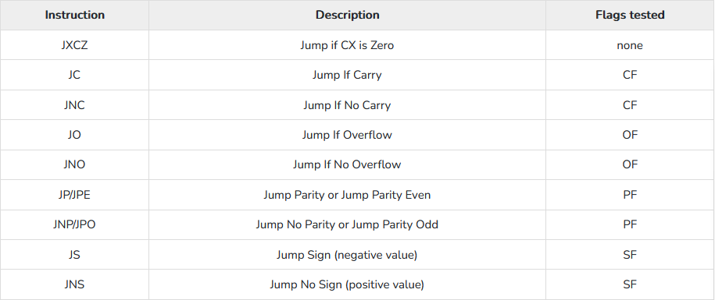

Conditional Jump
The following conditional jump instructions have special uses and check the value of flags −

Slide 43
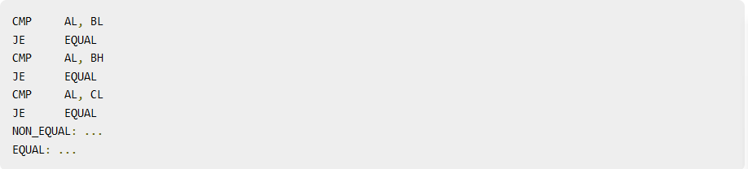
Syntax
The syntax for the J<condition> set of instructions −
Example,

Slide 44

THE END
Fangtian Zhong
CSCI 491
Gianforte School of Computing
Norm Asbjornson College of EngineerinE-mail: fzhong@montana.edu
2023.04.18

