Slide 1
2023.04.18
Malicious Code Analysis
Fangtian Zhong
CSCI 491
Gianforte School of Computing
Norm Asbjornson College of Engineering

Slide 2
Overview
Loops
Recursion
01
04
Numbers, Strings, Array
Variables
02
05
Prcedures and Macros
03

Slide 3

Loops
Part One
01

Slide 4

Loops
The JMP instruction can be used for implementing loops. For example, the following code snippet can be used for executing the loop-body 10 times.
MOV CX, 10
L1:
<LOOP-BODY>
DEC CX
JNZ L1

Slide 5
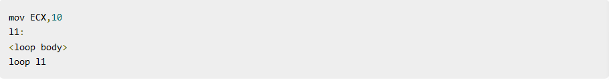
Loops
The processor instruction set, however, includes a group of loop instructions for implementing iteration.
The basic LOOP instruction has the following syntax −
LOOP label
Where, label is the target label that identifies the target instruction as in the jump instructions. The LOOP instruction
assumes that the ECX register contains the loop count. When the loop instruction is executed, the ECX register is
decremented and the control jumps to the target label, until the ECX register value, i.e., the counter reaches the value
zero.
The above code snippet could be written as −

Slide 6
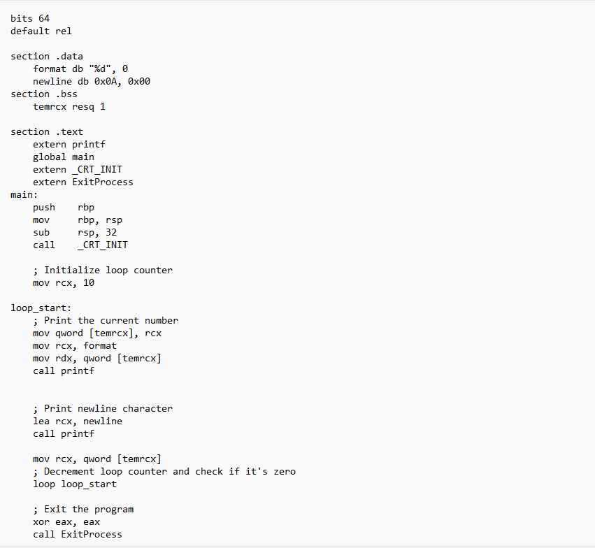
Examples

Slide 7
Numbers, Strings, Arrays
Part Two
02

Slide 8
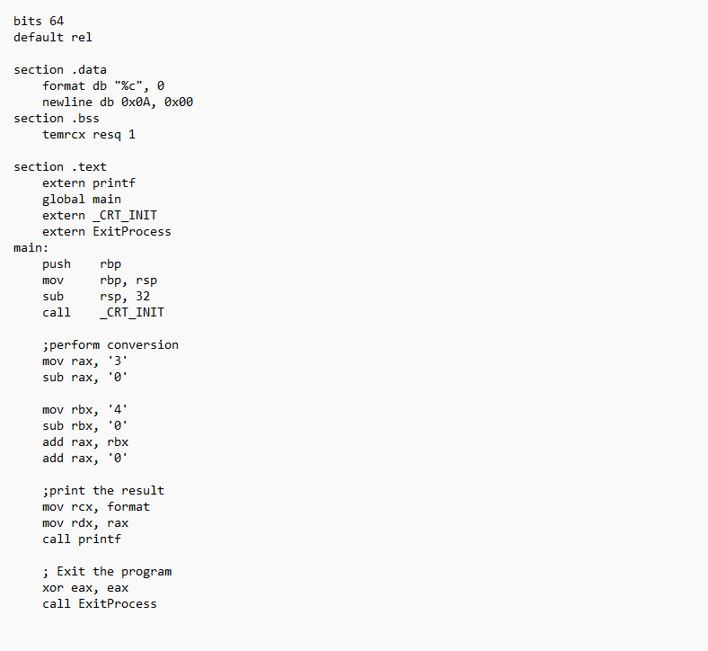
Numbers
Numerical data is generally represented in binary system. Arithmetic instructions operate on binary data.
When numbers are displayed on screen or entered from keyboard, they are in ASCII form.
we have converted this input data in ASCII form to binary for arithmetic calculations and converted the result back
to binary.

Slide 9

The ADD and SUB Instructions
The ADD and SUB instructions are used for performing simple addition/subtraction of binary data in byte, word and doubleword size, i.e., for adding or subtracting 8-bit, 16-bit, 32-bit or 64-bit operands, respectively.
The ADD and SUB instructions have the following syntax −
ADD/SUB destination, source
The ADD/SUB instruction can take place between −
Register to register
Memory to register
Register to memory
Register to constant data
Memory to constant data

Slide 10
Weakness
Such conversions, however, have an overhead, and assembly language programming allows processing numbers in a
more efficient way, in the binary form. Decimal numbers can be represented in two forms −
ASCII form
BCD or Binary Coded Decimal form
ASCII Representation
In ASCII representation, decimal numbers are stored as string of ASCII characters.
For example, the decimal value 1234 is stored as −
31 32 33 34H
Where, 31H is ASCII value for 1, 32H is ASCII value for 2, and so on. There are four instructions for processing numbers
in ASCII representation −
AAA − ASCII Adjust After Addition
AAS − ASCII Adjust After Subtraction
AAM − ASCII Adjust After Multiplication
AAD − ASCII Adjust Before Division
These instructions do not take any operands and assume the required operand to be in the AL register. However, they
are no longer supported in Windows x64.

Slide 11
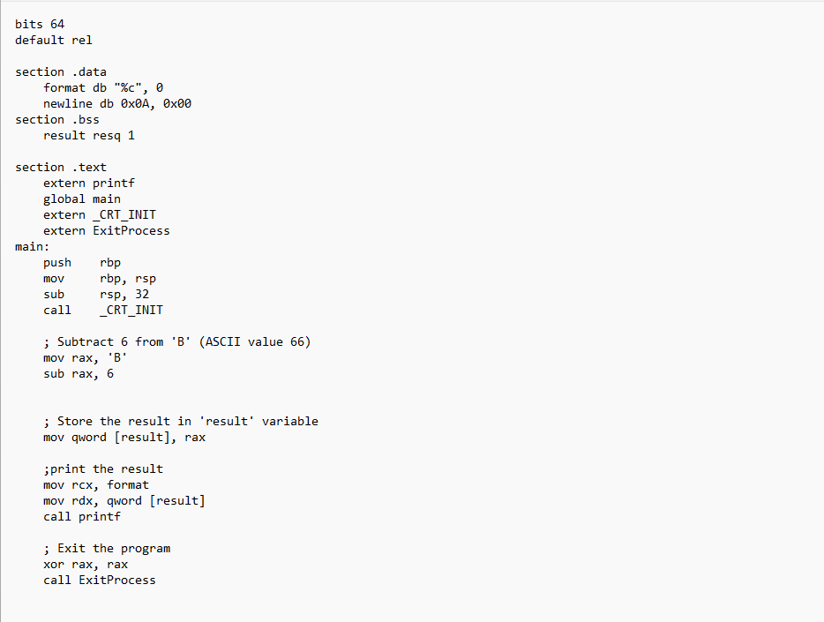
Solution

Slide 12
BCD Representation
There are two types of BCD representation −
Unpacked BCD representation
Packed BCD representation
In unpacked BCD representation, each byte stores the binary equivalent of a decimal digit. For example, the number 1234 is stored as −
01 02 03 04H

Slide 13
BCD Representation
There are two instructions for processing these numbers −
AAM − ASCII Adjust After Multiplication
AAD − ASCII Adjust Before Division
The four ASCII adjust instructions, AAA, AAS, AAM, and AAD, can also be used with unpacked BCD representation. In packed BCD representation, each digit is stored using four bits. Two decimal digits are packed into a byte. For example, the number 1234p is stored as −
12 34H
There are two instructions for processing these numbers −
DAA − Decimal Adjust After Addition
DAS − decimal Adjust After Subtraction
These instructions are no longer supported in Windows x64, only in x86.

Slide 14
Strings
We have already used variable length strings in our previous examples. The variable length strings can have as many
characters as required. Generally, we specify the length of the string by either of the two ways −
Explicitly storing string length
Using a sentinel character
We can store the string length explicitly by using the $ location counter symbol that represents the current value of the
location counter. In the following example −
msg db 'Hello, world!',0xa ;our dear string
len equ $ - msg ;length of our dear string
$ points to the byte after the last character of the string variable msg. Therefore, $-msg gives the length of the string.
We can also write
msg db 'Hello, world!',0xa ;our dear string
len equ 13 ;length of our dear string

Slide 15
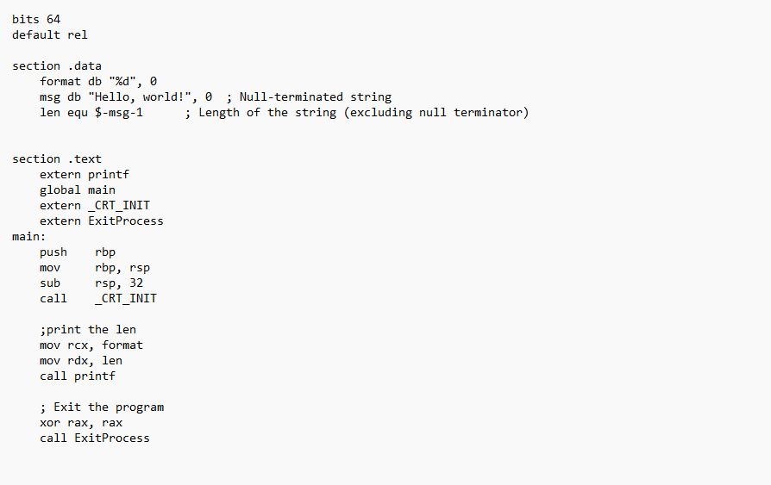
Strings
Alternatively, you can store strings with a trailing sentinel character to delimit a string instead of storing the string length explicitly. The sentinel character should be a special character that does not appear within a string.
For example −
message db 'Hello, world!', 0

Slide 16
String Instructions
Each string instruction may require a source operand, a destination operand or both. For 64-bit segments, string instructions use RSI and RDI registers to point to the source and destination operands, respectively.
For 32-bit segments, however, the ESI and the EDI registers are used to point to the source and destination, respectively.

Slide 17
String Instructions
There are five basic instructions for processing strings. They are −
MOVS − This instruction moves 1 Byte, Word or Doubleword of data from memory location to another.
LODS − This instruction loads from memory. If the operand is of one byte, it is loaded into the AL register, if the operand is one word, it is loaded into the AX register and a doubleword is loaded into the EAX register.
STOS − This instruction stores data from register (AL, AX, or EAX) to memory.
CMPS − This instruction compares two data items in memory. Data could be of a byte size, word or doubleword.
SCAS − This instruction compares the contents of a register (AL, AX or EAX) with the contents of an item in memory.

Slide 18
Examples
Each of the above instruction has a byte, word, doubleword, and quadword version, and string instructions can be repeated by using a repetition prefix.
These instructions use the ES:RDI and DS:RSI pair of registers, where RDI and RSI registers contain valid offset addresses that refers to bytes stored in memory. RSI is normally associated with DS (data segment) and RDI is always associated with ES (extra segment).

Slide 19
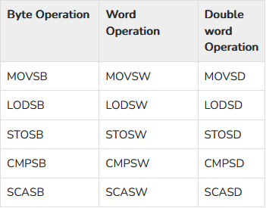
Versions of String Instructions
Quad word Operation
MOVSQ
LODSQ
STOSQ
CMPSQ
SCASQ

Slide 20
Repetition Prefixes
The REP prefix, when set before a string instruction, for example - REP MOVSB, causes repetition of the instruction based on a counter placed at the RCX register. REP executes the instruction, decreases RCX by 1, and checks whether RCX is zero. It repeats the instruction processing until RCX is zero.
The Direction Flag (DF) determines the direction of the operation.
Use CLD (Clear Direction Flag, DF = 0) to make the operation left to right.
Use STD (Set Direction Flag, DF = 1) to make the operation right to left.

Slide 21
REP Prefix Variants
The REP prefix also has the following variations:
REP: It is the unconditional repeat. It repeats the operation until CX is zero.
REPE or REPZ: It is conditional repeat. It repeats the operation while the zero flag indicates equal/zero. It stops when the ZF indicates not equal/zero or when CX is zero.
REPNE or REPNZ: It is also conditional repeat. It repeats the operation while the zero flag indicates not equal/zero. It stops when the ZF indicates equal/zero or when CX is decremented to zero.

Slide 22
Arrays
We have already discussed that the data definition directives to the assembler are used for allocating storage for variables. The variable could also be initialized with some specific value. The initialized value could be specified in hexadecimal, decimal or binary form.
For example, we can define a word variable 'months' in either of the following way −
MONTHS DW 12
MONTHS DW 0CH
MONTHS DW 0110B
The data definition directives can also be used for defining a one-dimensional array. Let us define a one-dimensional
array of numbers.
NUMBERS DW 34, 45, 56, 67, 75, 89
The above definition declares an array of six words each initialized with the numbers 34, 45, 56, 67, 75, 89. This
allocates 2x6 = 12 bytes of consecutive memory space. The symbolic address of the first number will be NUMBERS
and that of the second number will be NUMBERS + 2 and so on.

Slide 23
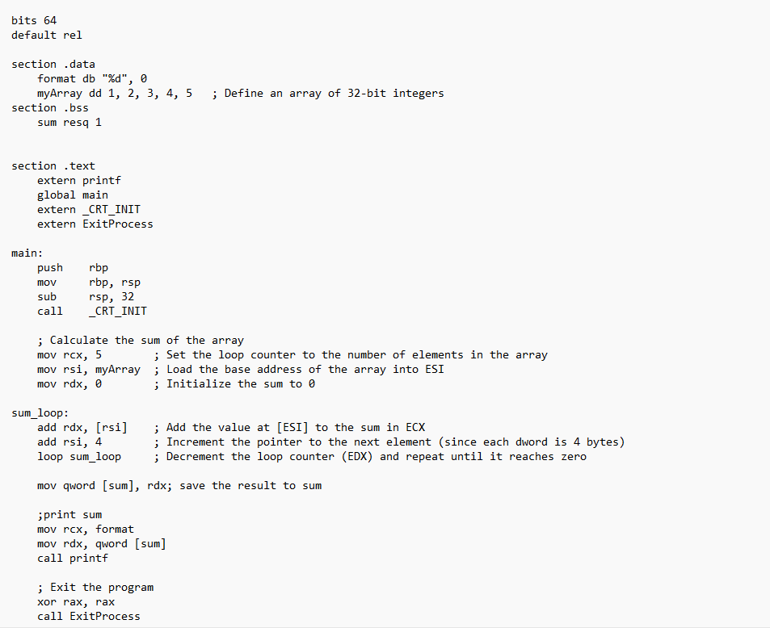
Examples
The times directive can also be used for multiple initializations to the same value. Using times, the inventory array can be defined as:
inventory times 8 dw 0

Slide 24
Part Three
Procedures, Recursion, Macro
03

Slide 25
Procedures
Procedures or subroutines are very important in assembly language, as the assembly language programs tend to be large in size. Procedures are identified by a name. Following this name, the body of the procedure is described which performs a well-defined job. End of the procedure is indicated by a return statement.
Following is the syntax to define a procedure −
proc_name:
procedure body
...
ret

Slide 26
call instruction
The procedure is called from another function by using the call instruction. The call instruction should have the name of the called procedure as an argument as shown below −
call proc_name
The called procedure returns the control to the calling procedure by using the ret instruction.

Slide 27
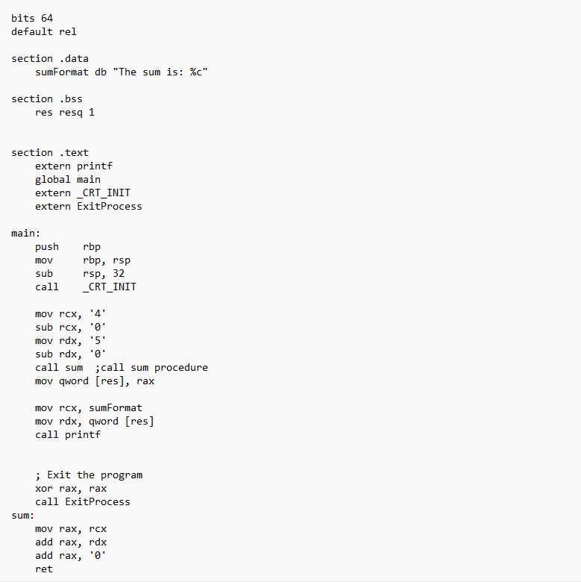
Examples

Slide 28
Stacks Data Structure
A stack is an array-like data structure in the memory in which data can be stored and removed from a location
called the 'top' of the stack. The data that needs to be stored is 'pushed' into the stack and data to be retrieved is
'popped' out from the stack. Stack is a LIFO data structure, i.e., the data stored first is retrieved last.
Assembly language provides two instructions for stack operations: PUSH and POP. These instructions have syntaxes like −
PUSH operand
POP address/register
The memory space reserved in the stack segment is used for implementing stack. The registers SS and RSP (ESP or SP) are
used for implementing the stack. The top of the stack, which points to the last data item inserted into the stack is pointed to
by the SS:RSP register, where the SS register points to the beginning of the stack segment and the RSP (ESP or SP) gives the
offset into the stack segment.

Slide 29
Stack Characteristics
The stack implementation has the following characteristics −
Only words or doublewords could be saved into the stack, not a byte.
The stack grows in the reverse direction, i.e., toward the lower memory address
The top of the stack points to the last item inserted in the stack; it points to the lower byte of the last word inserted.
As we discussed about storing the values of the registers in the stack before using them for some use;
it can be done in following way −
; Save the AX and BX registers in the stack
PUSH RAX
PUSH RBX
; Use the registers for other purpose
MOV RAX, VALUE1
MOV RBX, VALUE2
...
MOV VALUE1, RAX
MOV VALUE2, RBX
; Restore the original values
POP RBX
POP RAX

Slide 30
Recursion
A recursive procedure is one that calls itself. There are two kind of recursion: direct and indirect. In direct recursion,
the procedure calls itself and in indirect recursion, the first procedure calls a second procedure, which in turn calls the
first procedure.
Recursion could be observed in numerous mathematical algorithms. For example, consider the case of calculating the
factorial of a number. Factorial of a number is given by the equation −
Recursion could be observed in numerous mathematical algorithms. For example, consider the case of calculating the
factorial of a number. Factorial of a number is given by the equation −
Fact (n) = n * fact (n-1) for n > 0
For example: factorial of 5 is 1 x 2 x 3 x 4 x 5 = 5 x factorial of 4 and this can be a good example of showing a recursive
procedure. Every recursive algorithm must have an ending condition, i.e., the recursive calling of the program should
be stopped when a condition is fulfilled. In the case of factorial algorithm, the end condition is reached when n is 0.

Slide 31
Macros
Writing a macro is another way of ensuring modular programming in assembly language.
A macro is a sequence of instructions, assigned by a name and could be used anywhere in the program.
In NASM, macros are defined with %macro and %endmacro directives.
The macro begins with the %macro directive and ends with the %endmacro directive.
The Syntax for macro definition −
%macro macro_name number_of_params
<macro body>
%endmacro
Where, number_of_params specifies the number parameters, macro_name specifies the name of the macro.
The macro is invoked by using the macro name along with the necessary parameters. When you need to use some
sequence of instructions many times in a program, you can put those instructions in a macro and use it instead of
writing the instructions all the time.

Slide 32
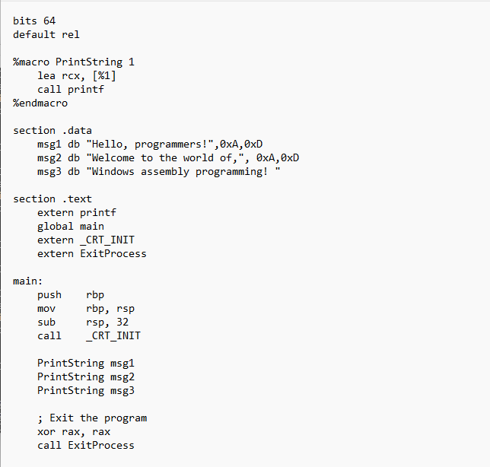
Macros
For example, a very common need for programs is to write a string of characters in the screen.
For displaying a string of characters, you need the following sequence of instructions −
lea rcx, [msg]
call printf

Slide 33

THE END
Fangtian Zhong
CSCI 491
Gianforte School of Computing
Norm Asbjornson College of EngineerinE-mail: fzhong@montana.edu
2023.04.18

