Slide 1
2023.04.18
Malicious Code Analysis
Fangtian Zhong
CSCI 491
Gianforte School of Computing
Norm Asbjornson College of Engineering

Slide 2
Overview
File Management
Recursion
01
04
Memory Management
Variables
02
05
Prcedures and Macros
03

Slide 3

File Management
Part One
01

Slide 4

File Management System
In Windows x64 assembly, file management can be accomplished using the WinAPI functions provided by the operating system. These functions allow you to perform various operations such as creating, opening, reading, writing, and closing files.There are three standard file streams −
Standard input (stdin),
Standard output (stdout), and
Standard error (stderr).

Slide 5
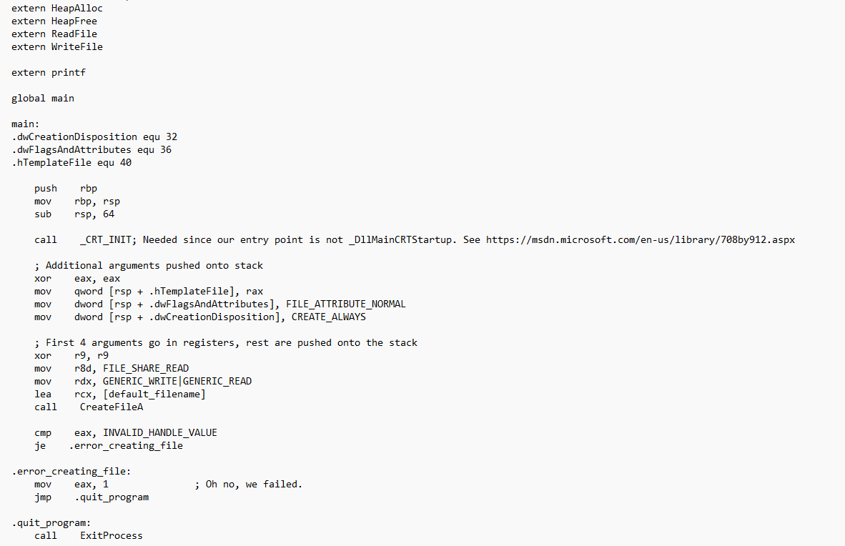
Create or Open a File:
To create a new file or open an existing file, you can use the CreateFile function. This function allows you to specify the
file name, desired access mode, file attributes, and other parameters. It returns a handle to the file that you can use for
subsequent operations.
HANDLE CreateFileA(
[in] LPCSTR lpFileName,
[in] DWORD dwDesiredAccess,
[in] DWORD dwShareMode,
[in, optional] LPSECURITY_ATTRIBUTES lpSecurityAttributes,
[in] DWORD dwCreationDisposition,
[in] DWORD dwFlagsAndAttributes,
[in, optional] HANDLE hTemplateFile
);

Slide 6
Create or Open a File:

Slide 7
Write
To write data to a file, you can use the WriteFile function. Similar to ReadFile, you need to provide the file handle, a
buffer containing the data to write, the number of bytes to write, and other required parameters. The function writes
the specified number of bytes from the buffer to the file.
BOOL WriteFile(
[in] HANDLE hFile,
[in] LPCVOID lpBuffer,
[in] DWORD nNumberOfBytesToWrite,
[out, optional] LPDWORD lpNumberOfBytesWritten,
[in, out, optional] LPOVERLAPPED lpOverlapped
);

Slide 8
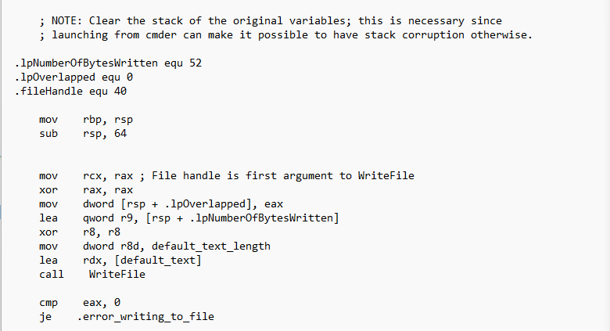
Write

Slide 9
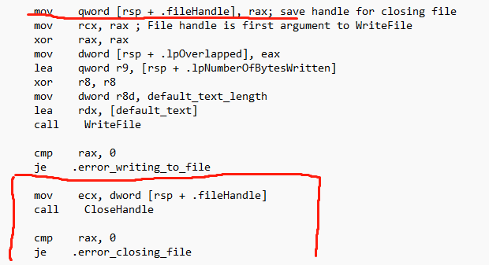
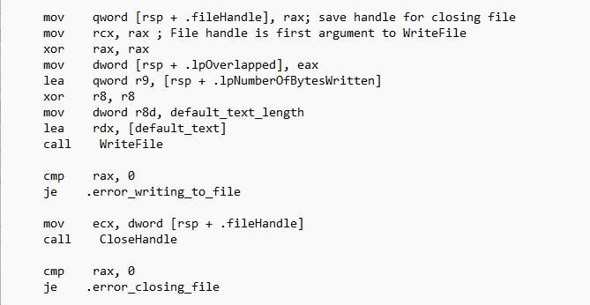
Close
After you finish working with a file, it's important to close it using the CloseHandle function. This function takes the file
handle as a parameter and releases any resources associated with the file.

Slide 10
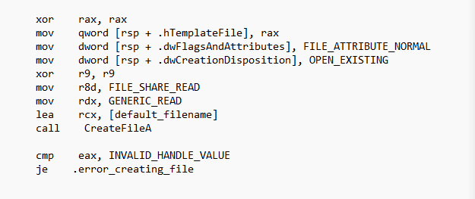
Read
To read data from a file, you can use the ReadFile function. You need to provide the file handle, a buffer to store the read
data, the number of bytes to read, and other necessary parameters. The function reads the specified number of bytes
from the file and stores them in the provided buffer.

Slide 11
Memory Management
Part Two
02

Slide 12
Memory Management System
In Windows x64 assembly, memory management is primarily handled by the operating system. However, as a developer,
you can interact with the memory management system using various WinAPI functions to allocate, deallocate, and
manipulate memory.
It's important to note that memory management in Windows x64 assembly involves a combination of assembly
instructions and WinAPI function calls. The assembly instructions are used to perform low-level memory operations,
while the WinAPI functions provide a higher-level interface to interact with the memory management system.

Slide 13

Allocate Memory
To allocate memory dynamically, you can use the HeapAlloc function. This function allows you to specify the size of the memory block, the desired allocation type, and other parameters. It returns a pointer to the allocated memory block.
DECLSPEC_ALLOCATOR LPVOID HeapAlloc(
[in] HANDLE hHeap,
[in] DWORD dwFlags,
[in] SIZE_T dwBytes
);

Slide 14
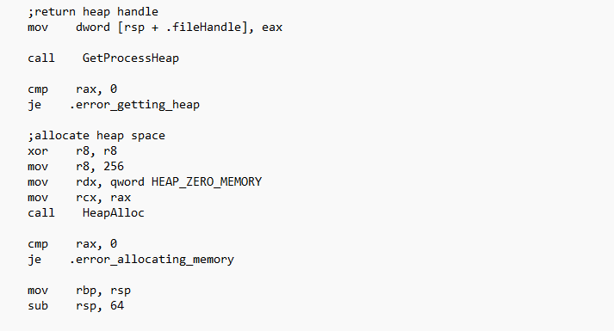
Allocate Memory

Slide 15
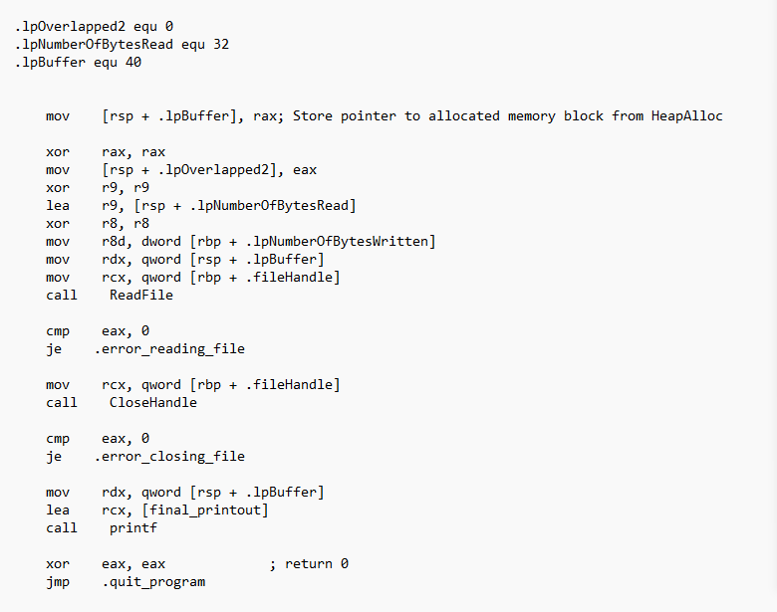
Read or Write Memory
Once you have allocated memory, you can read from or write to it using standard memory access instructions in
assembly, such as mov, add, sub, etc.

Slide 16
Deallocate Memory
To release the previously allocated memory, you can use the HeapFreefunction. This function takes the pointer to the
memory block and frees the associated memory. It also allows you to specify the desired release type and other parameters.

Slide 17

THE END
Fangtian Zhong
CSCI 491
Gianforte School of Computing
Norm Asbjornson College of EngineerinE-mail: fzhong@montana.edu
2023.04.18

