Slide 1

2023.11.02
Malicious Code Analysis
Fangtian Zhong
CSCI 591
Gianforte School of Computing
Norm Asbjornson College of Engineering
E-mail: fangtian.zhong@montana.edu

Slide 2

Part One
angr
01

Slide 3

angr
Framework for the analysis of binaries
Supports a number of architectures
x86, x64, MIPS, ARM, PPC, etc.
http://angr.io
https://github.com/angr

Slide 4

angr issues
angr is heavily developed and continuously re-worked
Backward-compatibility is not a priority
Expect some level of frustration
Expect some things in this tutorial to be outdated

Slide 5
angr Components
Binary Loader
angr
Control-Flow Graph
Static Analysis Routines
Data-Flow Analysis
Value-Set Analysis
Symbolic Execution Engine
Forward Symbolic Execution
Under-constrained SE

Slide 6
Installing angr (on Windows)
Use angr framework by pyCharm
Step 1: angr is a library for Python 3.8+, and must be installed into your Python environment before it can be used.
https://www.python.org/downloads/release/python-3810/
Step 2: pip install virtualenv
Step 3: download git from https://git-scm.com/download/win
Step 4: download pyCharm from https://www.jetbrains.com/pycharm/download/#section=windows
Step 5: Open pyCharm, New Project
Step 6: Open terminal in pyCharm
Step 7: virtualenv -p "C:\Path\To\python3\python.exe" env

Slide 7
Installing angr (on Windows)
Use angr framework by pyCharm
Step 8: env\Scripts\activate (if File C:\Users\defaultuser0.DESKTOP-931HL80\PycharmProjects\pythonProject\env\Scripts\activate.ps1 cannot be loaded. The file C:\Users\defaultuser0.DESKTOP-931HL80\PycharmProjects\pythonProject\env\Scripts\activate.ps1 is not digitally signed. You cannot run this script on the current system. For more... then switch to cmd.exe for Terminal: File | Settings | Tools | Terminal | Shell path. )
https://youtrack.jetbrains.com/issue/IDEA-293789/Pycharm-Windows-Pipenv-failure-to-elevate
Step 9: Change the Python Interpreter to the location of python.exe in the virtual environment (C:\Users\defaultuser0.DESKTOP-931HL80\PycharmProjects\pythonProject\env\Scripts).
Step 10: pip install angr.

Slide 8

Testing angr’s Installation
import angr
proj = angr.Project('CIH.exe')
print(proj.arch)
arch = proj.arch
print(arch.bits)
print(arch.bytes)

Slide 9


Workflow
Load a binary
Translate to an intermediate representation
Instrument
Analyze
Examine results

Slide 10
angr’s Loader: CLE
Before analyzing a program, it is necessary to load it into memory and parse it.
The CLE module is responsible for loading a program into the analysis framework.
ELF
PE
IDA Pro binaries
Blobs
All the information is accessible from the Project object.

Slide 11
angr’s IR: VEX
Binaries are lifted into VEX (Valgrind’s IR).
An intermediate representation allows for the abstraction of architecture-dependent features.
Register names: The quantity and names of registers differ between architectures, but modern CPU designs hold to a common theme: each CPU contains several general purpose registers, a register to hold the stack pointer, a set of registers to store condition flags, etc.
Memory access: Different architectures access memory in different ways. For example, ARM can access memory in both little-endian and big-endian mode.

Slide 12
angr’s IR: VEX
Memory segmentation: Some architectures, such as x86, support memory segmentation through the use of special segment registers. The IR understands such memory access mechanisms and abstracts them away.
Instruction side-effects: Most instructions have side-effects. For example, most operations in Thumb mode on ARM update the condition flags, and stack push/pop instructions update the stack pointer. Tracking these side-effects in an ad hoc manner in the analysis would be challenging. The IR makes these side effects explicit.
The VEX representation is accessed using the PyVEX module.

Slide 13

angr’s Project
The basic object that represents the current analysis.
Provides access everything else, such as the loader and the analysis backends.
print(proj.arch)
<Arch X86 (LE)>
print(proj.filename)
CIH.exe
print(proj.loader.main_object)
<PE Object CIH.exe, maps [0x1020000:0x10263ff]>

Slide 14
project.factory-blocks
project.factory provides constructors for common objects, such as basic blocks.
>> block = p.factory.block(proj.entry)
>> block.pp()
1023750 mov eax, dword ptr fs:[0x0]
1023756 push ebp
1023757 mov ebp, esp
1023759 push -0x1
102375b push 0x10210f8
1023760 push 0x1023878
1023765 push eax
1023766 mov eax, dword ptr [0x10249bc]
102376b mov dword ptr fs:[0x0], esp
1023772 mov ecx, dword ptr [0x1021008]
1023778 sub esp, 0x1c
102377b mov dword ptr [ecx], eax
102377d mov edx, dword ptr [0x10249b8]
1023783 mov eax, dword ptr [0x1021050]
1023788 push ebx
1023789 push esi
102378a push edi
102378b mov dword ptr [ebp-0x18], esp
102378e mov dword ptr [eax], edx
1023790 call 0x102386c

Slide 15
project.factory-States
A SimState contains a snapshot of the program state.
Memory (state.mem)
Registers (state.regs)
Filesystem
...
>> state = proj.factory.entry_state()
>> state.regs.esp
<BV32 0xfffefef8>
>> state.mem[proj.entry].int.resolved
<BV32 0x1af1e9>
SimStates are immutable

Slide 16
Bitvectors
Bitvectors are used to represent integers in a way that is consistent with how the architecture represents them.
>> bv = state.solver.BVV(0xFF, 16)
>> print(bv)
<BV16 0xff>
>> state.solver.eval(bv)
0xff

Slide 17
Bitvectors
Bitvectors can be stored in memory directly, however if a Python integer is used, it is automatically translated into a bitvector.
>> state.regs.eax = state.solver.BVV(3, 32)
>> state.regs.eax
<BV32 0x3>
>> state.regs.eax = 4
>>state.regs.eax
<BV32 0x4>

Slide 18
Memory
The SimState’s memory is accessed like an array
Access to a location need to be qualified by type
>> state.mem[100000].uint8_t = 0
>> state.mem[100000].uint32_t = state.solver.BVV(3, 32)
Values in memory can be retrieved using the .resolved (bitvector) and .concrete (Python int)
>> state.mem[100000].uint32_t.resolved
<BV32 0x3>
>> state.mem[100000].uint32_t.concrete
0x3

Slide 19
Simulation Managers
Simulation Managers are responsible for producing new SimStates given an initial set of SimStates.
SimStates are organized in stashes.
active: SimStates being executed
deadended: SimStates that cannot progress
unconstrained: SimStates in which the instruction pointer can be controlled (e.g., it has a symbolic value)
unsat: SimStates whose constraints are unsatisfiable
<custom>
step() executes a basic block of the active SimStates.

Slide 20
Simulation Managers
>> sm = proj.factory.simulation_manager(state)
>> sm.active
[<SimState @ 0x14001128a>]
>> sm.step()
<SimulationManager with 1 active>
…
>> sm.step()
<SimulationManager with 2 active>
…
>> sm.step()
<SimulationManager with 4 active>

Slide 21
History
state.history allows one to access the historical execution path up to the current state.
state.history.parent: The parent state
state.history.bbl_addrs: The basic block addresses executed by the state
state.history.jump_guards: The conditions guarding each of the branches that the state has encountered

Slide 22
SimProcedures
SimProcedures are procedures that model calls to external functions, specifying the effect of the function on the SimState.
>> angr.SIM_PROCEDURES['libc'].keys()
['strncmp',
'sscanf',
'snprintf', …
Libraries
System calls
They are also used for hooking, i.e., to associate an address with a SimProcedure.
When the address is reached the SimProcedure is invoked

Slide 23
SimProcedures
>> func = angr.SIM_PROCEDURES['stubs']['ReturnUnconstrained']
# Func is actually a class
>> p.hook(0x10000, func())
>> p.is_hooked(0x10000)
True
>> p.hooked_by(0x10000)
<SimProcedure ReturnUnconstrained>

Slide 24
Symbolic Values
Symbolic values are “placeholders” for an unknown value
Operations on symbolic values return an AST representing the operations (accessible with .op and .args)

Slide 25
Symbolic Values
>> x = state.solver.BVS("x", 64)
<BV64 x_3_64>
>> x + 1
<BV64 x_3_64 + 0x1>
>> (x + 1) / 2 * x
<BV64 ((x_3_64 + 0x1) / 0x2) * x_3_64>
>> ((x + 1) / 2 * x).op
'__mul__’
>> ((x + 1) / 2 * x).args
(<BV64 (x_3_64 + 0x1) / 0x2>, <BV64 x_3_64>)

Slide 26

Symbolic Constraints
Comparing symbolic values will return an AST with a Boolean type, which represents a constraint
Constraints can be added to a solver
The solver can then be asked to evaluate the constraints

Slide 27
Symbolic Constraints
>> state.solver.add(a > b)
[<Bool a_5_8 > b_6_8>]
>> state.solver.add(a == b * 2)
[<Bool a_5_8 == (b_6_8 * 2)>]
>> state.solver.add(b > 6)
[<Bool b_6_8 > 6>]
>> state.solver.constraints
[<Bool a_5_8 > b_6_8>,<Bool a_5_8==(b_6_8 * 2)>,<Bool b_6_8 > 6>]
>> state.solver.eval(a)
0xeL
>> state.solver.eval(b)
0x7L

Slide 28
Execution Engines
Execution Engines are responsible for evolving the state when step() is invoked on an Execution Manager.
The failure engine is invoked when the previous step took us to some un-continuable state
The syscall engine is invoked when the previous step ended in a syscall
The hook engine is invoked if the current address is hooked
The unicorn engine is invoked when the UNICORN state option is enabled and there is no symbolic data in the state
The VEX engine is invoked as the final fallback

Slide 29
Breakpoints
angr allows one to set breakpoints and test for sophisticated conditions.
Memory and registers reads/writes
A new symbolic variable is created
A call instruction is invoked
...
>> def debug_f (state):
... print "State %s just performed a memory write!”
>>> s.inspect.b('mem_write', when=angr.BP_AFTER, action=debug_f)

Slide 30
Analyses
angr provides a number of analyses:
>> p.analyses.[TAB]
p.analyses.BackwardSlice p.analyses.CFGFast p.analyses.Reassembler
p.analyses.BinaryOptimizer p.analyses.CongruencyCheck p.analyses.reload_analyses
p.analyses.BinDiff p.analyses.DDG p.analyses.StaticHooker
p.analyses.BoyScout p.analyses.DFG p.analyses.VariableRecovery
p.analyses.CalleeCleanupFinder p.analyses.Disassembly p.analyses.VariableRecoveryFast
p.analyses.CDG p.analyses.GirlScout p.analyses.Veritesting
p.analyses.CFG p.analyses.Identifier p.analyses.VFG
p.analyses.CFGAccurate p.analyses.LoopFinder p.analyses.VSA_DDG
The details about the analysis can be found in the API documentation

Slide 31
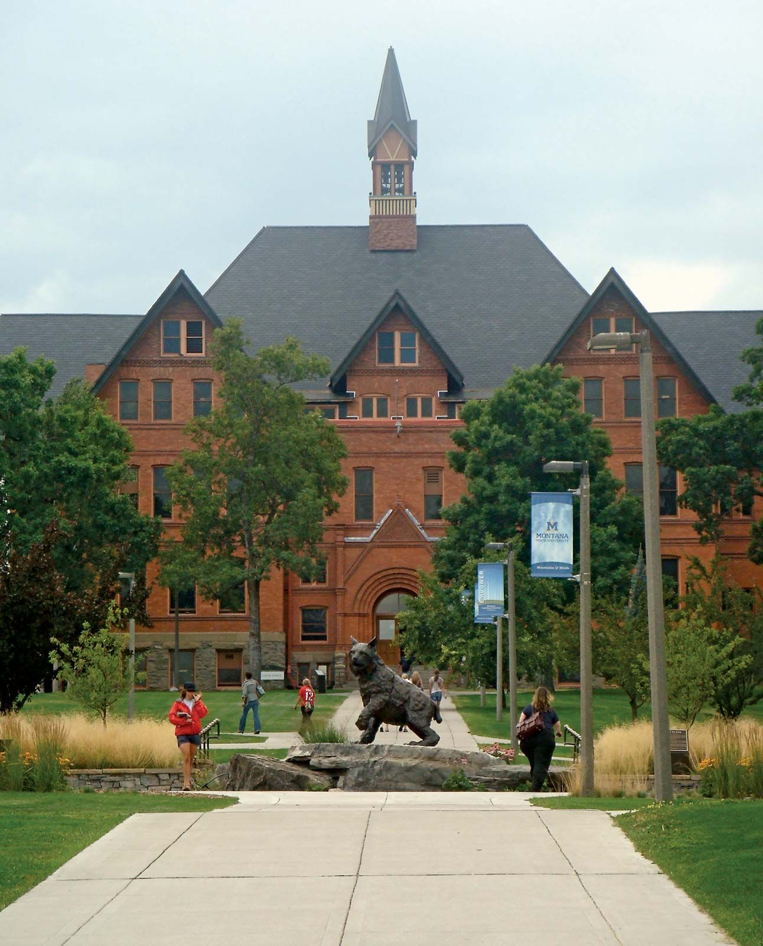
THE END
Fangtian Zhong
CSCI 591
Gianforte School of Computing
Norm Asbjornson College of Engineering
E-mail: fangtian.zhong@montana.edu
2023.11.02

