Slide 1
2023.04.18
Malicious Code Analysis
Fangtian Zhong
CSCI 491
Gianforte School of Computing
Norm Asbjornson College of Engineering

Slide 2
Overview
Basic Syntax
Addressing Modes
01
04
Type of Memory
Variables
02
05
System Calls
03

Slide 3

Basic Syntax
Part One
01

Slide 4

Assembly Program
An assembly program can be divided into three sections −
The data section,
The bss section,
The text section.

Slide 5
The data Section
The data section is used for declaring initialized data or constants.
This data does not change at runtime.
You can declare various constant values, file names, or buffer size, etc., in this section.
This section cannot be expanded after the data elements are declared, and it remains static throughout the program.
The syntax for declaring data section is −
section .data

Slide 6
The bss Section
The .bss section is a static memory section that contains buffers for data to be declared later in the program.
This buffer memory is zero-filled.
The syntax for declaring bss section is −
section .bss

Slide 7
The text section
The text section is used for keeping the actual code.
This section must begin with the declaration global _start, which tells the kernel where the program execution begins.
The syntax for declaring text section is −
section .text
global main
main:

Slide 8

Memory Segments
A segmented memory model divides the system memory into groups of independent segments referenced by pointers located in the segment registers.
Each segment is used to contain a specific type of data.
One segment is used to contain instruction codes, another segment stores the data elements, and a third segment keeps the program stack.

Slide 9
Data segment
It is represented by .data section and the .bss.
Each segment is used to contain a specific type of data.
One segment is used to contain instruction codes, another segment stores the data elements, and a third segment keeps the program stack.

Slide 10
Code segment
It is represented by .text section.
This defines an area in memory that stores the instruction codes.
This is also a fixed area.

Slide 11
Stack segment
This segment contains data values passed to functions and procedures within the program.

Slide 12
Comments
Assembly language comment begins with a semicolon (;). It may contain any printable character including blank. It can appear on a line by itself, like −
; This program displays a message on screen
or, on the same line along with an instruction, like −
add eax, ebx ; adds ebx to eax

Slide 13
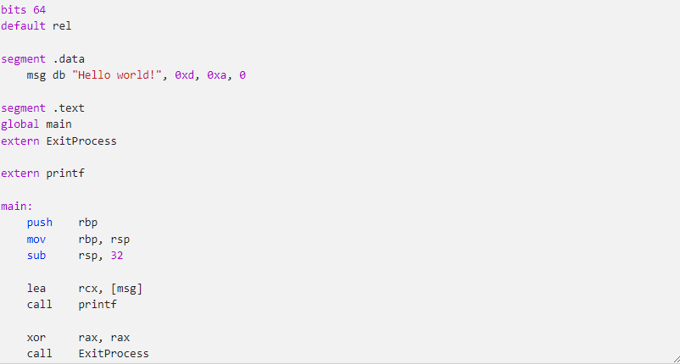
Compiling and Linking an Assembly Program in NASM
Once you have verified that the assembler is available on your PATH, you're ready to go! To test if the assembler is working,
create the following file and name it hello_world.asm:
Simiarly, you can change “segment” to “section” for compilation and linking

Slide 14
Compiling and Linking an Assembly Program in NASM
You might be asking, “what on earth am I typing here?” at this point. We'll go over this later. For now, though, let's just
make sure that your toolchain is working.
Let's go ahead and try to assemble this text into an object file. Go to the directory where hello_world.asm is located at and run the following command in a command prompt.
nasm -f win64 -o hello_world.obj hello_world.asm
If it worked, you should see the hello_world.obj file appear in the same directory as your hello_world.asm file. We can then use the linker to create an executable out of this object file.
Run the following command from a command prompt that has the Visual Studio environment variables set (x64 Native Tools Command Prompt for VS 2022)
link hello_world.obj /subsystem:console /out:hello_world_basic.exe kernel32.lib legacy_stdio_definitions.lib msvcrt.lib

Slide 15
Run
You might be asking, “what on earth am I typing here?” at this point. We'll go over this later. For now, though, let's just
make sure that your toolchain is working.
Let's go ahead and try to assemble this text into an object file. Go to the directory where hello_world.asm is located at and run the following command in a command prompt.
nasm -f win64 -o hello_world.obj hello_world.asm
If it worked, you should see the hello_world.obj file appear in the same directory as your hello_world.asm file. We can then use the linker to create an executable out of this object file.
Run the following command from a command prompt that has the Visual Studio environment variables set (x64 Native Tools Command Prompt for VS 2022)
link hello_world.obj /subsystem:console /out:hello_world_basic.exe kernel32.lib legacy_stdio_definitions.lib msvcrt.lib

Slide 16
Run
You should now have a hello_world.exe file in the directory. Run it, and if you get the following output, congratulations,
you've just wrote an assembly program that runs on Windows!
hello_world_basic.exe
Hello world!

Slide 17
Part Two
Types of Memory
02

Slide 18
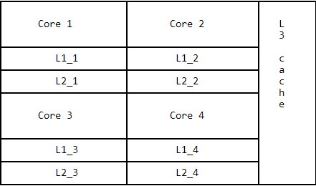
Memory
CPU registers (mostly 64 bits per register, with exceptions for some special registers that could go up to 512 bits wide)
CPU caches (L1, L2 and L3, with L1 and L2 being ~64 KB and ~256 KB per core, and L3 being shared across all cores with sizes ranging from 4 MB to 24 MB) An illustration of how these caches are shared among the cores is shown below:

Slide 19
Memory
RAM (The sticks that you put on your motherboard, generally measuring anywhere from 2 GB all the way to 128 GB or more)
PCI-E NVMe (If you have a solid state drive that uses this interface, which can be anywhere from a few hundred gigabytes to 4 terabytes' worth)
Hard disk (Through the SATA cables, regardless of whether your disk is a solid-state or spinning platter drive, which have similar sizes to SSDs)
Network (over a CAT5e cable or similar, which then must go through this entire list of memory all over again from whichever PC it's retrieving the information from)

Slide 20
Conclusion
It's no coincidence that memory seems to be a function of speed/distance/size; in other words, the faster the
memory is, the smaller capacity it tends to have, and the closer it seems to be to the CPU on the motherboard.
Memory access is not free, and abstractions have a cost, no matter how insignificant they may seem.

Slide 21
Type of Registers
General registers
Control registers
Segment registers

Slide 22
General Registers
Data registers: used for arithmetic, logical, and other operations.
Pointer registers: used for various purposes related to memory access and control flow within a program
Index registers: used for indexed addressing and sometimes used in addition and subtraction.

Slide 23
Data Registers
AX is the primary accumulator; it is used in input/output and most arithmetic instructions.
For example, in multiplication operation, one operand is stored in EAX or AX or AL register according to the size
of the operand.
BX is known as the base register, as it could be used in indexed addressing.
CX is known as the count register, as the ECX, CX registers store the loop count in iterative operations.
DX is known as the data register. It is also used in input/output operations. It is also used with AX register along with
DX for multiply and divide operations involving large values.
xmm0-xmm15: the floating point registers are used for storing actual floating point numbers.

Slide 24
Pointer Registers
Instruction Pointer (IP): The 16-bit IP register stores the offset address of the next instruction to be executed. IP in
association with the CS register (as CS:IP) gives the complete address of the current instruction in the code segment.

Slide 25
Index Registers
Source Index (SI) − It is used as source index for string operations.
Destination Index (DI) − It is used as destination index for string operations
Stack Pointer (SP): The 16-bit SP register provides the offset value within the program stack. SP in association with the
SS register (SS:SP) refers to be current position of data or address within the program stack.
Base Pointer (BP): The 16-bit BP register mainly helps in referencing the parameter variables passed to a subroutine.
The address in SS register is combined with the offset in BP to get the location of the parameter. BP can also be
combined with DI and SI as base register for special addressing.

Slide 26
Control Registers
Overflow Flag (OF): indicates the overflow of a high-order bit of data after a signed arithmetic operation.
Direction Flag (DF): determines left or right direction for moving or comparing string data. When the DF value
is 0, the string operation takes left-to-right direction and when the value is set to 1, the string operation takes
right-to-left direction.
Interrupt Flag (IF): determines whether the external interrupts like keyboard entry, etc., are to be ignored or
processed. It disables the external interrupt when the value is 0 and enables interrupts when set to 1.
Trap Flag (TF): allows setting the operation of the processor in single-step mode. The DEBUG program we
used sets the trap flag, so we could step through the execution one instruction at a time.
Sign Flag (SF): shows the sign of the result of an arithmetic operation. This flag is set according to the sign
of a data item following the arithmetic operation. The sign is indicated by the high-order of leftmost bit. A positive result
clears the value of SF to 0 and negative result sets it to 1.
Zero Flag (ZF): indicates the result of an arithmetic or comparison operation. A nonzero result clears the zero
flag to 0, and a zero result sets it to 1.

Slide 27
Control Registers
Auxiliary Carry Flag (AF): contains the carry from bit 3 to bit 4 following an arithmetic operation; used for
specialized arithmetic. The AF is set when a 1-byte arithmetic operation causes a carry from bit 3 into bit 4.
Parity Flag (PF): indicates the total number of 1-bits in the result obtained from an arithmetic operation.
An even number of 1-bits clears the parity flag to 0 and an odd number of 1-bits sets the parity flag to 1.
Carry Flag (CF): contains the carry of 0 or 1 from a high-order bit (leftmost) after an arithmetic operation.
It also stores the contents of last bit of a shift or rotate operation.

Slide 28
Segment Registers
Code Segment (CS): contains all the instructions to be executed. A 16-bit Code Segment register or CS register
stores the starting address of the code segment.
Data Segment (DS): contains data, constants and work areas. A 16-bit Data Segment register or DS register
stores the starting address of the data segment.
Stack Segment (SS): contains data and return addresses of procedures or subroutines. It is implemented as
a 'stack' data structure. The Stack Segment register or SS register stores the starting address of the stack.
Extra Segment (ES): used for accessing additional data segments or for specialized memory addressing needs.
Frame Segment (FS): used for accessing the Thread Information Block (TIB) that contains thread-specific data
in Windows x64.
General Segment (GS): used for accessing the Thread Information Block (TIB) that contains thread-specific data.

Slide 29
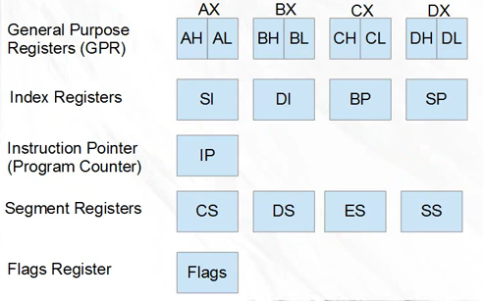
8086 Registers
The 8086 hit the world in 1978 and was incredibly popular. It was a 16 bit processor, which meas most of its general purpose registers are 16 bits, and most of its instructions operate on 16 bits.

Slide 30
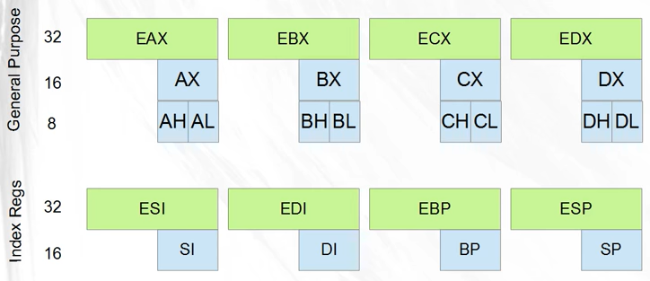
32 bit 80386:1
In 1985, the 386 processors came out, they included 32 bit instructions and registers.
For backwards compatibility, all of the 8086’s original 16 bit registers were maintained. But most registers also got a 32 bit version;

Slide 31
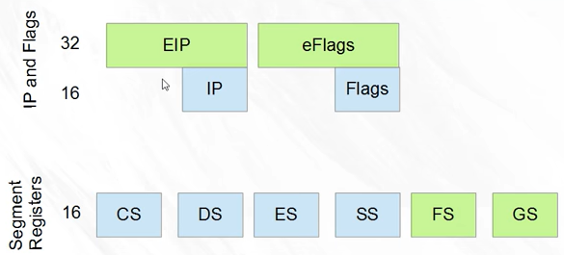

32 bit 80386:1

Slide 32
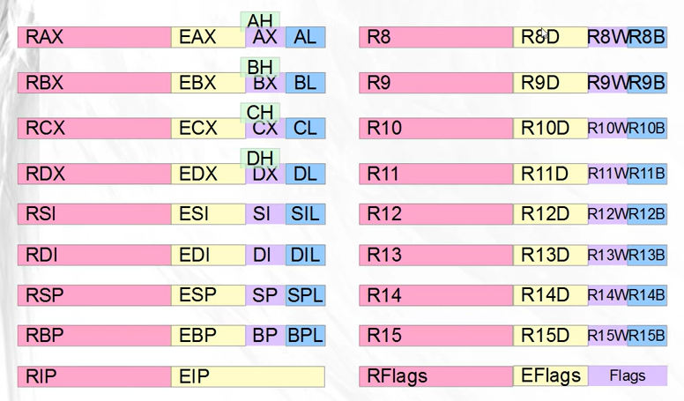
Pentium IV and x64

Slide 33
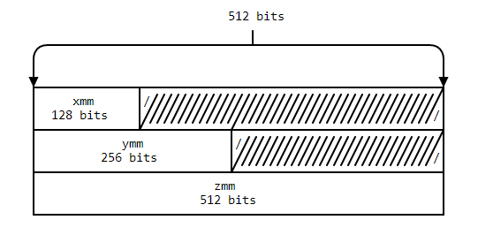
Pentium IV and x64
Streaming SIMD Extensions (SSE)
Advanced Vector Extensions (AVX)
AVX-512

Slide 34

THE END
Fangtian Zhong
CSCI 491
Gianforte School of Computing
Norm Asbjornson College of EngineerinE-mail: fzhong@montana.edu
2023.04.18

