Slide 1
2023.04.18
Malicious Code Analysis
Fangtian Zhong
CSCI 491
Gianforte School of Computing
Norm Asbjornson College of Engineering

Slide 2
Overview
Basic Syntax
Addressing Modes
01
04
Type of Memory
Variables
02
05
System Calls
03

Slide 3

Basic Syntax
Part One
01

Slide 4

Constants
There are several directives provided by NASM that define constants. We will particularly discuss three directives −
equ
%assign
%define

Slide 5
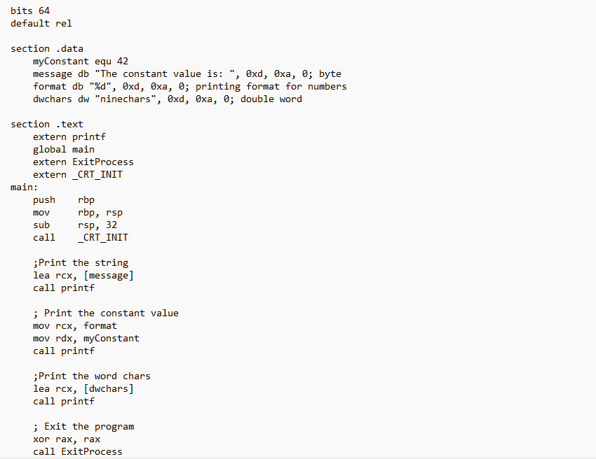
Constants Examples: equ

Slide 6
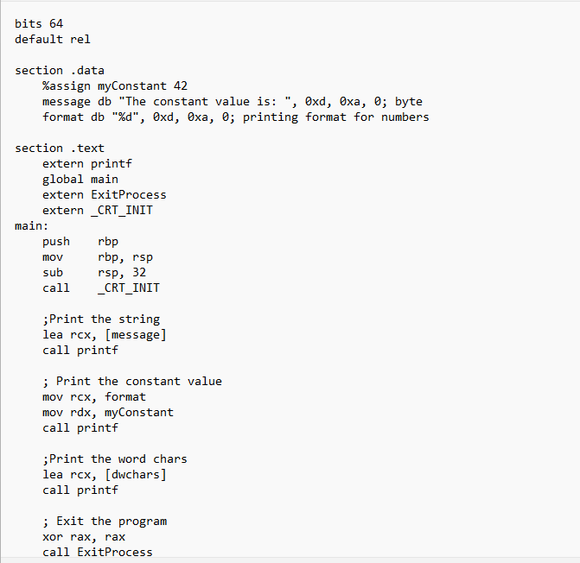
Constants Examples: %assign

Slide 7
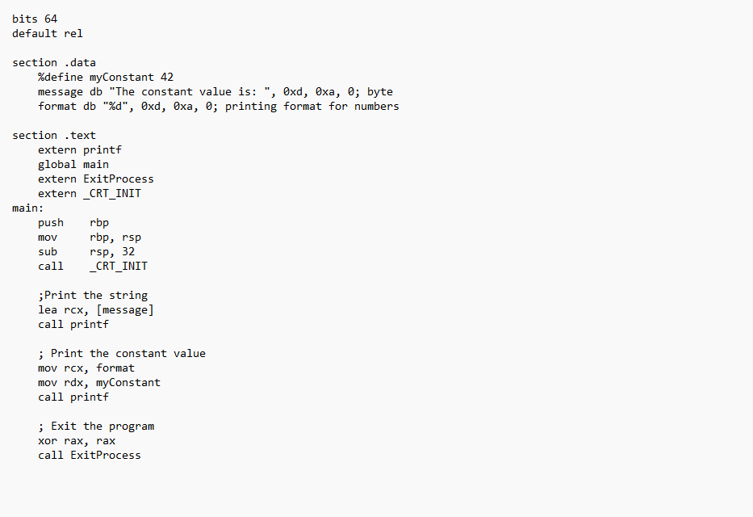
Constants Examples: %define

Slide 8
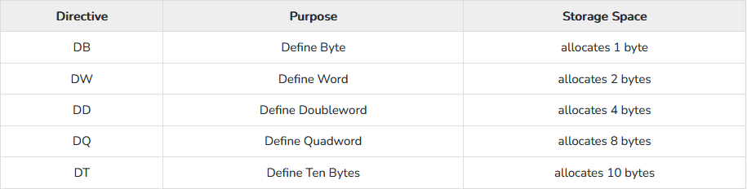
Variables
NASM provides various define directives for reserving storage space for variables. The define assembler directive is used
for allocation of storage space. It can be used to reserve as well as initialize one or more bytes.
The syntax for storage allocation statement for initialized data is −
[variable-name] define-directive initial-value [,initial-value]...
Where, variable-name is the identifier for each storage space. The assembler associates an offset value for each variable name defined in the data segment.
There are five basic forms of the define directive

Slide 9
Allocating Storage Space for initialized Data
choice db 'y'
number dw 12345
neg_number dw -12345
big_number dq 123456789 ; eight byte constant
real_number1 dd 1.234 ; floating-point constant
real_number2 dq 123.456 ; double-precision float
real_number_3 dt 1.234567e20 ; extended-precision float

Slide 10
Notes
Please note that −
Each byte of character is stored as its ASCII value in hexadecimal.
Each decimal value is automatically converted to its 16-bit binary equivalent and stored as a hexadecimal number.
Processor uses the little-endian byte ordering.
Negative numbers are converted to its 2's complement representation.
Short and long floating-point numbers are represented using 32, 64 or 80 bits, respectively.

Slide 11
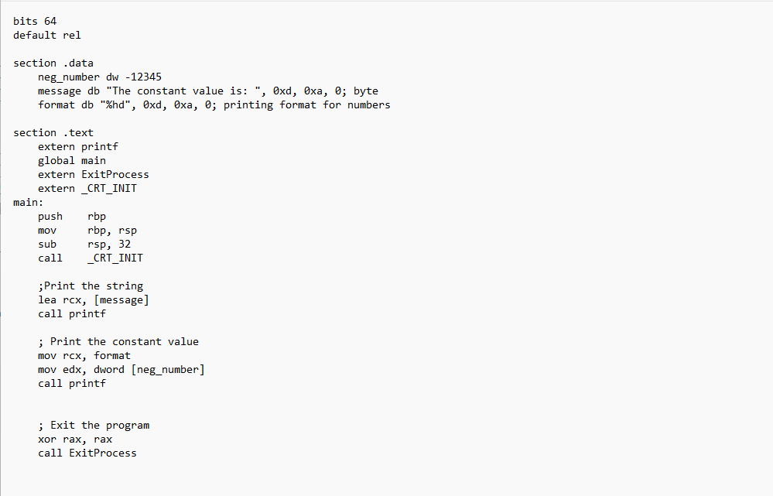
Examples

Slide 12
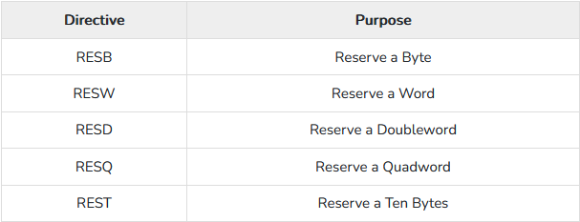

Allocating Storage Space for Uninitialized Data
The reserve directives are used for reserving space for uninitialized data. The reserve directives take a single operand that specifies the number of units of space to be reserved. Each define directive has a related reserve directive.
There are five basic forms of the reserve directive −

Slide 13
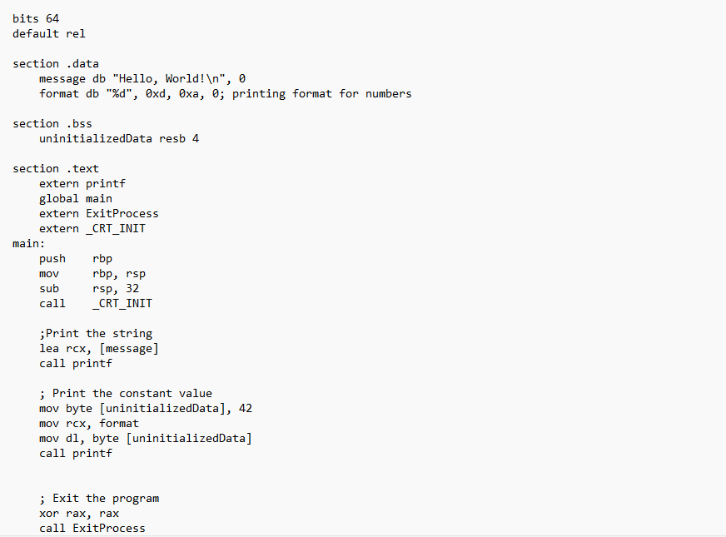
Examples

Slide 14
Multiple Definitions and Initializations
You can have multiple data definition statements in a program. For example −
choice dd 'Y' ;ASCII of y = 79H
number1 dw 12345 ;12345D = 3039H
number2 dd 12345679 ;123456789D = 75BCD15H
The assembler allocates contiguous memory for multiple variable definitions.

Slide 15
Multiple Definitions and Initializations
The TIMES directive allows multiple initializations to the same value. For example, an array named marks of size 9 can be defined and initialized to zero using the following statement −
marks TIMES 9 DW 0

Slide 16
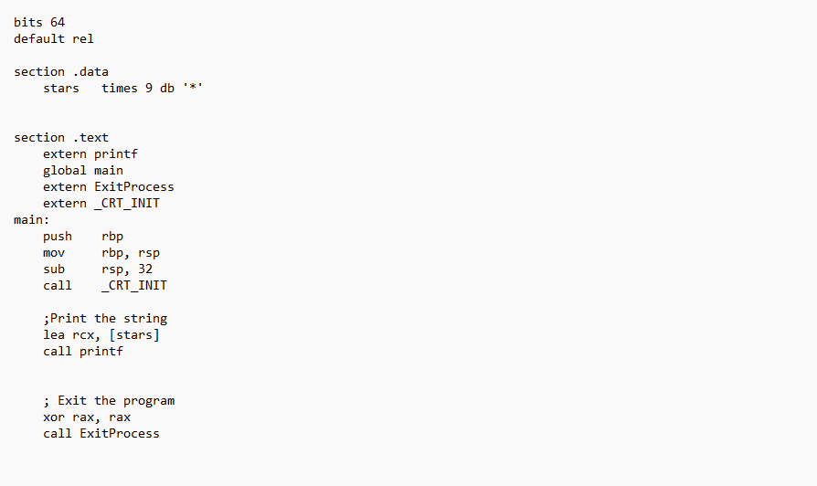
Multiple Definitions and Initializations
The TIMES directive is useful in defining arrays and tables. The following program displays 9 asterisks on the screen −

Slide 17
Part Two
Addressing Modes
02

Slide 18
Addressing Modes
Addressing modes, put simply, are the different conventions available by which an assembly instruction can access registers or other memory. For example, the instruction:
mov rax, 0
Is what's known as an immediate addressing mode. This is because the operand has a constant value.

Slide 19
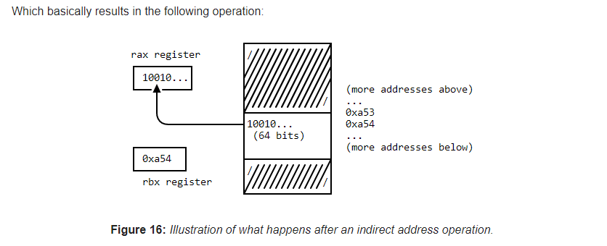
Addressing Modes
In contrast, the instruction:
mov rax, rbx
Is simply known as register addressing, for obvious reasons.
We can also do what is known as indirect register addressing:
mov rax, [rbx]
As we can see, the memory that was located by first dereferencing the address that was stored in rbx was then moved to rax as a result of the operation.

Slide 20
rip-relative addressing
Position-Independent Code
In the previous x86 ISA, some assembly instructions for working with memory loading/storing were absolute. There was no ability to reference data by using a displacement off the current instruction pointer (rip). This made it very difficult to generate code that was position-independent (PIC), which is to say, code that does not depend on where exactly it is loaded into memory by the operating system.

Slide 21
rip-relative addressing
Obviously, since programs generally weren't written by hardcoding base addresses all over the code (since you couldn't assume that your program would always be loaded by the operating system at the same base address each time it was run), the loader had to dynamically, at the time of loading your program into memory, fix up all the code to relocate any instances of memory addresses that were specified in an absolute manner and add the displacement that your program's base address was actually loaded at in order to make sure everything worked. What this meant in practice was that even the simplest of operations required vastly more instructions to execute, since the amount of fix-ups the loader would have to do was tremendous.

Slide 22
rip-relative addressing
Well, with the x64 ISA, the concept of allowing assembly instructions to reference memory by specifying a displacement (32 bit signed) from the current rip instruction pointer means that even though the program may be loaded at a different base address, because the data is now being referenced from the rip instruction pointer instead of an absolute address, the loader no longer has to perform any fixup process on that code. This means that x64 code in general which uses this form of addressing as opposed to the flat addressing model (i.e. hardcoding the address references) does not require the loader to perform the fixups, and results in a much reduced binary size, since the base address re-location information that the loader performs has to be stored in the PE file format (in the .reloc section).

Slide 23
Efficiency
To tell NASM to compile our program with rip-relative addressing, the following directive is used:
default rel
Thus, we get what we want; the loader does less work, and the program still runs, and we get our position-independent code.

Slide 24
Part Two
System Calls
02

Slide 25
Calling Convention
Simply put, it's a set of strict guidelines that our code must adhere to in order for the operating system to be able to
run our assembly code.
This is because assembly is, by nature, as close to the hardware as we can possibly get, and so compilers standardize
how our functions should be implemented and how they should be called by the actual hardware.
This allows code from multiple sources to all run together harmoniously, instead of having every developer try to
develop their own conventions around how the hardware should be used and potentially causing incompatibilties
between each other's code.

Slide 26
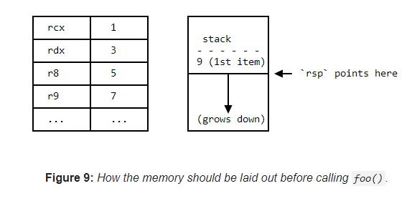
The Microsoft x64 Calling Convention
Function parameters and return values
The first four integer arguments are passed in registers. Integer values are passed in left-to-right order in RCX, RDX,
R8, and R9, respectively. Arguments five and higher are passed on the stack.
void foo(int a, int b, int c, int d, int e)
{
/// Some stuff happens here with the inputs passed in...
return;
}
In order to follow the x64 calling convention, we must therefore pass a, b, c and d in the registers rcx, rdx, r8 and r9
respectively, with e being pushed onto the stack before calling the function foo(). Thus, if I wanted to call foo()
like so:
foo(1, 3, 5, 7, 9);

Slide 27
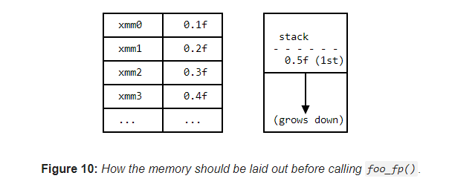
Floating-point arguments
Any floating-point and double-precision arguments in the first four parameters are passed in XMM0 - XMM3,
depending on position.
For floating-point arguments, the xmm registers 0 through 3 are used, for a total of 4 arguments being passed in the
SIMD registers, with the rest being pushed onto the stack.
Let's see how this works with another example:
void foo_fp(float a, float b, float c, float d, float e)
{
// Do something with these floats...
return;
}
Assuming I wanted to call foo_fp() like so:
foo_fp(0.1f, 0.2f, 0.3f, 0.4f, 0.5f);

Slide 28
Questions?
As we can see, the concept applies much like it for integers. But what if we have something like this?
void foo_mixed(int a, int b, float c, int d, float e)
{
// Variable types of arguments...now what?
return;
}
Which values go in which registers now?

Slide 29
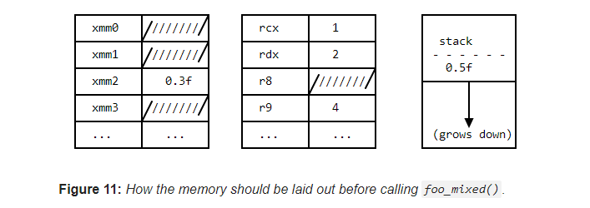
Mixing parameter types
The answer is that the position of the argument dictates which register it goes in. Therefore, if we called foo_mixed() like so:
foo_mixed(1, 2, 0.3f, 4, 0.5f);

Slide 30
Other Conventions
Intrinsic types, arrays and strings are never passed into a register directly. A pointer to their memory locations is what goes into the registers instead.
Structs/unions 8/16/32/64 bits in size may be passed as if they were integers of the same size. Those of other sizes are passed as a pointer as well.
For variadic arguments (i.e. foo_var(int a, ...)), the aforementioned conventions apply depending on the type of the arguments that are passed in. It is the caller's responsibility that the memory layout is correct before calling the function. Additionally, for floating-point values, both the integer and floating-point registers must have the same argument's value, in case the callee expects the value in the integer registers.

Slide 31
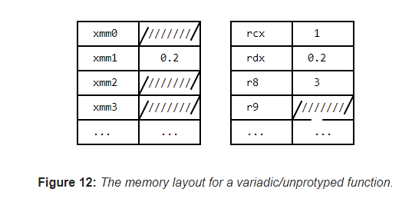
Other Conventions
For unprototyped functions (e.g. forward-declarations), the caller passes integer values as integers and floating-point values as double-precision. The same rule about floating-point values needing to be in both the integer and floating-point registers applies as well.
For example:
void foo_unprototyped();
void foo2()
{
foo_unprototyped(1, 0.2f, 3);
return;
}

Slide 32
Return Values
The Microsoft x64 calling convention, thankfully, has simpler rules when it comes to return values from functions.
Any scalar return value 64 bits or less in size is returned in rax.
Any floating-point value is returned in xmm0.
Thus, a function int foo() would return its value in the rax register, and a function float foo() or double foo() would return its value in the xmm0 register.
If your function is returning a user-defined type (such as a struct), the same rules apply to it as if it were being passed in a register: it must be of a size of 1/2/4/8/16/32/64 bits. If it is, it will be returned in the rax register; if not, a pointer to its memory will be returned instead.
The caller is responsible for allocating this memory and passing the pointer in the appropriate integer register before making the call to the function.

Slide 33
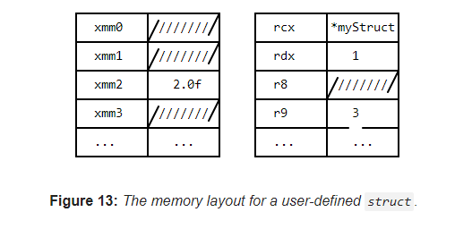
Return Values
An example to illustrate this case is shown below:
struct Foo
{
int a, b, c; // Total of 96 bits. Too big to fit in one of the GPRs.
}
Foo foo_struct(int a, float b, int c)
{
// Stuff happens...
return result; // This is a `Foo` struct.
}
Foo myStruct = foo_struct(1, 2.0f, 3);
The return value for the function will be a pointer to the myStruct result, in the rax register.

Slide 34
The Microsoft C Runtime Library
what's the odd extern _CRT_INIT symbol we're importing? What's that for?
If you're experienced enough with C/C++, you'll no doubt have guess that the CRT refers to the C standard run-time
library, more specifically, the Microsoft Visual C++ Runtime Library (MSVCRT), which is Microsoft's implementation of
the C99 ISO standard library.
by the powers of deduction, we can guess that _CRT_INIT means “hey, initialize the C runtime library”.
Why do we need to call this anyway?

Slide 35
WinMain and main
Well, let's look further down the code, to the first label in the .text section of our assembly program:
main:
All C/C++ programmers should be familiar by now with the concept of their program's entry point, that is, the initial point where code starts to execute when their program is loaded. The signature usually appears as
int main(int argc, char *argv[]).
However, if you're at all familiar with Win32 API programming, you'll know that things are not that simple. Technically, the entry point for Windows programs is defined as WinMain, not main; specifying the subsystem to the MSVC linker determines which entry point symbol is chosen by default. Additionally, the MSVCRT's implementation of main actually calls WinMain, which means that it's essentially a wrapper function. More than being just a simple wrapper, however, there's one other important thing that MSVCRT's main function does, and that is to also perform any static initialization of variables required.

Slide 36
_CRT_INIT
If your project is built using /ENTRY, and if /ENTRY is passed a function other than _DllMainCRTStartup, the function
must call _CRT_INIT to initialize the CRT.
If you don't do this, you'll get linker warnings when attempting to produce the final executable, such as:
warning LNK4210: .CRT section exists; there may be unhandled static initializers or terminators
Which is the linker telling us, “hey, it looks like you've got some data you wanted to statically initialize, but the
appropriate actions to take for actually initializing them haven't been taken.” This refers to the fact that for global
variables that need to be initialized before the `main()` function, the VCRuntime library startup code (which handles
running the static initializers or terminators) hasn't been run yet.

Slide 37
Making a stack
Let's continue looking at the example code.
push rbp
mov rbp, rsp
sub rsp, 32
The push psuedo-op takes the operand passed to it, decrements the stack pointer, and then stores the operand on top
of the stack. We do this to the base pointer so that we can save the current position of the stack. (So that if we need to
refer to variables on the stack, we have a base address to refer to, since we could be adding/removing objects from
the stack all the time and thus the stack pointer alone would be insufficient.)

Slide 38
Calling functions in assembly
Instruction Pointer (IP): The 16-bit IP register stores the offset address of the next instruction to be executed. IP in
association with the CS register (as CS:IP) gives the complete address of the current instruction in the code segment.
The next few lines are the real business logic of the example assembly code:
lea rcx, [msg]
call printf
The first instruction here is a little confusing.
Well, LEA actually stands for Load Effective Address, which comes no closer to explaining what it actually does. The way
I like to think about it is that lea serves essentially the same purpose as mov; they both move memory from the second
operand to the first. The difference is in how exactly they do it; the mov instruction moves memory directly from
operand to operand, while lea computes the effective address of the second operand, before moving it to the first
operand. As such, while both instructions technically could do the same thing (just with slightly different syntax), the
way they function is different enough to distinguish their use cases
In this case, we use lea to load the address of the msg variable (which is a pointer to our “Hello, world!” ) into the rcx
register. If you recall the calling conventions, this is the register that should contain the first argument for a function call.

Slide 39
Shutting down the program
Now that we've printed our line out to the console, we're good. It's time to shut it down!
xor rax, rax
call ExitProcess
Remember that according to the calling convention, the return value for a function goes into rax for integers. Well,
main is no different, and so we exclusive-or the rax register with itself, effectively zero-ing it out, before calling the
Win32 ExitProcess function, thus ending the application.

Slide 40
Part Three
Volatile
03

Slide 41
Volatile and Non-volatile
The concept of volatility differs from the volatile keyword in C/C++ slightly, though the general meaning doesn't change.
In the Microsoft x64 calling convention, certain registers are treated as volatile, meaning that they are subject to change
and are not guaranteed to be preserved between function calls or scope changes.
some registers are what's known as non-volatile, which means that we are potentially responsible for preserving the state
of the registers and restoring their states after our function call is complete. If we do not, then the caller might act upon
invalid data in those registers, since we failed to preserve their original values that the caller was dependent on.

Slide 42
Volatile and Non-volatile
Under the Microsoft x64 calling convention, the rax, rcx, rdx, r8, r9, r10 and r11 registers are considered volatile
the rbx, rbp, rdi, rsi, rsp, and r12 through r15 registers are considered non-volatile and must have their states saved
and preserved through function calls.

Slide 43
The shadow space
Under the Microsoft x64 calling convention, there is a unique concept of what's known as a shadow space, also referred to
as a home space. This is a space that is reserved every time you enter a function and is equal to at least 32 bytes (which is
enough space to hold 4 arguments).
While the calling convention does not explicitly require the callee to use the shadow space, you should allocate it regardless
when you are utilizing the stack, especially in a non-leaf function.
Also, as a reminder, no matter how much space you allocate for the shadow space and your own function's variables,
you still need to ensure that the stack pointer is aligned on a 16-byte boundary after all is said and done.

Slide 44

THE END
Fangtian Zhong
CSCI 491
Gianforte School of Computing
Norm Asbjornson College of EngineerinE-mail: fzhong@montana.edu
2023.04.18

