Slide 1
2023.04.18
Malicious Code Analysis
Fangtian Zhong
CSCI 491
Gianforte School of Computing
Norm Asbjornson College of Engineering

Slide 2


Info About Me
Fangtian Zhong
Education
Ph.D., George Washington University, 2021
Postdoc., Pennsylvnia State University and University of Notre Dame
Research interests
Software security
Program analysis
Machine learning for cybersecurity
More
https://fangtian-zhong.github.io/

Slide 3
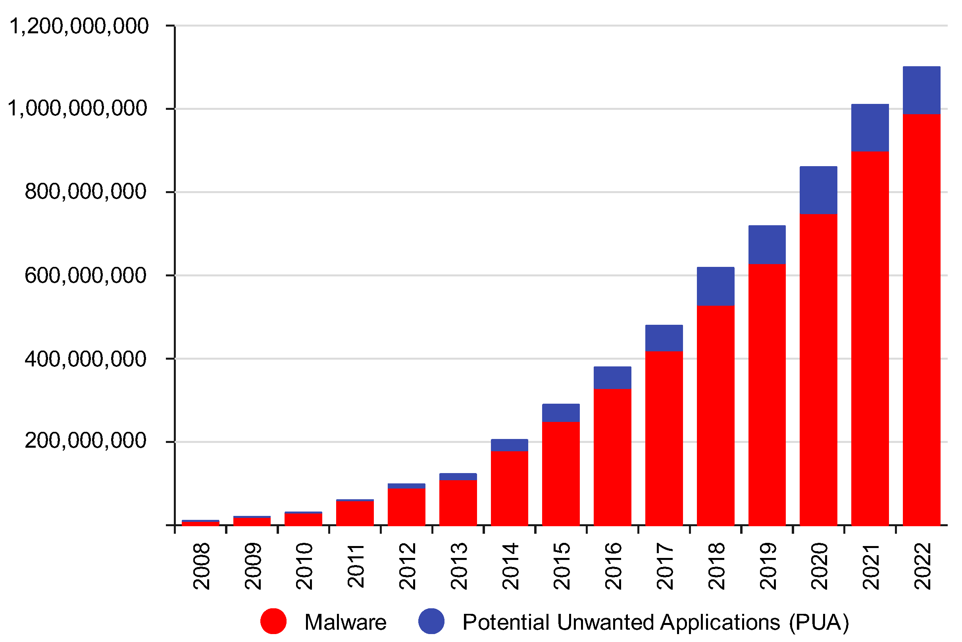
Necessity

Slide 4
Course Information
Website: https://fangtian-zhong.github.io/MalCodeA.html
Time: TR 12:15-13:30pm
Location: Barnard Hall 126
Office Hour: T 11:30 – 12:00pm and TR 11:00-12:00pm
Office: Barnard Hall 352
Email: fangtian.zhong@montana.edu
Phone: 202-460-7413

Slide 5
Text Books (Required)
Practical Malware Analysis: The Hands-On Guide to Dissecting Malicious Software by Michael Sikorski, Andrew Honig, No Starch Press, 2012
Windows 64-bit Assembly Language Programming Quick Start: Intel X86-64, SSE, AVX by Robert Dunne,Gaul Communications, 2018

Slide 6
Prerequisite
operating systems
C/C++
Python
and data structures/algorithms
Notes:
Screen sizes, Keyboards, Capabilities – GPS, Sensors, Near Field communications
Memory, processing capability and disk
Tablets are disruptive?

Slide 7
Course Objectives
Master the interaction between assembly codes and registers, and memory and manually analyze the changes in the stack by instruction execution.
Grasp the rationale for the malware taxonomy and learn to classify malware files manually.
Grasp binary retrofitting techniques to modify malware binaries.
Analyze and predict the potential malicious operations in different types of malware.
Understand security risks related to malicious content in malware and be able to recognize and respond the threats by using static or dynamic analysis.

Slide 8
Course Description
Introduction to malware analysis issues from end-user perspectives.
Topics include assembly basics, malware classification, malware retrofiting, malware analysis and malware detection.
Hands-on tools to identify and generate signatures for malware analysis will be introduced.

Slide 9
Grade Breakdown
Deliverable Points
Weekly Participation / Attendance 5%
Weekly Assignments / Quizzes 15%
4 Projects 40%
Midterm Exam 20%
Final Exam 20%
Total 100%
Notes:
table

Slide 10
Project Grading Policy
High Pass (Finish all required tasks) 100 points
Pass (Finish 50% of the tasks or above) 85 points
Low Pass (Finish 25% of the tasks but lower than 50%) 70 points
Much Low Pass (Runnable and finish partial task but lower than 25%) 50 points
Incomplete 0 points

Slide 11
Grading
I am always happy to chat, review ideas from this course, try to clarify lab/exam questions, and discuss any
questions or concerns you may have about graded work.
I do not pre-grade assignments. I typically do not curve grades.
Any grade disputes must be resolved within one week of the release of the grade.

Slide 12
Late Penalties
Your evaluation in this course is primarily based on completing the assignments, projects and exams.
As such, we take timely submissions seriously.
I encourage students to treat the posted deadlines as “hard” deadlines. However, there are “late coupons”.
Each student can extend the deadline for 48 hours 3 times, excluding the group project.
no submissions will be accepted/graded 48 hours after the original deadline. Each late submission will lose
50% of your full score.

Slide 13
Communication
We will use Slack for all course communication (except for sensitive stuff like grades!).
Please do not use other means of electronic communication (e.g., D2L, e-mail) unless you absolutely have to.
I typically won’t respond to emails or Slack direct messages (DMs) past 6 p.m. or so. Generally speaking,
I will not respond on weekends and certainly not immediately.
Please do not expect an instant answer if you send me an email or DM in Slack.

Slide 14
Academic Honesty
Please review MSU’s Code of Conduct, Policies, Regulations, & Reports. A couple of clarifications and additions:
Although you may discuss and design with others, the work you hand in (e.g., code, write-ups) must be entirely your
own. (Applies to individual assignments only.)
Anything you submit that did not originate from you must be accompanied by attribution.
Also, please do not share solutions or detailed information about solutions (e.g., specific code, non-trivial command
line sequences) with others.

Slide 15
More about you?

Slide 16


University of Central Missouri
Thank You!
Questions and comments?
Department of Computer Science and Cybersecurity
COLLEGE OF HEALTH, SCIENCE, AND TECHNOLOGY
E-mail: fzhong@ucmo.edu
2023.06.27

