Slide 1

2023.10.05
Malicious Code Analysis
Fangtian Zhong
CSCI 591
Gianforte School of Computing
Norm Asbjornson College of Engineering
E-mail: fangtian.zhong@montana.edu

Slide 2
Overview
Spyware
01
Adware
02
Polymorphism and Metamorphism
03

Slide 3

Part One
Spyware
01

Slide 4

What is Spyware?
Applications that send information from your computer to the creator of the spyware
Sometimes consists of an apparent core functionality and a hidden functionality of information gathering (Trojan)
Can be used by websites for marketing information, to determine their stance with regard to competitors and market trends
Can also be used to log keystrokes and send those to whomever

Slide 5
What is Spyware ?
Software or hardware installed on a computer without the user's knowledge which gathers information about that user for later retrieval by whomever controls the spyware.
Spyware can be broken down into two different categories:
surveillance spyware
advertising spyware.

Slide 6
What is Spyware ?
Surveillance software:
Includes key loggers, screen capture devices, and Trojans. These would be used by corporations, private detectives, law enforcement, intelligence agencies, suspicious spouses.
Advertising spyware:
Software that is installed alongside other software, often without the user's knowledge, or without full disclosure that it will be used for gathering personal information and/or showing the user ads.
Advertising spyware logs information about the user, possibly including passwords, email addresses, web browsing history, online buying habits, the computer's hardware and software configuration, the name, age, sex,etc.

Slide 7
Computers Get Infected
Basic forms of spyware can be picked up simply by visiting a Web page.
Spyware may also be picked up through email.
You are particularly likely to be exposed by downloading software, in particular "freeware" and "shareware" offerings.
Many software downloads are "free," but within the End User License Agreement (EULA) are provisions to use information from your computer or your email and other contact information. You have to agree to the EULA to download or install, so you essentially agree to allowing someone else to use information about your computer.
That's why the definition of spyware is "generally without your knowledge or consent." Often, you've consented. You just don't realize it because you didn't read the fine print. This is why the definition of spyware sometimes includes the lawyerism "potentially unwanted technologies."

Slide 8
Spyware Symptoms
Spyware often operate silently, monitoring your Web surfing activities and reporting back what sites you have visited to a marketing organization. Others display "pop-up" ads on your computer's desktop or on top of other Web pages.
More aggressive spyware will reset your browser's home page (the page that appears when the browser starts up), change the service your browser uses for Web searches, or add new sites to your favorites list. Or produce even more invasive advertisements.
The most damaging spyware programs can actually install "trojans" -- computer programs which allow other people to remotely access an infected computer. Such spyware programs can run silently "in the background" and are capable of doing anything that a typical computer program can do which does not require your intervention.
Sometimes a spyware-infected computer will run more slowly due to all the activity going on in the background. But just because your computer seems to be running at normal speed doesn't mean you are safe.
Increase in system crashes

Slide 9
Damages
Spyware can cause a number of negative impacts, including:
Privacy invasion: Spyware can gather sensitive information, such as login credentials, financial information, and personal data, and transmit it to attackers. This can result in identity theft, financial losses, and a loss of privacy.
Performance degradation: Spyware can slow down a computer's performance, as it can consume system resources and interfere with normal system operations.
Unwanted ads: Spyware can display unwanted ads, pop-ups, and other unwanted content, which can be distracting and annoying to users.
Spread of malware: Spyware can be used to spread other types of malware, such as viruses and Trojans, to other systems.
Increased risk of cybercrime: Spyware can be used by attackers to carry out other types of cybercrime, such as phishing scams and identity theft.

Slide 10
example
int main() {
if (_access("C:\\Users\\Public\\Public", 0)) {//exist?
_mkdir("C:\\Users\\Public\\Public");
}
if (_access("C:\\Users\\Public\\Public\\Screens", 0)) {
_mkdir("C:\\Users\\Public\\Public\\Screens");
}
string s = util.FindPath();
wstring stemp = wstring(s.begin(), s.end());
LPCWSTR path = stemp.c_str();
CopyFile(path, L"C:\\Users\\Public\\Public\\svchost.exe", TRUE);//Copies an existing file to a new file in order to hide itself.
string screen = "C:\\Users\\Public\\Public\\Screens\\screenshot.bmp";
char* bmp = new char[screen.size() + 1];
strcpy(bmp, screen.c_str());
util.HideConsole();//hide the window
//util.Autoload("hack.exe", util.FindPath());
util.Autoload("Firewall", "C:\\Users\\Public\\Public\\svchost.exe");//hide itself from firewall
util.Screenshot(0, 0, 1920, 1080, (char*)(bmp), NULL);//screen shot
thread logger(logger);
thread screens(screens);
if (logger.joinable())
logger.join();//finish its execution before continuing with the rest of the program
if (screens.joinable())
screens.join();
delete[] bmp;
return 0;
}

Slide 11
Part Two
Adware
02

Slide 12
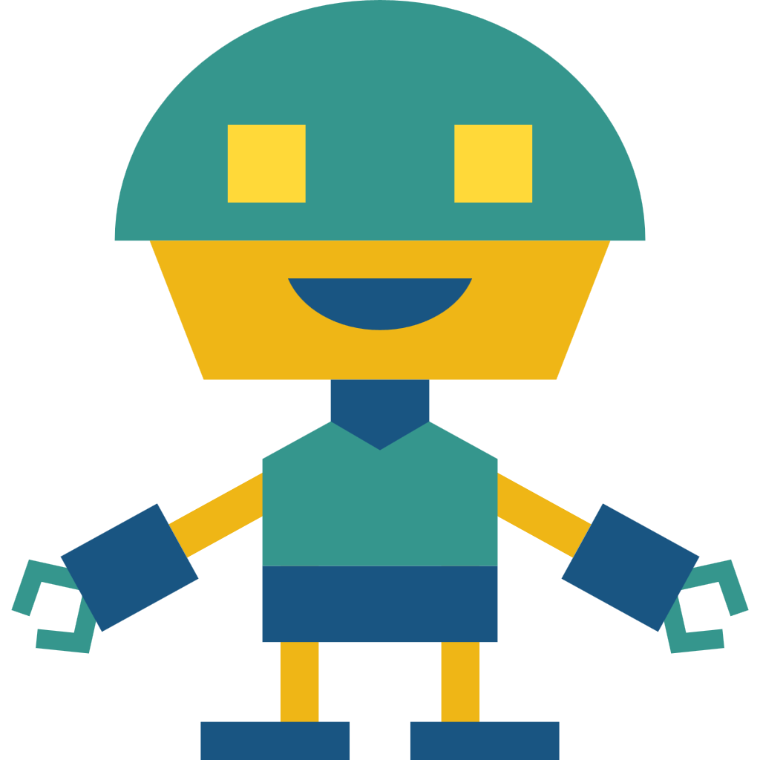

Adware
Adware is a type of software that displays advertisements on a computer or mobile device. Adware is typically installed along with free software and can be difficult to remove once it is on a system.

Slide 13

Install-Drive-by-downloading
The usage of drive by downloading is the other misleading methods utilized by adware developers. Drive by downloaded is the act of provoking an individual to install software when the user browses the website without the individual in fact wishing setup different software at the beginning.

Slide 14

Install-Continues Prompt
A writer uses continues prompting, representing the setup prompting till the individuals give up and agree to install. For instance, toolbarcash.com offers a program that trigger “automatically prompt installation and persistent retry” and this website succeeds that by using JavaScript that repeatedly insists the user to download the ActiveX program.

Slide 15
Install-Bundled and Chained Installment
Bundling adware with a third party program is another widespread way. The technique of installing additional software is named as chained installs. The vast majority of people dislike adware but why such businesses use bundling technique in their application. The answer is profit. For instance, the amount of money could be from pennies to 0.25 dollars for each installment, which can put, particularly when a program is commonly used.

Slide 16
Install-Exploits
users sometimes install some adware on their computers without their permission. That happens by abusing weaknesses in browsers that permit adware to be installed and run in an automatic way. The program downloaded consists of some piece of components that change the browser home page, show advertisements, and alter way of searching results, monitor individual computer behaviors.

Slide 17
Install-Load Points
When adware is set up on a computer, they need to make sure that they start when the system begins all the time. Some operation systems offer load points at different times throughout computer startup. There are load points for operating systems’ starts, when the user logs in, when browser executes, and when programs execute. adware can employ a load point as a minimum to make sure continuity via restarts.

Slide 18
Damages
Performance degradation: Adware can slow down a computer's performance and consume system resources, which can result in slow and unresponsive systems.
Annoying and distracting ads: Adware can display pop-up ads, banners, and other types of advertisements, which can be distracting and annoying to users.
Privacy invasion: Some adware programs collect information about a user's online activities, including their browsing history, search terms, and geolocation information, which can be used to deliver targeted ads. This can result in a loss of privacy.
Increased risk of malware: Some adware programs have been found to be bundled with malware, such as spyware and Trojans, which can cause further harm to a system.

Slide 19
Polymorphism and Metamorphism
Part Three
03

Slide 20

Polymorphism
Polymorphism is an evasion mechanism used by malware to evade detection by security software. Polymorphic malware is designed to change its appearance or behavior in order to evade detection by security software, such as antivirus programs. The malware modifies its code, file structure, or encryption method each time it is executed, making it difficult for security software to identify it.

Slide 21
Techniques
Code obfuscation: This involves using techniques such as code encryption, code packing, and code mutating to make the malware code appear different from one instance to another, while still performing the same malicious actions.
File packing: This involves using software that compresses and encrypts a malware executable into a single file, making it difficult for anti-virus software to detect.
File mutation: This involves making small modifications to the malware executable file, such as changing its size, timestamp, or adding junk data. This can make it difficult for signature-based anti-virus software to detect the malware, as its signature will be different from one instance to another.

Slide 22
Metamorphism
Malware metamorphism refers to the ability of a malicious software to modify its own code in a way that makes it difficult for anti-virus software to detect it. Metamorphic malware is a type of malicious software that changes its structure and appearance each time it is executed, while retaining its core functionality.
Metamorphism focuses on changing the code of the malware to evade detection while polymorphism focuses on changing the appearance of the malware to evade signature-based anti-virus software. However, it is also a more effective technique for evading anti-virus software, as it makes it difficult for security researchers to analyze and track the malware.

Slide 23
Techniques
Code Obfuscation: This technique involves using various methods to make the code of the malware difficult to understand and analyze. This includes techniques such as code substitution.
Dynamic Code Generation: This technique involves generating new code each time the malware is executed. The generated code retains the functionality of the original code, but is structurally different, making it difficult for anti-virus software to detect the malware.
Instruction Substitution: This technique involves modifying the code of the malware to use different machine instructions, while retaining its functionality. This makes it difficult for anti-virus software to detect the malware, as the code signatures generated by these different instructions are unique.
Data Encryption: This technique involves encrypting the data used by the malware to evade detection by anti-virus software. This makes it difficult for security researchers to analyze and track the malware.

Slide 24

THE END
Fangtian Zhong
CSCI 591
Gianforte School of Computing
Norm Asbjornson College of Engineering
E-mail: fangtian.zhong@montana.edu
2023.10.05

