Slide 1
ServAuto 服务顾问培训
Service Advisor Training
初级班 · 基础培训
Foundation Course
接待服务 · 收银结算 · 货品签收 · 套餐销售 · 拍摄与直播
Reception Service · Cashiering · Goods Receipt · Package Selling · Content & Live
适用对象：门店服务顾问（前台） | Audience: Store service advisors (front desk)

Slide 2
Overview | 内容导航
Table of Contents
目录
P0
Role & Scope
岗位认知与职责边界
P4
Package Selling
套餐销售与话术
P1
Image & Etiquette
职业形象与客户礼仪
P5
Cashiering & Goods Receipt
收银结算与货品签收
P2
Reception Service SOP
接待服务全流程
P6
Video & Live Streaming
视频拍摄与直播出镜
P3
Product & Package Knowledge
产品、项目与套餐知识
P7
Systems & Daily Operations
系统工具与日常运营

Slide 3


ServAuto 服务顾问培训 | Service Advisor Training
What the Front Desk Owns
前台承担的核心职责
第 5 项为硬性要求 · Item 5 is MANDATORY
Core Duty
接待主轴
客户接待服务 —— 岗位主轴
Reception service - your core duty
Settle & Send Off
结算送客
收款、结算、送客
Cashiering, settlement and sending off
Receive & Check
签收验收
货品签收与到货验收
Goods receipt and acceptance check
Package Sales
套餐销售
套餐销售
Package selling
Video & Live
拍摄直播
视频拍摄与直播出镜
Video shooting and live streaming
Your Neighbourhood Auto Care Expert
www.servauto.com.my

Slide 4

ServAuto 服务顾问培训 | Service Advisor Training
Eight Competency Domains
八大能力域（初级权重）
初级权重，合计 100% · Junior weights, total 100%
Image & Etiquette
形象礼仪与门店规范
12%
Reception & Process
接待服务与流程执行（主轴）
25%
Product & Package Knowledge
产品、项目与套餐知识
15%
Package Selling
套餐销售（仅限套餐）
12%
Cashiering & Goods Receipt
收银结算与货品签收
15%
Content & Live Streaming
内容生产与直播出镜（硬性）
13%
Customer Asset & Follow-up
客户资产经营与回访
5%
Data & Coaching
数据看板与带教协同
3%
Your Neighbourhood Auto Care Expert
www.servauto.com.my

Slide 5



ServAuto 服务顾问培训 | Service Advisor Training
Where You Sit in the Chain
你在业务链路里的位置
01
02
03
Traffic From the Matrix
流量进来
Your Service Starts Here
客户到店
Record and Pass It On
记录与传递
流量由公司线上内容矩阵供给
Traffic is supplied by the company content matrix
你的工作从客户到店那一刻开始
Your work starts the moment the customer arrives
准确记录需求，及时传递给技师与店长 / 套餐客户积累
Record the need accurately and pass it to the technician and manager
反哺闭环：你同时为公司流量矩阵反哺内容（视频 / 直播）。
Feedback loop: you feed content back into the company content matrix (video / live).
Your Neighbourhood Auto Care Expert
www.servauto.com.my

Slide 6

ServAuto 服务顾问培训 | Service Advisor Training
Professional Image & Etiquette
职业形象与客户礼仪
Uniform & Grooming
着装仪表
着装、工牌、发型、手部符合标准
Uniform, badge, hair and hands meet standard
Greet in 3 Seconds
3 秒问候
客户到店 3 秒内主动问候
Greet within 3 seconds of arrival
Standard Greeting
标准问候
按客群使用对应语言的标准问候
Use the ServAuto greeting in the right language
Seat & Offer
引导入座
引导入座、提供茶水、说明等待时间
Guide, offer drinks, explain the waiting time
Phone & Chat
电话与 WhatsApp
规范接听电话与回复 WhatsApp
Answer phone and WhatsApp professionally
Keep It Tidy
区域整洁
休息区与前台随时保持整洁
Keep the lounge and counter tidy at all times
Send Off & Book
送客预约
送客时明确预约下次到店
Send off with a clear next-visit reminder
No Public Dispute
争执红线
公共区域不与客户争执
Never argue with a customer in the open area
Your Neighbourhood Auto Care Expert
www.servauto.com.my

Slide 7

ServAuto 服务顾问培训 | Service Advisor Training
Reception Service SOP
接待服务
岗位主轴 · Your core duty
Arrival
到店接待
预约与到店接待
Appointment and arrival
Walk-around
环车检查
环车检查与车况拍照留档（无技师接车时）
Vehicle walk-around and photo record (no technician)
Valuables
贵重物品
提醒贵重物品、记录特别关注事项
Remind about valuables and note special concerns
Job Card
开单传递
引领客户至客休区 → 开立工单与信息传递
Escort to lounge, raise job card and pass on info
Progress
进度同步
施工进度跟踪与客户同步
Progress tracking and customer update
Handover
交车讲解
交车讲解与旧件展示
Vehicle handover and old-part show
Send Off
送客预约
送客与预约下次到店
Send off and book the next visit
Your Neighbourhood Auto Care Expert
www.servauto.com.my

Slide 8
ServAuto 服务顾问培训 | Service Advisor Training
What Good Looks Like at Each Step
每一步的达标动作
现场动作 | On the Floor
沟通与异常 | Talk & Exceptions
01
环车同行 / Walk with the Customer
01
给时间点 / Name the Time
无技师接车时，环车检查须与客户同行
With no technician, walk around the car with the customer
明确告知客户何时会有反馈
Tell the customer when to expect a call
02
当面确认 / Confirm Together
与客户确认贵重物品与特别关注事项
Confirm valuables and special concerns with the customer
02
主动同步 / Update First
在客户催问前主动同步进度
Update the customer before they ask
03
先安顿再开单 / Seat First
先引领客户至客休区，再开立工单
Escort to the lounge, then raise the job card
03
处理异常 / Handle Delays
04
旧件展示 / Show Old Parts
耐心处理等待过久、催问与临时改单
Handle delays, rush and order changes calmly
交车时展示更换下来的旧件
Show the replaced parts at handover
Your Neighbourhood Auto Care Expert
www.servauto.com.my

Slide 9
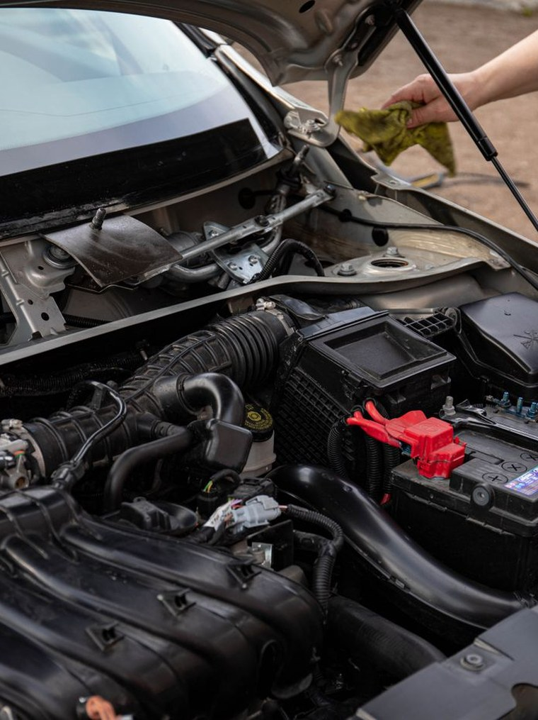
ServAuto 服务顾问培训 | Service Advisor Training
Products, Services & Packages
产品、项目与套餐知识
自己先懂，才能讲清楚 · Know it well, explain it clearly
Servicing
保养
保养：机油、滤芯、保养周期
Servicing: engine oil, filters, intervals
Tyres & Alignment
轮胎定位
轮胎与四轮定位
Tyres and wheel alignment
Fluids & Brakes
油液刹车
油液、冷却与刹车系统
Fluids, cooling and brake system
Battery & A/C
电瓶空调
电瓶、空调、美容与轻改
Battery, air-conditioning, detailing, light mods
Pricing Build-up
价格构成
工时费与配件价格构成
How labour and parts pricing is built
Package Lines
套餐体系
套餐体系：保养 / 轮胎 / 美容套餐
Packages: servicing, tyre, detailing
Member & Visit Cards
会员次卡
会员卡与次卡
Membership cards and visit-count cards
Validity & Benefits
权益规则
有效期、权益与使用规则
Validity, benefits and usage rules
Your Neighbourhood Auto Care Expert
www.servauto.com.my

Slide 10




ServAuto 服务顾问培训 | Service Advisor Training
Selling Packages with Confidence
套餐销售：敢开口、会算账
Value First
先讲价值
Do the Maths
当场算账
Read the Customer
判断客户
Confirm Benefits
确认权益
先讲价值，再讲价格
Lead with value, then talk about price
当场算账：客户能省多少
Do the maths out loud - show what they save
快速判断客户：新客 / 老客 / 保养到期 / 换胎
Read the customer: new, returning, due, tyre change
当场下单，并确认权益与有效期
Close the sale, then confirm benefits and validity
Your Neighbourhood Auto Care Expert
www.servauto.com.my

Slide 11
ServAuto 服务顾问培训 | Service Advisor Training
Handling Common Objections
常见异议的应对
异议与应对 | Objections & Answers
沟通原则 | Principles
01
太贵了 / Too Expensive
01
报价后停顿 / Pause After Price
拆到每次到店多少钱
Break it down per visit
报价后停顿，不要抢话
Pause after the price, do not talk over it
02
我不需要 / I Do Not Need It
02
不硬推 / No Hard Push
问年行驶里程
Ask about annual mileage
不推销客户未提出的项目
Never push a project the customer did not ask for
03
下次再说 / Maybe Next Time
03
拒绝也礼貌 / Stay Polite
提示权益到期时间
Remind them of the expiry
客户拒绝时保持礼貌
Stay polite when the answer is no
04
要问家人 / Ask My Family
04
记录原因 / Log the Reason
提供短暂锁价
Offer to hold the price
记录拒绝原因，用于优化套餐
Log the reason so we can improve the offer
Your Neighbourhood Auto Care Expert
www.servauto.com.my

Slide 12

ServAuto 服务顾问培训 | Service Advisor Training
Cashiering, Documents & Daily Reconciliation
收银、单据与日结对账
Four Documents
四类单据
报价单、工单、结算单、发票
Quote, job card, settlement note, invoice
Sign Before Work
施工前签字
施工前完成客户签字确认
Get the customer signature before work starts
Match Every Entry
逐笔核对
每笔收款与系统逐笔核对
Reconcile every payment against the system
Redeem Right
核销规范
套餐与优惠券正确核销
Redeem packages and vouchers correctly
Float & Change
备用金找零
备用金与找零规范管理
Manage the float and change carefully
Close the Day
日结差异
日结对账，差异当班说明
Close the day and explain any variance
File to Trace
归档可查
单据归档可追溯
File documents so they can be traced
No Off-System Payment
系统外收款红线
严禁系统外收款
Never take payment outside the system
Your Neighbourhood Auto Care Expert
www.servauto.com.my

Slide 13

ServAuto 服务顾问培训 | Service Advisor Training
Video Shooting & Live Streaming
视频拍摄与直播出镜（硬性要求）
每位服务顾问的硬性要求 · Mandatory for every service advisor
Vertical 9:16
竖屏 9:16
一律竖屏 9:16，忌横屏
Shoot vertical 9:16 - never landscape
First 2 Seconds
前 2 秒
前 2 秒必须抓住注意力
Hook the viewer within the first 2 seconds
Steady · Bright · Clear
稳 · 亮 · 清
画面稳定、光线干净、收音清楚
Steady hands, clean light, clear audio
What Works
有效素材
有效素材：施工前后对比、故障揭秘、交车瞬间
What works: before/after, fault reveal, handover
On Camera
出镜要求
出镜要求：自然、着工装、符合品牌形象
On camera: natural, in uniform, on brand
Your Neighbourhood Auto Care Expert
www.servauto.com.my

Slide 14

ServAuto 服务顾问培训 | Service Advisor Training
Content Quota & Delivery Standard
内容配额与交付标准
RED LINE · 配额不达标，直接卡认证
Short Video Quota
短视频配额
每月不少于 12条短视频
At least 4 short videos per month
Live Quota
直播配额
每周至少 1 场直播出镜
At least 1 live session per month
Submission
提交方式
月底前按要求提交到内容群
Submit through the content group before month end
Red Line
红线
配额不达标，直接卡认证
No quota, no certification
Topic Meeting
选题会
每周选题会确定下周选题与排班
The weekly content meeting sets next week's topics
Your Neighbourhood Auto Care Expert
www.servauto.com.my

Slide 15
ServAuto 服务顾问培训 | Service Advisor Training
Systems & Daily Operations
系统工具与日常运营
系统工具 | Systems
日常节奏 | Daily Rhythm
01
工单系统 / Job Card System
01
每日早会 / Morning Meeting
工单系统 —— 开立与更新
Job card system - create and update
每日早会 10 分钟
Morning meeting - 10 minutes daily
02
客户建档 / Customer Profile
02
离店前日报 / Daily Report
客户建档 —— 字段填写完整
Customer profile - complete every field
离店前完成日报
Daily report before you leave
03
库存查询 / Stock Check
03
交接班记录 / Shift Handover
库存与配件查询
Check stock and part availability
交接班记录
Handover notes between shifts
04
系统内收款 / In-System Payment
04
及时升级 / Escalate
系统内收款与核销
Take payment and redeem inside the system
无法处理的问题及时升级
Escalate anything you cannot resolve
Your Neighbourhood Auto Care Expert
www.servauto.com.my

Slide 16




ServAuto 服务顾问培训 | Service Advisor Training
Your First Twelve Months
入职一年的成长路径
Days 0–30
0–30 天
Months 1–3
1–3 个月
Months 3–6
3–6 个月
Months 6–12
6–12 个月
入职融入与跟岗
通过形象与礼仪检查
Onboard and shadow
Pass the image and etiquette check
基础集训与认证
开始按月产出内容
Foundation training and certification
Start delivering content every month
独立上岗
收银与签收零差错
Work independently
Cashiering and goods receipt with zero error
为高级班做准备
目标：高级服务顾问
Prepare for the advanced course
Target: an Advanced Service Advisor
Your Neighbourhood Auto Care Expert
www.servauto.com.my

Slide 17

Thank You
谢谢
Foundation Course | 初级课程
Your Neighbourhood Auto Care Expert
www.servauto.com.my

