Slide 1
ServAuto 店店长工作内容讲解
Store Manager Role Briefing
专题一：运营标准化
Part 1: Standardized Operations
适用对象：店长（岗前 / 在岗培训）
Audience: Store managers (pre-service & in-service training)

Slide 2

Standardized Operations
运营标准化
让服务质量变成门店能力
Turn service quality into store capability
01
Your Neighbourhood Auto Care Expert
www.servauto.com.my

Slide 3

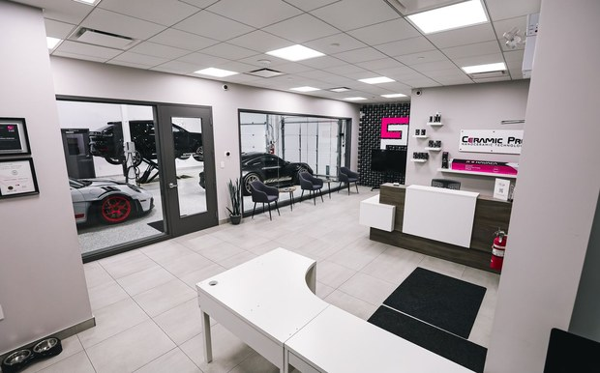

ServAuto 自营店长工作内容讲解 | Store Manager Role Briefing
The Store Manager Owns Store Results
店长是门店结果的第一负责人
Business Owner
经营负责人
Operations Owner
现场标准负责人
Team Owner
团队负责人
拆目标、看进度、做纠偏；对月度收入与毛利达成负责。
Break down targets, track progress, correct gaps; own monthly revenue and margin.
接待、检测、报价、施工、交车、回访六环节标准化，对 SOP 执行率负责。
Standardize the six steps; own SOP compliance.
招聘、训练、例会、复盘；对人员稳定性与新人达标周期负责。
Hiring, training, meetings, reviews; own staff stability and onboarding speed.
三项职责同步考核：只做业绩不管标准，或只守标准不管结果，都不合格。
All three are assessed together: results without standards, or standards without results, both fail.
Your Neighbourhood Auto Care Expert
www.servauto.com.my

Slide 4




ServAuto 自营店长工作内容讲解 | Store Manager Role Briefing
Four Closed-Loop Actions of Standardization
运营标准化的四个闭环动作
Define (manager-led)
定义标准（店长主导）
Train (weekly)
训练动作（每周 1 次）
Check (daily + weekly sampling)
检查执行（每日 + 每周抽查）
Improve (weekly meeting)
复盘优化（每周 1 次例会）
话术、检测项目、施工节点、交车检查、回访规则（跟随sop）。
Scripts, inspection items, service checkpoints, handover checks, follow-up sop.
新人带教、班前演练、现场示范、岗位认证后方可独立上岗。
Onboarding, pre-shift drills, live demonstration; no solo work before certification.
质检抽查留痕、系统记录完整、异常当日登记。
QC sampling leaves records, system entries complete, issues logged same day.
问题归因、责任到人、SOP 更新、例会同步到每位员工。
Root cause, named owner, SOP update, briefed to every staff member.
Your Neighbourhood Auto Care Expert
www.servauto.com.my

Slide 5

ServAuto 自营店长工作内容讲解 | Store Manager Role Briefing
5S Is the Foundation of Shop-Floor Standardization
5S 是现场标准化的地基
Sort (SEIRI)
整理 SEIRI
工位只留当日必用工具，多余物品当日清出。
Keep only today's required tools; clear everything else the same day.
Set in order (SEITON)
整顿 SEITON
工具定位划线，30 秒内可取可归位。
Marked positions; any tool reachable and returnable within 30 seconds.
Shine (SEISO)
清扫 SEISO
施工区每车清场，地面无油污、无零件遗留。
Clean the bay after every vehicle; no oil stains or left-over parts.
Standardize (SEIKETSU)
清洁 SEIKETSU
每日开店前、闭店后各 1 次 5S 点检并拍照留痕。
5S check twice daily - before opening and after closing - with photo records.
Sustain (SHITSUKE)
素养 SHITSUKE
点检结果挂钩班组，连续 2 周不合格进入辅导。
Results tied to the team; two consecutive failing weeks trigger coaching.
Your Neighbourhood Auto Care Expert
www.servauto.com.my

Slide 6
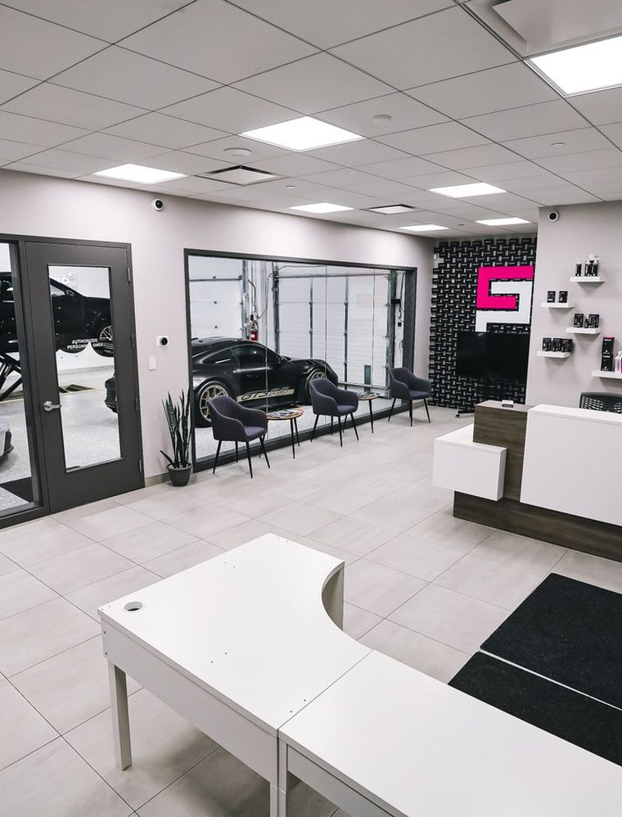
ServAuto 自营店长工作内容讲解 | Store Manager Role Briefing
Must Touchpoints: Who Does What, and by When
客户体验必须环节：谁做、多久做完
Arrival (advisor, within 3 min)
到店（服务顾问，3 分钟内）
主动迎接、确认需求、客户信息登记完整。
Greet, confirm needs, complete customer record.
Inspection (technician, within 30 min)
检测（技师，30 分钟内）
透明检查、问题分级、关键部位拍照留痕。
Transparent check, grade issues, photo key findings.
Quotation (advisor, within 15 min of inspection)
报价（服务顾问，检测后 15 分钟内）
方案清楚、价格逐项解释、客户书面确认。
Clear options, itemized pricing, written approval.
Service (technician, to promised hours)
施工（技师，按承诺工时）
进度同步、质检节点自检、异常立即上报。
Progress updates, self-check at QC points, escalate at once.
Handover (manager or advisor, same day)
交车（店长或顾问，当日）
项目逐项复核、使用提醒、下次保养时间确认。
Recheck every item, usage reminders, confirm next service date.
Follow-up (advisor, within 48 h of handover)
回访（服务顾问，交车后 48 小时内）
确认满意度、记录问题、引导线上评价。
Confirm satisfaction, log issues, invite an online review.
Your Neighbourhood Auto Care Expert
www.servauto.com.my

Slide 7

ServAuto 自营店长工作内容讲解 | Store Manager Role Briefing
Five Measurable Checks for Standardization
标准化落地的五条量化检验线
SOP compliance
SOP 执行率
月度抽查 ≥ 90%，低于线进入次月重点辅导。
Monthly sampling >= 90%; below the line triggers next-month coaching.
QC pass rate
质检合格率
一次交付合格 ≥ 95%，返工率环比不上升。
First-time-right >= 95%; rework rate must not rise month on month.
Customer reviews
客户评价
差评当日响应、3 个工作日内闭环，评分不低于 4.5 分。
Bad reviews answered same day, closed within 3 working days, rating >= 4.5.
On-time handover
交车准时率
按承诺时间交车 ≥ 90%，延误需当天向客户说明。
>= 90% delivered at the promised time; delays explained the same day.
5S checks
5S 点检
每日 2 次，月度不合格次数 ≤ 3 次。
Twice daily; no more than 3 failing checks per month.
Your Neighbourhood Auto Care Expert
www.servauto.com.my

Slide 8


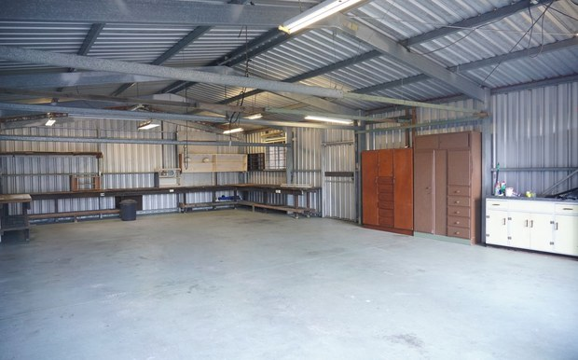
ServAuto 自营店长工作内容讲解 | Store Manager Role Briefing
Standardized Operations: Define, Train, Then Check
运营标准化：先定义，再训练，再检查
本周落地动作 | This week's actions
One booklet per role
一岗一册
Pre-shift drill
班前演练
5S and QC sampling
5S 与质检
各岗位执行sop跟话术
SOP & Talk Tracks for Each Position
排定本周 1 次班前演练，并指定带教责任人。
Schedule one pre-shift drill this week and name the coaching owner.
启动每日 2 次 5S 点检与每周 1 次质检抽查。
Start 5S checks twice daily and QC sampling once a week.
标准写在纸上不会自动执行，只有被训练、被检查、被复盘，才会变成门店能力。
Standards on paper do not execute themselves - only training, checking and review make them real.
Your Neighbourhood Auto Care Expert
www.servauto.com.my

