Slide 1
ServAuto 服务顾问培训
Service Advisor Training
高级班 · 进阶培训
Advanced Course
客户资产 · 回访召回 · 套餐匹配 · 客诉处理 · 内容策划
Customer Assets · Follow-up · Package Matching · Complaints · Content Strategy
适用对象：已通过初级认证的服务顾问 | Audience: Certified junior service advisors

Slide 2
Overview | 内容导航
Table of Contents
目录
S1
Customer File Classification
客户档案分类与分层经营
S5
Content & Live Streaming Strategy
内容运营与直播进阶
S2
Follow-up, Recall & Satisfaction
回访、召回与满意度管理
S6
Data Analysis & Self-Management
数据分析与自我经营
S3
Advanced Package Selling
套餐销售进阶与客户匹配
S7
Coaching & Collaboration
带教与跨岗协同
S4
Complaint Escalation
客诉升级处理与危机应对
CERT
Certification
高级认证标准

Slide 3

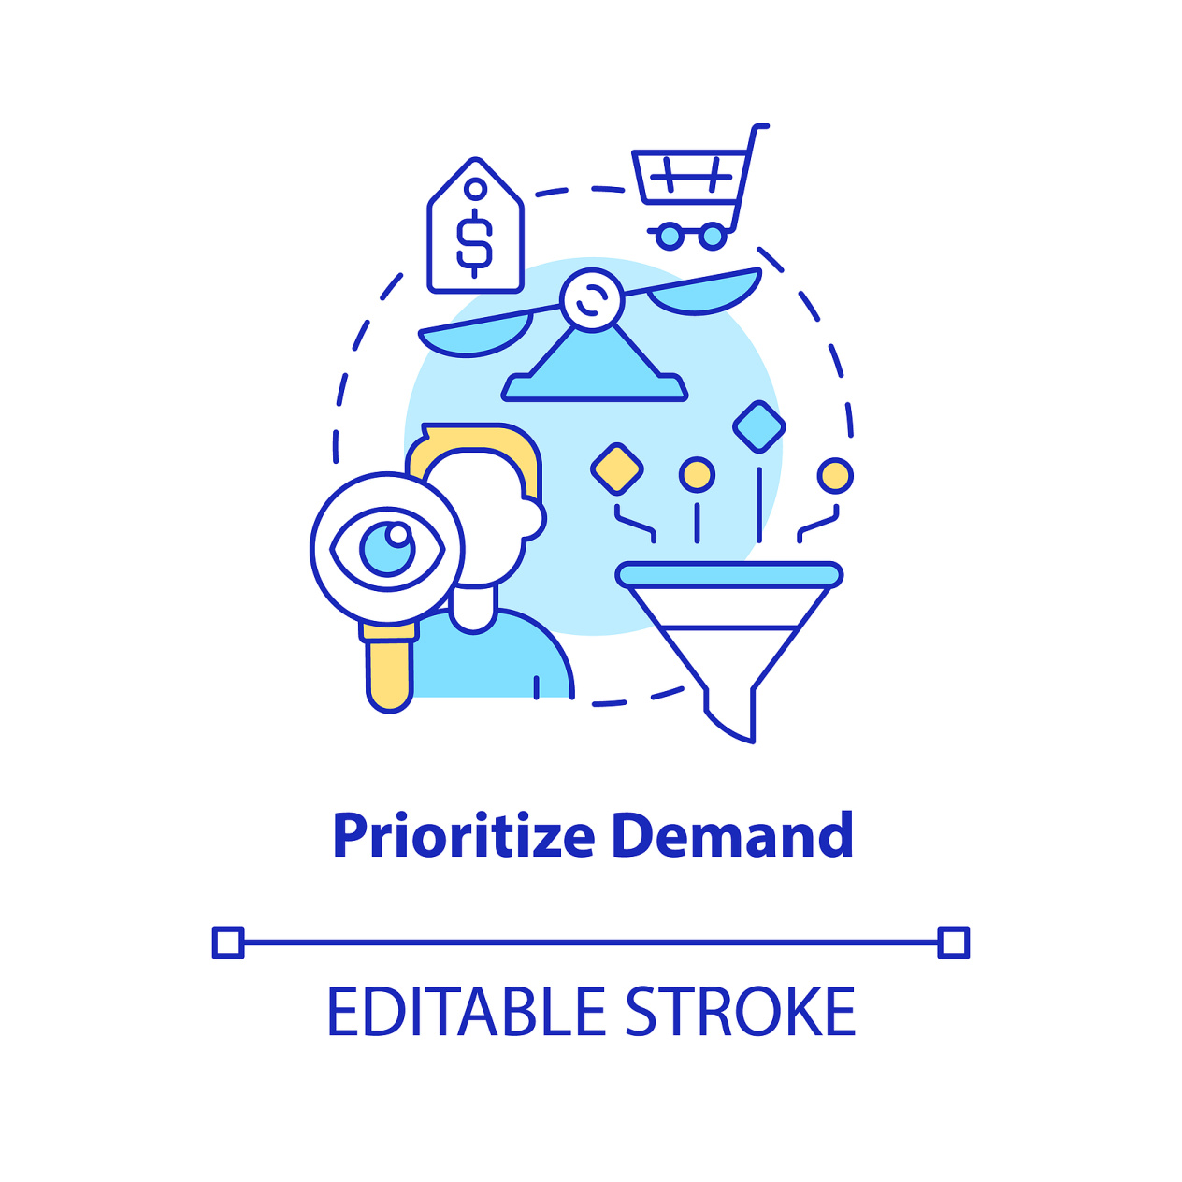
ServAuto 服务顾问培训 · 进阶 | Service Advisor Training - Advanced
From Doing to Owning
从接待好这一单，到经营好这批客户
初级 · JUNIOR | Do the Job
高级 · ADVANCED | Own the Pool
01
每一次到店 / Each Visit
01
客户资产 / Customer Pool
把每一次到店接待好
Handle each visit well
经营一批客户资产
Own a pool of customers
02
标准流程 / Standard Process
02
修补流程 / Fix the Gaps
执行标准流程
Follow the standard process
发现并修补流程漏洞
Spot and fix what the process misses
03
内容配额 / Content Quota
03
选题策划 / Topic Planning
按配额完成内容产出
Deliver content to quota
策划能带来到店的内容选题
Plan the topics that bring people in
Your Neighbourhood Auto Care Expert
www.servauto.com.my

Slide 4

ServAuto 服务顾问培训 · 进阶 | Service Advisor Training - Advanced
Where Advanced Advisors Win
高级阶段的能力重心
高级权重，合计 100% · Advanced weights, total 100%
Image & Etiquette
形象礼仪与门店规范
5%
Reception & Process
接待服务与流程执行
15%
Product & Package Knowledge
产品、项目与套餐知识
8%
Package Selling
套餐销售
12%
Cashiering & Goods Receipt
收银结算与货品签收
8%
Content & Live Streaming
内容生产与直播出镜（硬性）
20%
Customer Asset & Follow-up
客户资产经营与回访
22%
Data & Coaching
数据看板与带教协同
10%
Your Neighbourhood Auto Care Expert
www.servauto.com.my

Slide 5

ServAuto 服务顾问培训 · 进阶 | Service Advisor Training - Advanced
Building the Customer Asset Pool
客户档案分类与分层经营
Full Profile
完整建档
每位客户建立完整档案
Every customer gets a complete profile
Five Fields
五个字段
记录：车型、车龄、里程、消费力、活跃度
Capture model, age, mileage, spend, activity
Tiering
ABCD 分层
按价值与潜力分为 A / B / C / D 四类
Classify A / B / C / D by value and potential
Follow-up Rules
跟进口径
明确谁跟、跟多频、给什么
Decide who follows up, how often, with what
Handover
离职交接
人员离职时客户资产规范交接
Hand the pool over properly when staff leave
Your Neighbourhood Auto Care Expert
www.servauto.com.my

Slide 6

ServAuto 服务顾问培训 · 进阶 | Service Advisor Training - Advanced
A / B / C / D Tiering
四类客户的分层标准
A - High Value
A 类 · 高价值
高消费、稳定回店 —— 专人跟进、优先服务
High spend, returns regularly - personal contact and priority service
B - Room to Grow
B 类 · 有潜力
常规客户，有提升空间 —— 套餐匹配与到期提醒
Regular, with room to grow - package matching and due reminders
C - Low Frequency
C 类 · 低频
一次性或低频 —— 激活优惠
One-off or low frequency - activation offers
D - Dormant
D 类 · 沉睡
沉睡或流失 —— 召回活动
Dormant or lost - win-back campaign
Your Neighbourhood Auto Care Expert
www.servauto.com.my

Slide 7
ServAuto 服务顾问培训 · 进阶 | Service Advisor Training - Advanced
Turning One Visit into a Year
把一次性客户变成年度客户
触发时机 | When to Call
执行要点 | How to Do It
01
24 小时回访 / Within 24 h
01
节庆问候 / Greetings
交车后 24 小时内：满意度回访
Within 24h: satisfaction call
生日与节庆问候
Birthday and festive greetings
02
到期提醒 / Due Reminder
02
渠道 / Channel
保养到期前：提醒到店
Before service due: maintenance reminder
电话或 WhatsApp，保持简短
Use phone or WhatsApp, keep it short
03
流失预警 / Win-back
03
记录 / Log It
长期未到店：流失预警与召回
Inactivity alert: win-back call
回访结果全部记入客户档案
Log every outcome in the customer file
04
客诉回访 / Post-Complaint
04
转预约 / Book It
客诉之后：结果回访
After a complaint: outcome call
每次回访都要争取到预约
Turn every call into a booking
Your Neighbourhood Auto Care Expert
www.servauto.com.my

Slide 8

ServAuto 服务顾问培训 · 进阶 | Service Advisor Training - Advanced
Call Cadence & Script
回访节奏与话术结构
达成率 80% → 标杆 95% · Target 80% completion, 95% at best practice
Opening
开场
开头先报姓名与门店，不先推销
Open with your name and the workshop, not a pitch
Open Question
切入
用车况一个开放式问题切入
Ask one open question about the car
Confirm
确认
确认施工内容，并确认满意度
Confirm what was done and check satisfaction
Close
收口
直接给两个时间段，不做开放式结束
Offer two appointment slots instead of an open ending
Record
记录
记录结果，并设定下次提醒
Record the outcome and set the next reminder
Your Neighbourhood Auto Care Expert
www.servauto.com.my

Slide 9
ServAuto 服务顾问培训 · 进阶 | Service Advisor Training - Advanced
Matching Packages to the Right Customer
套餐销售进阶与客户匹配
匹配与推荐 | Match & Recommend
跟踪与底线 | Track & Guard
01
四维匹配 / Four-Factor Match
01
渗透率 / Penetration
按车龄 × 里程 × 用车场景 × 消费力匹配
Match on age x mileage x usage x budget
每周跟踪渗透率
Track penetration rate weekly
02
主力款先行 / Main First
02
核销率 / Redemption
先推主力款，再引导升级款
Lead with the main package, then the upgrade
跟踪核销率 —— 不只看销量
Track redemption rate, not just sales
03
不越层 / No Overreach
03
到期提醒 / Expiry Reminder
C 类客户不推高端套餐
Do not offer a high-end package to a C-tier customer
权益到期前主动提醒核销
Remind before the benefits expire
04
二次切入 / Second Approach
04
不推销 / No Upsell
被拒后需有真实理由再切入
Re-approach only when a real reason appears
不推销客户未提出的项目
Never upsell a project the customer did not ask for
Your Neighbourhood Auto Care Expert
www.servauto.com.my

Slide 10

ServAuto 服务顾问培训 · 进阶 | Service Advisor Training - Advanced
Complaint Tiers & Escalation
客诉分级与升级路径
Tier 1
一级 · 现场
一级 —— 现场即可解决
Tier 1 - solved at the counter
Tier 2
二级 · 介入
二级 —— 需店长或技师介入
Tier 2 - needs the manager or technician
Tier 3
三级 · 风险
三级 —— 舆情或法律风险
Tier 3 - reputation or legal risk
Your Scope
权限边界
一级由前台独立处理，二级配合处理
You own Tier 1 fully and assist on Tier 2
Escalate Now
立即上报
三级必须立即升级上报
Tier 3 must be escalated immediately
No Promises
不擅承诺
不擅自承诺赔偿
Never promise compensation on your own
Move Away
带离现场
把客户带离公共区域沟通
Move the customer away from the public area
Write It Down
当天记录
当天完成书面记录
Write it down the same day
Your Neighbourhood Auto Care Expert
www.servauto.com.my

Slide 11

ServAuto 服务顾问培训 · 进阶 | Service Advisor Training - Advanced
The Five-Step De-escalation
情绪安抚五步法
Listen
听完
听完 —— 不打断
Listen without interrupting
Acknowledge
共情
共情 —— 认情绪，不认责
Acknowledge the feeling, not the blame
Repeat Back
复述
复述 —— 确认事实一致
Repeat the facts back to confirm them
Act
给方案
给方案 —— 明确动作与时间
Give a clear next action and a time
Follow Up
跟进
跟进 —— 直到客户确认满意
Follow up until the customer confirms
Your Neighbourhood Auto Care Expert
www.servauto.com.my

Slide 12
ServAuto 服务顾问培训 · 进阶 | Service Advisor Training - Advanced
Planning Content That Brings People In
策划能带来到店的内容
内容结构 | Content Mix
引流与合规 | Leads & Compliance
01
内容配比 / Content Mix
01
直播留资 / Collect Leads
信任型 60% / 教育型 20% / 促销型 20%
Trust 60% / education 20% / promotion 20%
直播中收集留资
Collect leads during the live stream
02
选题会 / Topic Meeting
02
追踪到店 / Track Visits
主导每周选题会
Own the weekly topic meeting
用专属码或口令追踪到店
Use a code or keyword to track store visits
03
爆款拆解 / Break Down Hits
03
语言选择 / Language
拆解上一条爆款的爆点
Break down what made the last hit work
按目标客群选择语言
Keep the language right for the audience
04
直播排品 / Live Lineup
04
平台规范 / Compliance
直播排品：引流款 → 套餐 → 利润款
Plan the live run: hook, package, profit item
遵守平台与广告规范
Follow platform and advertising rules
Your Neighbourhood Auto Care Expert
www.servauto.com.my

Slide 13

ServAuto 服务顾问培训 · 进阶 | Service Advisor Training - Advanced
From Views to Bookings
从播放量到到店单
Visits Not Views
看到店
不看播放量，看带来到店数
Do not chase views - track store visits
Unique Code
独立追踪码
每条内容配独立追踪码
Give every piece of content its own code
Ask the Source
必问来源
新客到店必问获客来源
Ask new customers how they found you
Compare Types
分类对比
按选题类型对比到店转化率
Compare topic types against visit rate
Cut Losers
及时止损
持续不带来客户的选题直接放弃
Drop the formats that never bring anyone in
Your Neighbourhood Auto Care Expert
www.servauto.com.my

Slide 14

ServAuto 服务顾问培训 · 进阶 | Service Advisor Training - Advanced
Running Your Own Numbers
用数据管理自己的岗位产出
Reception
接待量与质量
接待量与接待质量评分
Reception volume and quality score
Content
内容与归因
内容产出量与归因到店数
Content output and attributed visits
Penetration
套餐渗透率
套餐渗透率
Package penetration rate
Follow-up
回访达成率
回访达成率
Follow-up completion rate
Goods Receipt
签收准确率
货品签收准确率
Goods receipt accuracy
Plan
日周计划
制定日计划与周计划
Set a daily and a weekly plan
Find the Gap
找差距
找到差距，只改一个动作
Find the gap, then pick one action
Weekly Review
每周复盘
每周复盘，不等月底
Review every week, not only at month end
Your Neighbourhood Auto Care Expert
www.servauto.com.my

Slide 15
ServAuto 服务顾问培训 · 进阶 | Service Advisor Training - Advanced
Coaching New Advisors
带教与跨岗协同
带教方法 | How to Coach
协同边界 | Hand-off Lines
01
一日跟岗 / Shadow Plan
01
交技师 / To Technician
设计一日跟岗计划
Design a one-day shadowing plan
清楚哪些该交给技师
Know what to hand to the technician
02
示范放手 / Show, Do, Fix
02
交库管 / To Storekeeper
先示范、再放手、后纠偏
Show, then let them do, then correct
清楚哪些该交给库管
Know what to hand to the storekeeper
03
纠动作 / Fix the Action
03
报店长 / To Manager
纠动作，不纠人
Correct the action, not the person
清楚哪些必须报店长
Know what must go to the manager
04
早会带教 / Morning Meeting
04
通过率 / Pass Rate
每周主持一次早会
Run the morning meeting once a week
新人认证通过率算你的成绩
New advisors' pass rate is on you
Your Neighbourhood Auto Care Expert
www.servauto.com.my

Slide 16

ServAuto 服务顾问培训 · 进阶 | Service Advisor Training - Advanced
Advanced Certification Standard
高级认证标准
ASSESSMENT · 六项全部达标方可获得高级认证
Tiering Plan
客户分层
客户分层方案与执行结果
Customer tiering plan and its results
Monthly Review
月度经营分析
个人月度经营分析
Monthly personal performance review
Live & Review
直播与复盘
主导一场直播并输出复盘
Run one live session and review it
Complaint Case
客诉案例
处理一起升级客诉案例
Handle one escalated complaint case
Coach to Certify
带教认证
带教一名新人通过认证
Coach one new advisor to certification
KPI Pass Line
指标及格线
各项指标均达及格线以上
Meet the KPI pass line on every metric
Your Neighbourhood Auto Care Expert
www.servauto.com.my

Slide 17

Thank You
谢谢
Advanced Course | 48 Hours | 高级课程 · 48 课时
Your Neighbourhood Auto Care Expert
www.servauto.com.my

