Slide 1
ServAuto 自营店店长工作内容讲解
Store Manager Role Briefing
专题三：团队与日常管理
Part 3: Team & Daily Routines
适用对象：店长（岗前 / 在岗培训）
Audience: Store managers (pre-service & in-service training)

Slide 2

Team & Daily Routines
团队与日常管理
把管理动作变成固定节奏
Turn management into a fixed rhythm
03
Your Neighbourhood Auto Care Expert
www.servauto.com.my

Slide 3




ServAuto 自营店长工作内容讲解 | Store Manager Role Briefing
Hiring and Coaching Determine Long-Term Stability
招聘与带教决定门店长期稳定性
Hiring profile
招聘画像
Interview evidence
面试看证据
Trial shift
试岗看现场
Coaching loop
带教闭环
按岗位明确能力、性格、排班适配；缺编 7 天内启动招聘。
Define capability, attitude and schedule fit per role; hire within 7 days.
服务意识、抗压、纪律性、学习速度，四项各留评分记录。
Service mindset, pressure tolerance, discipline, learning speed.
沟通、记录、协作、纪律，试岗 1-3 天并出具结论。
Observe communication, records, teamwork, discipline; 1-3 days, written conclusion.
第 1 天标准红线；第 1 周跟岗；第 2 周低风险任务；1 个月认证；每周反馈 1 次。
Standards day 1, shadowing week 1, low-risk tasks week 2, certification in month 1.
Your Neighbourhood Auto Care Expert
www.servauto.com.my

Slide 4
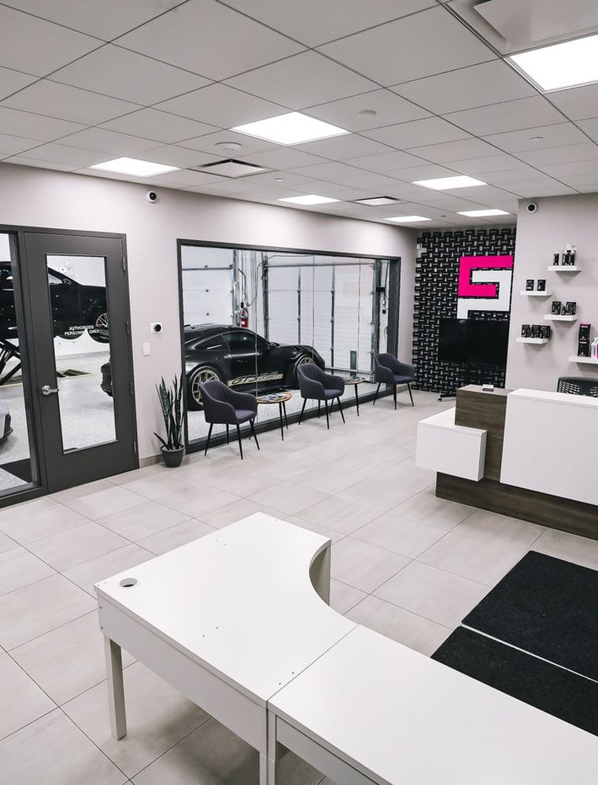
ServAuto 自营店长工作内容讲解 | Store Manager Role Briefing
Daily Management Needs a Stable Rhythm
日常管理要形成固定节奏
Before opening (manager, 30 min ahead)
开店前（店长，开业前 30 分钟）
到岗、环境设备、预约工单、重点客户、当天目标。
Attendance, equipment, appointments, targets.
During service (manager, floor walk every 2 h)
营业中（店长，每 2 小时巡场 1 次）
接待质量、施工进度、报价转化、异常升级。
Reception, progress, conversion, escalation.
After closing (manager, within 30 min)
闭店后（店长，闭店后 30 分钟内）
账务核对、库存变动、未结工单、客户回访、问题复盘。
Accounts, stock, open orders, follow-up, review.
Weekly (40-min meeting)
每周（周会 40 分钟）
经营分析、排班优化、培训计划、招聘进度、绩效沟通。
Business analysis, scheduling, training, hiring, performance talks.
Monthly (business review)
每月（月度经营会）
目标达成复盘 + 下月目标拆解 + 团队评估。
Attainment review, next-month targets, team assessment.
Your Neighbourhood Auto Care Expert
www.servauto.com.my

Slide 5

ServAuto 自营店长工作内容讲解 | Store Manager Role Briefing
Risks Must Be Handled Quickly, Accurately, and Traceably
异常和风险处理要快、准、可追溯
Safety risk
安全风险
设备、用电、施工防护、试车规范；发现即停工，当日上报区域经理。
Equipment, electricity, protection, test-drive rules; stop work, report same day.
Complaint
服务投诉
先安抚、查事实、给方案、复盘标准；24 小时内首次回复，3 个工作日内闭环。
Calm, verify facts, offer a solution; first reply within 24 h, closed in 3 working days.
Finance risk
财务风险
收款核对、退款审批、账实一致；当日账款当日核清。
Payment checks, refund approval, account consistency; reconcile the same day.
Inventory risk
库存风险
盘点、损耗、呆滞品、供应异常；月度盘点差异率超标须书面说明。
Counting, loss, slow stock, supply; variance over the limit needs a written note.
People risk
人员风险
迟到缺岗、冲突、违规、离职预警；关键岗位异动 24 小时内上报。
Absence, conflict, violations, attrition; report key-role changes within 24 h.
Your Neighbourhood Auto Care Expert
www.servauto.com.my

Slide 6
ServAuto 自营店长工作内容讲解 | Store Manager Role Briefing
Meetings and Motivation: Fixed Routines, Stable Team
例会与团队激励：固定动作，稳定人心
Meeting rhythm | 会议节奏
Motivation actions | 激励动作
01
晨会 10 分钟（店长，开店前）
01
公开认可（每周）
10-min morning meeting (manager, before opening)
昨日问题、今日目标、当日分工。
Public recognition (weekly)
好案例当场表扬，服务动作具体到人。
02
夕会 10 分钟（班组长，闭店前）
02
即时反馈（当日）
10-min evening meeting (team lead, before closing)
当日完成、异常上报、明日准备。
Instant feedback (same day)
问题不过夜，当面沟通不留尾巴。
03
周会 40 分钟（店长，固定日）
03
成长路径（月度）
40-min weekly meeting (manager, fixed day)
经营数据、短板训练、下周重点。
Growth path (monthly)
认证、晋级、带教新人，让员工看得到下一步。
Your Neighbourhood Auto Care Expert
www.servauto.com.my

Slide 7



ServAuto 自营店长工作内容讲解 | Store Manager Role Briefing
Team & Daily Routines: A Stable Rhythm Keeps a Stable Team
团队与日常管理：节奏稳定，团队才稳定
本周落地动作 | This week's actions
Pre-opening checklist
开店前点检表
Fix meeting times
固定会议时间
Coaching owner and date
新人带教节点
把日常五项确认做成开店前点检表，贴在办公室。
Turn the five pre-opening confirmations into a checklist and post it in the office.
固定晨会、夕会、周会时间并写入排班表。
Fix the morning, evening and weekly meeting times and put them in the schedule.
对每位新员工确定带教责任人和 1 个月认证节点。
Assign a coaching owner and a one-month certification date to every new hire.
招聘看证据、带教有闭环、日常有节奏、异常有标准，团队才会稳定产出。
Hire on evidence, coach in a loop, keep a daily rhythm, handle exceptions by standard.
Your Neighbourhood Auto Care Expert
www.servauto.com.my

