Slide 1
Joint Extraction of Clinical Entities and Relations Using Multi-head Selection Method
IALP​ 2021
​
Ritsumeikan University, Japan​
Xintao Fang, Yuting Song, Akira Maeda​

Slide 2
Introduction
Electronic health records contain large amounts of free-text data that includes detailed records about clinical events
Extracting clinical entities and their relations is helpful for supporting clinical research and application such as constructing clinical knowledge graphs
An example of clinical entities and relations
Entity type： Medical problem
Entity type： Treatment
Relation type： Treatment improves medical problem (TrIP)
Hypertension was controlled on hydrochlorothiazide
Medical problem
Treatment
hydrochlorothiazide-TrIP-Hypertension

Slide 3
Entity With Multiple Relations
 | Texts | Triples
Normal | The patient was thrombocytopenic with a platelet count of 49 on the 23. | (thrombocytopenic, TeRP, a platelet count)
SingleEntity Overlap (SEO) | Electrocardiogram at that time showed st elevations and j point elevations in v2 through v4. | (Electrocardiogram, TeRP, st elevations ) (Electrocardiogram, TeRP, j point elevations in v2 through v4)
Multi-relations issue in clinical entity and relation extraction
We utilize the multi-head selection model to extract clinical entities and their relations

Slide 4
Related Work (1)
Entity and relation extraction in general domain and medical domain
Two main frameworks
Pipeline method: first identify entities and then classify relations for the entity pairs
Joint method: Extract entities and relations simultaneously
Early methods and current methods
Early methods require manually designed features or existing NLP tools
Current methods based on deep learning methods especially after the emergence of the pre-trained language model

Slide 5
Related Work (2)
Pre-trained language model
The pre-trained language model (e.g. BERT) has become the most widely used for building NLP systems
Many variants of BERT model have been proposed for clinical domain
Medical BERT
Continue to pretrain the BERT model on medical corpuses
Character BERT
Replace the wordpiece system with Character-CNN module

Slide 6
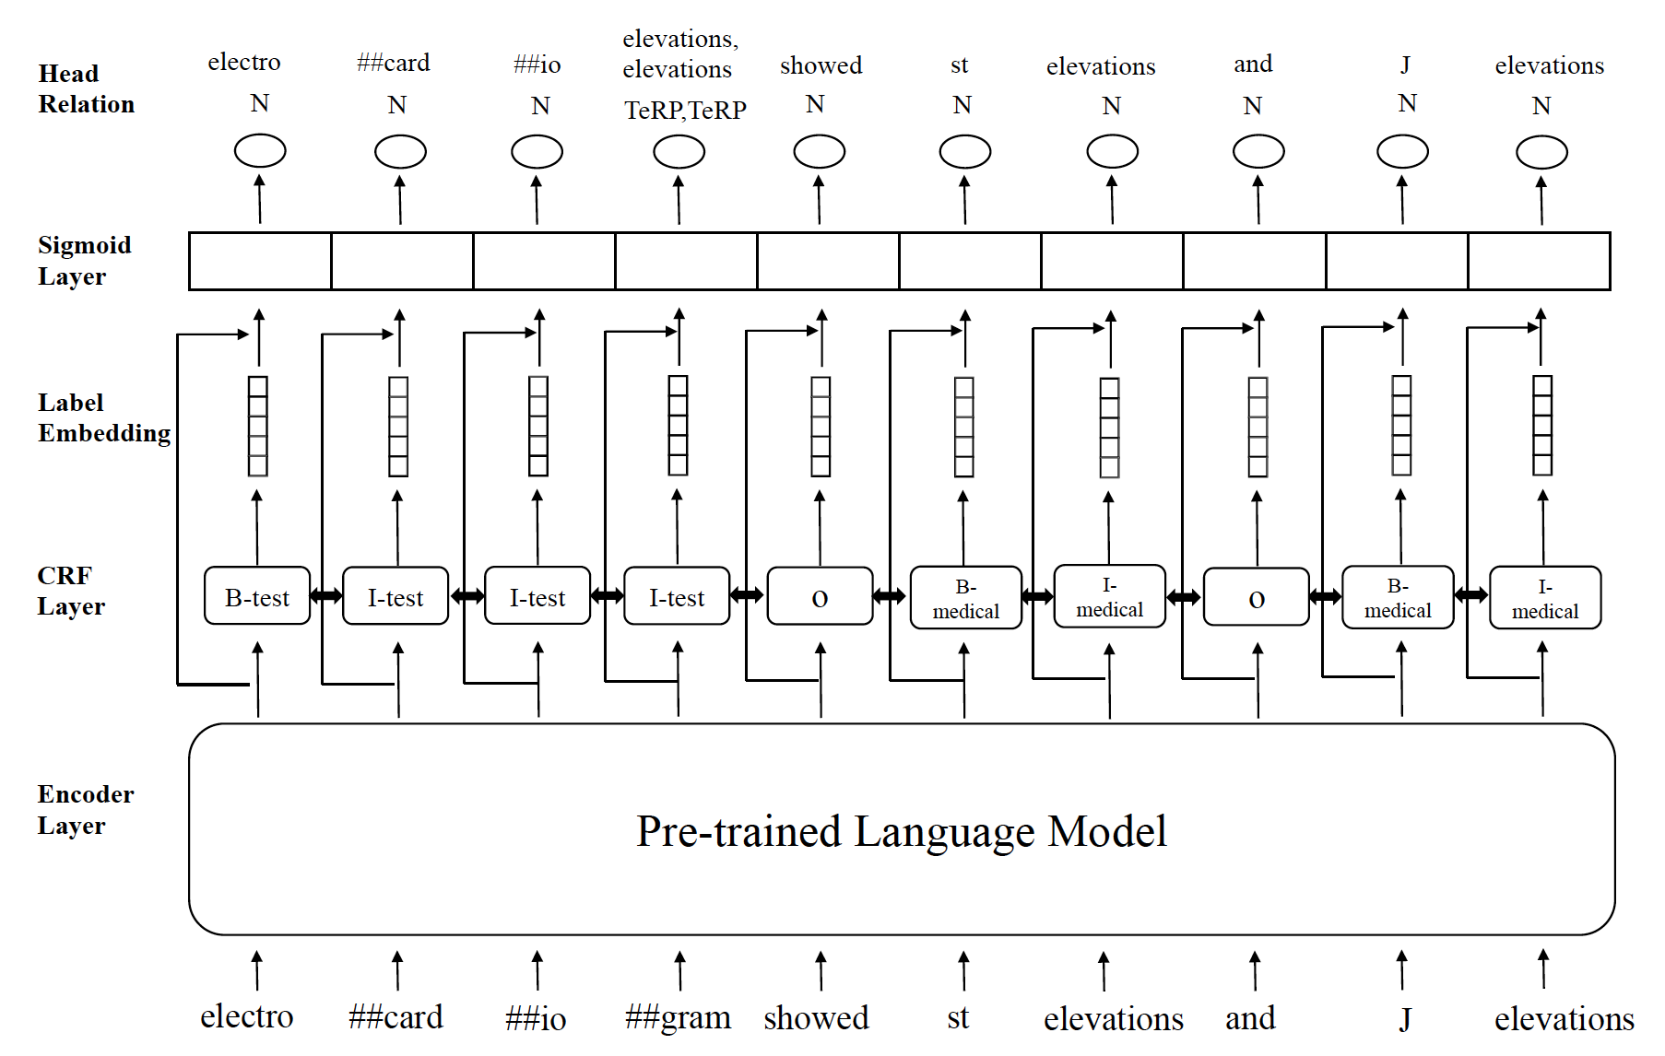
Proposed Method
We proposed multi-head selection model integrated with pre-trained language model for clinical entities and relation extraction
Relation extraction
Entity extraction
Word representation

Slide 7
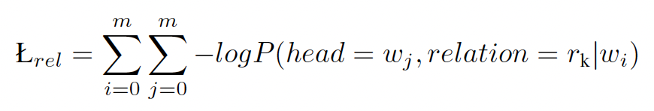
Multi-head Selection Method
We formulate the relation extraction as a multi-head selection problem
For the input token sequence W and a set of relation R
For each token w_{i} (w_{i} ∈ W), our goal is to identify:
The most probable head token w_{j} (w_{j} ∈ W)
The most probable corresponding relation label r_{k} (r_{k} ∈ R)
Because the entity may have multiple relations, we adopt sigmoid layer the predict relations
We minimize the cross-entropy loss during training phase

Slide 8
Experimental Datasets
n2c2 2018
9 entity types and 8 relation types
i2b2/VA 2010
3 entity types and 8 relation types
Train data | Dev data | Test data
9105 sentences | 2904 sentences | 3112 sentences
Train data | Dev data | Test data
3128 sentences | 1069 sentences | 867 sentences

Slide 9
n2c2 Experimental results
Model | Named entity recognition |  |  | Relation extraction
 | precision(%) | recall(%) | F1-score(%) | precision(%) | recall(%) | F1-score(%)
UTH | - | - | 89.03 | - | - | 81.97
UFL | - | - | 88.10 | 83.37 | 77.73 | 80.48
NaCT | - | - | 88.05 | - | - | 80.43
BERT _{(general)} | 92.26 | 92.44 | 92.35 | 82.37 | 79.49 | 80.91
CharacterBERT _{(general)} | 91.41 | 91.82 | 91.61 | 81.54 | 80.08 | 80.81
BERT _{(medical)} | 93.02 | 94.16 | 93.59 | 84.36 | 84.51 | 84.44
CharacterBERT _{(medical)} | 92.27 | 93.37 | 92.82 | 81.77 | 85.59 | 83.64
n2c2 challenge participants’ methods
Our method
Our method outperformed these top-ranking systems in n2c2 challenge
Medical domain pre-trained language models were more effective than the general domain pre-trained language models

Slide 10
i2b2 Experimental Results
Model | Named entity recognition |  |  | Relation extraction
 | precision(%) | recall(%) | F1-score(%) | precision(%) | recall(%) | F1-score(%)
BERT _{(general)} | 84.45 | 86.07 | 85.25 | 51.93 | 41.05 | 45.86
CharacterBERT _{(general)} | 83.35 | 83.86 | 83.60 | 49.31 | 42.79 | 45.82
BERT _{(medical)} | 91.77 | 91.74 | 91.76 | 57.15 | 53.08 | 55.04
CharacterBERT _{(medical)} | 88.36 | 87.38 | 87.87 | 54.22 | 53.80 | 54.01
BERT_{(medical)} achieved the best results

Slide 11
Multiple Relation Examples
Dataset | Text | Gold | Prediction
n2c2 | toprol xl 50mg daily | (50mg, Strength-Drug, toprol xl), (daily, Frequency-Drug, toprol xl) | (50mg, Strength-Drug, toprol xl), (daily, Frequency-Drug, toprol xl)
i2b2 | electrocardiogram at that time showed st elevations and j point elevations in v2 through v4 | (electrocardiogram, TeRP, st elevations), (electrocardiogram, TeRP, j point elevations in v2 through v4) | (electrocardiogram, TeRP, st elevations), (electrocardiogram, TeRP, j point elevations in v2 through v4)
Our method successfully extracted entity with multiple relations

Slide 12
Conclusion and Future work
We proposed a multi-head selection model with pre-trained language models for clinical entity and relation extraction
We investigated the impact of pre-trained language models on entity and relation extraction task
Future work
We plan to conduct experiment on Chinese and Japanese dataset

Slide 13
付録一
実験データi2b2
医学的エンティティ関係
8つカテゴリー

Slide 14
Multiple Relation Examples
Dataset | Test | Multi-relation | Correct
n2c2 | 3112 sentences | 2387 sentences | 1709 sentences
Positive example
Dataset | Text | Gold | Prediction
n2c2 | toprol xl 50mg daily | (50mg, Strength-Drug, toprol xl), (daily, Frequency-Drug, toprol xl) | (50mg, Strength-Drug, toprol xl), (daily, Frequency-Drug, toprol xl)
i2b2 | electrocardiogram at that time showed st elevations and j point elevations in v2 through v4 | (electrocardiogram, TeRP, st elevations), (electrocardiogram, TeRP, j point elevations in v2 through v4) | (electrocardiogram, TeRP, st elevations), (electrocardiogram, TeRP, j point elevations in v2 through v4)

Slide 15
医学的エンティティ関係（カテゴリ１〜3）
Medical problem and treatment(医療問題と治療法)
カテゴリ１：Treatment improves medical problem(TrIP)
Infection resolved with antibiotic courseHypertension was controlled on hydrochlorothiazide
カテゴリ2：Treatment worsens medical problem(TrWP)
Culture taken from the lumbar drain showed Staphylococcus aureus resistant to Nafcillin
カテゴリ3： Treatment causes medical problem(TrCP)
Hypothyroidism following near total thyroidectomy

Slide 16
医学的エンティティ関係（カテゴリ4〜5）
（続き） medical problem and Treatment (医療問題と治療法)
カテゴリ4： Treatment is administered for medical problem(TrAP)
Antibiotic therapy for presumed right forearm phlebitis
カテゴリ5： Treatment is not administered because of medical problem(TrNAP)
Relafen which is contra-indicated because of ulcers

Slide 17
医学的エンティティ関係（カテゴリ6〜8）
Test relations with medical problem(検査と医療問題)
カテゴリ6： Test reveals medical problem(TeRP)
An abdominal ultrasound was performed showing no stones
カテゴリ7： Test conducted to investigate medical problem(TeCP)
Chest x-ray done to rule out pneumonia
Medical problem relations with other medical problems(医療問題とほかの医療問題)
カテゴリ8： Medical problem indicates medical problem(PIP)
A history of noninsulin dependent diabetes mellitus, now presenting with acute blurry vision on the left side

Slide 18
付録二
実験データn2c2
医学的エンティティ関係
8つカテゴリー

Slide 19
医学的エンティティ関係（カテゴリ1〜2）
カテゴリ1:Strength-Drug
The patient suffers from steroid-induced hyperglycemia. Patient prescribed 1 x 20mg prednisone tablet daily for 5 days.
Strength-Drug relation : 20 mg → Prednisone
カテゴリ2：Dosage-Drug
The patient suffers from steroid-induced hyperglycemia. Patient prescribed 1 x 20mg prednisone tablet daily for 5 days.
Dosage-Drug relation : 1 → Prednisone

Slide 20
医学的エンティティ関係（カテゴリ3〜4）
カテゴリ3：Duration-Drug
The patient suffers from steroid-induced hyperglycemia. Patient prescribed 1 x 20mg prednisone tablet daily for 5 days.
Duration-Drug relation : 5 days → Prednisone
カテゴリ4：Frequency-Drug
The patient suffers from steroid-induced hyperglycemia. Patient prescribed 1 x 20mg prednisone tablet daily for 5 days.
Frequency-Drug relation : daily → Prednisone

Slide 21
医学的エンティティ関係（カテゴリ5〜6）
カテゴリ5：Form-Drug
The patient suffers from steroid-induced hyperglycemia. Patient prescribed 1 x 20mg prednisone tablet daily for 5 days.
Form-Drug relation : tablet → Prednisone
カテゴリ6：Route-Drug
Patient received 100 Units/kg IV heparin sodium injection for treatment of deep vein thrombosis.
Route-Drug relation : injection → heparin

Slide 22
医学的エンティティ関係（カテゴリ7〜8）
カテゴリ7：Reason-Drug
Patient received 100 Units/kg IV heparin sodium injection for treatment of deep vein thrombosis
Reason-Drug relation : deep vein thrombosis → heparin sodium
カテゴリ8：ADEs-Drug
Patient is experiencing muscle pain, secondary to statin therapy for coronary artery disease.
ADEs-Drug relation : muscle pain → statin

