Slide 1
共同学習方式による電子カルテからの​ エンティティ関係抽出手法
第三回ゼミ​
ディジタル図書館研究室 ​
M２ FANG Xintao​
2021-05-14

Slide 2
研究背景
情報技術の発展に伴い、電子カルテ（EMR: electrical medical records）は従来のカルテと比較して、保存と管理に便利であるため、各病院で普及しつつある
電子カルテに含まれる情報量は膨大であるため、電子カルテに基づいて医療エンティティ関係の抽出を行うことにより、価値ある医療情報を獲得できる

Slide 3
エンティティ関係抽出
テキストから「固有表現ー関係ー固有表現」のような構造化されている三つ組を結果として抽出する​
例：
固有表現： Medical problem
固有表現： Treatment
関係： Treatment improves medical problem (TrIP)
医学的問題
治療
治療は医学的問題を改善する
心臓病
ヒドロクロロチアジド 薬
Hypertension was controlled on hydrochlorothiazide
Medical problem
treatment
hydrochlorothiazide-TrIP-Hypertension

Slide 4
エンティティ関係抽出方法
固有表現抽出モデル
固有表現と関係
関係分類 モデル
データ
固有表現
パイプライン方式
(Pipline method)
固有表現と関係
エンティティ関係分類 モデル
データ
共同学習方式(Joint method)
パイプライン方式の欠点
誤った累積伝播が存在する
サブタスク間の依存関係が無視される
冗長な固有表現が生じる

Slide 5
研究目的
共同学習モデル（Joint model）を電子カルテデータに応用する
エンティティ関係抽出の精度を向上する

Slide 6
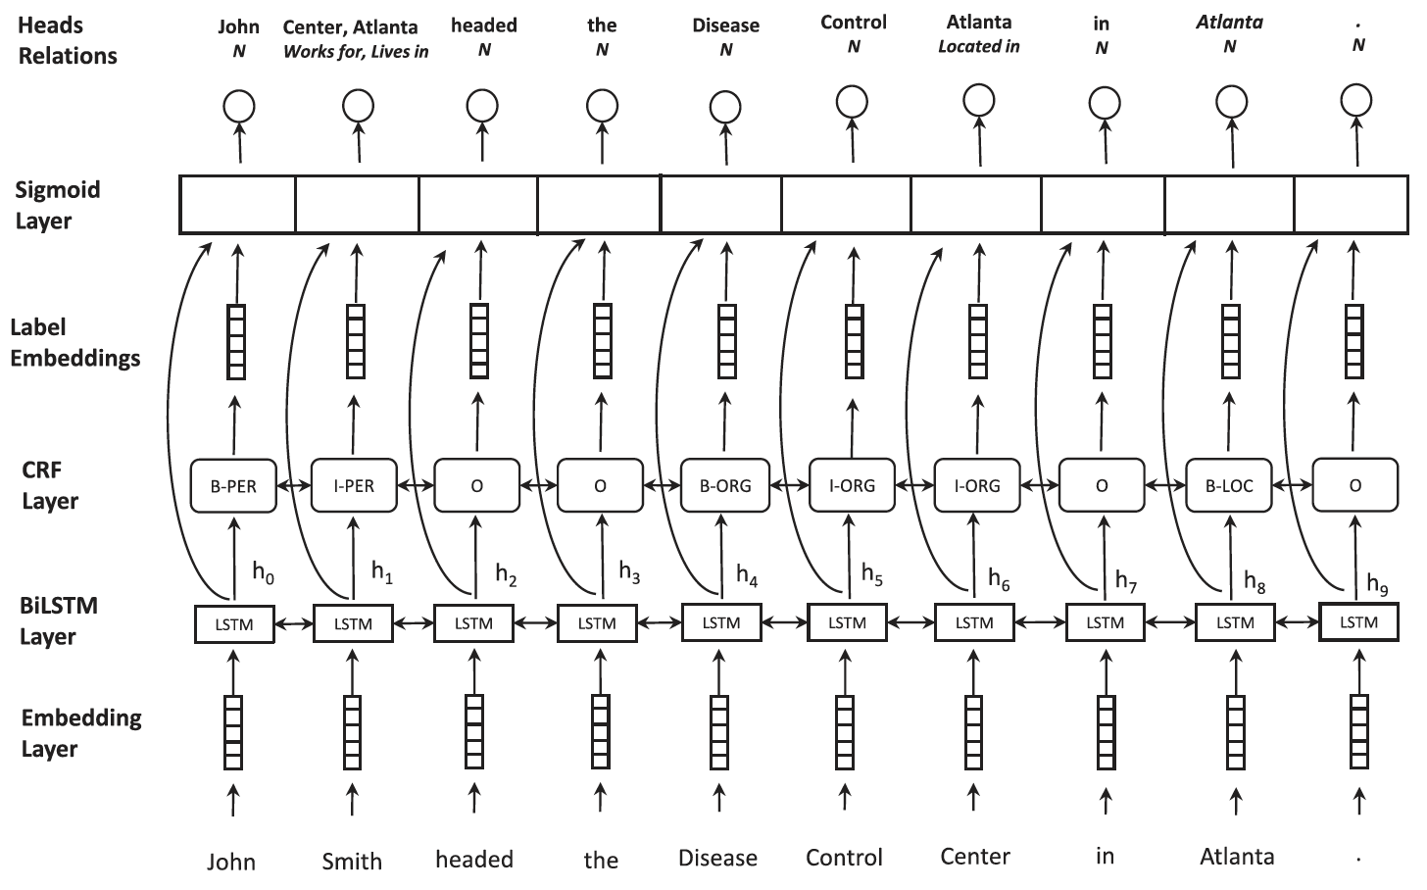
既存の共同学習手法
エンティティ関係抽出の
Jointモデル[１]
BiLSTMの代わりにBERTを使う
[1] Bekoulis, G., Deleu, J., Demeester, T. and Develder, C., 2018. Joint entity recognition and relation extraction as a multi-head selection problem. Expert Systems with Applications, 114, pp.34-45.

Slide 7
BERT
BERTとは”Bidirectional Encoder Representations from Transformers”を指し、Googleにより発表された自然言語処理モデル[2]
BERTは事前学習モデルであり、既存のタスク実行モデルにFine-tuningすることで、そのモデルの精度を向上させられる
少ないデータを追加学習するのみで動作するので、一からモデルを構築しなくてすむ
[2]J. Devlin, M.-W. Chang, K. Lee, and K. Toutanova. BERT: Pre-training of deep bidirectional transformers for language understanding. In Proceedings of the 2019 Conference of the North American Chapter of the Association for Computational Linguistics: Human Language Technologies, Volume1 (Long and Short Papers), pages 4171–4186, 2019

Slide 8
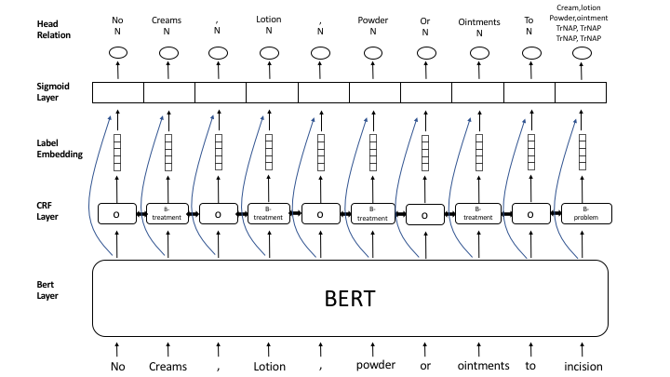
提案手法
BERTに基づくエンティティ関係抽出のJointモデル
生物医療分野のBERT[3]
[3] Peng, Yifan, Shankai Yan, and Zhiyong Lu. "Transfer Learning in Biomedical Natural Language Processing: An Evaluation of BERT and ELMo on Ten Benchmarking Datasets." In Proceedings of the 18th BioNLP Workshop and Shared Task, pp. 58-65. 2019.

Slide 9
実験（１）
BiLSTM、BERT、生物医療分野のBERTそれぞれに基づいて実験を行う
BiLSTMに基づいたモデルをBaseline手法として、提案手法と比較した
実験データ
2010 i2b2/va challenge
データ量
170件の訓練レポート、256件のテストレポート
1件レポートに約15文(タグあり)が利用できる
訓練データ：検証データ：テストデータ＝3：1：1

Slide 10
実験（２）
2010 i2b2/VA challenge は２つのタスクを提案して、それらにデータを提供した(170件の訓練レポートと256件のテストレポート)
2010 i2b2/VA challenge はカルテデータに対するチャレンジ
固有表現抽出の３つのカテゴリ
医療問題（medical problem）
治療法（treatment）
検査（test）
関係抽出の８つのカテゴリ

Slide 11
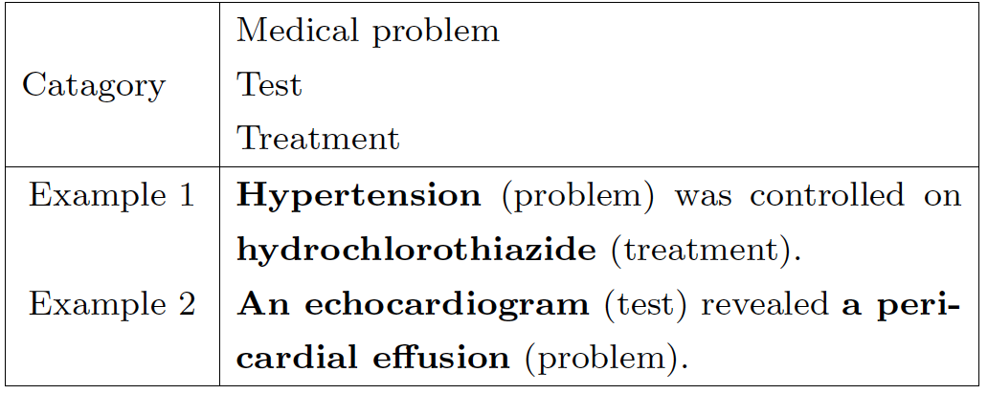
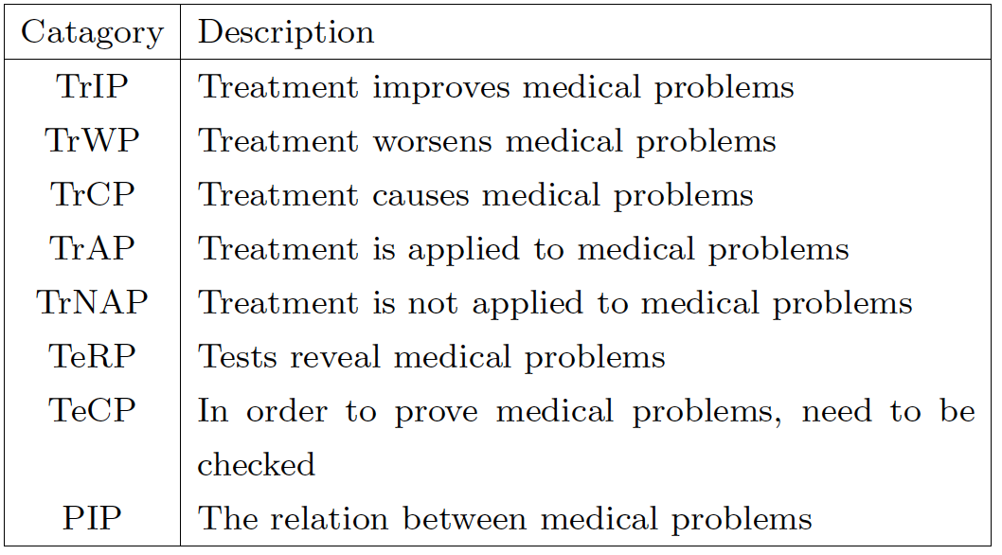
実験（３）
2010 i2b2/va challenge に提供されたデータ
Entity(固有表現)
Relation(関係)
詳細は付録を参考

Slide 12
DEIM2021実験結果(1)
baseline
手法 （データセット） | 固有表現抽出 |  |  | 関係抽出
 | 適合率(%) | 再現率(%) | F値(%) | 適合率(%) | 再現率(%) | F値(%)
Bi-LSTM _{(based)} | 83.98 | 82.87 | 83.42 | 43.26 | 21.28 | 28.53
Bi-LSTM _{(medical)} | 84.28 | 82.36 | 83.31 | 43.22 | 22.35 | 29.46
BERT _{(based)} | 89.91 | 95.32 | 92.53 | 37.17 | 29.73 | 33.04
BERT _{(medical)} | 92.90 | 92.95 | 92.92 | 38.91 | 37.31 | 38.09
BERT _{(medical+clinical)} | 93.95 | 95.01 | 94.30 | 40.77 | 42.11 | 41.43
生物医療
分野のWord2vec
生物医療
分野のBERT
Bi-LSTM_{(based)}: pre-trained GloVe on Wikipedia and Gigaword
Bi-LSTM_{(medical)}: pre-trained Word2vec on PubMed abstracts and PMC
BERT_{(based)} : pre-trained BERT on BooksCorpus and English Wikipedia
BERT_{(medical)} : pre-trained BERT on PubMed abstracts
BERT_{(medical+clinical)}: pre-trained BERT on PubMed abstracts and MIMIC-III (clinical notes)

Slide 13
DEIM2021実験結果（２）
F値
固有表現
エンティティ関係

Slide 14
前回の振り返り
N2C2データセット
固有表現のカテゴリ（９つ）
Drug,Strength, Form, Dosage, Frequency, Route, Duration, Reason, Adverse drug events
関係のカテゴリ（８つ）
Strength-Drug, Form-Drug, Dosage-Drug, Frequency-Drug, Route-Drug, Duration-Drug, Reason-Drug, ADE-Drug
End-to-End system
最上位チーム
実験手法：bilstm + crf(joint method)
実験結果：F値：0.8905
n2c2 vs i2b2
データ量(train data + dev data)
n2c2:18617文 i2b2:5022文
固有表現と関係のカテゴリ
n2c2: 固有表現:9 関係：8
i2b2: 固有表現:3 関係：8
[4] Henry, S., Buchan, K., Filannino, M., Stubbs, A., & Uzuner, O. (2020). 2018 n2c2 shared task on adverse drug events and medication extraction in electronic health records. Journal of the American Medical Informatics Association, 27(1), 3-12.

Slide 15
進捗
I2b2データ前処理のエラー訂正
一文に複数の関係が存在するのは正しくと含めていなかった
BERT_{(general)}, BERT_{(medical)} ,Character-BERT _{(general)}, Character-BERT _{(medical)}を用いて、改めて実験を行った
DEIMで使ったBERTとは異なる
[5] El Boukkouri, H., Ferret, O., Lavergne, T., Noji, H., Zweigenbaum, P., & Tsujii, J. I. (2020, December). CharacterBERT: Reconciling ELMo and BERT for Word-Level Open-Vocabulary Representations From Characters. In Proceedings of the 28th International Conference on Computational Linguistics (pp. 6903-6915).

Slide 16
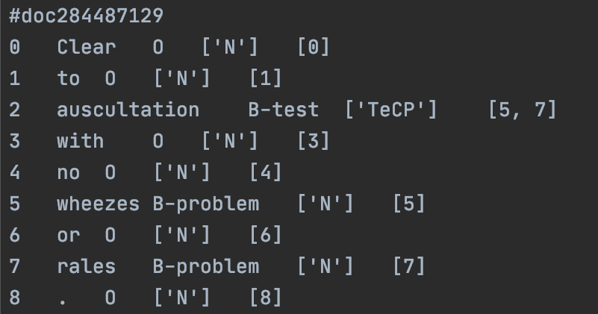
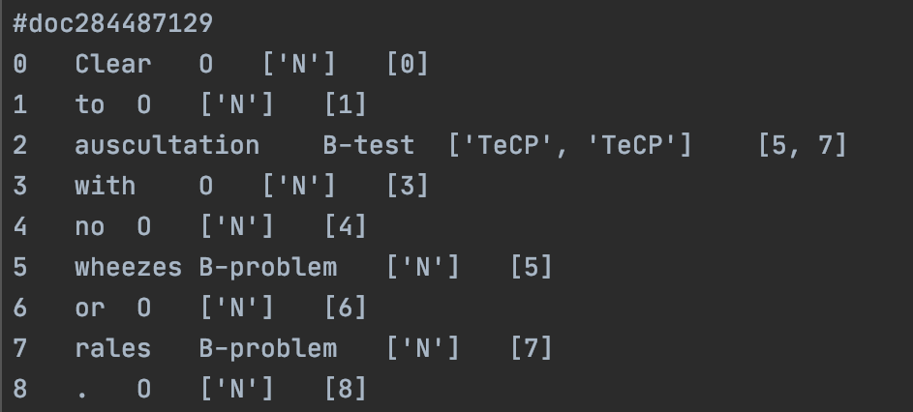
I2B2前処理の修正
修正前
修正後

Slide 17
実験結果(1)
Encoder | 固有表現抽出 |  |  | 関係抽出
 | 適合率(%) | 再現率(%) | F値(%) | 適合率(%) | 再現率(%) | F値(%)
BERT _{(general)} | 92.01 | 91.94 | 91.97 | 41.84 | 42.80 | 42.31
CharacterBERT _{(general)} | 89.20 | 87.27 | 88.22 | 45.37 | 42.11 | 43.68
BERT _{(medical)} | 93.82 | 93.39 | 93.63 | 52.21 | 49.86 | 51.01
CharacterBERT _{(medical)} | 91.63 | 90.54 | 91.08 | 51.98 | 47.30 | 49.53
BERT_{(general)}: a general-domain model obtained by pre-training BERT on a general corpus. It uses the same architecture and wordpiece vocabulary as BERT (base, uncased).
CharacterBERT_{(general)}: a general-domain model obtained by training CharacterBERT on a general corpus. Besides the Character-CNN, it uses the same architecture as BERT(general).
BERT_{(medical)}: a medical model obtained by re-training BERT_{(general)} on a medical corpus.
CharacterBERT_{(medical)}: a medical model obtained by re-training CharacterBERTgeneral on a medical corpus. This is the Character-CNN analog of BERT(medical)
BERT_{(base,uncased)}: pre-trained BERT on BooksCorpus and English Wikipedia

Slide 18
実験結果（２）
F値
固有表現
エンティティ関係

Slide 19
実験結果(3)
Normal
Input sentence:
’you were started on a 2 week course of vancomycin to be given at hemodialysis for your line infection.’
Label:
[{‘subject’: “vancomycin”, ‘predicate’:”TrAP”, ‘object’: ”your line infection”}]
SingleEntityOverlap
Input sentence:
’electrocardiogram at that time showed st elevations and j point elevations in v2 through v4.’
Label:
[{‘subject’: “electrocardiogram”, ‘predicate’:”TeRP”, ‘object’: ”st elevations”}, {‘subject’: “electrocardiogram”, ‘predicate’:”TeRP”, ‘object’: ”j point elevations in v2 through v4”}]

Slide 20
Normal(1)
Input sentence: ‘he eloped prior to formal discharge when his FS was found to be critically high – recommended to patient that he stay for repeat, but left AMA without signing any forms.’
Label: [{‘subject’: “his fs”, ‘predicate’:”TeRP”, ‘object’: ”critically high”}]
Tokenizer
BERT:
["[CLS]", "he", "el", "##oped", "prior", "to", "formal", "discharge", "when", "his", "f", "##s", "was", "found", "to", "be", "critically", "high", "-", "recommended", "to", "patient", "that", "he", "stay", "for", "repeat", ",", "but", "left", "ama", "without", "signing", "any", "forms", ".", "[SEP]"]
CharacterBERT:
["[CLS]", "he", "eloped", "prior", "to", "formal", "discharge", "when", "his", "fs", "was", "found", "to", "be", "critically", "high", "-", "recommended", "to", "patient", "that", "he", "stay", "for", "repeat", ",", "but", "left", "ama", "without", "signing", "any", "forms", ".", "[SEP]"]

Slide 21
Normal(2)
Input sentence: ‘he eloped prior to formal discharge when his fs was found to be critically high – recommended to patient that he stay for repeat, but left ama without signing any forms.’
Label:
[{‘subject’: “his fs”, ‘predicate’:”TeRP”, ‘object’: ”critically high”}]
Prediction(BERT_{general}):
[]
Prediction(BERT_{medical}):
[{‘subject’: “his f ##s”, ‘predicate’:”TeRP”, ‘object’: ”critically high”}]
Prediction(CharacterBERT_{general}):
[]
Prediction(CharacterBERT_{medical}):
[{‘subject’: “his fs”, ‘predicate’:”TeRP”, ‘object’: ”critically high”}]

Slide 22
Normal(3)
Input sentence: ’pt with two episodes of hypoglycemia (fsbs 22 and 27), etiology unclear, pt followed by strickland, who recommend no changes to current insulin regimen.’
Label:
[{‘subject’:”fsbs”, ‘predicate’:”TeRP”, ‘object’: ”hypoglycemia”}]
Tokenizer
BERT
["[CLS]", "pt", "with", "two", "episodes", "of", "h", "##yp", "##og", "##ly", "##ce", "##mia", "(", "f", "##sb", "##s", "22", "and", "27", ")", ",", "et", "##iology", "unclear", ",", "pt", "followed", "by", "st", "##rick", "##land", ",", "who", "recommend", "no", "changes", "to", "current", "insulin", "regime", "##n", ".", "[SEP]"]
CharacterBERT
["[CLS]", "pt", "with", "two", "episodes", "of", "hypoglycemia", "(", "fsbs", "22", "and", "27", ")", ",", "etiology", "unclear", ",", "pt", "followed", "by", "strickland", ",", "who", "recommend", "no", "changes", "to", "current", "insulin", "regimen", ".", "[SEP]"]

Slide 23
Normal(4)
Input sentence: ’pt with two episodes of hypoglycemia (fsbs 22 and 27), etiology unclear, pt followed by strickland, who recommend no changes to current insulin regimen.’
Label:
[{‘subject’:”fsbs”, ‘predicate’:”TeRP”, ‘object’: ”hypoglycemia”}]
Prediction(BERT_{medical}):
[{‘subject’:”f ##sb ##s”, ‘predicate’:”TeRP”, ‘object’: ”h ##yp ##og ##ly ##ce ##mia”}]
Prediction(CharacterBERT_{medical}):
[{‘subject’:”fsbs”, ‘predicate’:”TeRP”, ‘object’: ”hypoglycemia”},
{‘subject’:” current insulin regimen”, ‘predicate’:”TeRP”, ‘object’: ”hypoglycemia”}]

Slide 24
Normal(5)
Input sentence: ’the patient was thrombocytopenic with a platelet count of 49 on the 23.’
Label:
[{‘subject’:” thrombocytopenic”, ‘predicate’:”TeRP”, ‘object’: ” a platelet count ”}]
Tokenizer
BERT
["[CLS]", "the", "patient", "was", "th", "##rom", "##bo", "##cy", "##top", "##eni", "##c", "with", "a", "plate", "##let", "count", "of", "49", "on", "the", "23", ".", "[SEP]"]
CharacterBERT
["[CLS]", "the", "patient", "was", "thrombocytopenic", "with", "a", "platelet", "count", "of", "49", "on", "the", "23", ".", "[SEP]"]

Slide 25
Normal(6)
Input sentence: ’the patient was thrombocytopenic with a platelet count of 49 on the 23.’
Label:
[{‘subject’:” thrombocytopenic”, ‘predicate’:”TeRP”, ‘object’: ” a platelet count ”}]
Prediction(BERT_{medical}):
[]
Prediction(CharacterBERT_{medical}):
[{‘subject’:” thrombocytopenic”, ‘predicate’:”TeRP”, ‘object’: ” a platelet count ”}]

Slide 26
SingleEntityOverlap(1)
Input sentence:
’her son reports that she then developed a headache and fevers started three days ago which were treated with tylenol.’
Label
[{‘subject’: “tylenol”, ‘predicate’:”TeRP”, ‘object’: ”a headache”},
{‘subject’: “tylenol”, ‘predicate’:”TeRP”, ‘object’: ” fevers”}]
Tokenize
BERT:
["[CLS]", "her", "son", "reports", "that", "she", "then", "developed", "a", "headache", "and", "fever", "##s", "started", "three", "days", "ago", "which", "were", "treated", "with", "ty", "##len", "##ol", ".", "[SEP]"]
CharacterBERT:
["[CLS]", "her", "son", "reports", "that", "she", "then", "developed", "a", "headache", "and", "fevers", "started", "three", "days", "ago", "which", "were", "treated", "with", "tylenol", ".", "[SEP]"]

Slide 27
SingleEntityOverlap(2)
Input sentence:
’her son reports that she then developed a headache and fevers started three days ago which were treated with tylenol.’
Label
[{‘subject’: “tylenol”, ‘predicate’:”TeRP”, ‘object’: ”a headache”},
{‘subject’: “tylenol”, ‘predicate’:”TeRP”, ‘object’: ” fevers”}]
Prediction(BERT_{general}):[{‘subject’: ”a headache”, ‘predicate’:”PIP”, ‘object’: ” fevers”}]
Prediction(BERT_{medical}):[{‘subject’: ”a headache”, ‘predicate’:”PIP”, ‘object’: ” fevers”},
{‘subject’: “tylenol”, ‘predicate’:”TrIP”, ‘object’: ”a headache”},
{‘subject’: “tylenol”, ‘predicate’:”TrWP”, ‘object’: ” fevers”}]
Prediction(CharacterBERT_{general}): {‘subject’: “tylenol”, ‘predicate’:”TrIP”, ‘object’: ”a headache”},
Prediction(CharacterBERT_{medical}):[{‘subject’: ”a headache”, ‘predicate’:”PIP”, ‘object’: ” fevers”}, {‘subject’: “tylenol”, ‘predicate’:”TrIP”, ‘object’: ”a headache”}]

Slide 28
SingleEntityOverlap(3)
Input sentence:
’electrocardiogram at that time showed st elevations and j point elevations in v2 through v4.’
Label
[{‘subject’: “electrocardiogram”, ‘predicate’:”TeRP”, ‘object’: ”st elevations”}, {‘subject’: “electrocardiogram”, ‘predicate’:”TeRP”, ‘object’: ” j point elevations in v2 through v4”}]
Tokenize
BERT:
["[CLS]", "electro", "##card", "##io", "##gram", "at", "that", "time", "showed", "st", "elevations", "and", "j", "point", "elevations", "in", "v", "##2", "through", "v", "##4", ".", "[SEP]"]
CharacterBERT:
["[CLS]", "electrocardiogram", "at", "that", "time", "showed", "st", "elevations", "and", "j", "point", "elevations", "in", "v2", "through", "v4", ".", "[SEP]"]

Slide 29
SingleEntityOverlap(4)
Input sentence:
’electrocardiogram at that time showed st elevations and j point elevations in v2 through v4.’
Label
[{‘subject’: “electrocardiogram”, ‘predicate’:”TeRP”, ‘object’: ”st elevations”}, {‘subject’: “electrocardiogram”, ‘predicate’:”TeRP”, ‘object’: ” j point elevations in v2 through v4”}]
Prediction(BERT_{medical}):
[{“subject”: “electro ##card ##io ##gram”, “predicate”: “TeRP”, “object”: “stelevations”}, {“subject”: “electro ##card ##io ##gram”, “predicate”: “TeRP”, “object”: “j point elevations in v ##2"}]
Prediction(CharacterBERT_{medical}):
[{“subject ”:”electrocardiogram” ,”predicate“: ”TeRP“, ”object”:“j point elevations in v 2"}]

Slide 30
SingleEntityOverlap(5)
Input sentence:
‘54 yo f with crohn’s disease s/p ileostomy and subsequent short gut syndrome with port-o-catch for tpn who presents with acute onset pleuritic chest pain with fever, chills, and sob.’
Label
[{‘subject’: “ileostomy”, ‘predicate’:”TrCP”, ‘object’: ” short gut syndrome ”},
{‘subject’: “ileostomy”, ‘predicate’:”TrAP”, ‘object’: ” crohn’s disease ”},
{‘subject’: “tpn”, ‘predicate’:”TrCP”, ‘object’: ” short gut syndrome ”}]
Tokenize
BERT:
["[CLS]", "54", "yo", "f", "with", "cr", "##oh", "##n", "'", "s", "disease", "s", "/", "p", "ile", "##ost", "##omy", "with", "subsequent", "short", "gut", "syndrome", "with", "port", "-", "o", "-", "cat", "##h", "for", "t", "##p", "##n", "presents", "with", "acute", "onset", "pl", "##eur", "##itic", "chest", "pain", "with", "fever", ",", "chill", "##s", ",", "and", "sob", ".", "[SEP]"]
CharacterBERT:
["[CLS]", "54", "yo", "f", "with", "crohn", "'", "s", "disease", "s", "/", "p", "ileostomy", "with", "subsequent", "short", "gut", "syndrome", "with", "port", "-", "o", "-", "cath", "for", "tpn", "presents", "with", "acute", "onset", "pleuritic", "chest", "pain", "with", "fever", ",", "chills", ",", "and", "sob", ".", "[SEP]"]

Slide 31
SingleEntityOverlap(6)
Input sentence:
‘54 yo f with crohn’s disease s/p ileostomy and subsequent short gut syndrome with port-o-catch for tpn who presents with acute onset pleuritic chest pain with fever, chills, and sob.’
Label
[{‘subject’: “ileostomy”, ‘predicate’:”TrCP”, ‘object’: ” short gut syndrome ”},
{‘subject’: “ileostomy”, ‘predicate’:”TrAP”, ‘object’: ” crohn’s disease ”},
{‘subject’: “tpn”, ‘predicate’:”TrCP”, ‘object’: ” short gut syndrome ”}]
Prediction(BERT_{medical}):
[]
Prediction(CharacterBERT_{medical}):
[{"subject": "ileostomy", "predicate": "TrAP", "object": "crohn‘s disease"}, {"subject": "tpn", "predicate": "TrAP", "object": "crohn'sdisease”}]

Slide 32
まとめ
生物医療分野のデータセットにより訓練されたBERT, CharacterBERTのほうは関係抽出に良い影響を与えている
Character BERTはBERTと比較すると、関係抽出タスクに対して、著しい差異がない

Slide 33
今後の課題
n2c2データ前処理し続く
前処理はが終わったら、実験を行う
共同学習方式でエンティティ関係抽出に関する論文を読む

Slide 34
付録一
実験データi2b2
医学的エンティティ関係
8つカテゴリー

Slide 35
医学的エンティティ関係（カテゴリ１〜3）
Medical problem and treatment(医療問題と治療法)
カテゴリ１：Treatment improves medical problem(TrIP)
Infection resolved with antibiotic courseHypertension was controlled on hydrochlorothiazide
カテゴリ2：Treatment worsens medical problem(TrWP)
Culture taken from the lumbar drain showed Staphylococcus aureus resistant to Nafcillin
カテゴリ3： Treatment causes medical problem(TrCP)
Hypothyroidism following near total thyroidectomy

Slide 36
医学的エンティティ関係（カテゴリ4〜5）
（続き） medical problem and Treatment (医療問題と治療法)
カテゴリ4： Treatment is administered for medical problem(TrAP)
Antibiotic therapy for presumed right forearm phlebitis
カテゴリ5： Treatment is not administered because of medical problem(TrNAP)
Relafen which is contra-indicated because of ulcers

Slide 37
医学的エンティティ関係（カテゴリ6〜8）
Test relations with medical problem(検査と医療問題)
カテゴリ6： Test reveals medical problem(TeRP)
An abdominal ultrasound was performed showing no stones
カテゴリ7： Test conducted to investigate medical problem(TeCP)
Chest x-ray done to rule out pneumonia
Medical problem relations with other medical problems(医療問題とほかの医療問題)
カテゴリ8： Medical problem indicates medical problem(PIP)
A history of noninsulin dependent diabetes mellitus, now presenting with acute blurry vision on the left side

Slide 38
付録二
実験データn2c2
医学的エンティティ関係
8つカテゴリー

Slide 39
医学的エンティティ関係（カテゴリ1〜2）
カテゴリ1:Strength-Drug
The patient suffers from steroid-induced hyperglycemia. Patient prescribed 1 x 20mg prednisone tablet daily for 5 days.
Strength-Drug relation : 20 mg → Prednisone
カテゴリ2：Dosage-Drug
The patient suffers from steroid-induced hyperglycemia. Patient prescribed 1 x 20mg prednisone tablet daily for 5 days.
Dosage-Drug relation : 1 → Prednisone

Slide 40
医学的エンティティ関係（カテゴリ3〜4）
カテゴリ3：Duration-Drug
The patient suffers from steroid-induced hyperglycemia. Patient prescribed 1 x 20mg prednisone tablet daily for 5 days.
Duration-Drug relation : 5 days → Prednisone
カテゴリ4：Frequency-Drug
The patient suffers from steroid-induced hyperglycemia. Patient prescribed 1 x 20mg prednisone tablet daily for 5 days.
Frequency-Drug relation : daily → Prednisone

Slide 41
医学的エンティティ関係（カテゴリ5〜6）
カテゴリ5：Form-Drug
The patient suffers from steroid-induced hyperglycemia. Patient prescribed 1 x 20mg prednisone tablet daily for 5 days.
Form-Drug relation : tablet → Prednisone
カテゴリ6：Route-Drug
Patient received 100 Units/kg IV heparin sodium injection for treatment of deep vein thrombosis.
Route-Drug relation : injection → heparin

Slide 42
医学的エンティティ関係（カテゴリ7〜8）
カテゴリ7：Reason-Drug
Patient received 100 Units/kg IV heparin sodium injection for treatment of deep vein thrombosis
Reason-Drug relation : deep vein thrombosis → heparin sodium
カテゴリ8：ADEs-Drug
Patient is experiencing muscle pain, secondary to statin therapy for coronary artery disease.
ADEs-Drug relation : muscle pain → statin

