Slide 1
Myelofibrosis Facts Overview
Myelofibrosis(MF) is a cancer of blood and bone marrow, a kind of hematologic malignancies.

Slide 2

Key Factors About Myelofibrosis
What are the Statistics ?
MF occurs when bone marrow cells(fibroblasts) cause excessive scar tissue
Bone Marrow scarring generally lead: --Decreased production of normal blood cells caused fewer red blood cells, fewer blood platelets, and the need for red blood cell transfusions
The enlarged Spleen size, splenomegaly, because Spleen and liver have to work harder.
Patients with MF tend to have shortened lives and a compromised quality of life
Every year in the U.S, there are approximately 18k people diagnosed

Slide 3
Number Facts
60-67years old
The median Age of Diagnosis
Survival length is highly correlated with patients’ age (65 years old is the risk factor)

Slide 4
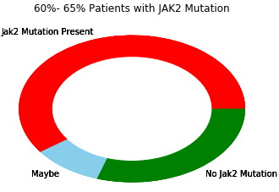
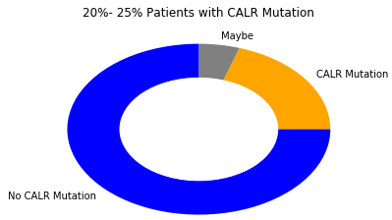
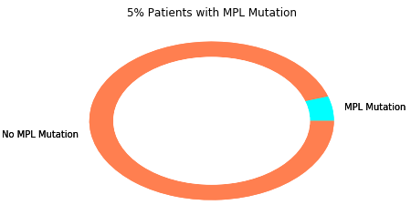
Facts of Secret Gene Mutations?
At Least 1 gene mutation is presented in 88% of patients with MF among
JAKE2 , CALR , MPL

Slide 5
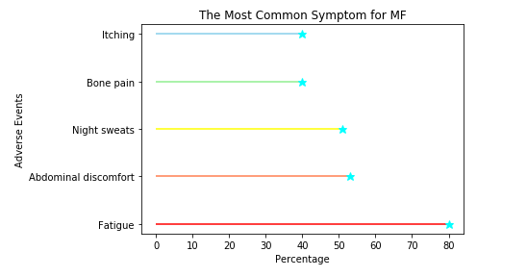
Common Symptom Facts:
At the early stage of Myelofibrosis, about 1/3 of patients have NO symptoms of the disease.
As the disease progresses, the symptoms of Itching, Bone Pain, Night sweats, Abdominal discomfort and Fatigue would show up and eventually results to Enlarged Spleen, and poor blood cell production.

Slide 6



Detailed Symptom Facts
Inflammation
Enlarged Spleen
Poor blood cell Production
Itching
Night sweats
Fever
Unexplained weight loss
Pain of discomfort in the abdomen or under left ribs
Feeling full all the time
Feel oxygen shortage
Feeling tired, weak, or short of breath due to anemia
Easy brusing or bleeding
Fatigue or Bone Pain

