Slide 1

MLDV Assignment 2
Looi Fang Yi
1906198E

Slide 2

How Long Can I Live?
predict life expectancy
develop & improve machine learning model
make predictions based off model

Slide 3

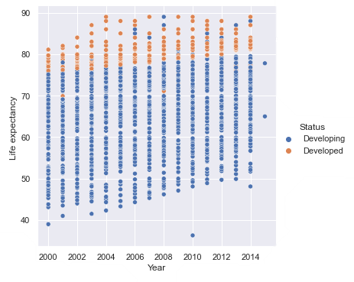

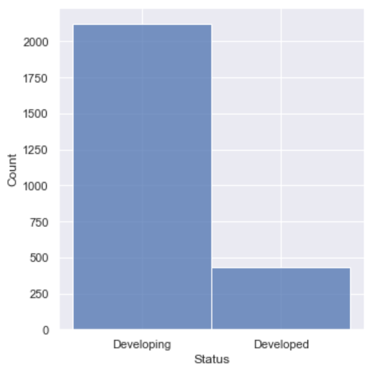
Data Exploration
Scatter Plot
HEAD
peek at first few rows of dataset
IsNull
null values found in 14 categories
Histogram
SHAPE
2938 rows
& 22 columns

Slide 4

Data Preparation
Drop features containing plenty of null cells & unique values
del df[‘’]
Combine similar features into 1
del df[‘’]
Remove missing values
df.dropna()
Bin features into a broader value
np.select()
Add new feature concatenating binned features
df.insert()
Convert Unordered Categorical Data to Numeric Data using OHE
get_dummies()
Perform Feature Selection & drop irrelevant features
nsmallest()
Manually Convert Categorical Data with binary values to Numeric Data
df.replace()

Slide 5

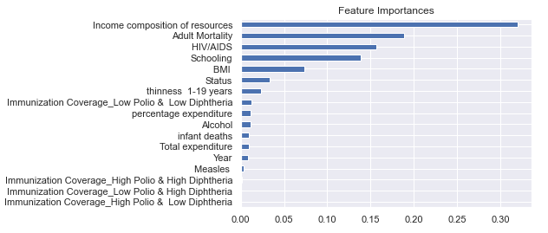
Feature Selection
Plot graph of feature importance for better visualization.
Top 3 most relevant features:
Income composition of resources
Adult Mortality
HIV/AIDS
The bottom 3 features which have 0 importance were subsequently removed from the dataset.

Slide 6


Types of Algorithms
Random Forest Regressor
Combines the output of multiple decision trees to predict output value
Training Set MSE: 0.4326
Test Set MSE: 1.1630
Gradient Boosting Regressor
Creates decision trees that builds on each other and predicts output value with final tree
Training Set MSE: 1.2751
Test Set MSE: 1.5462
Linear Regression
Use a best fit line to predict output value
Training Set MSE: 2.9086
Test Set MSE: 2.9903

Slide 7


Parameter Tuning
Check list of available parameters for RDF model using get_params().keys()
Tune parameters using param_grid
Determine best combination of hyper-parameters using best_params_
Check MSE on grid search model
Training Set MSE: 0.0000 Test Set MSE: 1.0536

Slide 8



The best algorithm is the Random Forest Regressor.
The model was further improved with parameter tuning.

Slide 9

References
Life Expectancy(WHO) Dataset
https://www.kaggle.com/kumarajarshi/life-expectancy-who
Seaborn Replot
https://seaborn.pydata.org/generated/seaborn.relplot.html
Converting values based on conditions
https://stackoverflow.com/questions/19377969/combine-two-columns-of-text-in-pandas-dataframe
Adding a new column
https://www.geeksforgeeks.org/adding-new-column-to-existing-dataframe-in-pandas/
Tuning Hyperparameters for Random Forest Regressor
https://scikit-learn.org/stable/modules/generated/sklearn.ensemble.RandomForestRegressor.html
https://towardsdatascience.com/hyperparameter-tuning-the-random-forest-in-python-using-scikit-learn-28d2aa77dd74

