Slide 1
Funnel Progression – Weekly Trend
iTrade | Wealth Management
Campaigns at the beginning of 2021 boosted both consideration and conversion, but a reversion occurred after that. | In periods 1 and 2, consideration and conversion remain relatively static.
Around June 2022, consideration and conversion did not align with each other, which needs further investigation. | An increase in consideration is observed in July 2022, while there is not a climb in conversion accordingly.
Period 1
Period 2
Period 3
Period 1
Period 2
Period 3
Consideration: Application starts
Conversion: Application completions
Consideration: Unique visitors on the Contact-Us page
Conversion: Unique visitors on the Contact-Us-Thank-You page

Slide 2
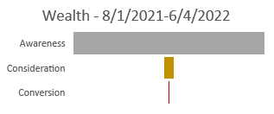
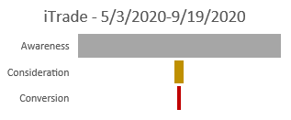
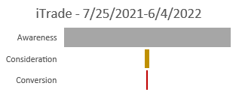

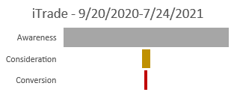
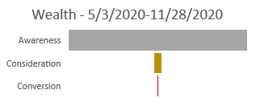
Funnel Charts for iTrade and Wealth Management
Relatively more web visitors consider starting applications in period 2, but that does not promote conversion (application completions).
Both consideration and conversion shrink in period 3 compared to periods 1 and 2.
Web visitors consider contacting us (consideration) and completing the contact-us form (conversion) remain static relatively in periods 1 and 2.
In period 3, relatively more web visitors consider contacting us, but the number of visitors completing the contact-us form (conversion) stays the same.
iTrade
Quarterly Funnel Charts
1
2
3
Wealth Management
1
2
3

