Slide 1
Foodle
by Yiwen Fang, Yiran Lin, Bohua Liu, Guoshiwen Han

Slide 2
Problem definition/goal
Foodle is a web application for recipe searching and intake monitoring. Based on users' body conditions and taste preference, this app will display various matching dishes with nutrition information and cooking instructions.

Slide 3
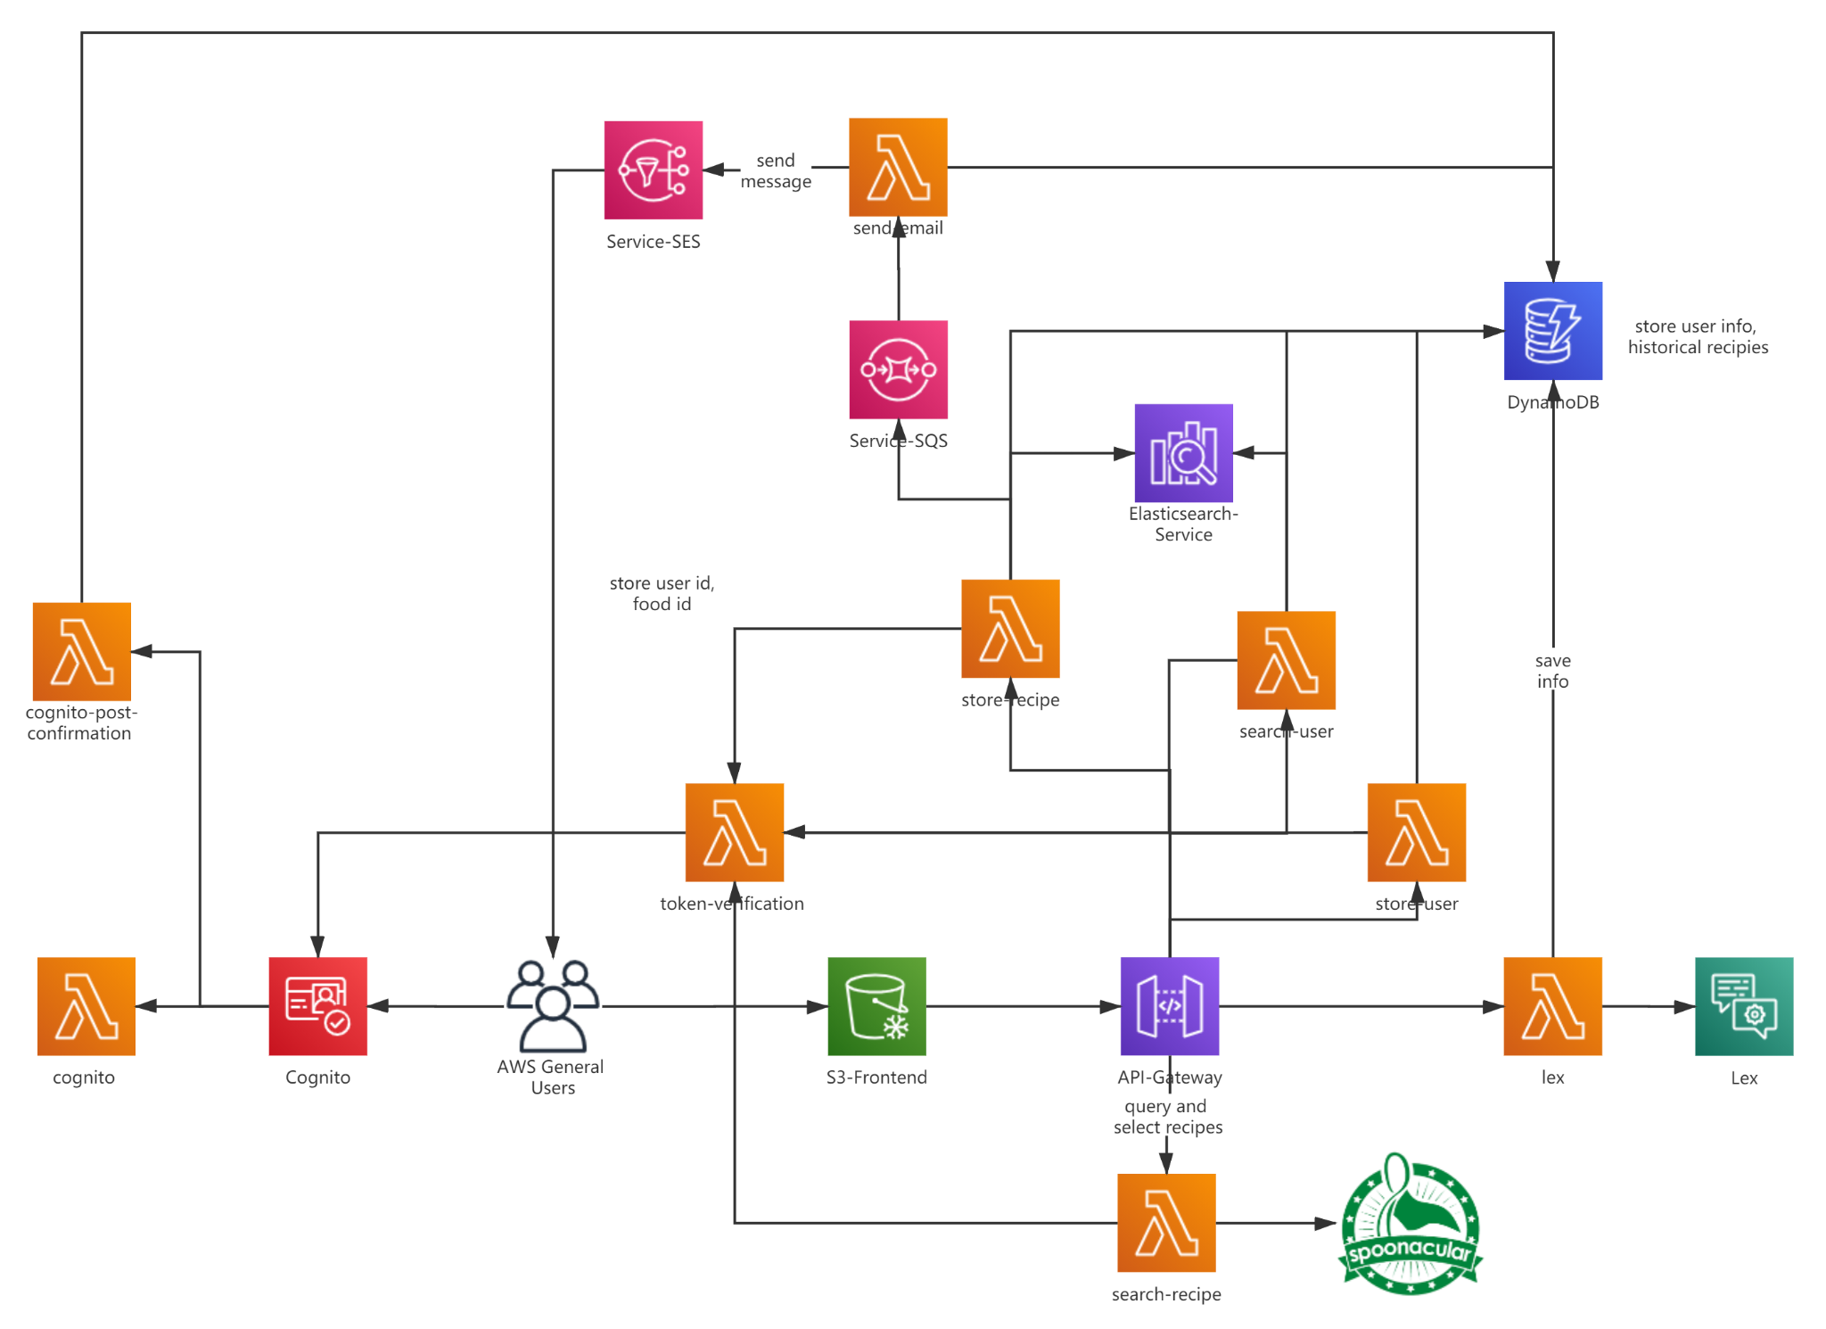
Architecture

Slide 4
API
9 Lambda functions
Cognito/cognito-post-confirmation/token-verification: Access control for Cognito
Store/search-user: save or search user information in DynamoDB/Elasticsearch
Store/search-recipe: save users’ recipe frequencies in Elasticsearch and update current recipes in DynamoDB or query and select recipes through spoonacular API
Lex: interact with Lex to let users input information
Send-email: inform users when they confirm the recipes by email
Lex: Collect a user’s profile information
SQS: Receives messages from store-recipe Lambda Function and provides guarantees that every recipe that users have confirmed will not be lost
SES: If a recipe is selected, an email will be sent to the user.
Spoonacular API: Query and select recipes as well as their information.

Slide 5
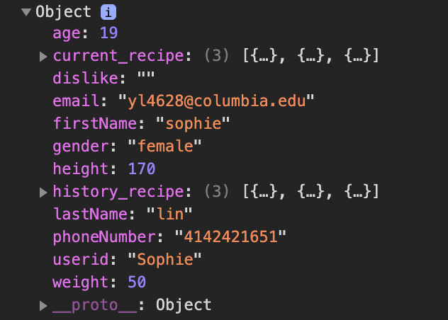
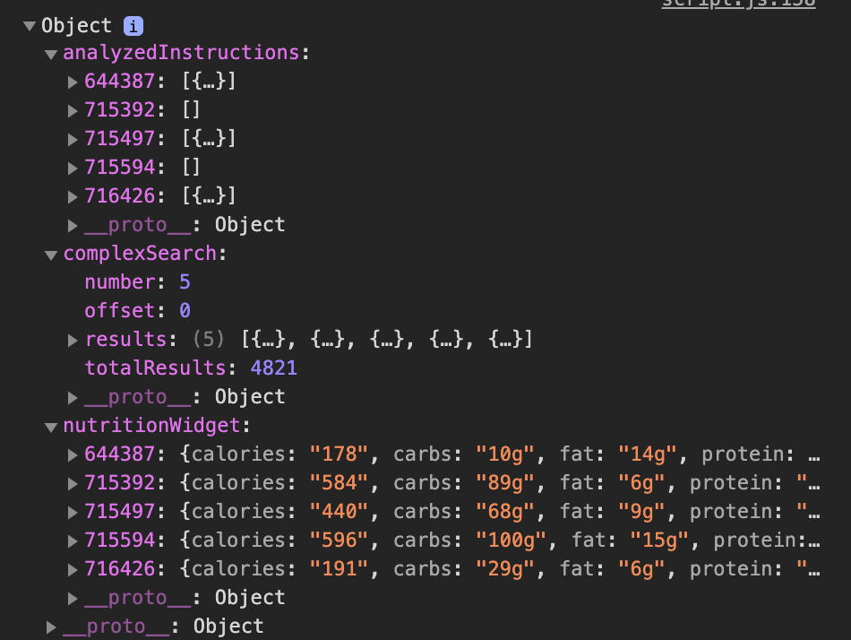
Implementation
Function 1: Verification
Without signing up, users are unable to use anything in Foodle. Token verification provided by Cognito. During signing up, users provide information like name, gender, phone number, height, weight, age, email, diet labels, etc. Then, Foodle automatically offers recipes based on Food and Recipe Search API for users to choose and confirm. Furthermore, it records users’ diet history and calculates total calories.
Function 2: Recipe provider
Users input available ingredients, and Foodle provides a list of recipes that the user can cook.
Function 3: Recommendation
Foodle recommends recipes based on the weighted frequency equation as described one the next slide.
Function 4: Visualization
On the profile page, users’ information is listed, and their standard intake calories are visualized by means of vivid charts as well as their actual intake calories.

Slide 6

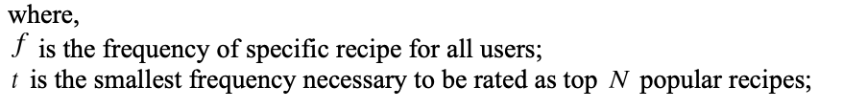

Recommendation
The recommended recipes will be presented on the search page based on their weighted frequency in descending order. WF makes Foodle personalize with the parameter, which is also tuned by the global variable. And both parameters are weighted with a reasonable sum consisting of the specific user-recipe pair frequency and the recommended frequency parameter. The function mentioned above is accomplished by a modified Bayes formula, of which we make some adjustments to accommodate Foodle’s circumstance. The modified is represented as follows:

Slide 7

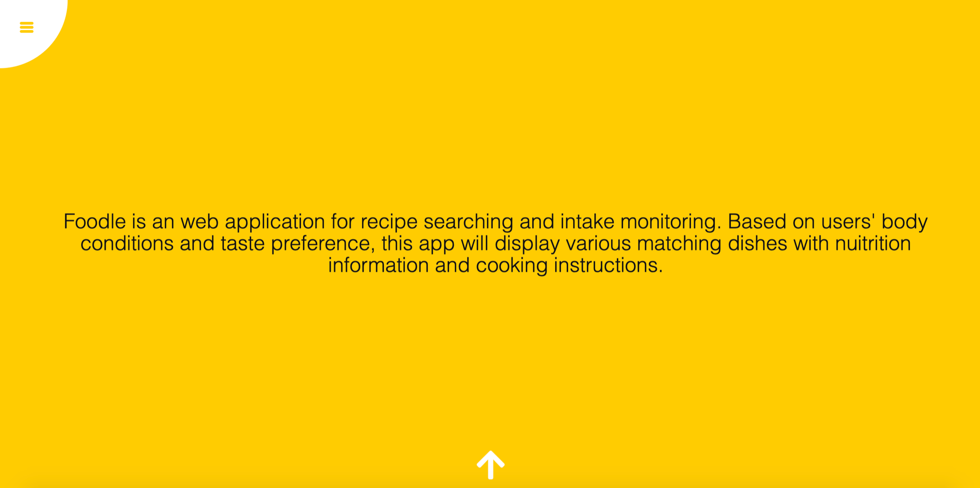
Key results - Home Page

Slide 8
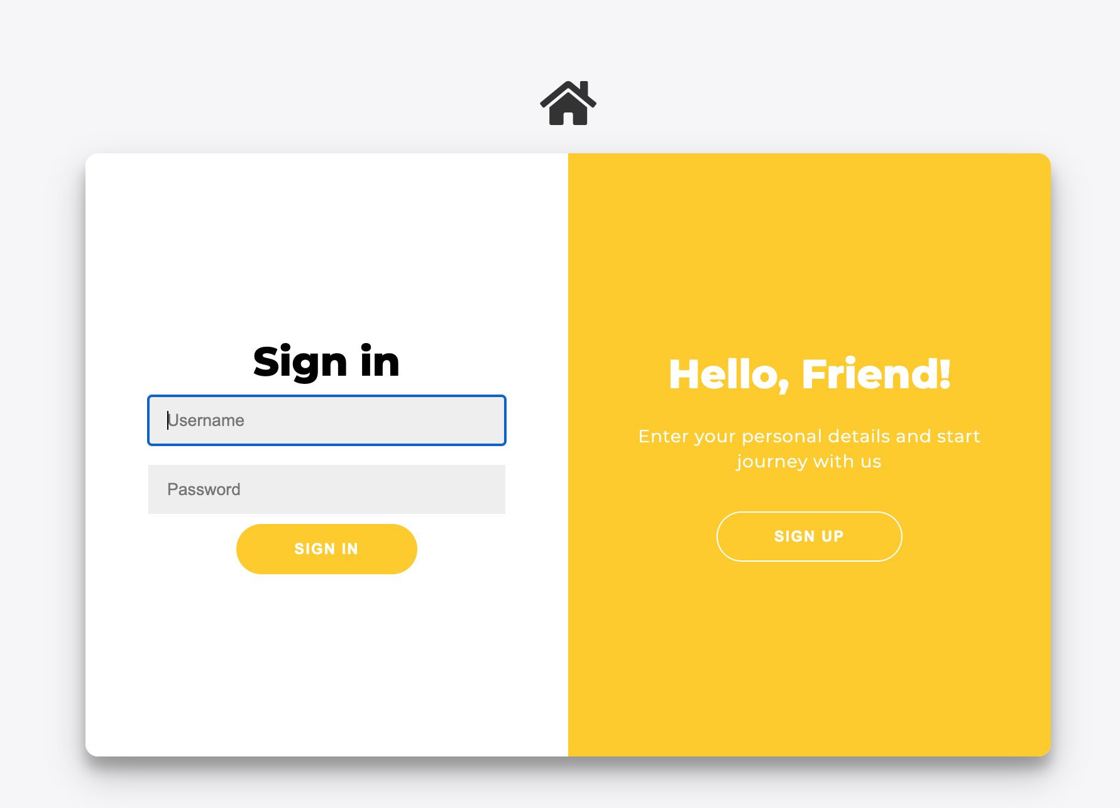

Key results - Sign in Page

Slide 9
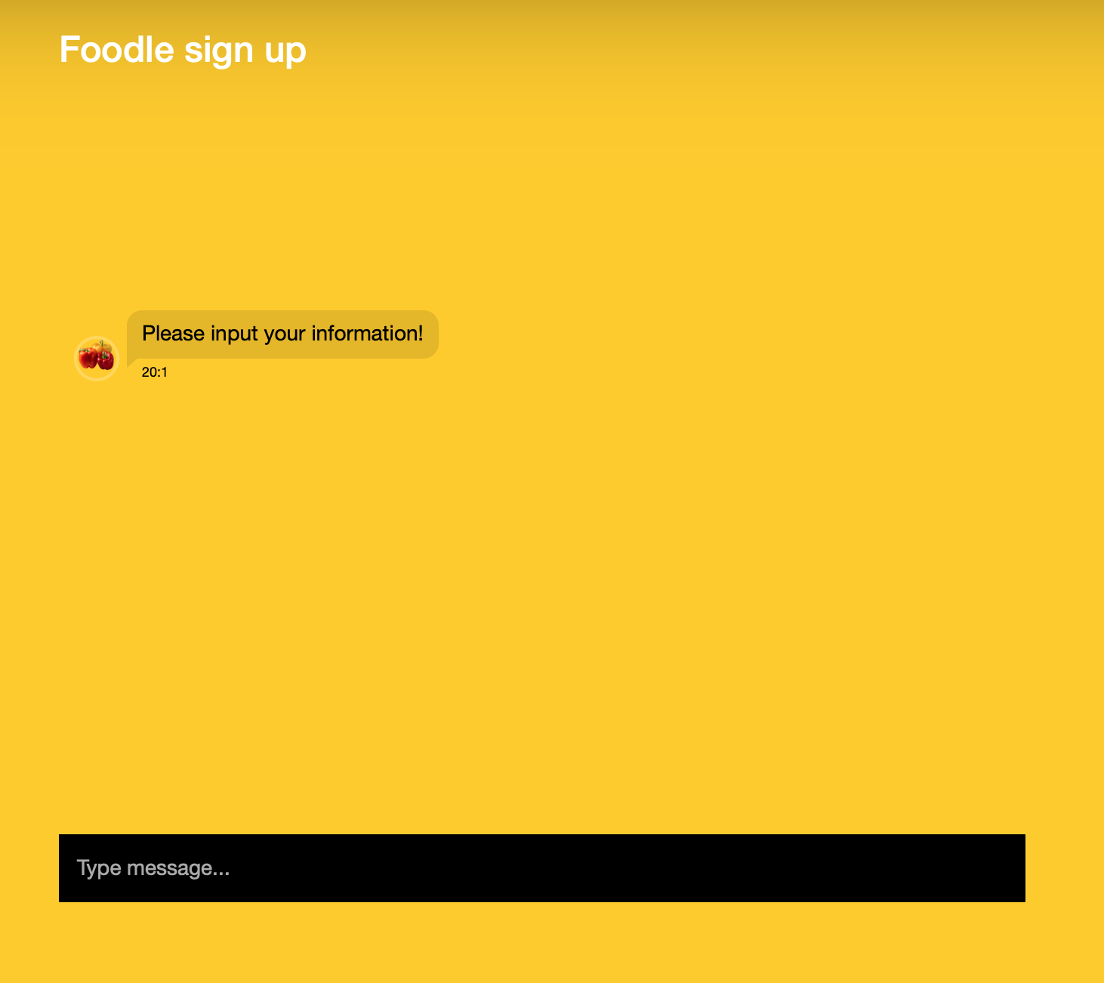
Key results - Lex Page

Slide 10
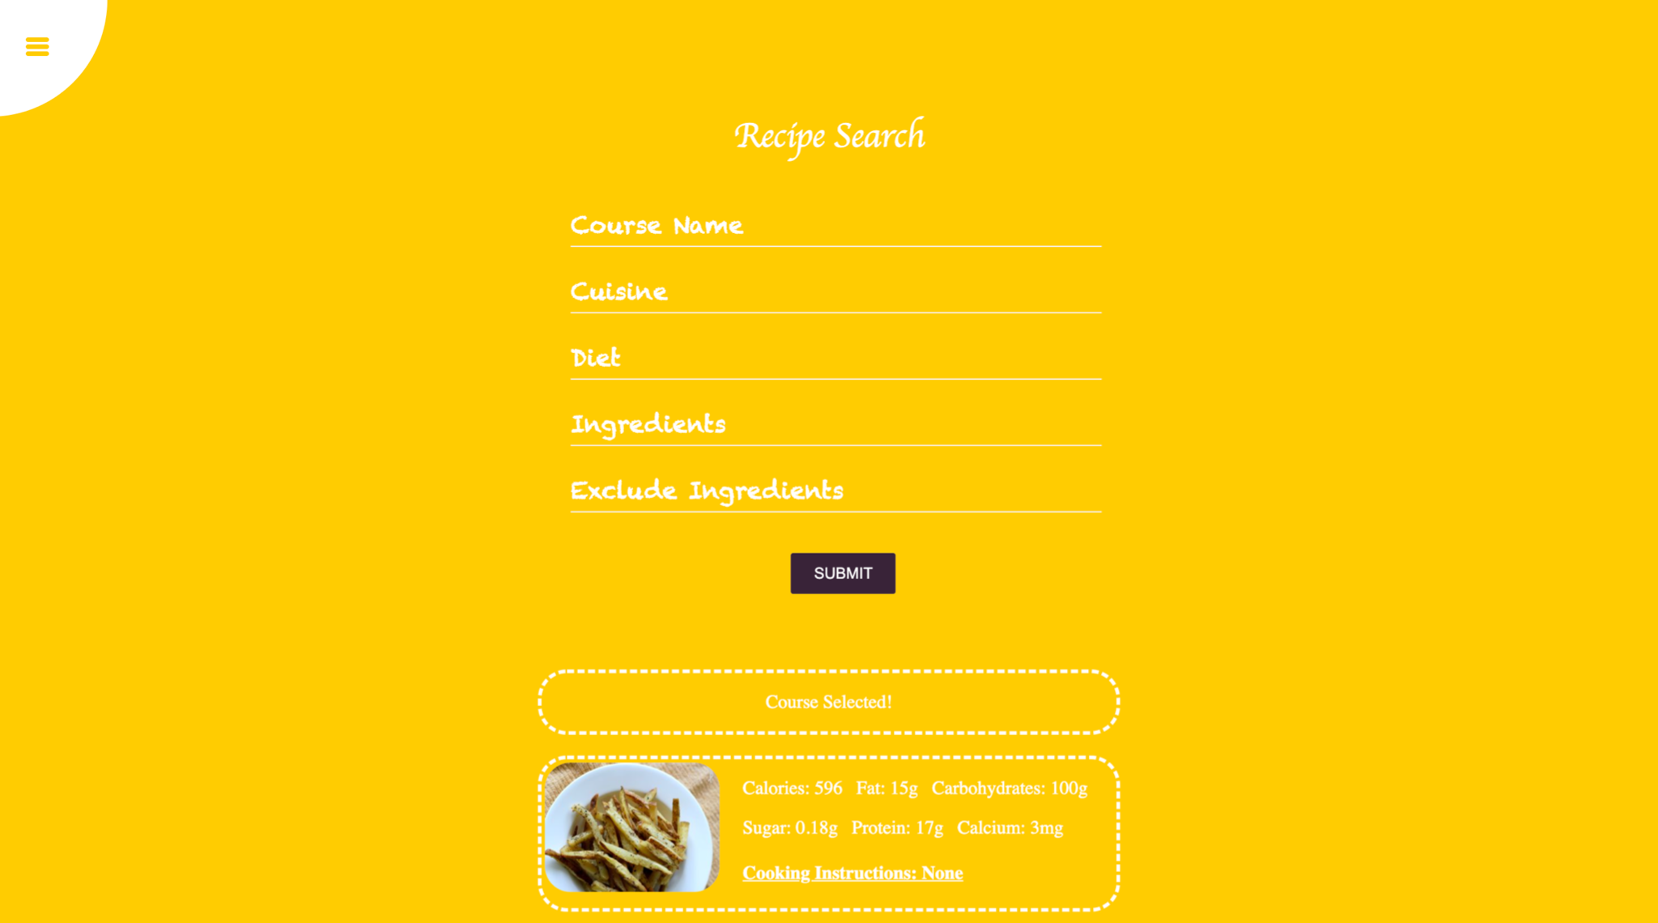
Key results - Search Page
Notes:
email

Slide 11
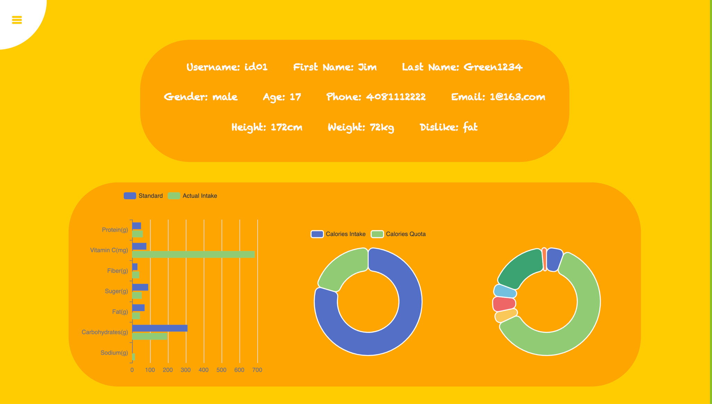
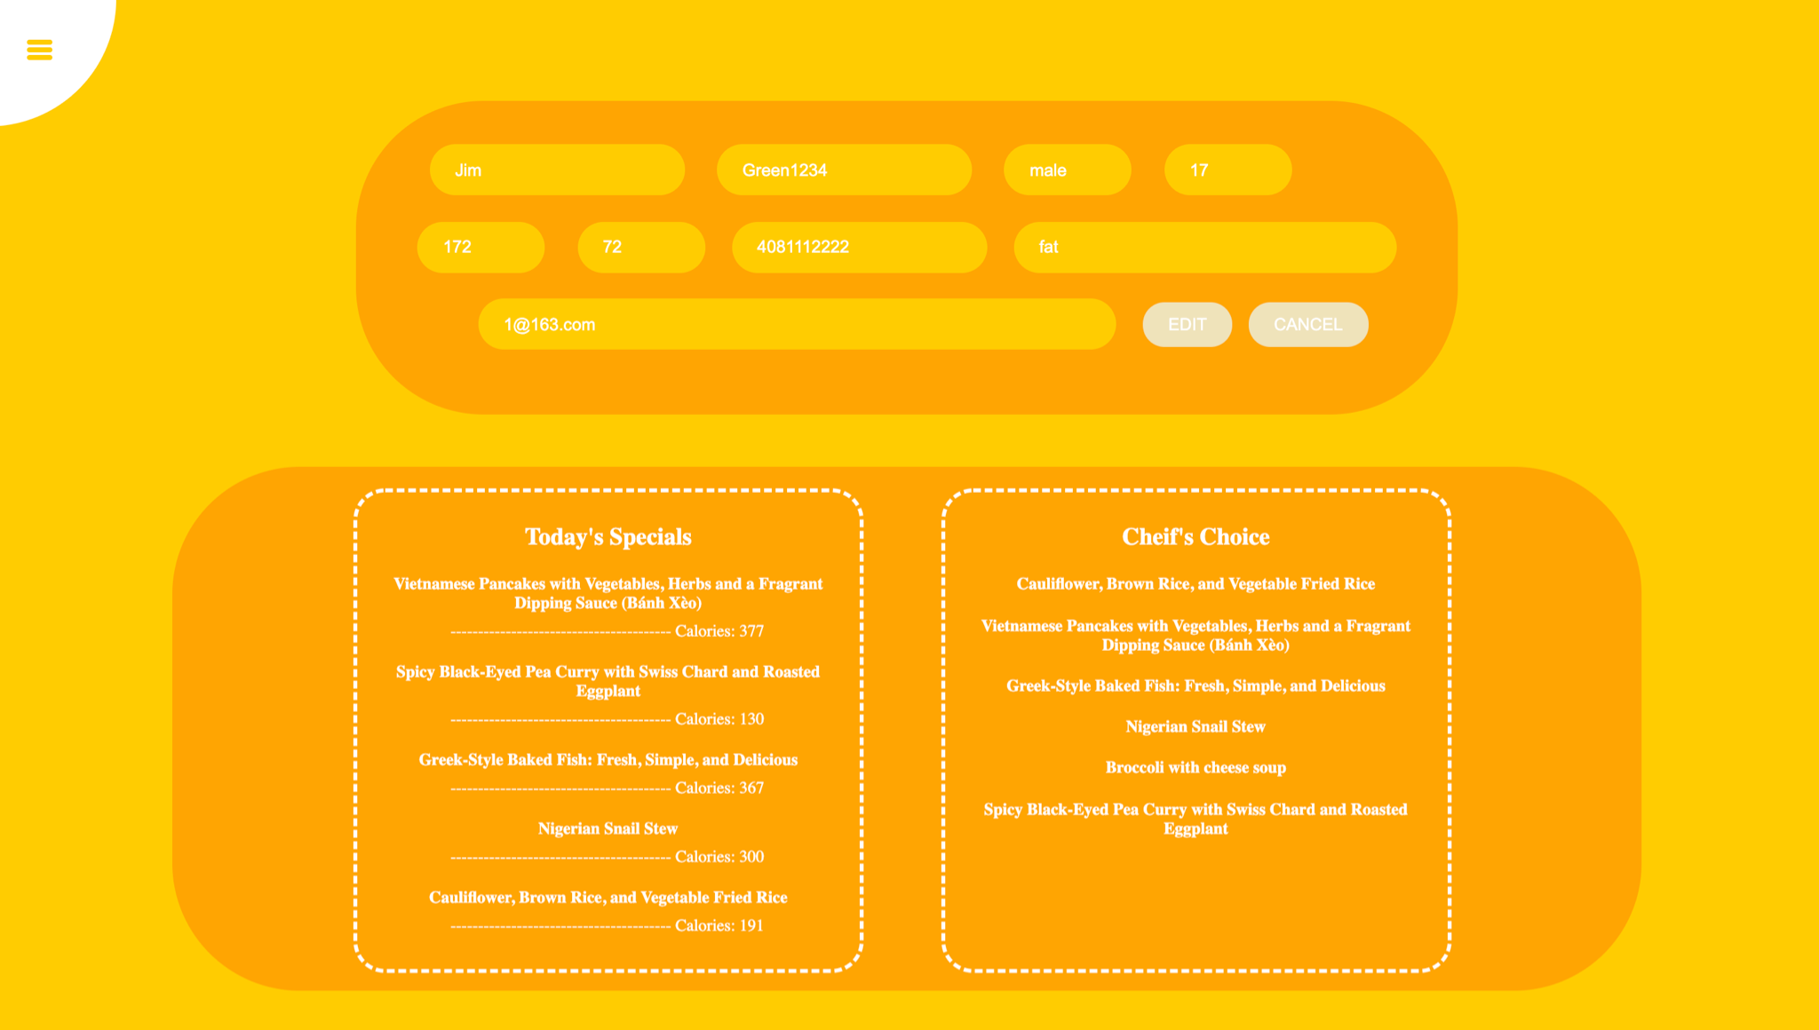
Key results - Profile Page

