Slide 1





Chinese Classical Poem Generation
Frank Fangzhe Li
Apr. 13, 2022

Slide 2




About

Slide 3
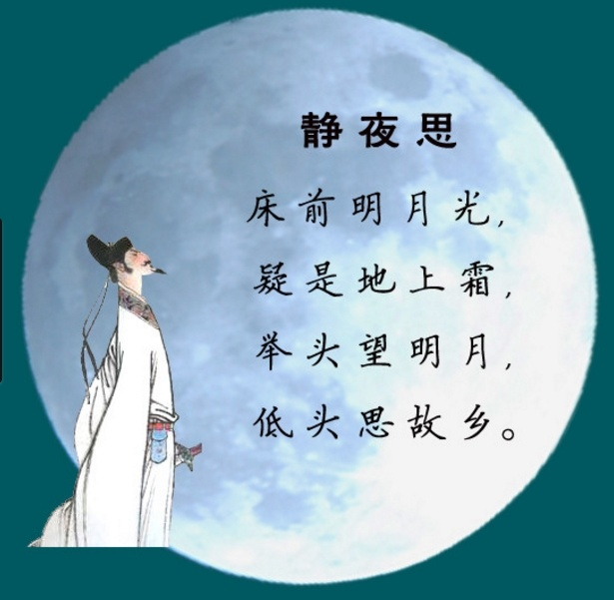
Thoughts on a Tranquil Night
Before my bed a pool of light— O can it be hoar-frost on the ground? Looking up, I find the moon bright; Bowing, in homesickness I’m drowned.
--Translated by Yuan Xu
https://www.google.com/url?sa=i&url=https%3A%2F%2Fzhuanlan.zhihu.com%2Fp%2F30517618&psig=AOvVaw3nQNl__YUgyW2tnppZImyw&ust=1649962721676000&source=images&cd=vfe&ved=0CAwQjRxqFwoTCJihkaHckfcCFQAAAAAdAAAAABAO

Slide 4


Challenges

Slide 5

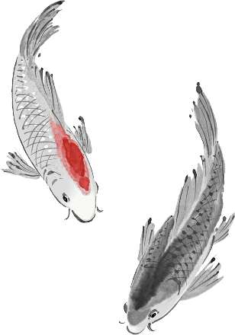
Language
Format
Compactness

Slide 6
●
Methodology

Slide 7

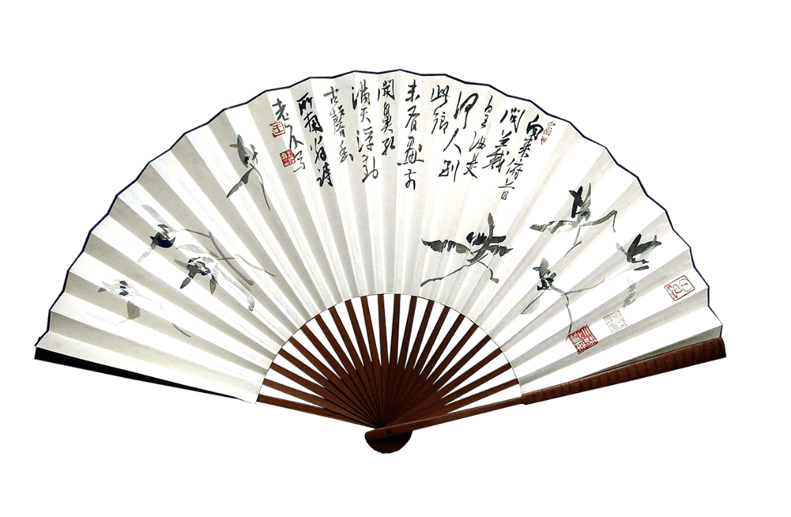
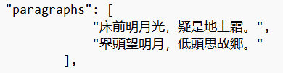
Data
315000 poems in chinese-poetry project in GitHub
https://github.com/chinese-poetry/chinesepoetry/
tree/master/json

Slide 8

Data Processing
Converted traditional Chinese to simplified Chinese
Cut 8-line poems to two 4-line poems
Remove punctuation
PPT模板 http://www.1ppt.com/moban/

Slide 9
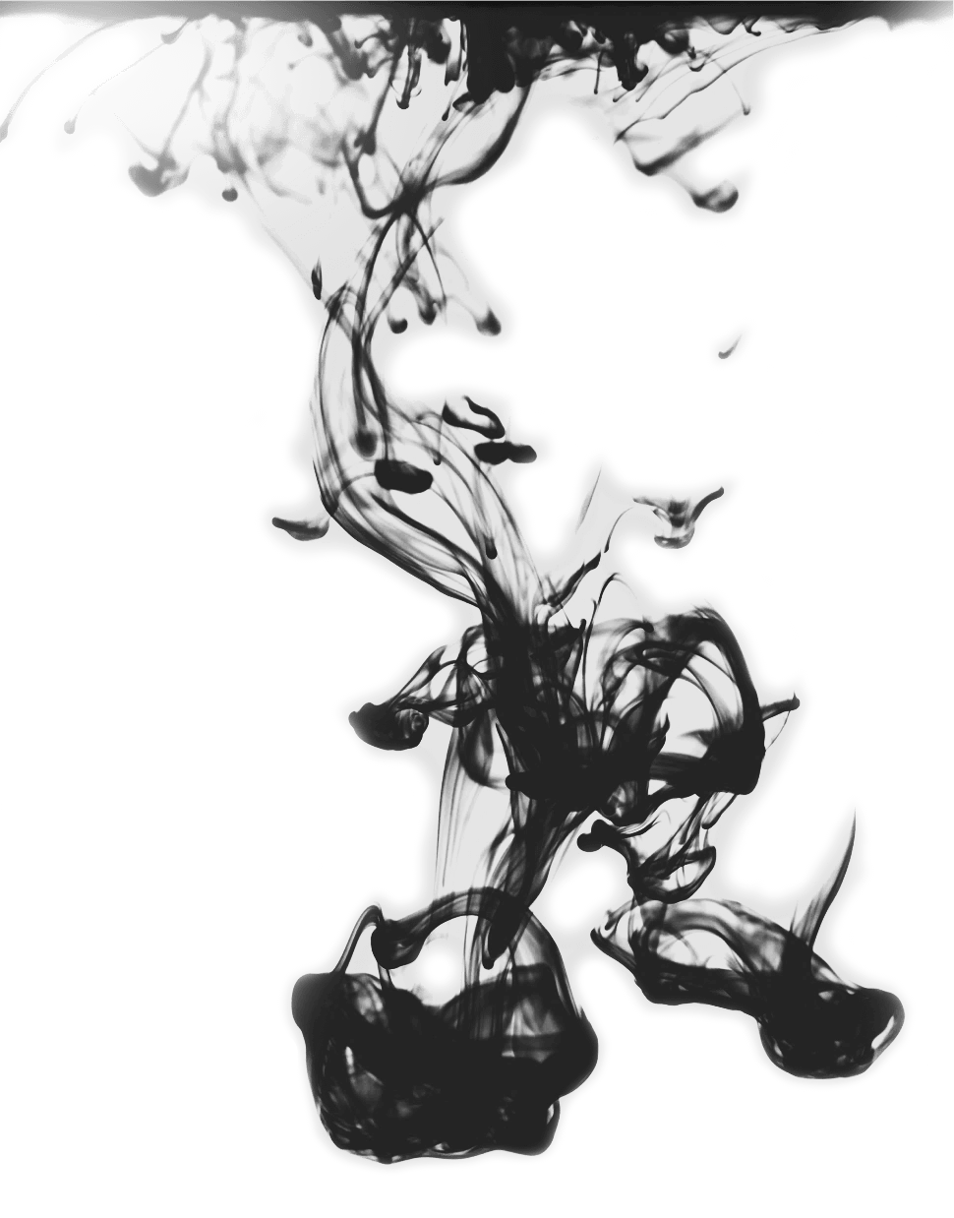
Model
Chinese Version of GPT2
1 epoch

Slide 10

Model Output
Input: 床前明月光
Output:
床前明月光，
池上新歌扇 。
行将近君床 ，
重叠绣双燕 。
Original:
床前明月光，疑是地上霜。
举头望明月，低头思故乡。

Slide 11

Output:
床前明月光，
池上新歌扇 。
行将近君床 ，
重叠绣双燕 。
Original:
床前明月光，疑是地上霜。
举头望明月，低头思故乡。
Before my bed a pool of light— Can you hear someone singing outside? Going near your bed,
Seeing you embroidering two swallows, again and again
Before my bed a pool of light— O can it be hoar-frost on the ground? Looking up, I find the moon bright; Bowing, in homesickness I’m drowned.
--Translated by Yuan Xu

Slide 12


Q & A

