Slide 1
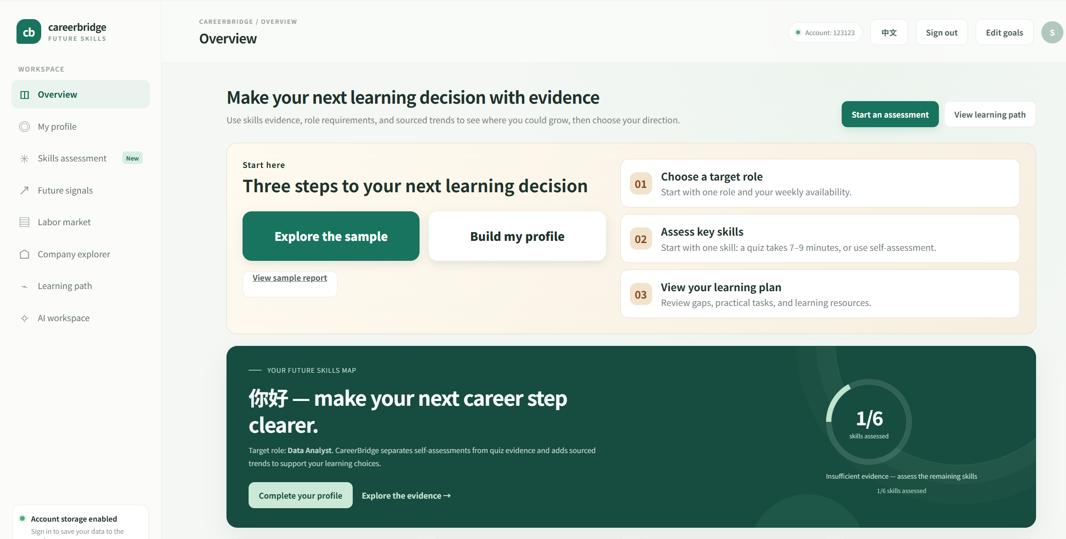
CAREERBRIDGE / FUTURE SKILLS
Make Your Next
Learning Decision
with evidence.
PROJECT
CareerBridge AI
TEAM
CodeCatalyst
Turn vague career anxiety into an explainable,
executable next step.
https://codecatalyst-careerbridge-ai.onrender.com/
PRODUCT DEMO

Slide 2
CONTENTS
The plan for today
01
The Problem
02
The Solution
Why career decisions keep stalling
One-line positioning and core promise
03
How It Works
04
Product Walkthrough
Five steps that close one loop
The live product, screen by screen
05
Trust by Design
06
Value & Impact
Transparent scoring, traceable sources
What three audiences actually gain
07
Boundaries
The things we refuse to do
Source: CareerBridge · careerbridge-ai-9whl.onrender.com
02

Slide 3
01 THE PROBLEM
Why learning investment becomes a gamble
01
02
03
Fragmented information
Distorted self-assessment
Trend noise overwhelms
Job requirements are scattered across job boards, course pages and forums — each with its own vocabulary, none of them comparable on one ruler.
Self-rated scores are treated as proof of ability. The more confident you are, the more you overestimate, and the real gaps get systematically hidden.
Everyone talks about the next hot skill, yet few label where the data came from, what time range it covers, or where it applies.
The result:
people study a great deal, yet can't tell whether it was the right thing — or which gap to close first.
CareerBridge · careerbridge-ai-9whl.onrender.com
03

Slide 4
02 THE SOLUTION
One-line positioning
Turn vague career anxiety into an
explainable, executable next step.
Not a score — a decision path you can audit and adjust yourself.
Traceable
Explainable
Actionable
Every number links back to its source page
The formula is laid out, not hidden
Resolved into tasks, hours and order
Source: CareerBridge · careerbridge-ai-9whl.onrender.com
04

Slide 5
03 HOW IT WORKS
Five steps, one closed loop
From assessment to direction — every step's output is visible to the next.
1
2
3
4
5
Dual-track assessment
Skill map
Gap analysis
Learning path
Trends & direction
Self-report and verified evidence are collected separately.
Coverage and alignment at a glance.
Level-by-level distance to each requirement.
Sequenced, with hours estimated.
Sourced industry signals layered on top.
The loop closes:
change the target role, edit a requirement or reorder a task, and the path recalculates immediately.
CareerBridge · careerbridge-ai-9whl.onrender.com
05

Slide 6
03 HOW IT WORKS · STEP 1
A self-rating is not evidence
SELF-REPORT
VERIFIED EVIDENCE
Self-assessment
Assessed evidence
—
Judges your own level from experience
Level decided by actual answers to questions
vs
—
Reflects confidence, not capability
Every level is on record and reviewable
—
Stored separately — never merged into the score
The only track that feeds the ability score
The key distinction:
“I think I'm good” and “the system verified it” are stored apart — confidence never becomes a score.
CareerBridge · careerbridge-ai-9whl.onrender.com
06

Slide 7
03 HOW IT WORKS · STEP 2
Skill map: coverage first, then alignment
62%
100%
7 / 7
Alignment score
Evidence coverage
Coverage count
How close assessed skills are to the bar
7 of 7 skills have been assessed
Unassessed skills never count as zero
WHAT THE MAP ANSWERS
HOW IT'S COUNTED
Coverage
Have we actually assessed this skill?
min(current, required)
÷ required level
Alignment
How far is it from what the role asks for?
Averaged across skills with level evidence. Skills without evidence are excluded — never scored zero.
Gaps
Where does the learning path need to start?
CareerBridge · careerbridge-ai-9whl.onrender.com
07

Slide 8
03 HOW IT WORKS · STEP 3
Gap analysis: how many levels short, at a glance
Beginner
Foundational
Independent
Advanced
Python
-2
levels short
SQL
-1
levels short
Data analytics
-1
levels short
Data visualization
-1
levels short
Current level
Job requirement
Gaps are counted in levels — not in number of questions answered.
CareerBridge · careerbridge-ai-9whl.onrender.com
08

Slide 9
03 HOW IT WORKS · STEP 4
Learning path: sequenced, estimated, editable
01
Close Python first
0/4
Two levels behind — highest priority, start in week one.
Path tasks completed
Lift SQL to Independent
02
The daily baseline for pulling data; practise alongside Python.
18
03
Data analytics methods
hours · ~4 weeks
Based on 5 hours per week
Connect tool skills to an analysis framework.
Reorder anytime — the plan recalculates.
04
Data visualization
Make conclusions legible to everyone else.
CareerBridge · careerbridge-ai-9whl.onrender.com
09

Slide 10
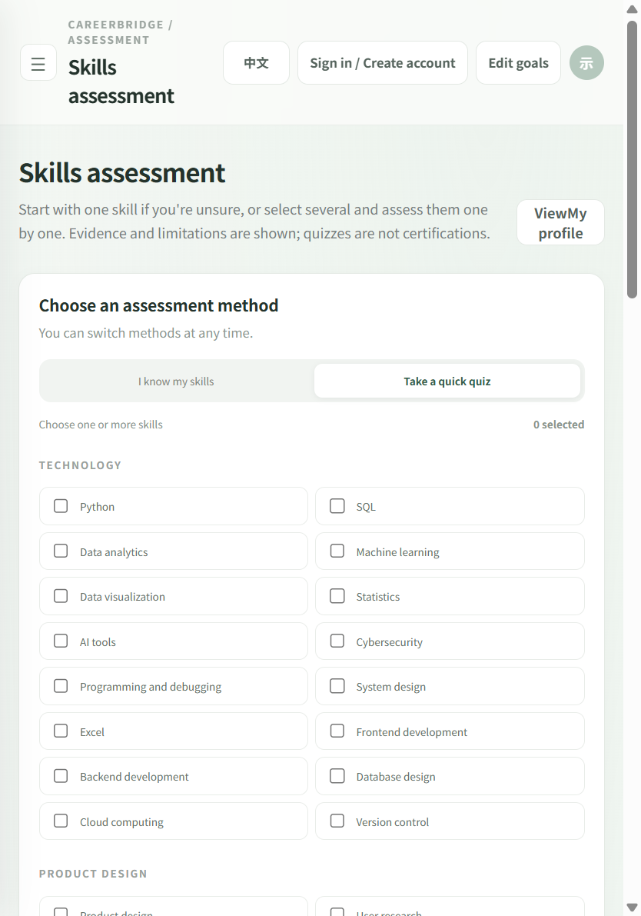
04 PRODUCT WALKTHROUGH · 1 OF 5
Assessment: self-report or quiz — your call
Step 1 of the loop · the live /assessment page
careerbridge-ai-9whl.onrender.com/assessment
ON THIS SCREEN
1
Two methods, one switch
“I know my skills” self-report, or “Take a quick quiz” for verified evidence — switchable at any time.
2
Skills grouped by domain
Technology, Product Design and more; every skill is opt-in via checkbox.
3
Honest framing up front
Stated on the page: evidence and limitations are shown; quizzes are not certifications.
4
Feeds the whole loop
Each assessed skill becomes level evidence the map, gaps and path all build on.
CareerBridge · careerbridge-ai-9whl.onrender.com
10

Slide 11
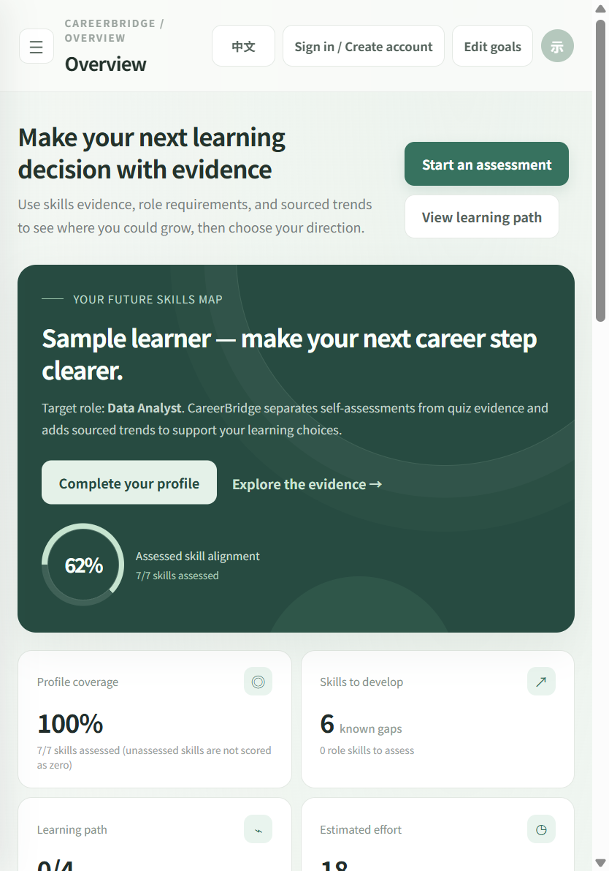
04 PRODUCT WALKTHROUGH · 2 OF 5
Overview: the whole decision on one screen
Step 2 of the loop · the live overview page
careerbridge-ai-9whl.onrender.com/
ON THIS SCREEN
1
62% assessed alignment
Donut averages min(current, required) across assessed skills — here 7/7 assessed.
2
100% profile coverage
Unassessed skills count toward coverage and are never scored as zero.
3
6 known gaps
“Skills to develop” measures the distance to the target role: Data Analyst.
4
Two clear next actions
Start an assessment, or jump straight to the learning path.
CareerBridge · careerbridge-ai-9whl.onrender.com
11

Slide 12
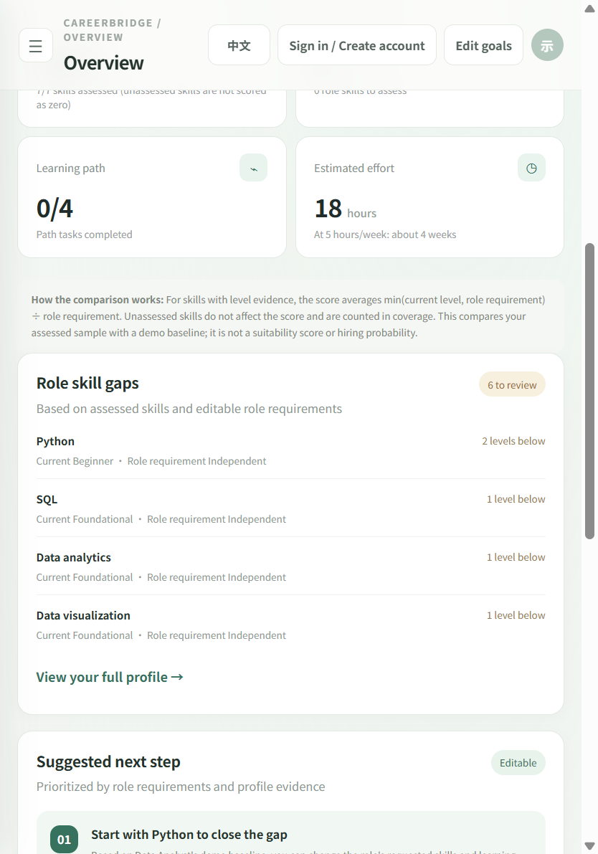
04 PRODUCT WALKTHROUGH · 3 OF 5
Gap analysis, printed with its own math
Step 3 of the loop · overview, “Role skill gaps” section
careerbridge-ai-9whl.onrender.com/
ON THIS SCREEN
1
Gaps stated in levels
Python is 2 levels below; SQL, analytics and visualization each 1 level below.
2
Both sides shown
Every row: “Current Beginner · Role requirement Independent” — nothing hidden.
3
Method on the page
The comparison formula and its limits are printed right above the list.
4
Next step suggested
“Start with Python to close the gap” — prioritized, editable, never locked.
CareerBridge · careerbridge-ai-9whl.onrender.com
12

Slide 13
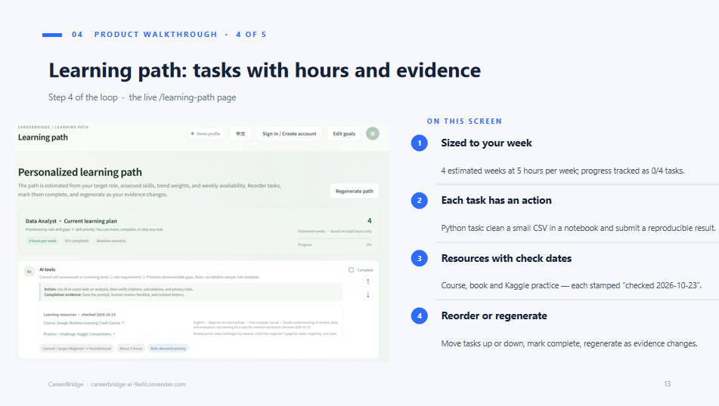
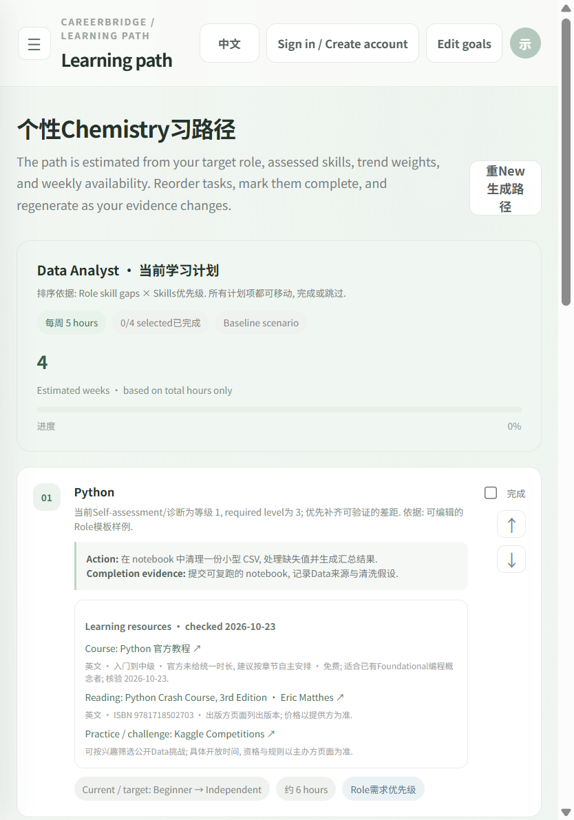
04 PRODUCT WALKTHROUGH · 4 OF 5
Learning path: tasks with hours and evidence
Step 4 of the loop · the live /learning-path page
careerbridge-ai-9whl.onrender.com/learning-path
ON THIS SCREEN
1
Sized to your week
4 estimated weeks at 5 hours per week; progress tracked as 0/4 tasks.
2
Each task has an action
Python task: clean a small CSV in a notebook and submit a reproducible result.
3
Resources with check dates
Course, book and Kaggle practice — each stamped “checked 2026-10-23”.
4
Reorder or regenerate
Move tasks up or down, mark complete, regenerate as evidence changes.
CareerBridge · careerbridge-ai-9whl.onrender.com
13

Slide 14
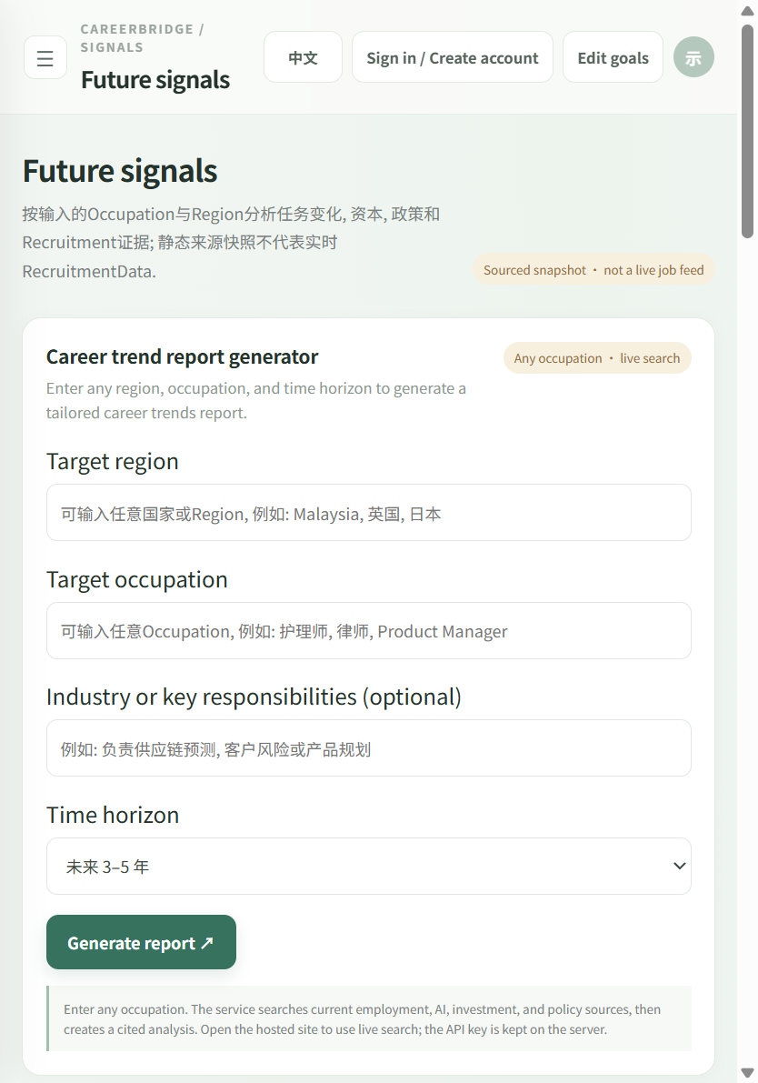
04 PRODUCT WALKTHROUGH · 5 OF 5
Trends as a cited report, not a feed
Step 5 of the loop · the live /signals page
careerbridge-ai-9whl.onrender.com/signals
ON THIS SCREEN
1
Any occupation, any region
Target region, occupation and time horizon generate a tailored trend report.
2
An honest badge
“Sourced snapshot · not a live job feed” is declared before you generate.
3
Cited analysis
Searches employment, AI, investment and policy sources, then writes a cited report.
4
WEF as baseline
Overview trend cards reference the WEF Future of Jobs Report 2025.
CareerBridge · careerbridge-ai-9whl.onrender.com
14

Slide 15
05 TRUST BY DESIGN
The algorithm is laid open; the sources are traceable
ALIGNMENT SCORE
TRENDS & SOURCES
min( current , required ) ÷ required
WEF
Future of Jobs Report 2025 (2025–2030)
SDG 4
Target 4.4 · lifelong learning
Computed per skill that carries level evidence, then averaged. Skills with no evidence are excluded from the average entirely.
SDG 8
Target 8.5 · decent work
WHAT WE DON'T CLAIM
—
This is not a fit score, and it is not a probability of being hired.
—
Global reports are cited as context — they do not replace local hiring data.
—
SDG mapping is a product-level goal alignment, not a causal social-impact assessment.
Sources: CareerBridge · WEF Future of Jobs 2025 · sdgs.un.org
15

Slide 16
06 VALUE & IMPACT
Three audiences, three kinds of certainty
LEARNERS
EDUCATORS
ENTERPRISE L&D
Fewer detours
Explainable, intervenable
Quantified gaps
Know exactly what to do next, not just “study more”
Every conclusion traces back to evidence
Benchmark the gap against role requirements
Effort is estimated: 18 hours over ~4 weeks
Gaps aggregate per skill, so scheduling gets easier
Rank training spend by level difference
Priority is yours to change — never locked by the system
One shared vocabulary instead of competing claims
Trend signals arrive sourced and citable internally
CareerBridge · careerbridge-ai-9whl.onrender.com
16

Slide 17
07 BOUNDARIES
Boundaries are part of credibility
No hiring decisions
No job-outcome promises
No invented data
The system takes no part in recruitment screening or HR judgement.
No offer probability is estimated, and no outcome is guaranteed.
Missing evidence is labelled “not assessed” — never filled with a guess.
Use evidence.
Choose your direction.
Thank you — walk through
a full assessment with us.
careerbridge-ai-9whl.onrender.com
LIVE DEMO
CareerBridge · careerbridge-ai-9whl.onrender.com
17

