Slide 1

Community Preserving Network Embedding
方子玄
2018/9/19

Slide 2
Introduction
Network embedding, aiming to learn the low-dimensional representations of nodes in networks, is of paramount importance in many real applications.
2. One basic requirement of network embedding is to preserve the structure and inherent properties of the networks.

Slide 3
Motivation
While previous network embedding methods primarily preserve the microscopic structure, such as the first- and second-order proximities of nodes.
The mesoscopic community structure, which is one of the most prominent feature of networks, is largely ignored.
Therefore, this paper propose a novel Modularized Nonnegative Matrix Factorization (M-NMF) model to incorporate the community structure into network embedding.

Slide 4
Advantage
The representations of nodes within a community should be more similar than those belonging to different communities.
for two nodes within a community, even if they only have weak relationship in microscopic structure due to the data sparsity issue, their similarities will also be strengthened by the community structure constraint.
Thus, the incorporation of community structure in network embedding can provide effective and rich information to solve data sparsity issues in microscopic structures and also make the learned node representations more discriminative.

Slide 5

Modeling community structure
The modularity maximization based community detection method, one of the most widely used algorithms (Newman 2006a), is adopted to model the community structure.
Specifically, given a network A with two communities, the modularity is defined as follows (Newman 2006b):

Slide 6


extend to k > 2 communities :
generalize the community membership indicator as with one column for each community.
In each row of H, only one element is 1 and all the others are 0.
After suppressing the constant which has no effect on the maximum of the modularity, we have

Slide 7



Modeling microscopic structure
First-order proximity :
The first-order proximity is the observed pairwise proximity between two nodes, i.e., if there exists positive first-order proximity between nodes i and j, otherwise, the first-order proximity is 0.
Basically, because the first proximity is the the most direct expression of network, it is necessary to preserve the first-order proximity.
A complementary solution is to consider their common neighbors. Intuitively, if two nodes share many neighbors, even if they do not have a direct link, they are still similar.

Slide 8




Second-order Proximity :
Let be the first-order proximity between node i and other nodes.
Here we consider the cosine similarity as the second-order proximity, i.e.,

Slide 9

final similarity matrix:
objective function:

Slide 10
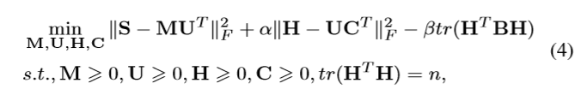
The unified network embedding model
To this end, we introduce an auxiliary nonnegative matrix , named community representation matrix, where the r-th row (Cr) is the representation of community r.
If the representation of a node is highly similar to that of a community, the node may have a high propensity to be in this community.
overall objective function:

Slide 11
Experimental evaluations
We compared M-NMF against the following five network embedding algorithms: DeepWalk (Perozzi, Al-Rfou, and Skiena 2014), LINE (Tang et al. 2015), GraRep (Cao, Lu, and Xu 2015), Node2Vec (Grover and Leskovec 2016) and M-NMF0.
LINE1 to represent the LINE preserving the first-order proximity and LINE2 to represent the LINE preserving the second-order proximity.
M-NMF0 is our proposed M-NMF model which only preserves the first- and second-order proximities. M-NMF0 is used to verify the effectiveness of incorporating community structure.

Slide 12
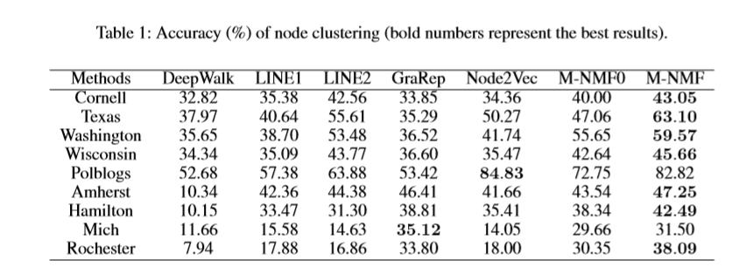
M-NMF achieves the best results on seven of nine networks (except Polblogs and Mich).
M-NMF consistently shows better performance than M-NMF0 on all the tested networks, further suggesting the importance of incorporating the community structure to learn the representations of nodes.

Slide 13
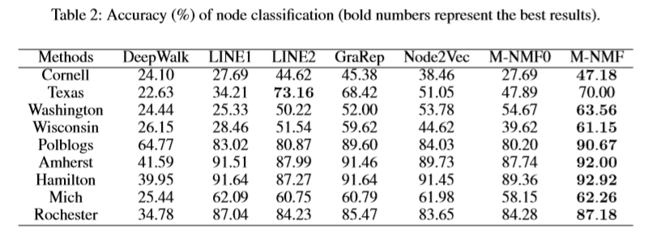
As we can see, M-NMF outperforms the other methods on eight of nine networks (except Texas), which demonstrates the effectiveness of M-NMF on classiﬁcation task.

Slide 14
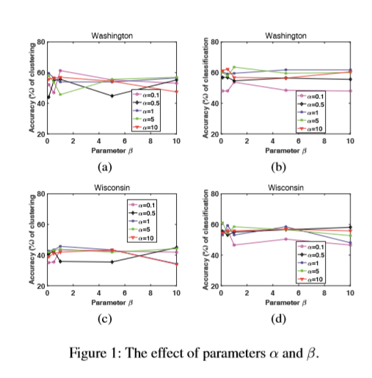
As seen from Figure 1, the accuracies do not change too much and the performances are relatively stable.
we noticed that MNMF on these two networks still shows competitive performances even when the accuracies are relatively low.

Slide 15
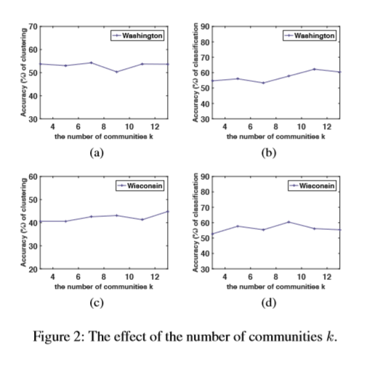
As we can see, the curve of accuracies are relatively stable, indicating its robustness to the number of communities k.

Slide 16
Thanks!

