Slide 1
Static Analysis of Interrupt-driven Programs Synchronized via the Priority Ceiling Protocol
POPL 2011

Slide 2
Priority Ceiling Protocol (PCP)
Each resource r obtains a ceiling priority, which is the maximal priority of tasks acquiring the resource r.
Develop static analyses for programs synchronized via the PCP.
The dynamic priority of tasks, the maximum of a task’s static priority and the ceiling priorities of all resources it has acquired.

Slide 3
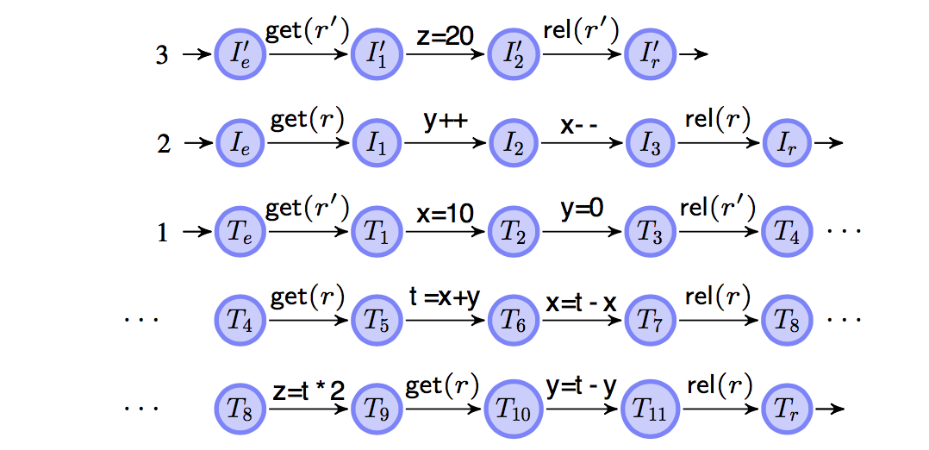
Example Program
r ceiling priority:2
r’ ceiling priority:3
Notes:
Interrupt: I pri:2,I’ pri:3
Task: T pri:1.
Resource: r ceiling pri:2,r’ ceiling pri:3
This is an example of swap variable x and y with a temp variable t.

Slide 4

Data Race
The assignment $z=t∗2$ may overwrite the assignment in I’ or overwritten by I’ at T₈.
At T₁₀, variable y is overwritten with a value that might have become outdated due to an occurrence of I.

Slide 5
Nontransactional Behavior
Note that this occurs although all accesses to x and y are protected by the resource r. We call this nontransactional behavior.
In the example, this will result in failing to correctly swap the variables x and y.

Slide 6
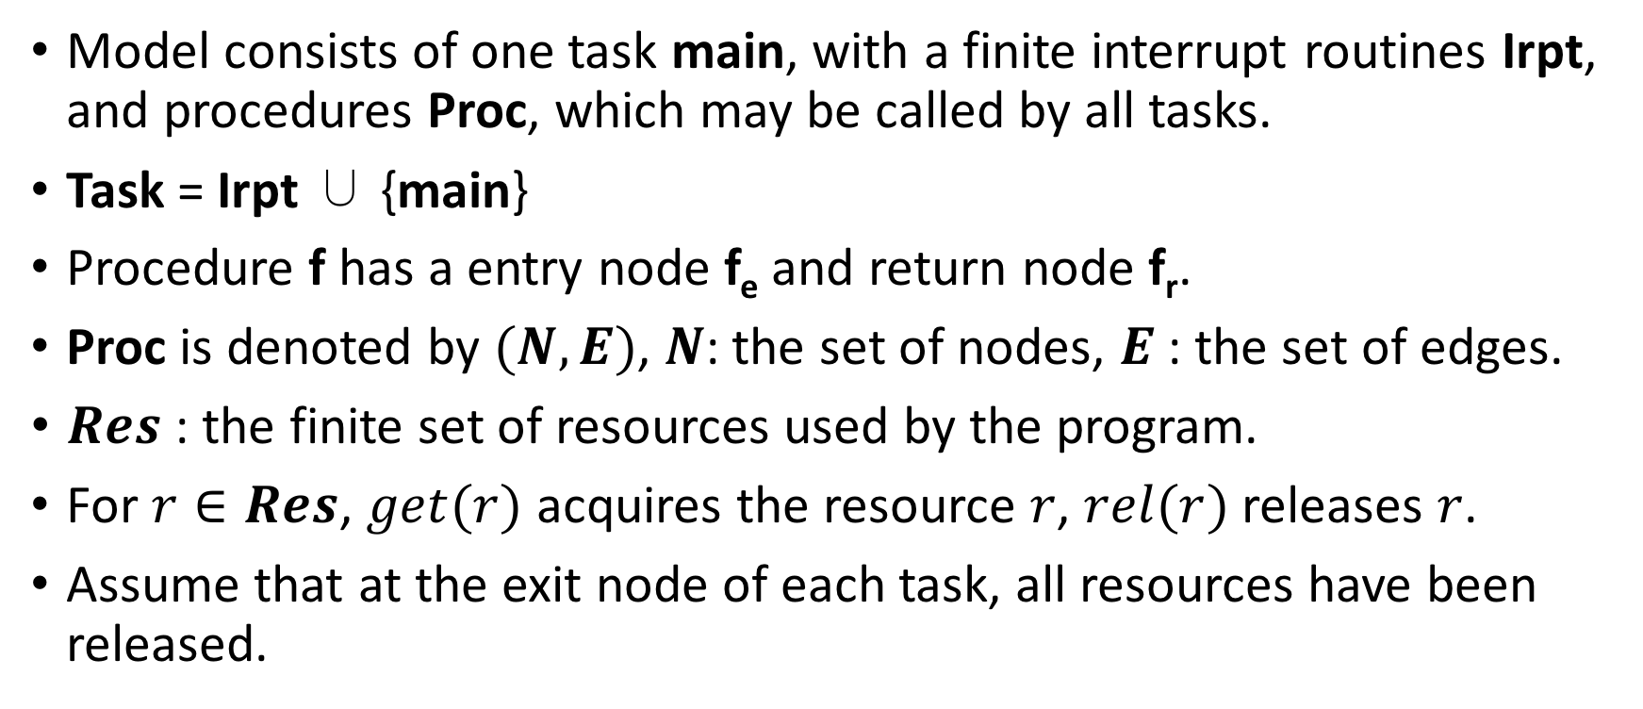
PCP Models and Semantics
Model consists of one task main, with a finite interrupt routines Irpt, and procedures Proc, which may be called by all tasks.
Task = Irpt ∪ {main}
Procedure f has a entry node f_{e} and return node f_{r}.
Proc is denoted by $(N,E)$, $N$: the set of nodes, $E$ : the set of edges.
$Res$ : the finite set of resources used by the program.
For $r∈Res$, $get(r)$ acquires the resource $r$, $rel(r)$ releases $r$.
Assume that at the exit node of each task, all resources have been released.

Slide 7

Semantics
$𝒫:Task→ℕ$ : static priorities of Task.
$𝒰:Task⟶2^{Res}$ : the resources possibly acquired by Task.
Ceiling priority : $𝒫\left(r\right)=\max\left\{𝒫\left(q\right) | r∈𝒰\left(q\right)\right\}, r∈Res$.
$𝒫\left(R\right)=\max\left\{𝒫\left(r\right) | r∈R\right\},𝒫\left(∅\right)=−∞$.

Slide 8
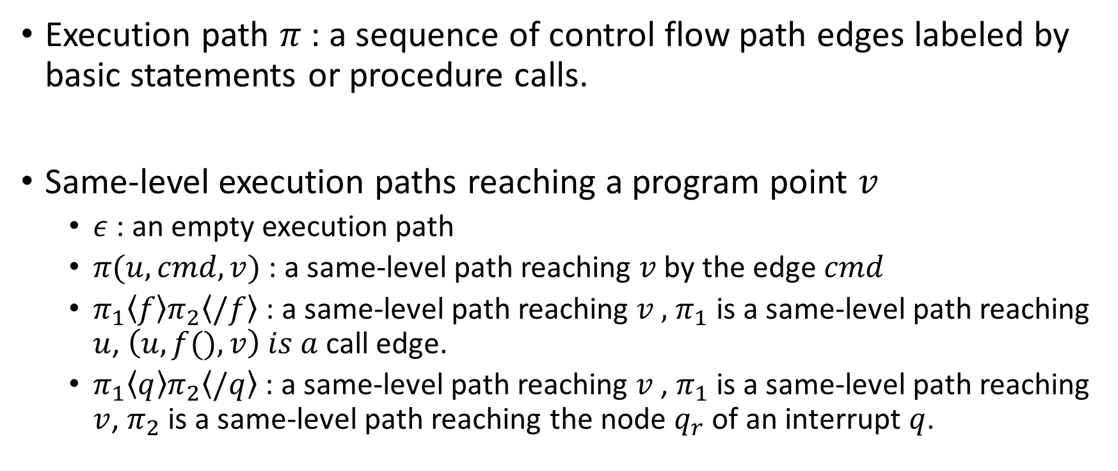
Execution Paths
Execution path $π$ : a sequence of control flow path edges labeled by basic statements or procedure calls.
Same-level execution paths reaching a program point $v$
$ε$ : an empty execution path
$π(u,cmd,v)$ : a same-level path reaching $v$by the edge $cmd$
$π_{1}\left\langle f\right\rangle π_{2}\left\langle /f\right\rangle$ : a same-level path reaching $v ,$ $π_{1}$ is a same-level path reaching $u$, $\left(u,f(),v\right) is a$call edge.
$π_{1}\left\langle q\right\rangle π_{2}\left\langle /q\right\rangle$ : a same-level path reaching $v$, $π_{1}$ is a same-level path reaching $v$, $π_{2}$ is a same-level path reaching the node $q_{r}$ of an interrupt $q$.

Slide 9
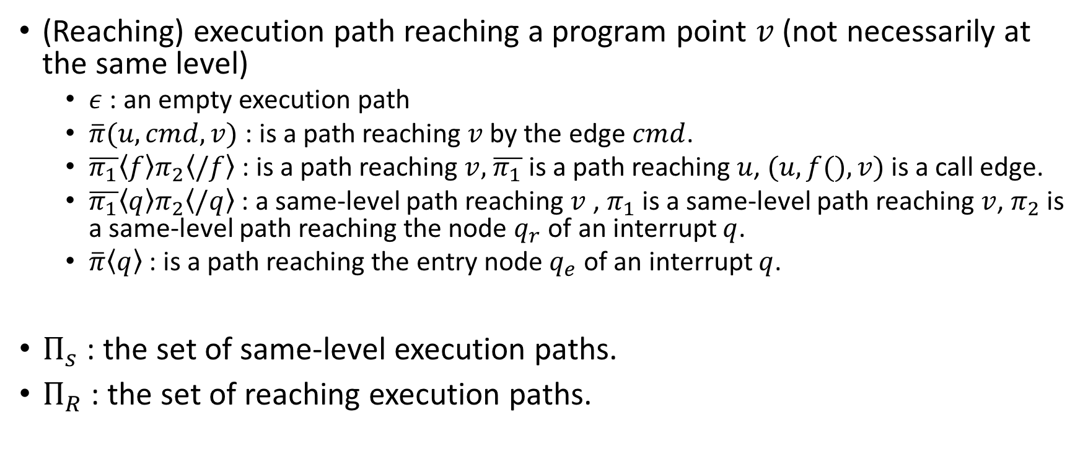
Execution Paths
(Reaching) execution path reaching a program point $v$ (not necessarily at the same level)
$ε$ : an empty execution path
$\overline{π}(u,cmd,v)$ : is a path reaching $v$ by the edge $cmd$.
$\overline{π_{1}}\left\langle f\right\rangle π_{2}\left\langle /f\right\rangle$ : is a path reaching $v,$ $\overline{π_{1}}$ is a path reaching $u$, $(u,f(),v)$ is a call edge.
$\overline{π_{1}}\left\langle q\right\rangle π_{2}\left\langle /q\right\rangle$ : a same-level path reaching $v$, $π_{1}$ is a same-level path reaching $v$, $π_{2}$ is a same-level path reaching the node $q_{r}$ of an interrupt $q$.
$\overline{π}\left\langle q\right\rangle$ : is a path reaching the entry node $q_{e}$ of an interrupt $q$.
$Π_{s}$ : the set of same-level execution paths.
$Π_{R}$ : the set of reaching execution paths.

Slide 10
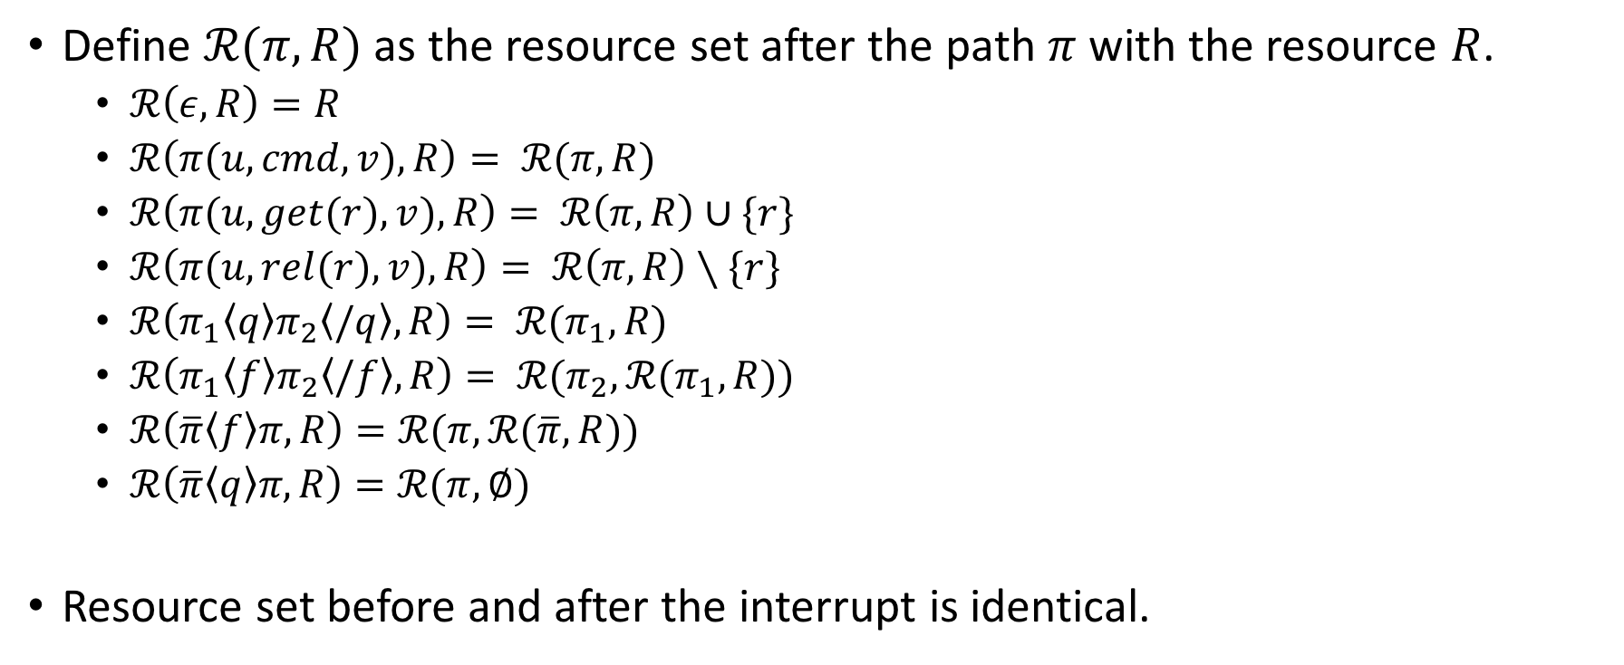
Resource Set
Define $ℛ(π,R)$ as the resource set after the path $π$ with the resource $R$.
$ℛ\left(ε,R\right)=R$
$ℛ\left(π(u,cmd,v),R\right)= ℛ(π,R)$
$ℛ\left(π(u,get(r),v),R\right)= ℛ\left(π,R\right)∪\{r\}$
$ℛ\left(π(u,rel(r),v),R\right)= ℛ\left(π,R\right)∖\{r\}$
$ℛ\left(π_{1}\left\langle q\right\rangle π_{2}\left\langle /q\right\rangle ,R\right)= ℛ(π_{1},R)$
$ℛ\left(π_{1}\left\langle f\right\rangle π_{2}\left\langle /f\right\rangle ,R\right)= ℛ(π_{2},ℛ(π_{1},R))$
$ℛ\left(\overline{π}\left\langle f\right\rangle π,R\right)=ℛ(π,ℛ(\overline{π},R))$
$ℛ\left(\overline{π}\left\langle q\right\rangle π,R\right)=ℛ(π,∅)$
Resource set before and after the interrupt is identical.

Slide 11
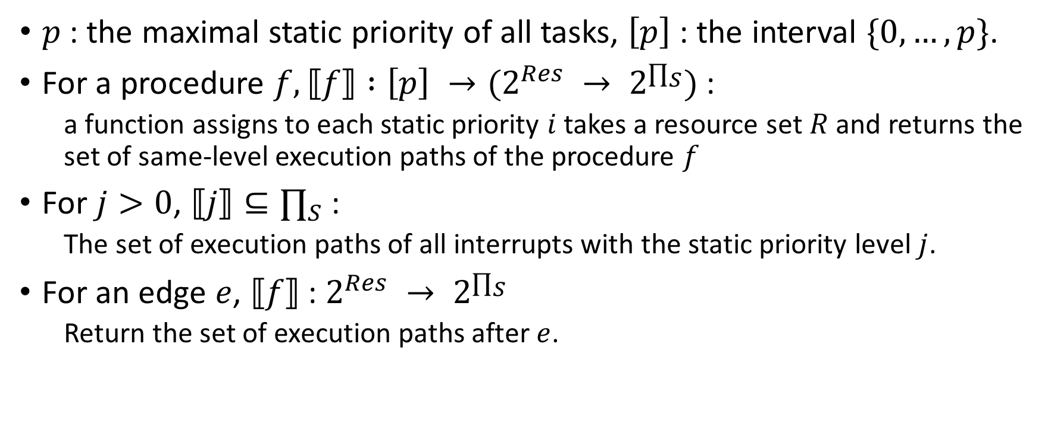
Path Semantics
$p$ : the maximal static priority of all tasks, $\left[p\right]$ : the interval $\{0,…,p\}$.
For a procedure $f, ⟦f⟧ :\left[p\right] →(2^{Res} → 2^{∏_{S}})$ :
a function assigns to each static priority $i$ takes a resource set $R$ and returns the set of same-level execution paths of the procedure $f$
For $j>0$, $⟦j⟧⊆∏_{S}$ :
The set of execution paths of all interrupts with the static priority level $j$.
For an edge $e$, $⟦f⟧$ : $2^{Res} → 2^{∏_{S}}$
Return the set of execution paths after $e$.

Slide 12

Composition Operator
The composition of the mappings $M_{1},M_{2} :2^{Res} → 2^{∏_{S}}$
$$\left(M_{2}∘M_{1}\right)R=\left\{π_{1}π_{2} | π_{1}∈M_{1}\left(R\right),π_{2}∈M_{2}\left(ℛ\left(π_{1},R\right)\right)\right\}$$
$S_{j}$ : $2^{Res} → 2^{∏_{S}}$ the set of execution paths of interrupts of priority $j$.
$$\left(S_{j}∙_{j}M\right)R=\left\{π_{1}π_{2} | π_{1}∈M\left(R\right),π_{2}∈S_{j}, j>𝒫\left(ℛ\left(π_{1},R\right)\right)\right\}$$

Slide 13
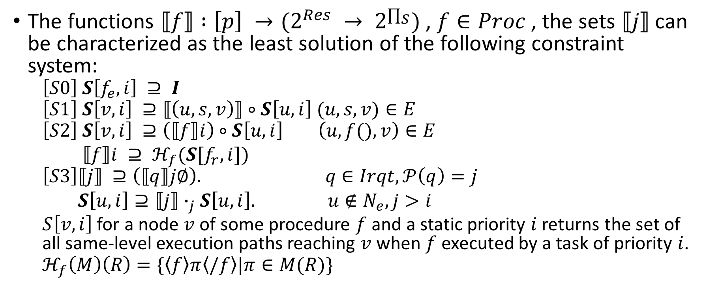
Constraint System
The functions $⟦f⟧ :\left[p\right] →(2^{Res} → 2^{∏_{S}})$ , $f∈Proc$ , the sets $⟦j⟧$ can be characterized as the least solution of the following constraint system:
$$\left[S0\right] S\left[f_{e},i\right] ⊇ I$$
$$\left[S1\right] S\left[v,i\right] ⊇⟦\left(u,s,v\right)⟧∘S\left[u,i\right] (u,s,v)∈E$$
$$\left[S2\right] S\left[v,i\right] ⊇\left(⟦f⟧i\right)∘S\left[u,i\right] \left(u,f(),v\right)∈E$$
$⟦f⟧i ⊇ ℋ_{f}(S[f_{r},i])$
$$\left[S3\right]⟦j⟧ ⊇\left(⟦q⟧j∅\right). q∈Irqt,𝒫\left(q\right)=j$$
$S\left[u,i\right]⊇⟦j⟧∙_{j}S\left[u,i\right]. u∉N_{e},j>i$
$S\left[v,i\right]$ for a node $v$ of some procedure $f$ and a static priority $i$ returns the set of all same-level execution paths reaching $v$ when $f$ executed by a task of priority $i$.
$$ℋ_{f}\left(M\right)\left(R\right)=\{\left\langle f\right\rangle π\left\langle /f\right\rangle |π∈M(R)\}$$

Slide 14
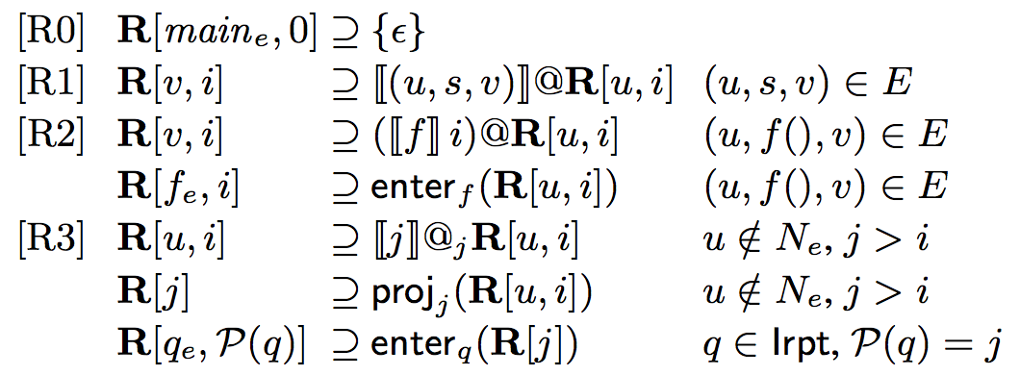

Reaching Path Semantics
$M : 2^{Res}→2^{∏_{S}}$ : edges or procedures to sets of reaching paths $S$
$M@S=\{\overline{π_{1}}π_{2}|\overline{π_{1}}∈S,π_{2}∈M(ℛ\left(\overline{π_{1}},∅\right))\}$
$S_{2}@_{j}S_{1}=\left\{\overline{π_{1}}π_{2} | \overline{π_{1}}∈S_{1},π_{2}∈S_{2}, 𝒫\left(ℛ\left(\overline{π_{1}},∅\right)\right)<j\right\}$
${enter}_{f}\left(S\right)=\{\overline{π}\left\langle f\right\rangle |\overline{π}∈S\}$
${proj}_{j}\left(S\right)=\{\overline{π}|\overline{π}∈S,𝒫\left(ℛ\left(\overline{π},∅\right)\right)<j\}$

Slide 15
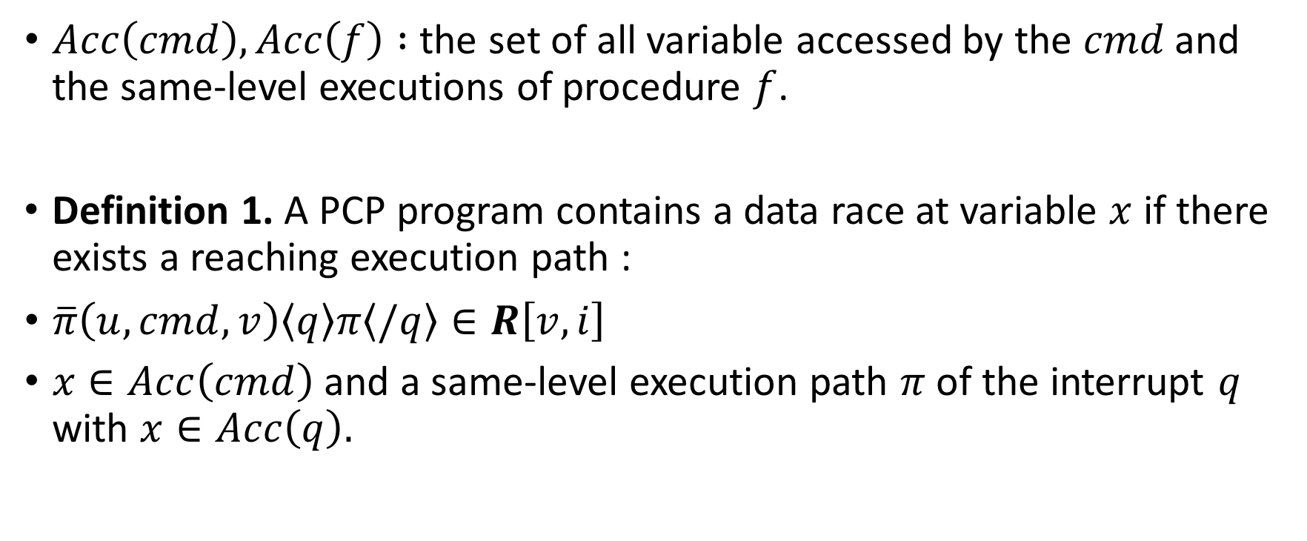
Data Races and Nontransactional Behavior
$Acc\left(cmd\right), Acc\left(f\right) :$ the set of all variable accessed by the $cmd$ and the same-level executions of procedure $f$.
Definition 1. A PCP program contains a data race at variable $x$ if there exists a reaching execution path :
$\overline{π}\left(u,cmd,v\right)\left\langle q\right\rangle π\left\langle /q\right\rangle ∈R\left[v,i\right]$
$x∈Acc\left(cmd\right)$ and a same-level execution path $π$ of the interrupt $q$ with $x∈Acc\left(q\right).$

Slide 16
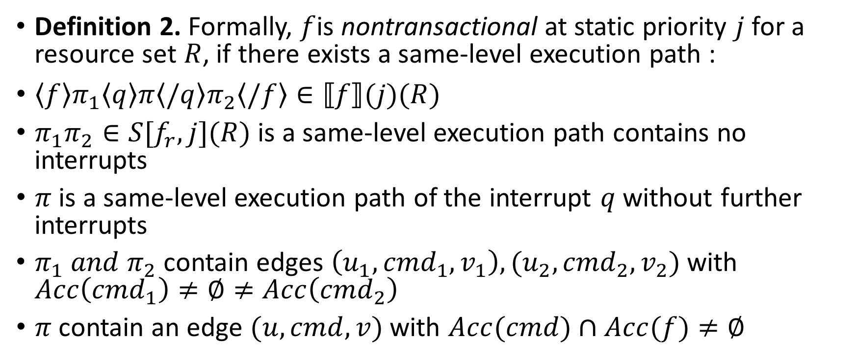
Data Races and Nontransactional Behavior
Definition 2. Formally, $f$is nontransactional at static priority $j$ for a resource set $R$, if there exists a same-level execution path :
$\left\langle f\right\rangle π_{1}\left\langle q\right\rangle π\left\langle /q\right\rangle π_{2}\left\langle /f\right\rangle ∈⟦f⟧(j)(R)$
$π_{1}π_{2}∈S[f_{r},j](R)$ is a same-level execution path contains no interrupts
$π$ is a same-level execution path of the interrupt $q$ without further interrupts
$π_{1} and π_{2}$ contain edges $\left(u_{1},{cmd}_{1},v_{1}\right),(u_{2},{cmd}_{2},v_{2})$ with $Acc\left({cmd}_{1}\right)≠∅≠Acc\left({cmd}_{2}\right)$
$π$ contain an edge $(u,cmd,v)$ with $Acc(cmd)∩Acc(f)≠∅$

Slide 17
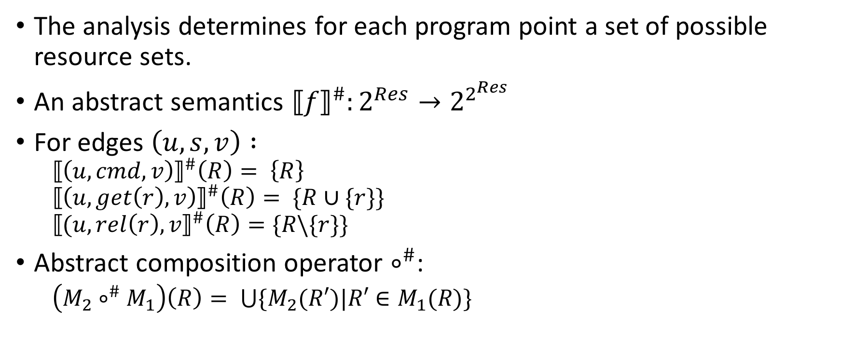
Analyzing Resources
The analysis determines for each program point a set of possible resource sets.
An abstract semantics ${⟦f⟧}^{\#}:2^{Res}→2^{2^{Res}}$
For edges $\left(u,s,v\right) :$
$${⟦\left(u,cmd,v\right)⟧}^{\#}\left(R\right)= \left\{R\right\}$$
$${⟦\left(u,get\left(r\right),v\right)⟧}^{\#}\left(R\right)= \{R∪\{r\}\}$$
$${⟦(u,rel\left(r\right),v⟧}^{\#}\left(R\right)=\{R\backslash \{r\}\}$$
Abstract composition operator $∘^{\#}$:
$\left(M_{2}∘^{\#}M_{1}\right)\left(R\right)= \bigcup{\{M_{2}(R′)|R′∈M_{1}(R)\}}$

Slide 18
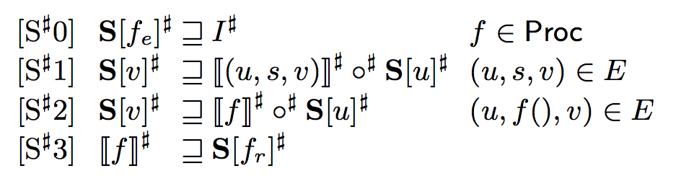

Constraint System
The functions ${⟦f⟧}^{\#} : 2^{Res}→2^{2^{Res}}, f∈Proc$ are given by the least solution of the constraint system:

Slide 19
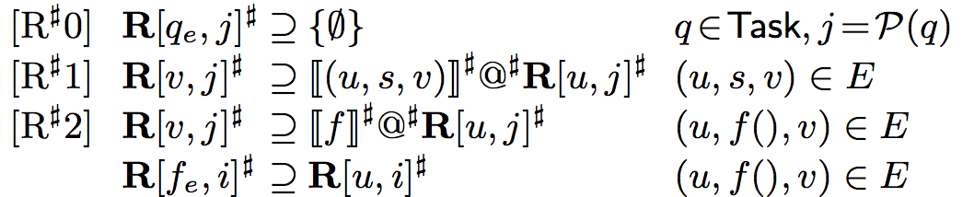

Constraint System
For the sets of reaching resource sets, define an abstract application operator $@^{\#}$:
$$M@^{\#}S= ∪\{M(R)|R∈S\}$$
The sets of resource sets reaching a node $v$ at static priority level $i$, we consider the constraint system:

Slide 20

Abstract Function
In order to relate the concrete and abstract semantics, we introduce the abstract function:
$α :(2^{Res}→2^{∏_{S}})→(2^{Res}→2^{2^{Res}})$ and $\overline{α} : 2^{Π_{R}}→2^{2^{Res}}$
$α\left(M\right)\left(R\right)=\{ℛ(π,R)|π∈M(R)\}$
$\overline{α}\left(X\right)=\{ℛ(\overline{π},∅)|\overline{π}∈X\}$

Slide 21
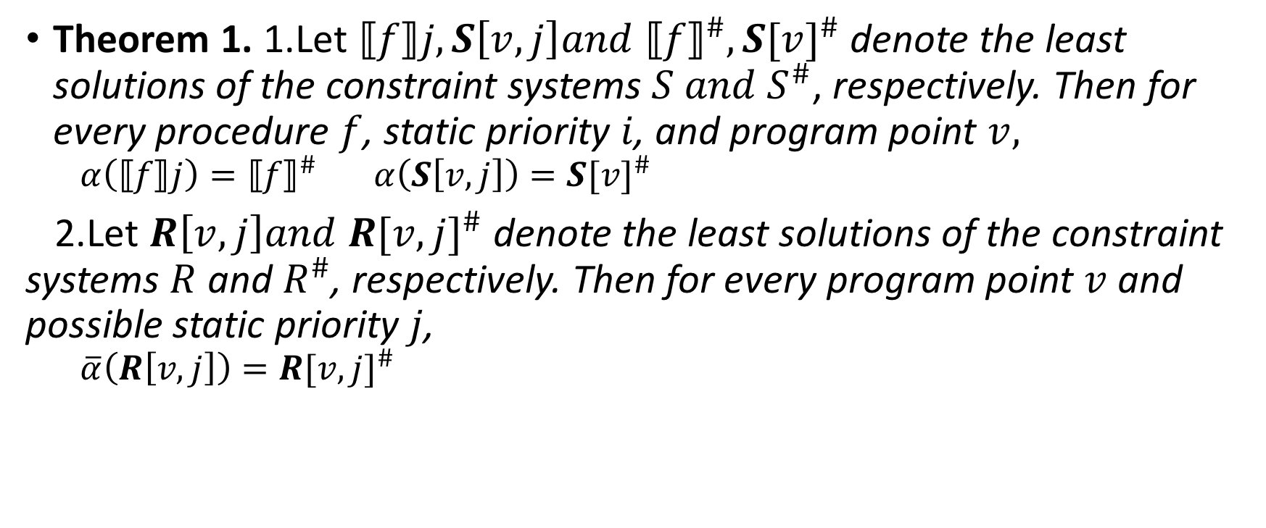
Theorem
Theorem 1. 1.Let $⟦f⟧j, S\left[v,j\right]and {⟦f⟧}^{\#},S{[v]}^{\#}$ denote the least solutions of the constraint systems $S and S^{\#}$, respectively. Then for every procedure $f$, static priority $i$, and program point $v,$
$$α\left(⟦f⟧j\right)={⟦f⟧}^{\#} α\left(S\left[v,j\right]\right)=S{[v]}^{\#}$$
2.Let $R\left[v,j\right]and R{[v,j]}^{\#}$ denote the least solutions of the constraint systems $R$ and $R^{\#}$, respectively. Then for every program point $v$ and possible static priority$j$,
$$\overline{α}\left(R\left[v,j\right]\right)=R{[v,j]}^{\#}$$

Slide 22
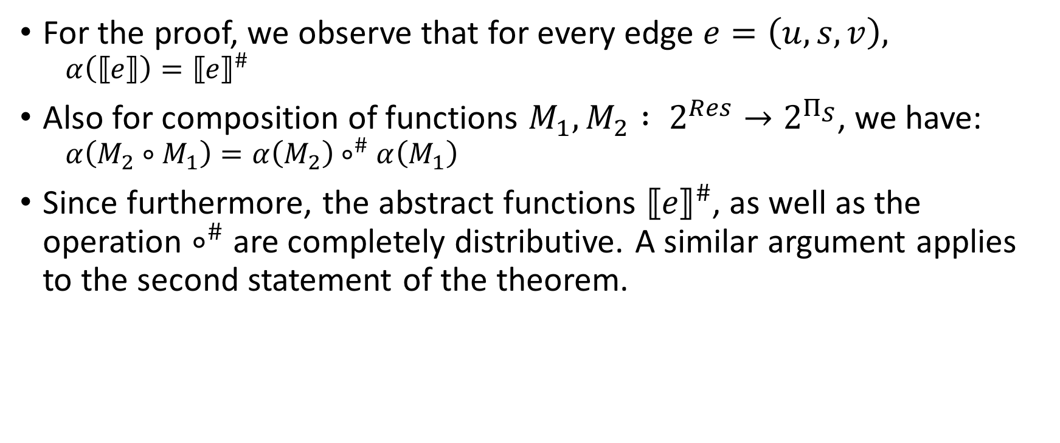
Proof
For the proof, we observe that for every edge $e=\left(u,s,v\right),$
$$α\left(⟦e⟧\right)={⟦e⟧}^{\#}$$
Also for composition of functions $M_{1},M_{2} : 2^{Res}→2^{Π_{S}}$, we have:
$$α\left(M_{2}∘M_{1}\right)=α\left(M_{2}\right)∘^{\#}α\left(M_{1}\right)$$
Since furthermore, the abstract functions ${⟦e⟧}^{\#}$, as well as the operation $∘^{\#}$ are completely distributive. A similar argument applies to the second statement of the theorem.

Slide 23
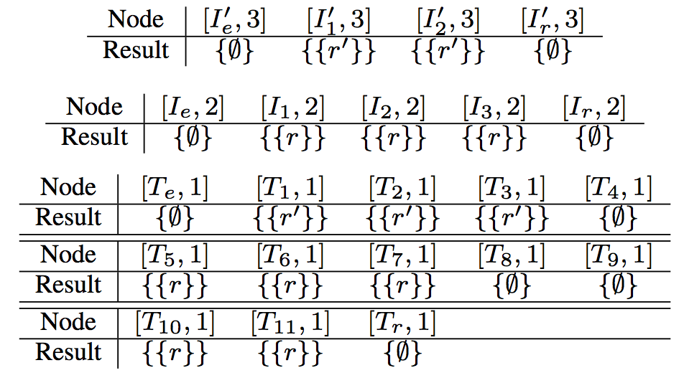
Example Programs
The example program does not use any procedures, each node is only reached with the static priority of its task.

Slide 24
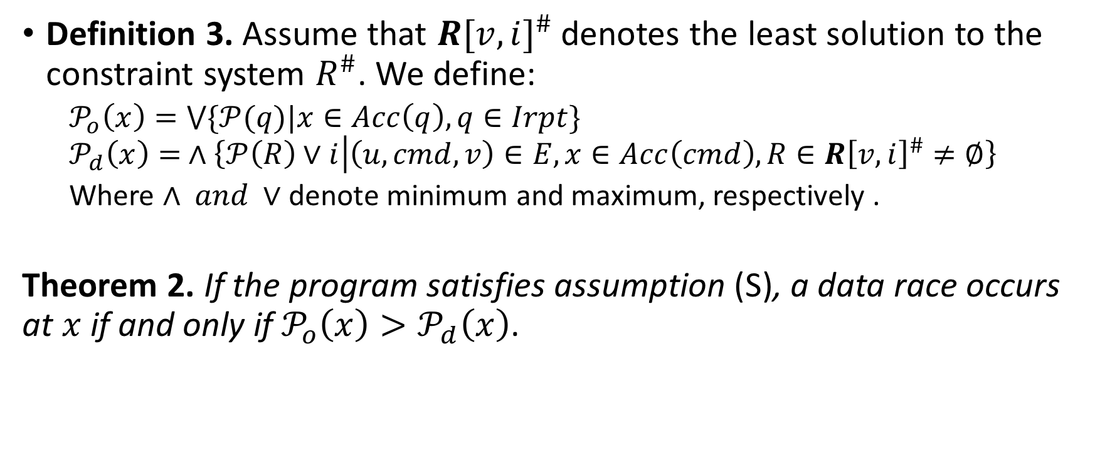
Data Races
Definition 3. Assume that $R{[v,i]}^{\#}$ denotes the least solution to the constraint system $R^{\#}$. We define:
$𝒫_{o}\left(x\right)=\bigvee{\{𝒫(q)|x∈Acc\left(q\right), q∈Irpt\}}$
$$𝒫_{d}\left(x\right)= ∧\left\{𝒫\left(R\right)∨i | \left(u,cmd,v\right)∈E,x∈Acc\left(cmd\right),R∈R{\left[v,i\right]}^{\#}≠∅\right\}$$
Where $∧ and ∨$ denote minimum and maximum, respectively .
Theorem 2. If the program satisfies assumption (S), a data race occurs at $x$ if and only if${ 𝒫}_{o}\left(x\right)>𝒫_{d}\left(x\right)$.
Notes:
One can think of a task using its dynamic priority to defend against interfering interrupts. Interrupts use their static priority to attack other tasks.

Slide 25
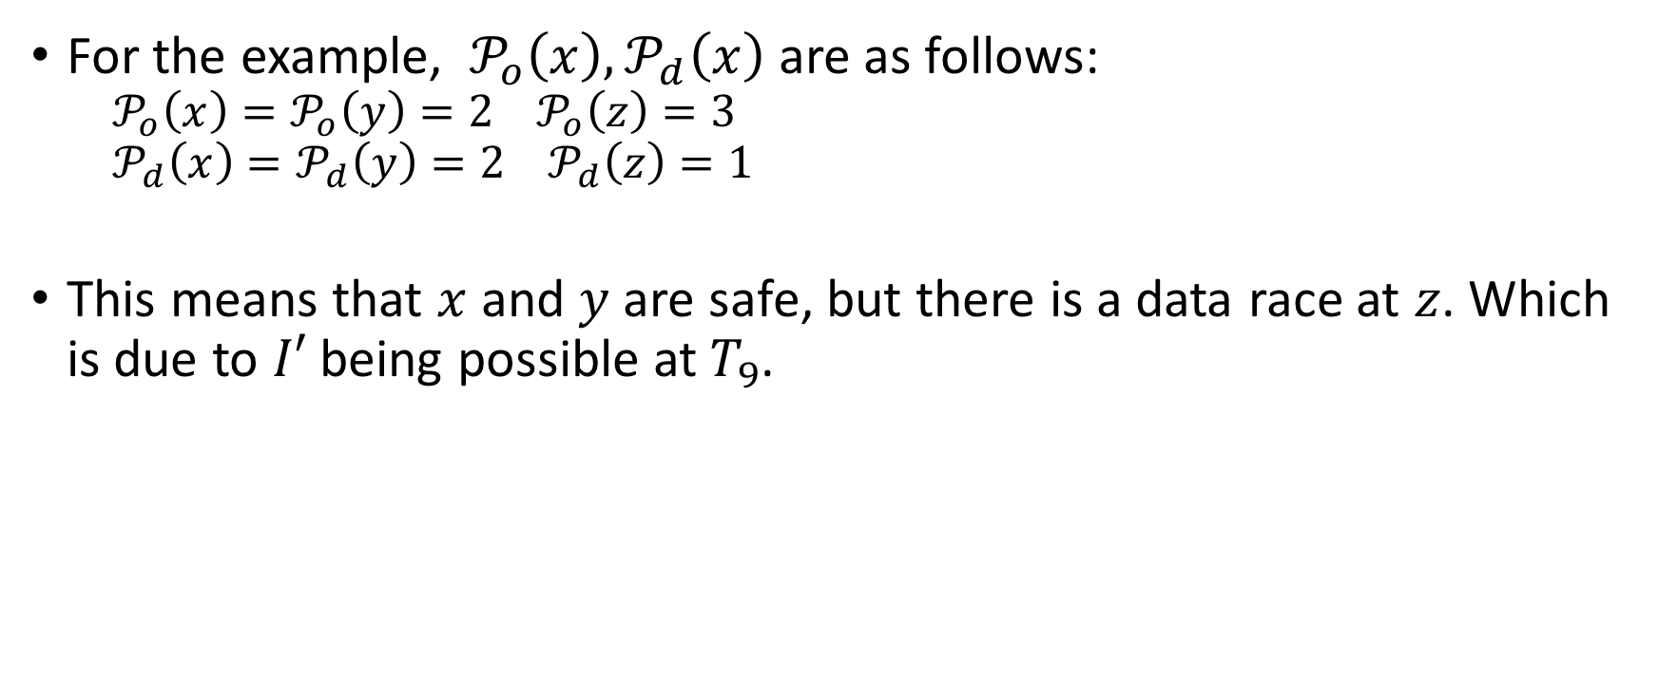
Example Program
For the example, ${ 𝒫}_{o}\left(x\right),𝒫_{d}\left(x\right)$ are as follows:
$${ 𝒫}_{o}\left(x\right)=𝒫_{o}\left(y\right)=2 𝒫_{o}\left(z\right)=3$$
$${ 𝒫}_{d}\left(x\right)=𝒫_{d}\left(y\right)=2 𝒫_{d}\left(z\right)=1$$
This means that $x$ and $y$ are safe, but there is a data race at $z$. Which is due to $I′$ being possible at$T_{9}$.

Slide 26
Analyzing Transactionality
Nontransactional behavior occurs when a fragment of a program which is meant to be executed atomically is interrupted by a task which accesses data manipulated by this fragment.
These problems are avoided if the defensive priority is sufficiently large not only for a single access, but for the whole program fragment in question.

Slide 27
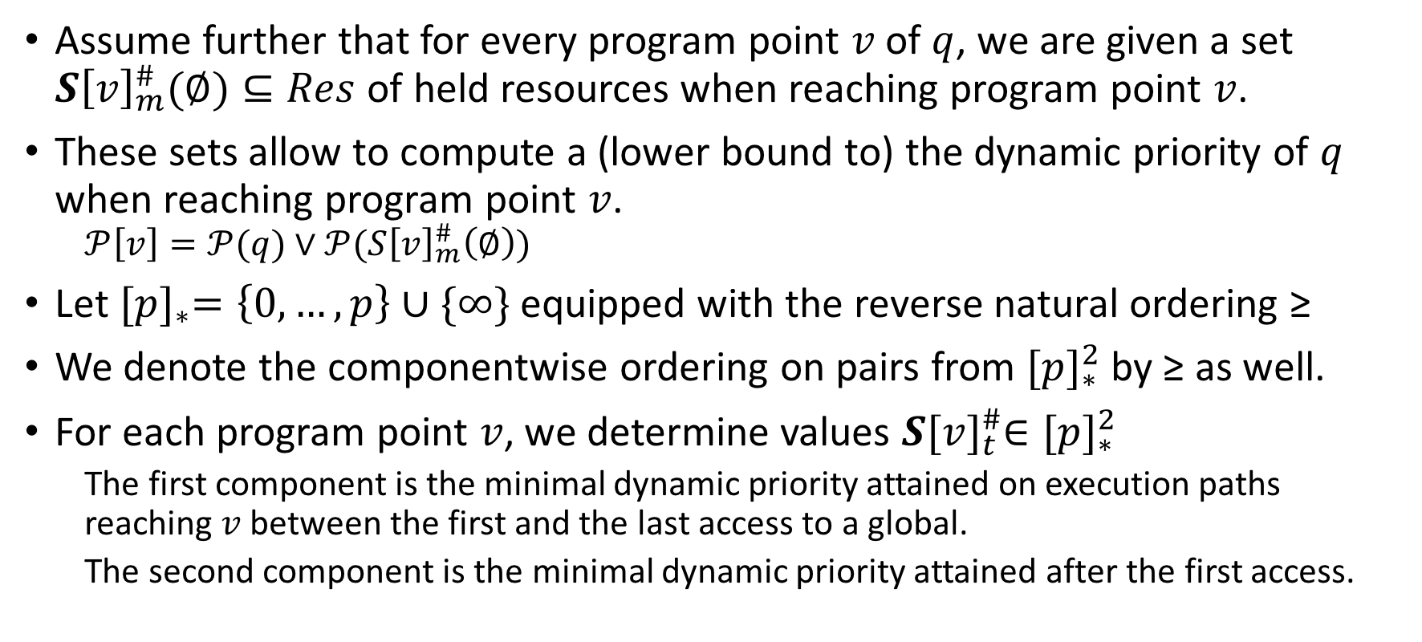
Analyzing Transactionality
Assume further that for every program point $v$ of $q$, we are given a set $S{\left[v\right]}_{m}^{\#}(∅)⊆Res$ of held resources when reaching program point $v$.
These sets allow to compute a (lower bound to) the dynamic priority of $q$ when reaching program point $v$.
$$𝒫\left[v\right]=𝒫(q)∨𝒫(S{\left[v\right]}_{m}^{\#}\left(∅\right))$$
Let ${[p]}_{∗}=\left\{0,…,p\right\}∪\{∞\}$ equipped with the reverse natural ordering ≥
We denote the componentwise ordering on pairs from ${[p]}_{∗}^{2}$ by ≥ as well.
For each program point $v$, we determine values $S{[v]}_{t}^{\#}∈{[p]}_{∗}^{2}$
The first component is the minimal dynamic priority attained on execution paths reaching $v$ between the first and the last access to a global.
The second component is the minimal dynamic priority attained after the first access.

Slide 28
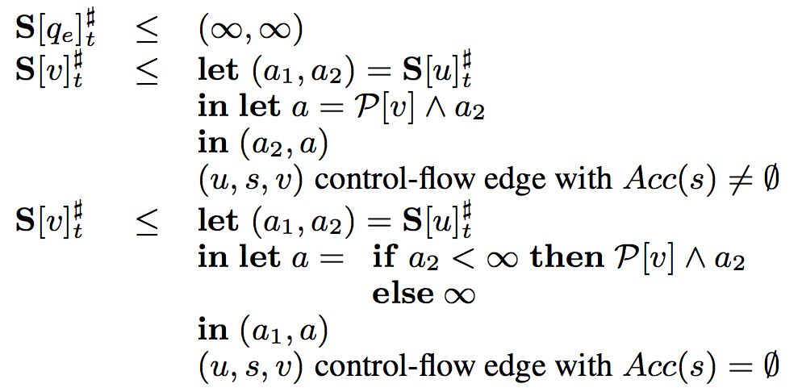

Constraint System
The pairs $S{[v]}_{t}^{\#}$ are characterized as the least solution of the constraint system:
Let ${ 𝒫}_{d}\left(q\right)$ be the first component of $S{[v]}_{t}^{\#}$. Then task $q$ is transactional, if and only if ${ 𝒫}_{d}\left(q\right)$≥ ${ 𝒫}_{o}\left(x\right)$ holds for all global $x$ accessed by $q$. Where${ 𝒫}_{o}\left(x\right)$ is the offensive priority in Definition 3.

Slide 29
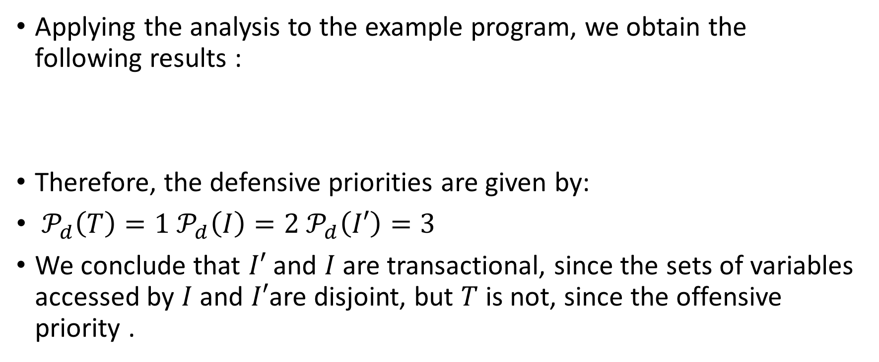
Example Program
Applying the analysis to the example program, we obtain the following results :
Therefore, the defensive priorities are given by:
${ 𝒫}_{d}\left(T\right)=1{ 𝒫}_{d}\left(I\right)=2{ 𝒫}_{d}\left(I′\right)=3$
We conclude that $I′$ and $I$ are transactional, since the sets of variables accessed by $I$ and $I′$are disjoint, but $T$ is not, since the offensive priority .

Slide 30
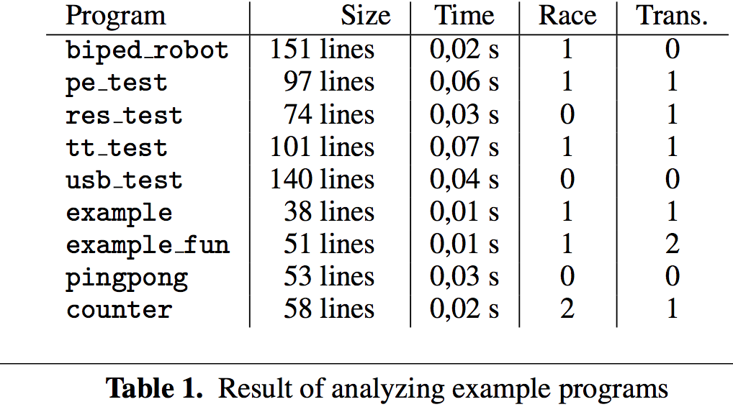
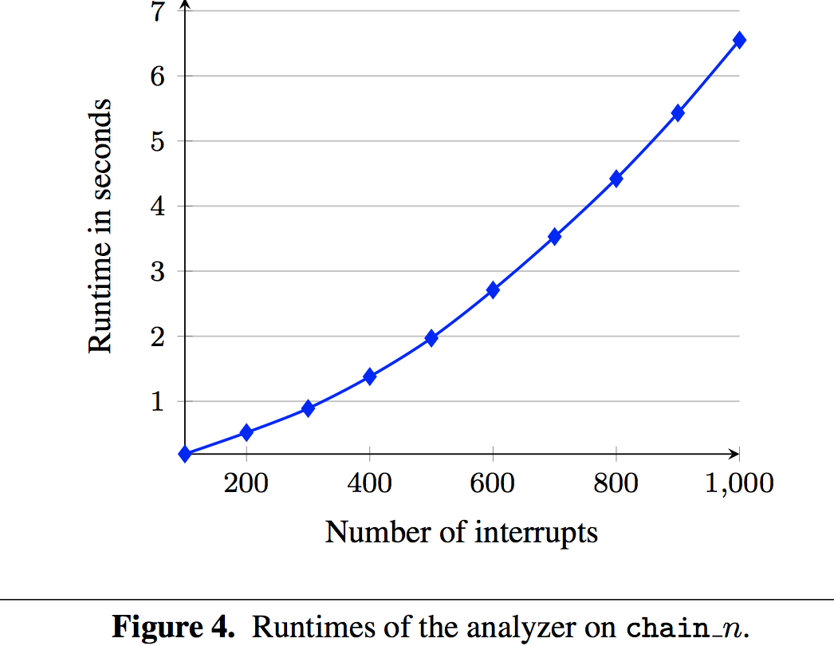
Implementation
The data race and transactionality analyses have been implemented in the analyzer Goblint for multi-threaded C.

