Slide 1
Modular Verification of Interrupt-Driven Software
ASE 2017
Chao Wang.et.al

Slide 2
Introduction
Interrupt-Driven Software
share many similarities with threads
interrupts often have various levels of priority
IntAbs ：an iterative abstract interpretation framework for interrupt-driven software

Slide 3
Contributions
A new abstract interpretation framework for interrupt-driven programs.
A method for infeasible data flows between interrupts.
The implementation on a large number of benchmark programs.

Slide 4
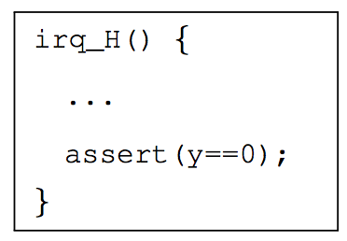
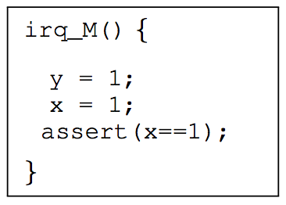
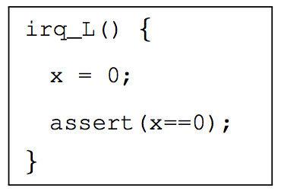
EXAMPLE
An example program with three interrupt handlers(x,y are set to 0 initially)

Slide 5
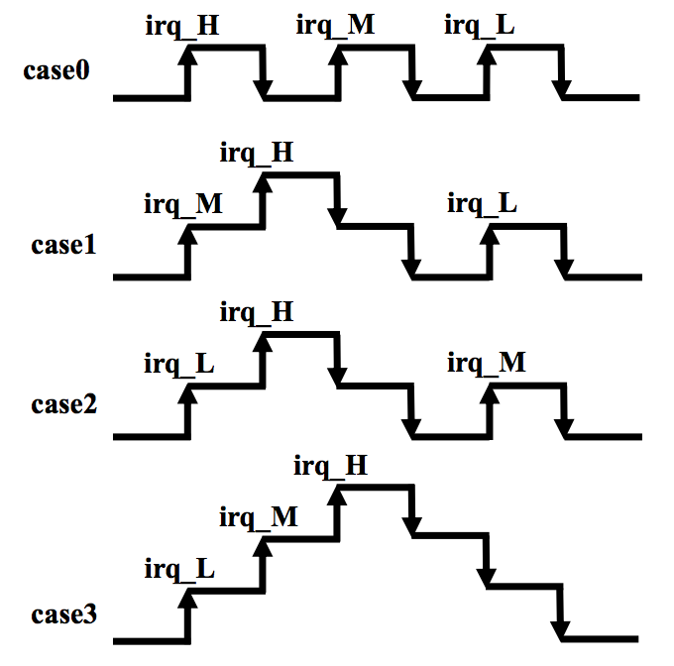
EXAMPLE POSSIBLE SEQUENCES
An example program with three interrupt handlers(x,y are set to 0 initially)

Slide 6
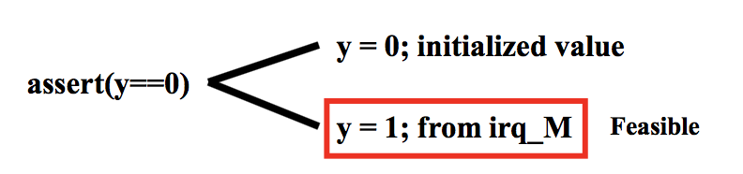
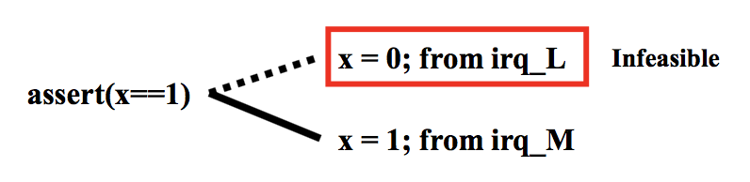
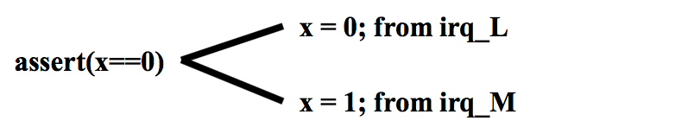
EXAMPLE FEASIBILITY
An example program with three interrupt handlers(x,y are set to 0 initially)

Slide 7
Abstract Interpretation
Abstract Interpretation for threads are over-approximated analysis
when they prove an assertion holds, the assertion indeed holds
when they cannot prove an assertion, the result is inconclusive

Slide 8
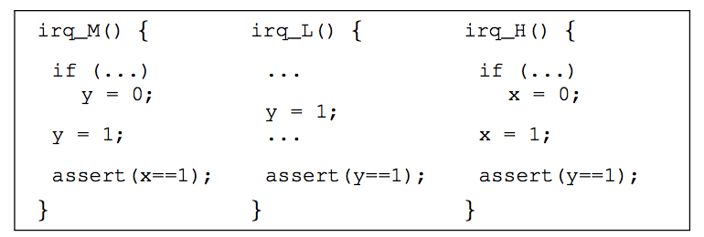
Abstract Interpretation
Abstract Interpretation for threads are over-approximated analysis
when they prove an assertion holds, the assertion indeed holds
when they cannot prove an assertion, the result is inconclusive
CASE

Slide 9
Abstract Interpretation
Abstract Interpretation for threads are over-approximated analysis
when they prove an assertion holds, the assertion indeed holds
when they cannot prove an assertion, the result is inconclusive
CASE (AI for threads)

Slide 10
Abstract Interpretation
Abstract Interpretation for threads are over-approximated analysis
when they prove an assertion holds, the assertion indeed holds
when they cannot prove an assertion, the result is inconclusive
CASE (AI for interrupts)

Slide 11
Preliminary
Theorem 1: Since the interleaving behavior of interrupts is a subset of the interleaving behavior of threads, proofs obtained by any sound abstract interpretation over threads remain valid for interrupts.
(the reverse is not true.)

Slide 12
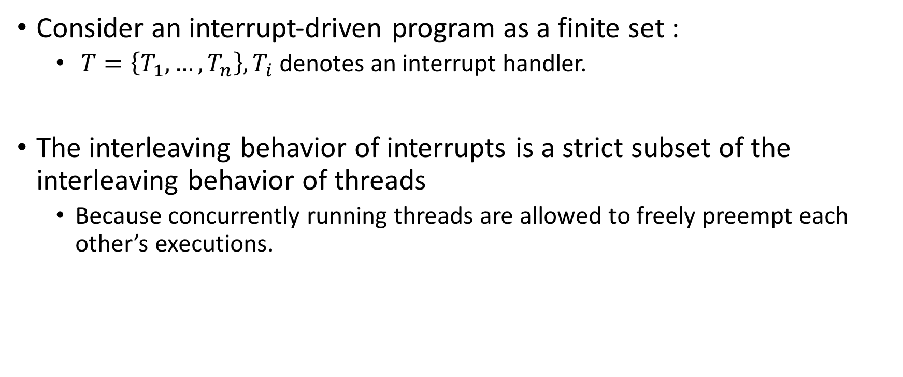
Preliminary
Consider an interrupt-driven program as a finite set :
$T=\left\{T_{1},…,T_{n}\right\}, T_{i}$denotes an interrupt handler.
The interleaving behavior of interrupts is a strict subset of the interleaving behavior of threads
Because concurrently running threads are allowed to freely preempt each other’s executions.
Notes:
Theorem1 的证明

Slide 13
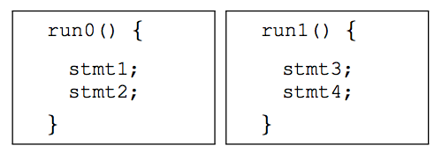
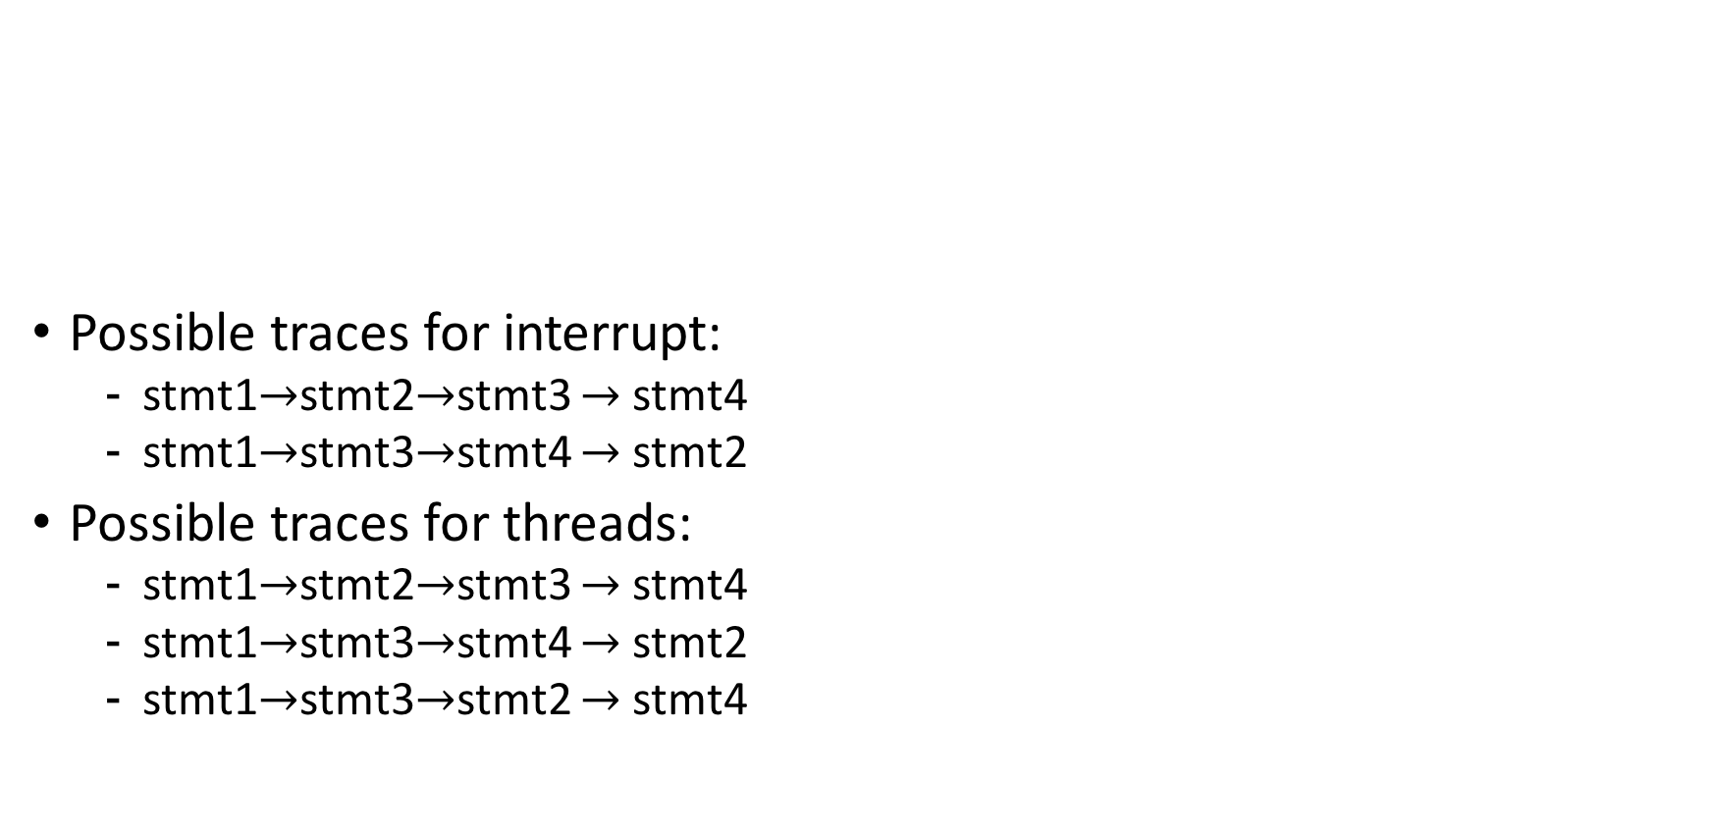
Case
Possible traces for interrupt:
stmt1$→$stmt2$→$stmt3 $→$stmt4
stmt1$→$stmt3$→$stmt4 $→$stmt2
Possible traces for threads:
stmt1$→$stmt2$→$stmt3 $→$stmt4
stmt1$→$stmt3$→$stmt4 $→$stmt2
stmt1$→$stmt3$→$stmt2 $→$stmt4

Slide 14
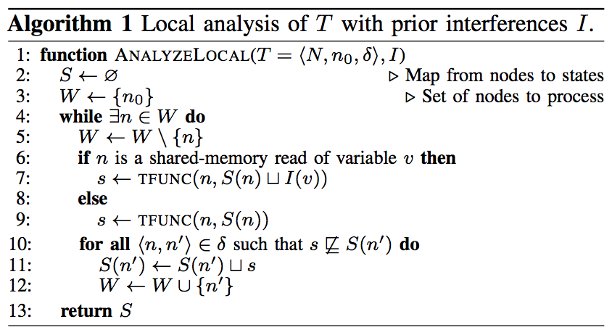
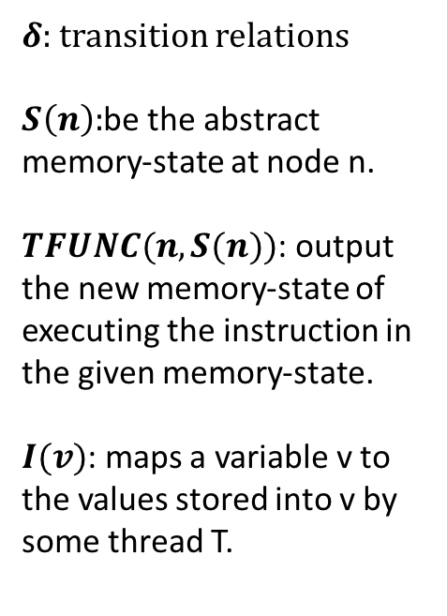
Abstract Interpretation for Threads
$δ$: transition relations
$S\left(n\right):$be the abstract memory-state at node n.
$TFUNC(n,S(n))$: output the new memory-state of executing the instruction in the given memory-state.
$I(v)$: maps a variable v to the values stored into v by some thread T.
Notes:
宽度有限搜索
集合S表示节点n的语句执行前的变量取值

Slide 15
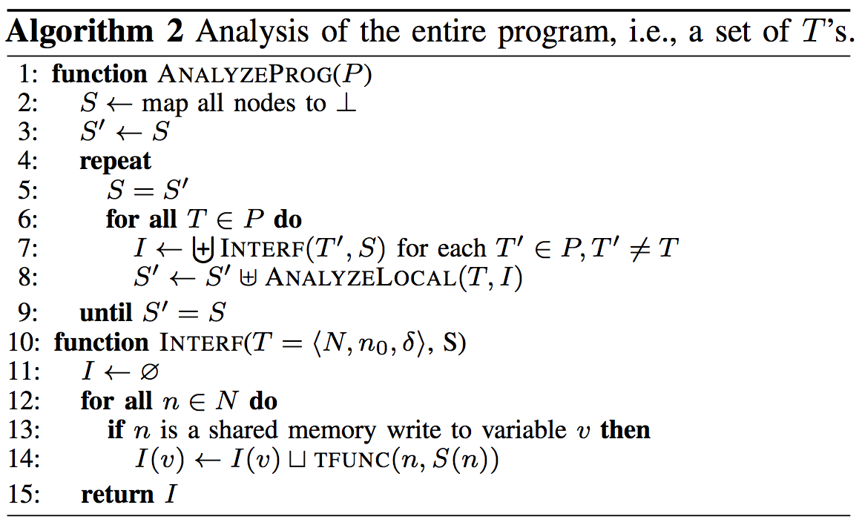
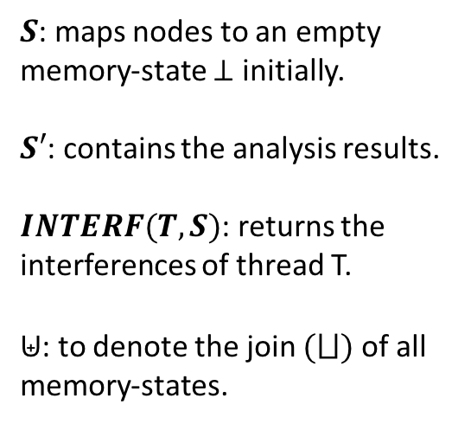
Abstract Interpretation for Threads
$S$: maps nodes to an empty memory-state $⊥$ initially.
$S′$: contains the analysis results.
$INTERF(T,S)$: returns the interferences of thread T.
$⊎$: to denote the join $(⨆)$ of all memory-states.
Notes:
迭代计算集合S

Slide 16
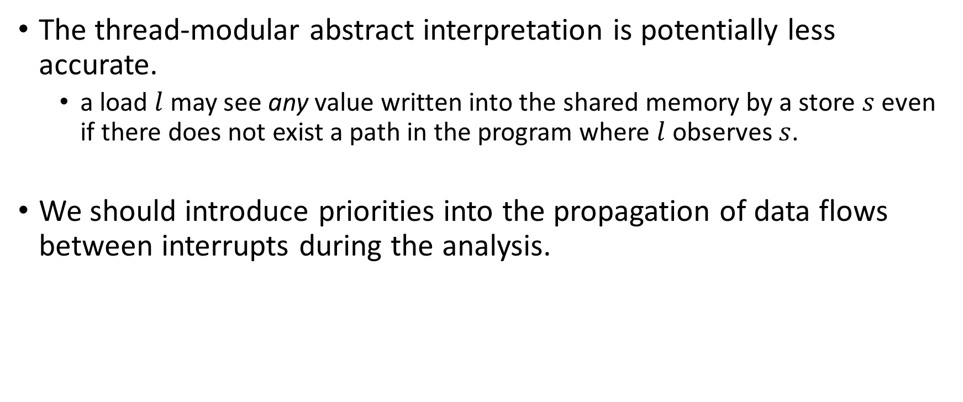
Abstract Interpretation for Threads
The thread-modular abstract interpretation is potentially less accurate.
a load $l$ may see any value written into the shared memory by a store $s$ even if there does not exist a path in the program where $l$ observes $s$.
We should introduce priorities into the propagation of data flows between interrupts during the analysis.
Notes:
引入中断优先级进行分析

Slide 17
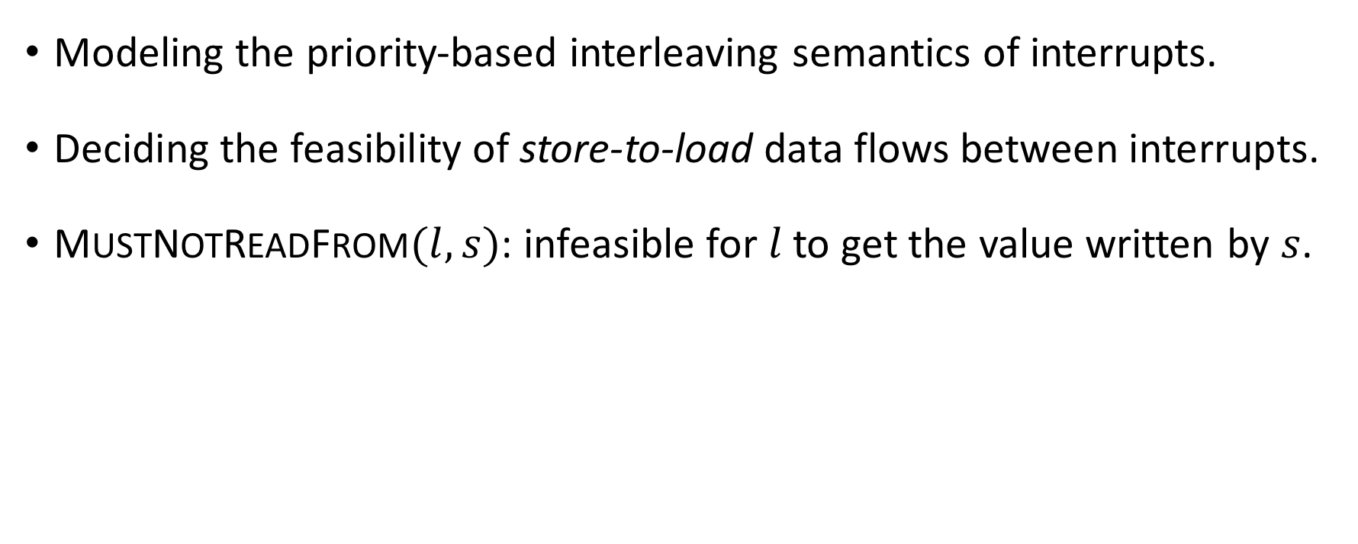
FEASIBILITY OF DATA FLOWS BETWEEN INTERRUPTS
Modeling the priority-based interleaving semantics of interrupts.
Deciding the feasibility of store-to-load data flows between interrupts.
MUSTNOTREADFROM$(l,s)$: infeasible for $l$ to get the value written by $s$.
Notes:
通过中断优先级别计算MUSTNOTREADFROM判断feasibility

Slide 18
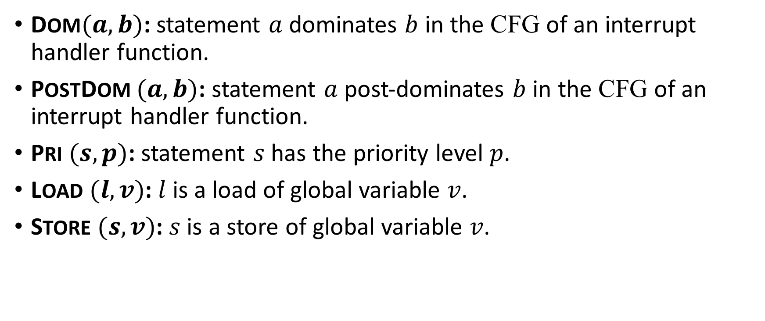
Relations
DOM$(a,b)$: statement $a$ dominates $b$ in the CFG of an interrupt handler function.
POSTDOM $(a,b)$: statement $a$ post-dominates $b$ in the CFG of an interrupt handler function.
PRI $(s,p)$: statement $s$ has the priority level $p$.
LOAD $(l,v)$: $l$ is a load of global variable $v$.
STORE $(s,v)$: $s$ is a store of global variable $v$.
irq0{
x = 0;
x = 1;
assert (x==1);
}
Notes:
Dominate:指定

Slide 19
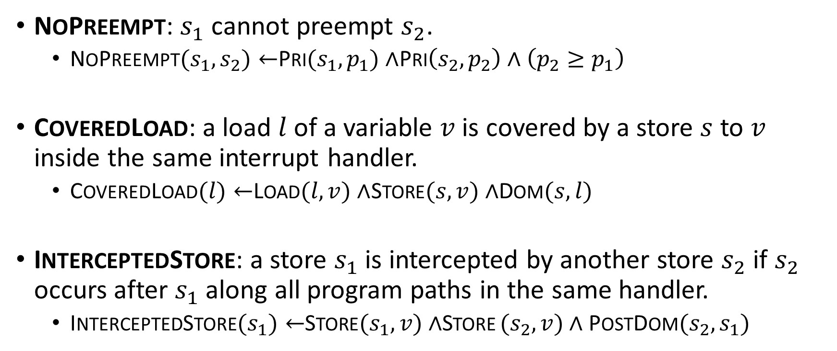




Three new relations
NOPREEMPT: $s_{1}$ cannot preempt $s_{2}$.
NOPREEMPT$(s_{1},s_{2})←$PRI$(s_{1},p_{1})∧$PRI$\left(s_{2},p_{2}\right)∧\left(p_{2}≥p_{1}\right)$
COVEREDLOAD: a load $l$ of a variable $v$ is covered by a store $s$ to $v$ inside the same interrupt handler.
COVEREDLOAD$(l)←$LOAD$(l,v)∧$STORE$(s,v)∧$DOM$(s,l)$
INTERCEPTEDSTORE: a store $s_{1}$ is intercepted by another store $s_{2}$ if $s_{2}$ occurs after $s_{1}$ along all program paths in the same handler.
INTERCEPTEDSTORE$(s_{1})←$STORE$(s_{1},v)∧$STORE $(s_{2},v)∧$POSTDOM$(s_{2},s_{1})$
$$s_{ }$$
$$l$$
$$s_{1}$$
$$s_{2}$$
Notes:
COVEREDLOAD(l)：l在同一中断之前存在赋值
INTERCEPTEDSTORE(s)：s在同一中断之后存在其他赋值

Slide 20
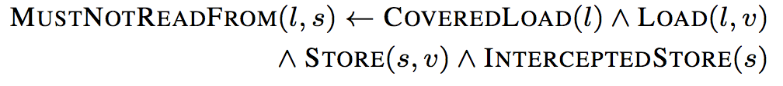
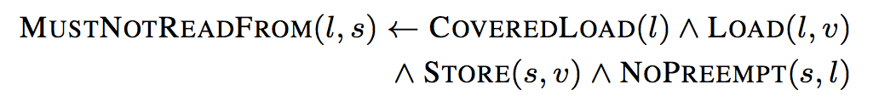
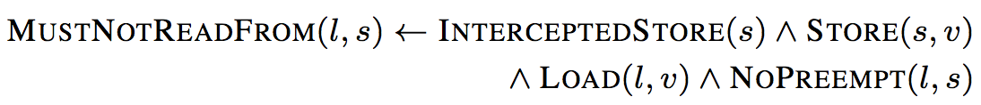









MUSTNOTREADFROM rules
$$s_{ }$$
$$s_{1}$$
$$l$$
$$s_{1}$$
$$s_{ }$$
$$l$$
$$s_{ }$$
$$l$$
$$s_{1}$$

Slide 21
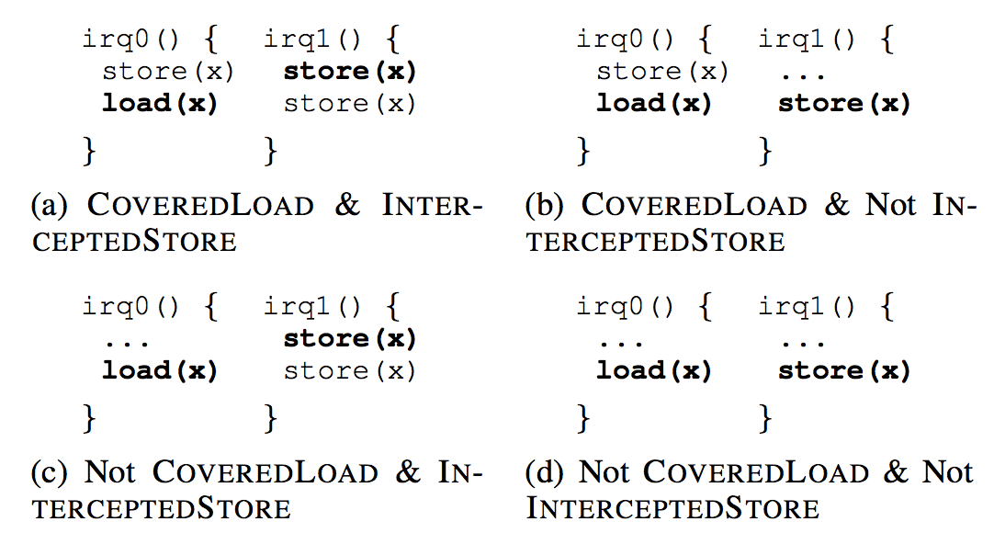
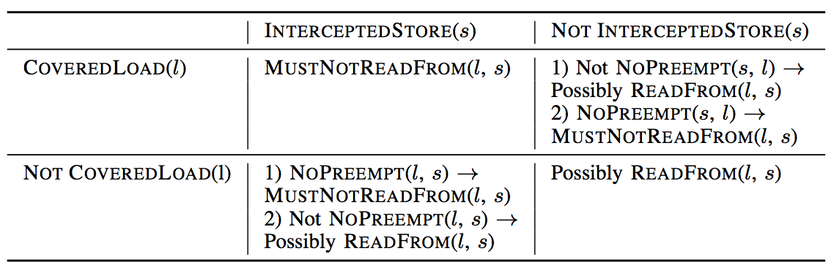
Running Examples

Slide 22
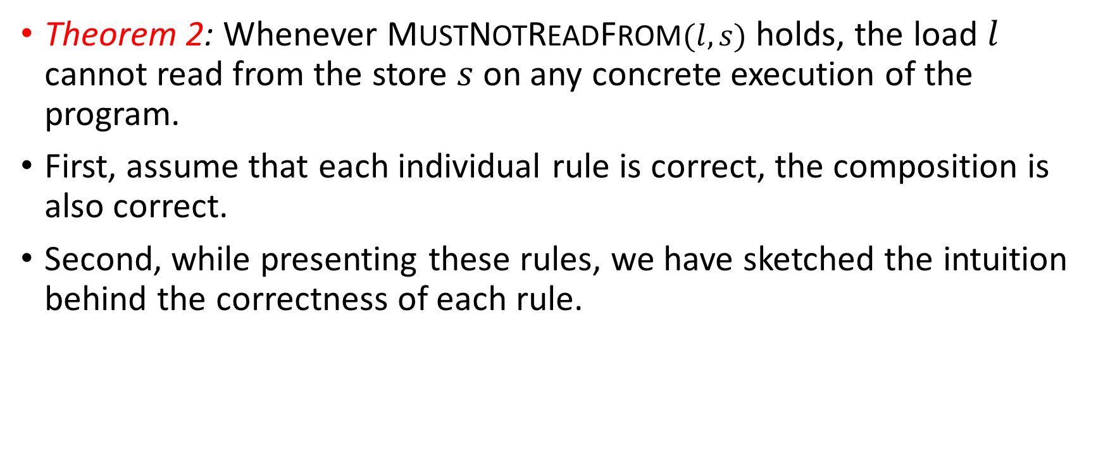
Soundness of the Analysis
Theorem 2: Whenever MUSTNOTREADFROM$(l,s)$ holds, the load $l$ cannot read from the store $s$ on any concrete execution of the program.
First, assume that each individual rule is correct, the composition is also correct.
Second, while presenting these rules, we have sketched the intuition behind the correctness of each rule.
Notes:
证明Theorem2

Slide 23
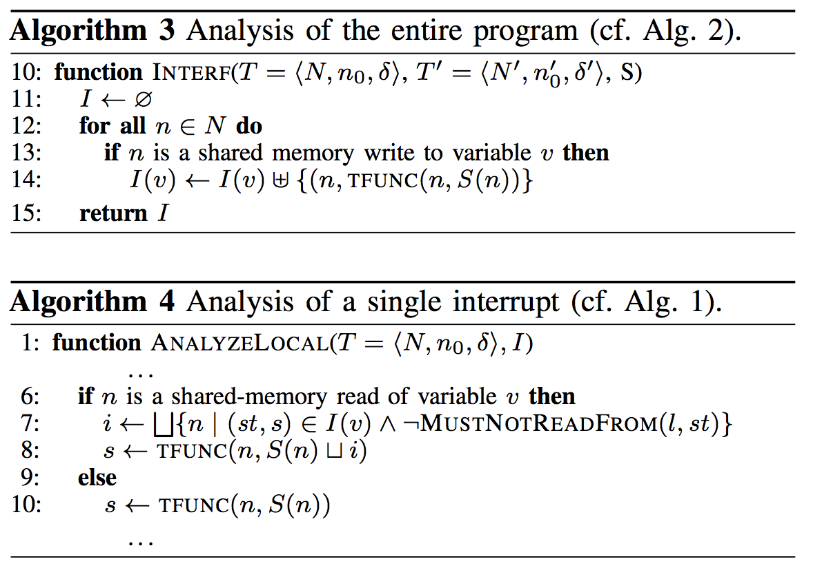
ANALYSIS PROCEDURE

Slide 24
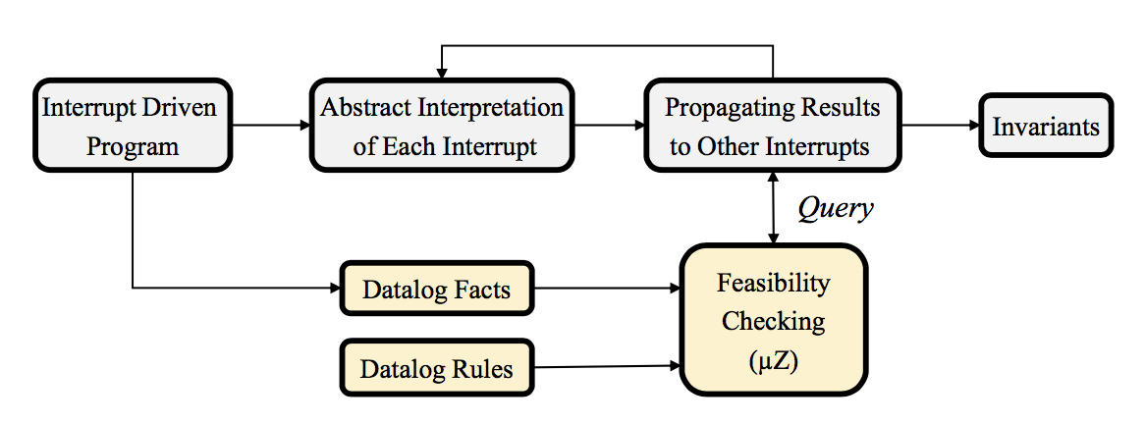
IntAbs
Framework：
Feasibility
Notes:
IntAbs：AI for Interrupt；Feasibility checking 可行性研究

Slide 25
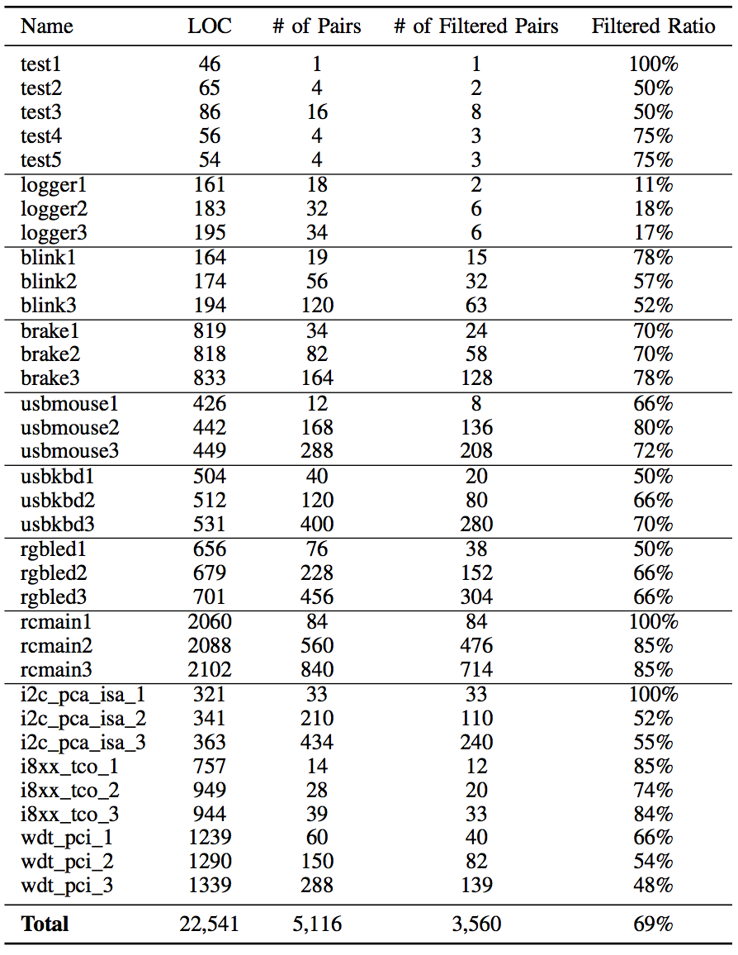
Experiment
Evaluated IntAbs on 35 interrupt-driven applications with a total of 22,541 lines of C code.
LOC: lines of code.
Pairs: store-load pairs.
Notes:
实验部分，Filtered Pairs 判定为infeasible的pairs

Slide 26
CONCLUSION
An abstract interpretation framework for static verification of interrupt-driven software.
analyzes each individual handler function in isolation and propagates the results to other handler functions
developed a constraint-based analysis of the scheduling semantics of interrupts with priorities

