Slide 1
Infinite-state Invariant Checking with IC3 and Predicate Abstraction （IC3 Modulo Theories via Implicit Predicate Abstraction）
2020.07.30
杨柳

Slide 2
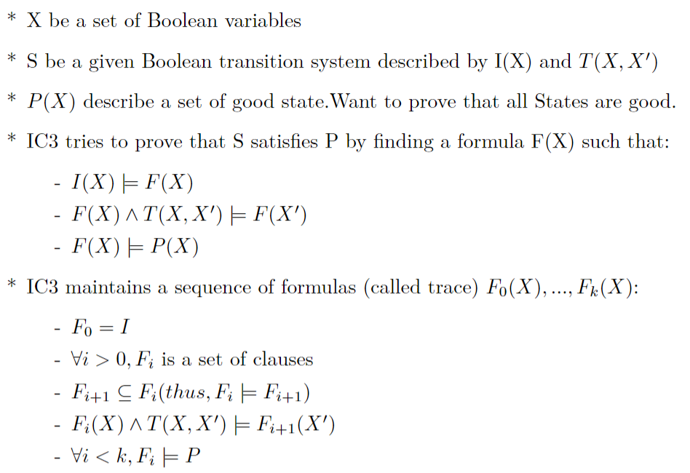
IC3

Slide 3
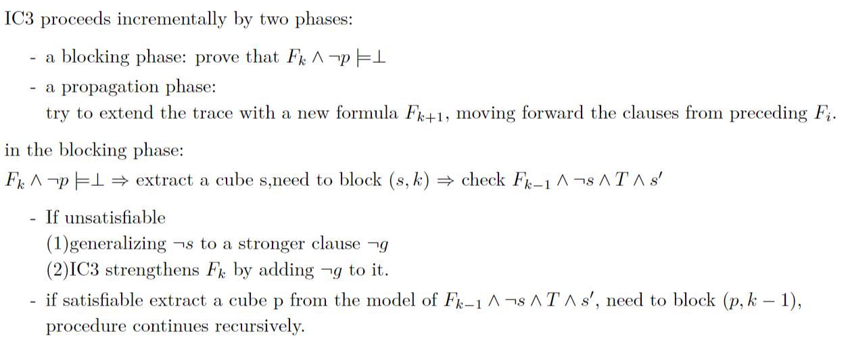
IC3

Slide 4
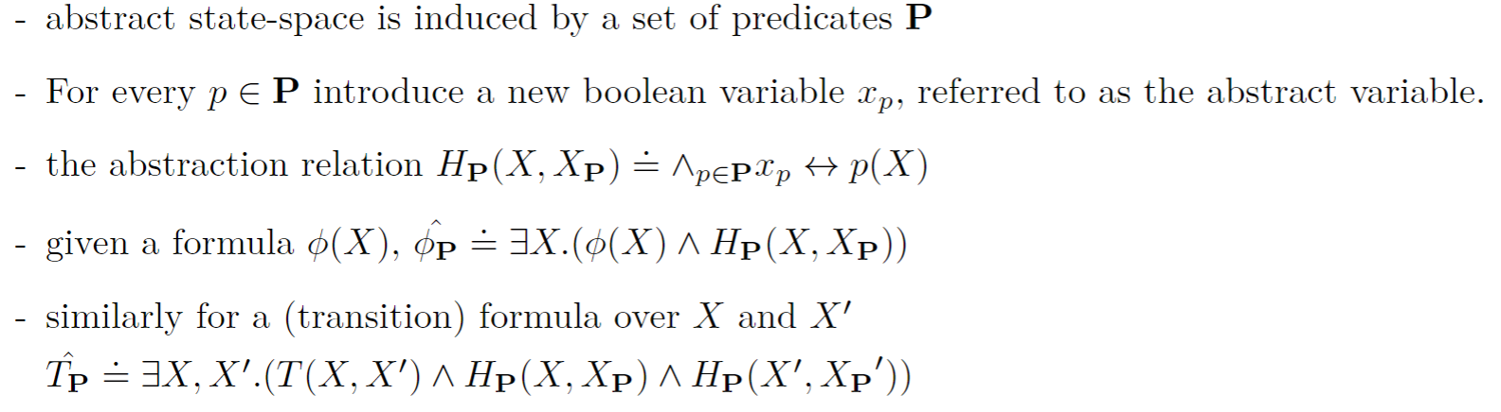
Predicate abstraction

Slide 5
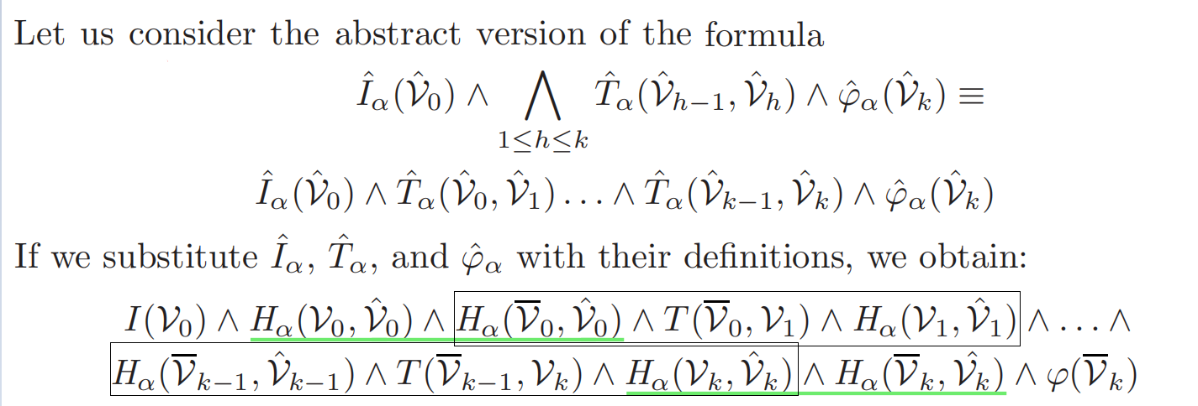
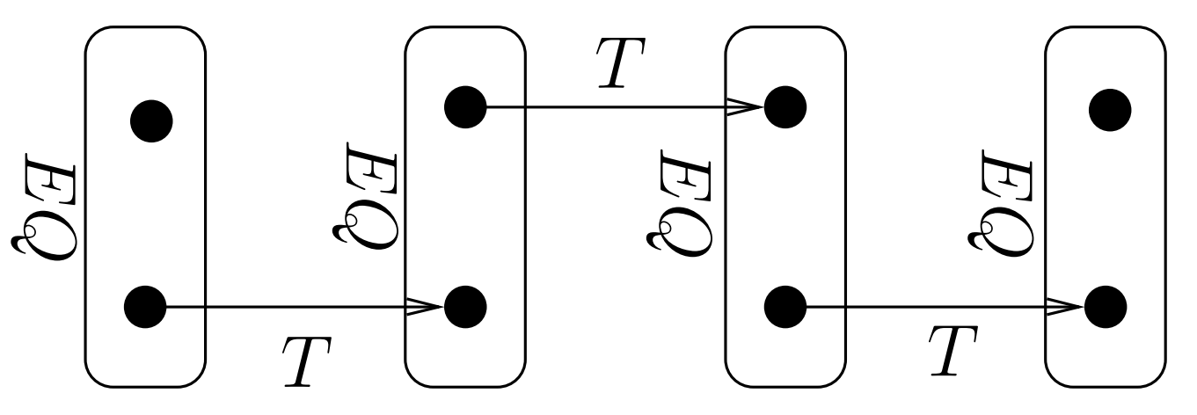
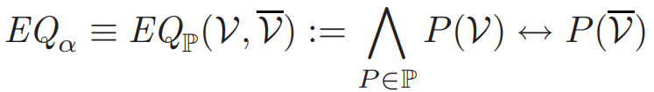
Implicit abstraction

Slide 6
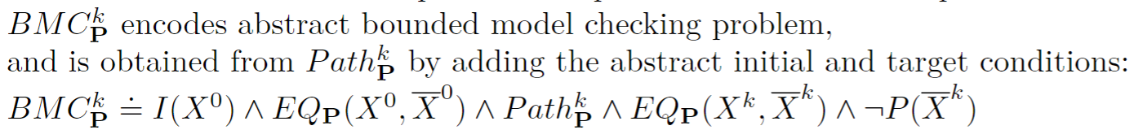
Implicit predicate abstraction

Slide 7
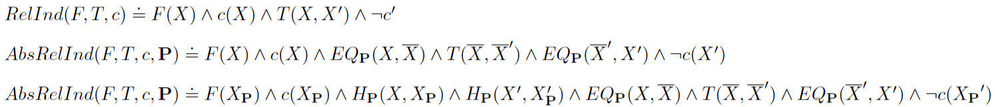
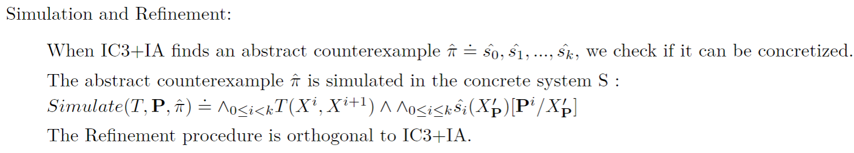
IC3 with Implicit Abstraction

Slide 8
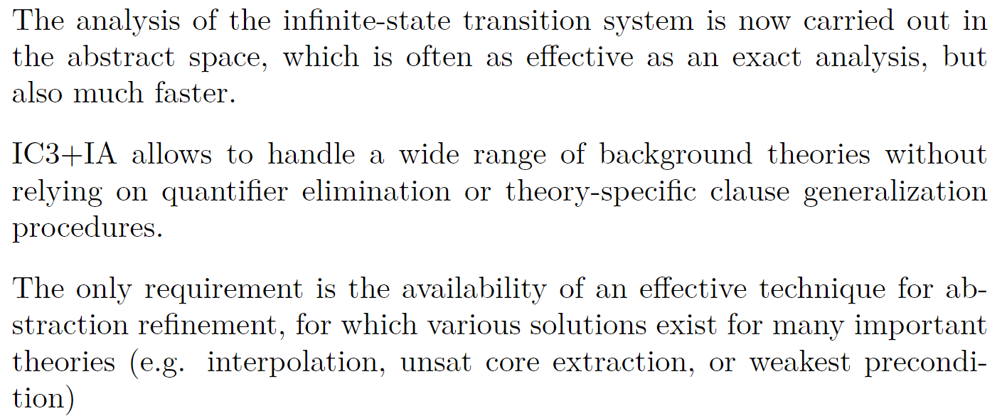
Conclusion

