Slide 1

AI Based Smart Appliance Power Consumption Analyzer
Department of Electrical engineering
Supervisor Name : Assistant Professor Kiran Khurshid
Co supervisor Name : Engineer Abdul Rehman
External Mentor: Imran Ul Haq Qureshi (EmbeddIn)
Group Members :
1. Farhan Tariq UET-21
2. Asim Siddique UET-48
3. Huzefa Ali UET-72

Slide 2
Contents
Problem statement
Type of project
Literature Review
Block diagram
Tentative Time line
FYP Objective
FYP Outcome
Q &A

Slide 3
Problem Statement
Problem statement Type of project Literature Review Block diagram Tentative Time line FYP Objective FYP Outcome Additional requirements Q &A
The existing utility system only provides feedback at the end of the month in the form of a bill and consumed kilowatt hours (kWh).
With this Analyser, the consumer can better manage its appliances to lower the cost per month and track their power usage on more immediate basis.

Slide 4
Analysis of the Project
HEMS is a great concept but it does not provide us with current sensing feature.
We will bill our appliances which will provide us with monthly usage data.
Appliances utilizing more power than necessary can be detected.
Smart power control feature introduced by using Raspberry Pi 3.
Manually also operate-able using mobile application.

Slide 5
Strategy to complete the Project
First we will need to design current sensing device. Which will contain sensors, Microcontroller and additional electronic components.
We will need to convert our data from Analog to Digital signal using Analog to Digital converter.
After conversion we need to filter our signal and save our data in data logger.
Now we will need a smartphone from which we can control our appliances through app manually.(This app will be developed)
Whenever a certain current level is reached our appliances will turn off by Raspberry Pi.

Slide 6
We will be using Raspberry Pi 3.
Raspberry Pi 3 along with relays will control our appliances.
Sensors being used in detection of appliances activities which output its data to Raspberry Pi 3 are:
PIR Sensor (HC-SR501)
Temperature Sensor
Current Sensor

Slide 7
Modern Tools
The softwares that we are using to design the software part and the interfacing of the hardware part are:
Proteus (to design all the required circuits).
Arduino IDE (to compile the program and remove errors from the code and burn code to the Arduino).
Keil uvision (to write and burn the program for microcontroller).
Matlab (for graphs if required).

Slide 8
Type of project
Problem statement Type of project Literature Review Block diagram Tentative Time line FYP Objective FYP Outcome Additional requirements Q &A
Implementation type project
A narrow margin for research after implementation
60% hardware
35% software
5% paper

Slide 9
Literature Review
Problem statement Type of project Literature Review Block diagram Tentative Time line FYP Objective FYP Outcome Additional requirements Q &A
Bin Zhou, Wentao Li, Ka Wing Chan, Yijia Cao, Yonghong Kuang, Xi Liu, Xiong Wang, “Smart Home Energy Management Systems: Concept, Configurations, and Scheduling Strategies“ , Renewable and Sustainable Energy Reviews, vol. 61, pg 30-40, March 2016.
C. Metoo, S. Bahadoorsingh, C. Sharma, “Wireless Residential Power Monitoring System” 2017 IEEE Conference, Manchester, July 2017

Slide 10

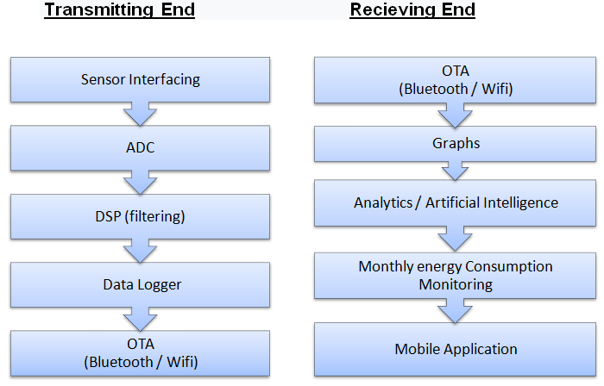
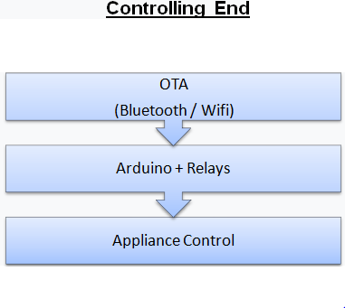
Block diagram
Problem statement Type of project Literature Review Block diagram Tentative Time line FYP Objective FYP Outcome Additional requirements Q &A

Slide 11
Tentative Time line
Problem statement Type of project Literature Review Block diagram Tentative Time line FYP Objective FYP Outcome Additional requirements Q &A
2019
Sep
Oct
Nov
Dec
2019
Feb
Mar
Apr
May
Jun
2020
Proposal defence
Sep 11 – Oct 7
Thesis literature review
Oct 8 - Nov 6
device Evaluation
Hardware Testing /Designing
Nov 10 - Feb 8
Hardware /Software integeration
Feb 26 - Apr 1
Final presentation
Apr 2 - May 25.
Thesis

Slide 12
FYP Objective
Problem statement Type of project Literature Review Block diagram Tentative Time line FYP Objective FYP Outcome Additional requirements Q &A
Following are Phases / Milestones for the Project:
Current sensing (sensor interfacing)
Use of DSP (ADC + filtering)
Artificial Intelligence
Analytics of the data collected (mobile app)

Slide 13
FYP Deliverables
Problem statement Type of project Literature Review Block diagram Tentative Time line FYP Objective FYP Outcome Additional requirements Q &A
AI Based Real-time power consumption monitoring algos
Real-time plots and graphs
Keep track of monthly power consumtion
Mobile app
Working Prototype (portable monitoring device)
Appliance control

Slide 14
Q & A
Problem statement Type of project Division of project Literature Review Block diagram Tentative Time line FYP Objective FYP Outcome Additional requirements Q &A

Slide 15


