Slide 1

AI Based Smart Appliance Power Consumption Analyzer
Department of Electrical Engineering
Supervisor Name: Assistant Professor Kiran Khurshid
Co-Supervisor Name: Engineer Abdul Rehman
External Mentor: Imran Ul Haq Qureshi (EmbeddIn)
Group Members :
1. Farhan Tariq UET-21
2. Asim Siddique UET-48
3. Huzefa Ali UET-72

Slide 2
Contents
Problem statement
Block diagram
Simulation work
Simulation Results
Q &A

Slide 3
Problem Statement
The existing utility system only provides feedback at the end of the month in the form of a bill and consumed kilowatt hours (kWh).
With this Analyser, the consumer can better manage its appliances to lower the cost per month and track their power usage on more immediate basis.

Slide 4

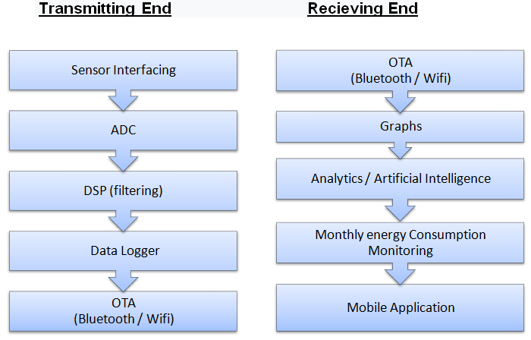
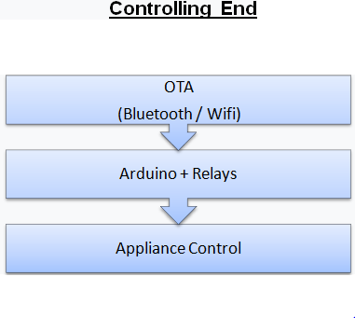
Block Diagram

Slide 5
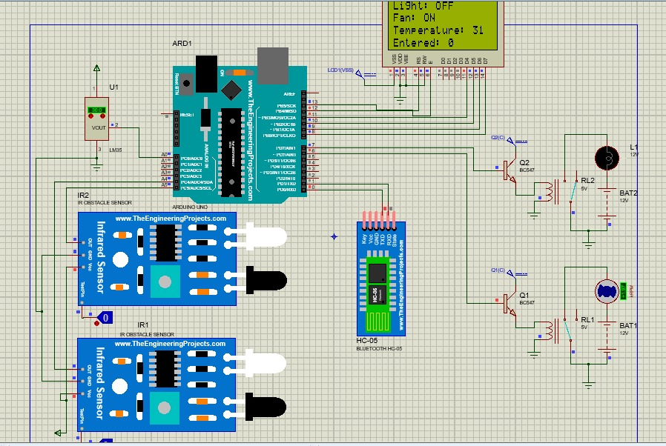
Simulation Work

Slide 6
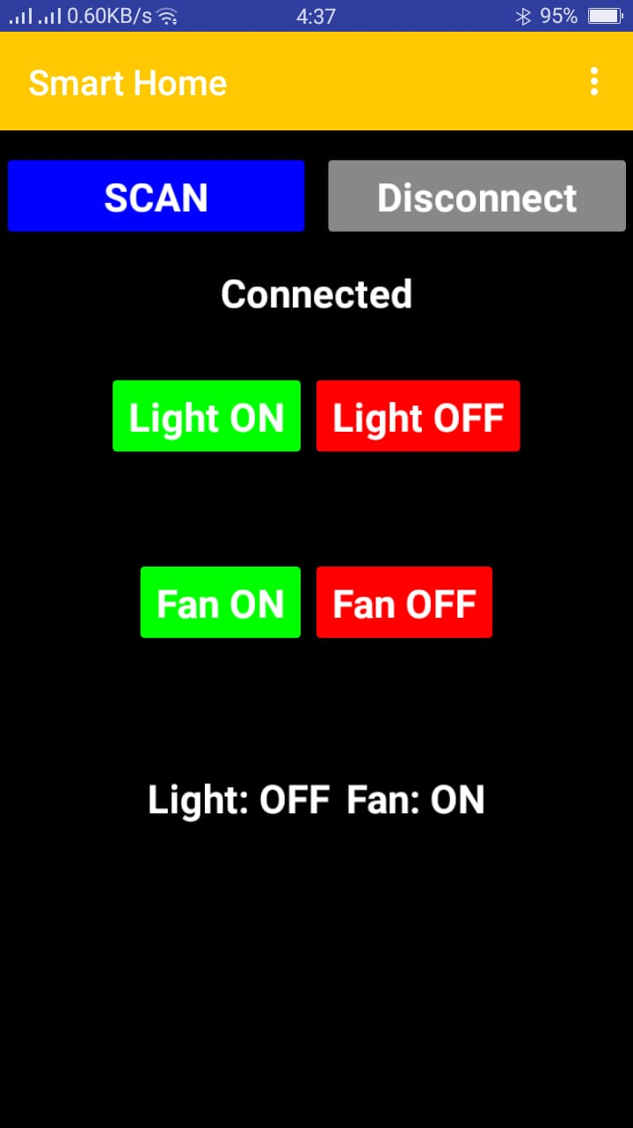
Simulation Work

Slide 7
Simulation Results
We have completed simulation of switching circuit and mobile app of our project.
Which makes up-to 60% of simulation overall.
40% for switching circuit and 20% for application.

Slide 8
Q & A

Slide 9


