Slide 1

Title of FYP
APCOMS Insignia
Department of Electrical engineering
Supervisor Name
Co supervisor Name
Group Members
1…………………………………….
2……………………………………..
3………………………………………

Slide 2
Contents
Problem statement
Type of project
Literature Review
Block diagram
Tentative Time line
FYP Objective
FYP Outcome
Additional requirements
Q &A

Slide 3
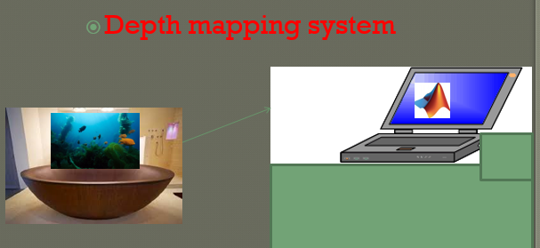
Grid based depth mapping system
Problem statement Type of project Literature Review Block diagram Tentative Time line FYP Objective FYP Outcome Additional requirements Q &A
Bathymetry is depth mapping of water body
It is used in mineral exploration, surveillance, defense etc

Slide 4
Type of project
Problem statement Type of project Literature Review Block diagram Tentative Time line FYP Objective FYP Outcome Additional requirements Q &A
Implementation type project
A narrow margin for research after implementation
60% hardware
35% software
5% paper

Slide 5
Literature Review
Problem statement Type of project Literature Review Block diagram Tentative Time line FYP Objective FYP Outcome Additional requirements Q &A
A new bathymetry model for the Baltic Sea
by B Hell, H Öiås - The International Hydrographic Review, 2015
Arctic Ocean Bathymetry: A Necessary Geospatial Framework
By M Jakobsson, L Mayer, D Monahan - ARCTIC, 2015

Slide 6
Block diagram
Problem statement Type of project Literature Review Block diagram Tentative Time line FYP Objective FYP Outcome Additional requirements Q &A
Sensor read the depth
Transmit over the usb/serial
U-controller process the data
Transmit over the usb/serial
Time series output
Matlab plot the data

Slide 7
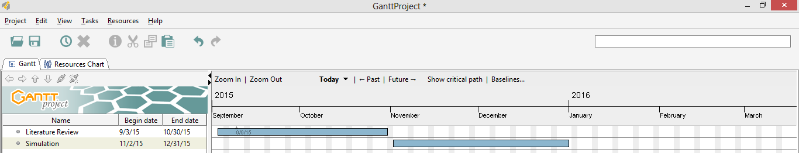
Tentative Time line
Problem statement Type of project Literature Review Block diagram Tentative Time line FYP Objective FYP Outcome Additional requirements Q &A

Slide 8
FYP Objective
Problem statement Type of project Literature Review Block diagram Tentative Time line FYP Objective FYP Outcome Additional requirements Q &A
Bathymetry study
Grid based time series plot

Slide 9
FYP Deliverables
Problem statement Type of project Literature Review Block diagram Tentative Time line FYP Objective FYP Outcome Additional requirements Q &A
Time Series Matlab Plot
Communication hardware module
Aquarium with acoustic grid
time series plot of a fish tank for a minute duration
It will demonstrate the real depth of tank bottom in presence of fish

Slide 10
Additional requirements
Problem statement Type of project Division of project Literature Review Block diagram Tentative Time line FYP Objective FYP Outcome Additional requirements Q &A

Slide 11
Q & A
Problem statement Type of project Division of project Literature Review Block diagram Tentative Time line FYP Objective FYP Outcome Additional requirements Q &A

