Slide 1
STEP INTO ARTIFICIALINTELLIGENCE
Snake Gaming
Yifan Qiu
ID:21012688

Slide 2
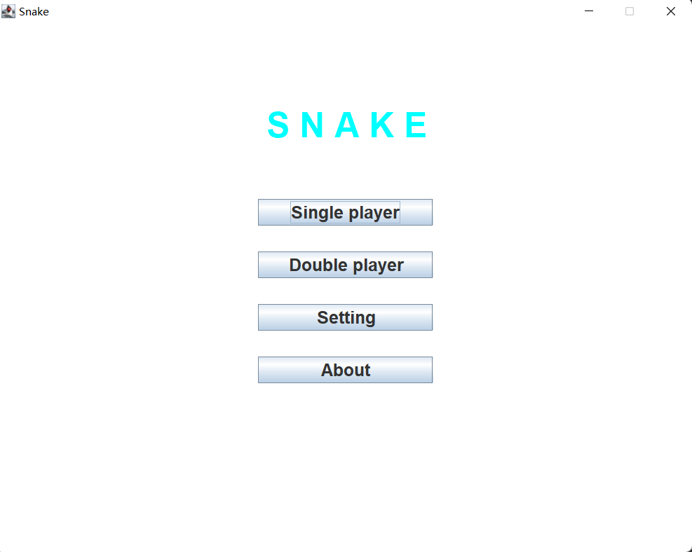
include
01
03
Single-
player
Setting
02
04
two-
players
About

Slide 3
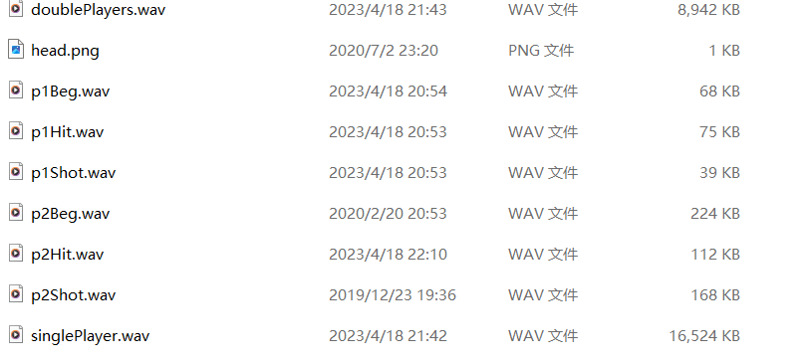
design decisions
At the beginning of the design, I chose to simplify the functions of the single-player mode and increase the functions of the two-player mode, in order to give more leisure to the single-player, while the strategy and fun are mainly reflected in the double mode, so that not only the single player can play with moderate difficulty, but also have a higher difficulty for players who like to challenge.

Slide 4
1
Chapter 01
Single-player

Slide 5
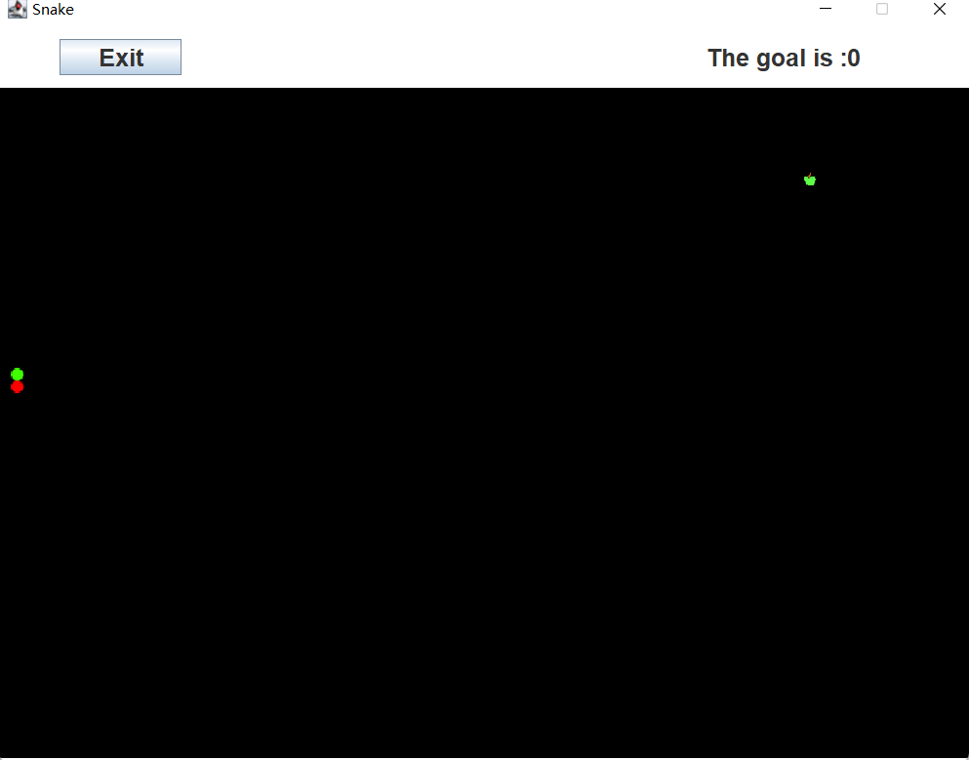
Single-player
In single-player mode, the player has to move by "WASD" to achieve the goal of eating 20 food items, note that the player cannot hit himself or the border, otherwise, the game is considered lost, and that’s the only way of losing in the Single-player! In addition to this, I have added a relaxing and soothing music track to set the scene for a relaxing time.
Also at the top of the game page, there is a display of the player's score and a function to return to the main page

Slide 6
2
Chapter 02
Two-players

Slide 7
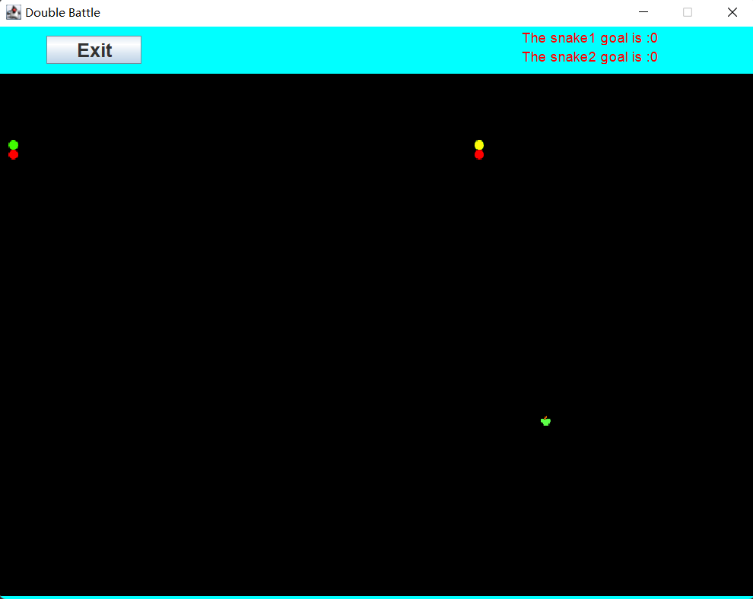
Two-players
In two-player mode, player 1 uses "WASD" to move and "J" to shoot, and player 2 uses the arrow buttons to move and "1" to shoot: In two-player mode, I've added shooting and boundary reduction, where players need to eat eight objectives or survive to the end to the sound of tense music.
Also at the top, the player score is displayed along with a button with an exit function
Not only that, but I've added some comical lines to the opening, shooting and getting shot at to add to the fun, all created by some famous comedians on the Chinese internet

Slide 8
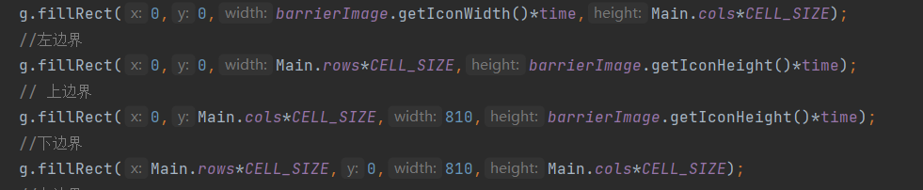
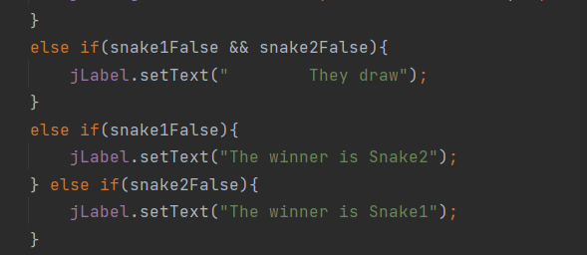
Some Two-player’s function
In the shooting system, each snake has an initial number of four bullets, if you want more bullets you need to grab the apple, and each bullet that hits an enemy will reduce one life; when playing, players should carefully consider the timing of firing bullets to gain an advantage
The way of Victory
Shooting System
Boundary shrinkage systems
There are various ways to win in two-player mode: 1. Eat eight apples to win; 2. Shoot your opponent four times so that your opponent has zero life; 3. Your opponent hits a border (gas) or your body; 4. During the game, you will need to use various strategies to win the game, e.g. use bullets to force your opponent when the apples are far away from you, use continuous button acceleration to dodge bullets when eating apples, btw, if you are at a disadvantage, it is also good to try to trigger a draw.
At the beginning of the game, the "poisonous gas" does not spread to the inner side. After a certain period of time without a winner, the "poisonous gas" will continue to expand towards the center and the snake's field of activity will be reduced and the apples will be refreshed.

Slide 9
3
Chapter 03
Settings

Slide 10
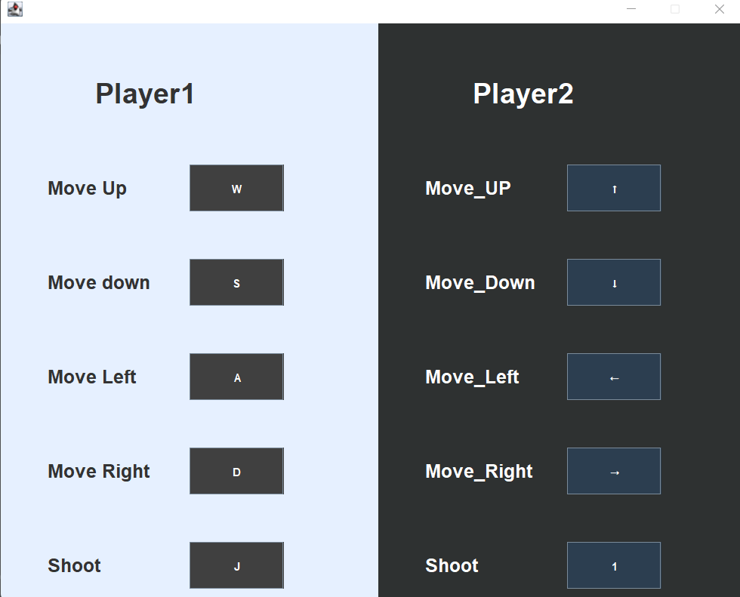
Settings
The player can modify the buttons to suit their needs, but the game will be incorrect if they are modified to the same buttons。

Slide 11
4
Chapter 04
About&future

Slide 12
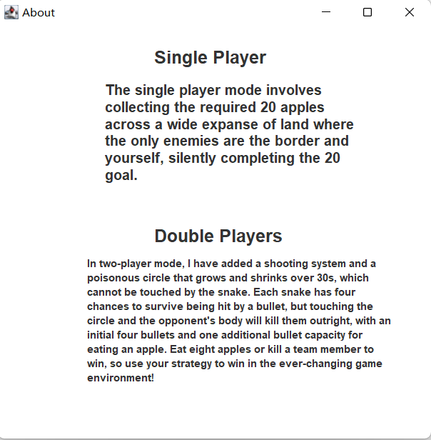
About
The player can get some basic information at About .

Slide 13
Future
In the future, I think more bonus points could be added to the single-player mode to encourage players; more types of apples could be added to the two-player mode along with the associated bullet types and life algorithms to increase the playability of the two-player mode. and the page needs to be modified to make it more beautiful.

