Slide 1
SIEM Implementation
Project Completion Report
[CUSTOMER_NAME]
Prepared by Seekurity
[DATE]

Slide 2
Agenda
# | Topic | Duration
1 | Executive Summary | 10 min
2 | Project Achievements | 15 min
3 | Technical Delivery | 20 min
4 | Metrics & Performance | 10 min
5 | Lessons Learned | 10 min
6 | Support & Maintenance | 10 min
7 | Recommendations | 10 min
8 | Sign-off & Closure | 5 min

Slide 3
01
Executive Summary

Slide 4
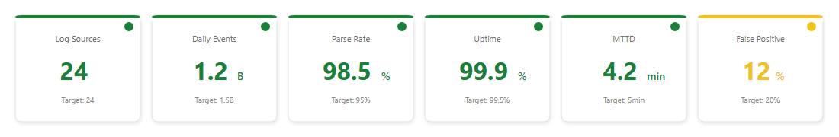
Key Outcomes
Project Status: COMPLETED
Metric | Target | Achieved | Status
Log Sources | [X] | [X] | 100%
Use Cases | [X] | [X] | 100%
Training | [X] sessions | [X] sessions | 100%
On-Time | [DATE] | [DATE] | On Schedule

Slide 5
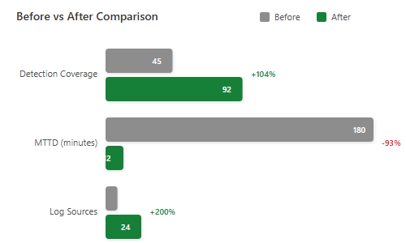
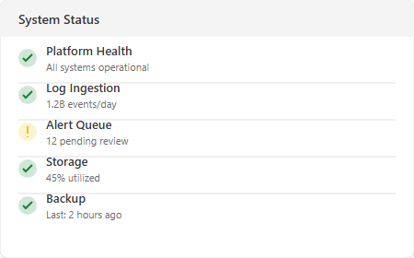
Value Delivered

Slide 6
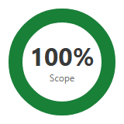
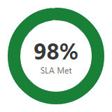
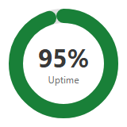
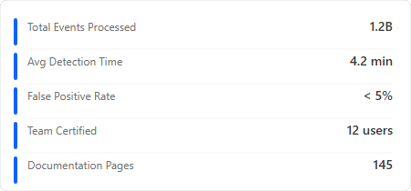
Executive Dashboard
Project completion at a glance
100%
24/24
156
0
Scope Delivered
Log Sources
Detection Rules
Open Issues

Slide 7
02
Project Achievements

Slide 8
Implementation Phases
What we delivered in each phase
1
2
3
Foundation
Integration
Operationalize
Completed
Completed
Completed
• Infrastructure deployed
• Platform installed
• Network configured
• Security hardened
• Backup configured
• 24 log sources connected
• Parsers configured
• Data normalization
• Quality validation
• Performance tuning
• 156 detection rules
• 12 dashboards built
• SOC playbooks
• Team training
• Documentation

Slide 9
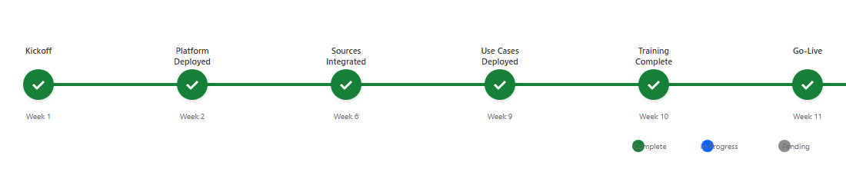
Milestone Completion
# | Milestone | Target | Actual | Status
M1 | Infrastructure Ready | [DATE] | [DATE] | PASS
M2 | Platform Deployed | [DATE] | [DATE] | PASS
M3 | Sources Integrated | [DATE] | [DATE] | PASS
M4 | Use Cases Deployed | [DATE] | [DATE] | PASS
M5 | Go-Live | [DATE] | [DATE] | PASS

Slide 10
03
Technical Delivery

Slide 11
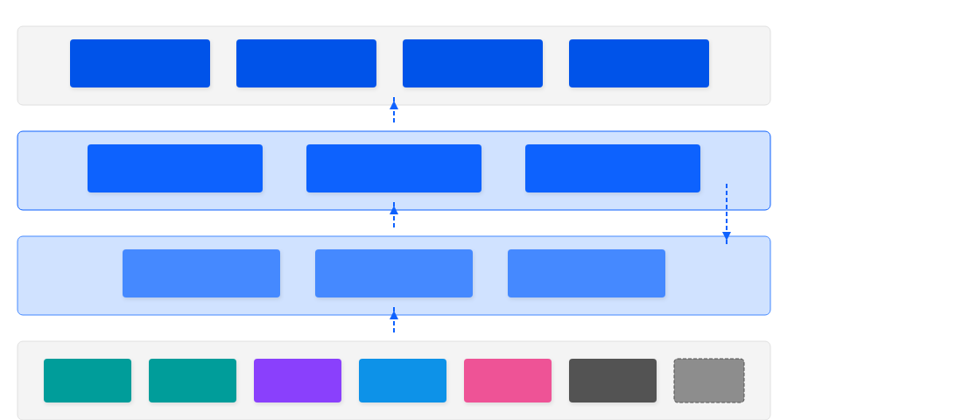
Architecture Deployed
Editable diagram - click text to customize
PRESENTATION TIER
Dashboards
Real-time Views
Alerts
Notifications
Reports
Scheduled
Investigation
Ad-hoc Search
PROCESSING TIER
Indexer Cluster
Index & Store Events
Correlation Engine
Rules & Analytics
Search Cluster
Distributed Search
Data Flow
COLLECTION TIER
Log Collectors
Syslog / Agent / API
Heavy Forwarders
Parse & Transform
Load Balancer
HA Distribution
[X] EPS
DATA SOURCES
Firewall
Palo Alto
EDR
CrowdStrike
Identity
Azure AD
Cloud
AWS/Azure
Email
O365
Apps
Custom
+ More

Slide 12
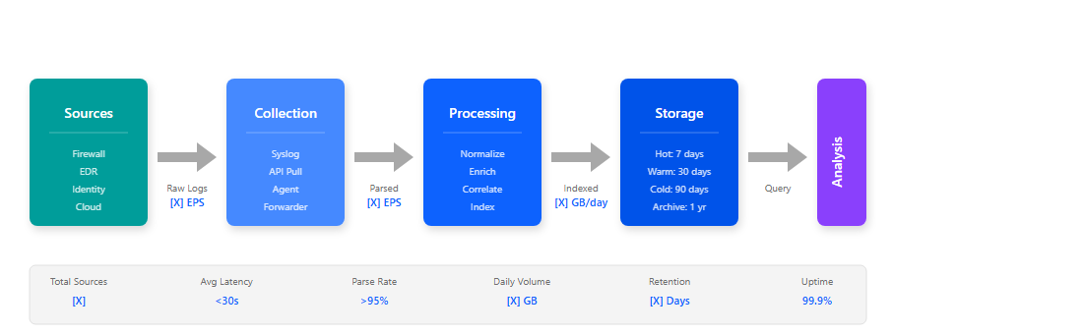
Data Pipeline Performance

Slide 13
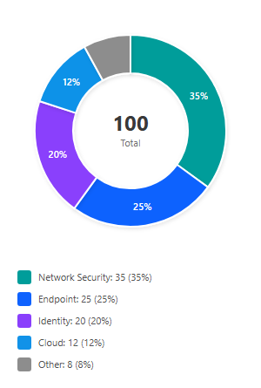
Log Source Integration
Category | Planned | Integrated | EPS
Network Security | [X] | [X] | [X]
Endpoint | [X] | [X] | [X]
Identity | [X] | [X] | [X]
Cloud | [X] | [X] | [X]
Applications | [X] | [X] | [X]
Total | [X] | [X] | [X]

Slide 14
04
Metrics & Performance

Slide 15
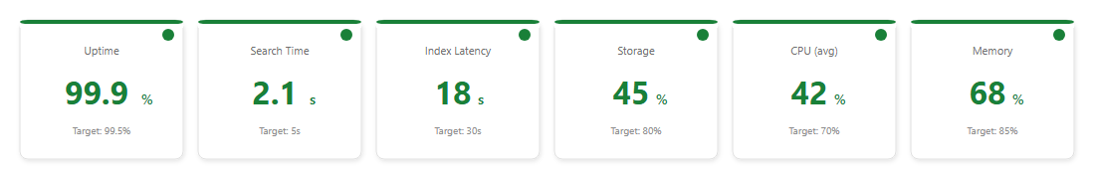
Platform Performance

Slide 16
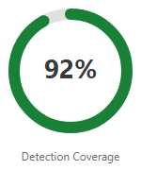
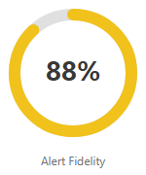
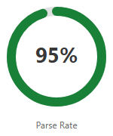
Detection Effectiveness

Slide 17
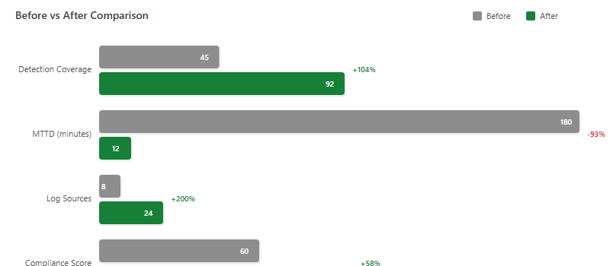
Before vs After

Slide 18
05
Lessons Learned

Slide 19
⌂ LESSONS LEARNED
PROJECT RETROSPECTIVE
A SUCCESSFUL SIEM IMPLEMENTATION REQUIRES STRONG COLLABORATION BETWEEN SECURITY, IT, AND BUSINESS TEAMS. CLEAR COMMUNICATION AND EARLY STAKEHOLDER ENGAGEMENT ARE CRITICAL SUCCESS FACTORS.
Key Takeaways for Future Projects
• Start credential provisioning early in the project lifecycle
• Regular status meetings maintain alignment across teams
• Pre-validation checklists reduce integration issues by 60%
• Buffer time in UAT schedule prevents last-minute pressure
• Recording training sessions enables on-demand learning
• Detailed change requests accelerate approval processes

Slide 20
What Went Well
Category | Observation
Planning | Thorough scoping minimized scope creep
Communication | Regular status meetings kept all parties aligned
Technical | Pre-validation checklist reduced integration issues
Collaboration | Strong customer engagement accelerated decisions
Quality | Iterative testing caught issues early

Slide 21
Areas for Improvement
Category | Observation | Recommendation
Access | Credential provisioning delays | Earlier IAM engagement
Testing | UAT window was tight | Allocate buffer for UAT
Training | Some missed sessions | Record for on-demand
Change Control | Some requests lacked detail | Improve CR template

Slide 22
06
Support & Maintenance

Slide 23
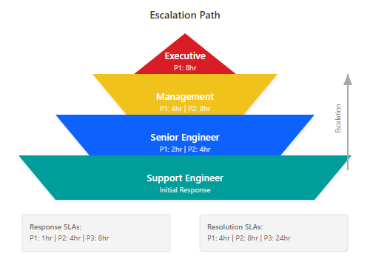
Support Escalation Path

Slide 24
Support SLAs
Severity | Description | Response | Resolution
P1 - Critical | Platform down | 1 hour | 4 hours
P2 - High | Major feature impacted | 4 hours | 8 hours
P3 - Medium | Minor feature impacted | 8 hours | 24 hours
P4 - Low | General questions | 24 hours | 72 hours

Slide 25
07
Recommendations

Slide 26
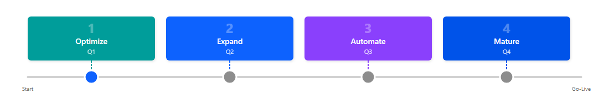
Roadmap Recommendations
# | Recommendation | Priority | Timeframe
1 | Complete use case tuning | High | 30 days
2 | Implement SOAR automation | High | Q1
3 | Expand log source coverage | Medium | Q2
4 | Deploy behavior analytics | Medium | Q3
5 | Establish threat hunting program | Medium | Q4

Slide 27
08
Sign-off & Closure

Slide 28
Acceptance Criteria Verification
# | Criteria | Target | Actual | Status
1 | Log sources integrated | [X] | [X] | PASS
2 | Parse success rate | >95% | [X]% | PASS
3 | Use cases deployed | [X] | [X] | PASS
4 | False positive rate | <20% | [X]% | PASS
5 | Platform uptime | >99.5% | [X]% | PASS
6 | Training completed | [X] staff | [X] staff | PASS
7 | Documentation delivered | [X] docs | [X] docs | PASS

Slide 29
Thank You
Seekurity
Enterprise Security Solutions
contact@seekurity.com
+1 (555) 123-4567
www.seekurity.com

