Slide 1
SIEM Implementation
Project Kickoff
[CUSTOMER_NAME]
Prepared by Seekurity
[DATE]

Slide 2
Agenda
# | Topic | Duration
1 | Introduction & Objectives | 10 min
2 | Project Scope & Deliverables | 15 min
3 | Technical Architecture | 20 min
4 | Implementation Approach | 15 min
5 | Timeline & Milestones | 10 min
6 | Governance & Communication | 10 min
7 | Risks & Mitigation | 10 min
8 | Next Steps & Q&A | 10 min

Slide 3
01
Introduction & Objectives

Slide 4
⌂ SIEM IMPLEMENTATION PROJECT
PROJECT KICKOFF
Project Introduction
[Image Placeholder]
Background & Context
This SIEM implementation project aims to establish a comprehensive security monitoring capability. The solution will integrate log sources across your enterprise infrastructure, enabling real-time threat detection and rapid incident response.
Our Approach
We follow a proven methodology combining industry best practices with tailored solutions. Our team will work closely with your security and IT teams to ensure seamless integration and knowledge transfer throughout the project lifecycle.

Slide 5
Meeting Objectives
Objective | Outcome
Alignment | Confirm project goals and success criteria
Scope | Review deliverables and exclusions
Architecture | Understand technical design and integrations
Timeline | Agree on milestones and dependencies
Governance | Establish communication and escalation paths
Risks | Identify and plan mitigations

Slide 6
02
Project Scope & Deliverables

Slide 7
Scope Overview
Category | In Scope | Details
Platform | Yes | SIEM deployment and configuration
Log Sources | Yes | [X] sources across [Y] categories
Use Cases | Yes | [Z] detection rules and alerts
Integrations | Yes | Ticketing, SOAR, threat intelligence
Training | Yes | Administrator and analyst sessions
Managed Services | No | Post-warranty support

Slide 8
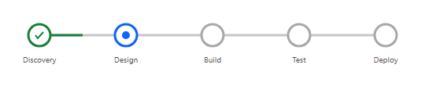
Project Overview
Scope and Objectives at a Glance
Project Details
24
156
• Customer: [CUSTOMER_NAME]
• Project Type: SIEM Implementation
• Duration: 12 weeks
• Team Size: 8 resources
• Methodology: Agile/Iterative
Log Sources
Detection Rules
12
8
Week Timeline
Team Members
Success Criteria
• 24/7 log collection from all sources
• < 5 minute mean time to detect
• 95%+ parsing accuracy
• Zero critical vulnerabilities
• Full team certification

Slide 9
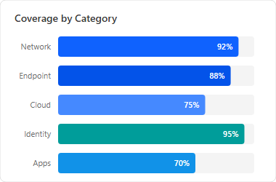
Deliverables Breakdown
Detailed scope components
Deliverable | Description | Priority
Platform Setup | Core SIEM installation and configuration | P1
Log Integration | Connect 24 log sources across 5 categories | P1
Detection Rules | 156 custom rules + threat intelligence | P1
Dashboards | 12 operational dashboards + reports | P2
SOAR Integration | Automated response playbooks | P2
Training | Admin + Analyst certification courses | P2
Documentation | Runbooks, SOPs, architecture docs | P3
Requirements Gathered
Architecture Approved
Infrastructure Ready
Log Access Confirmed

Slide 10
03
Technical Architecture

Slide 11
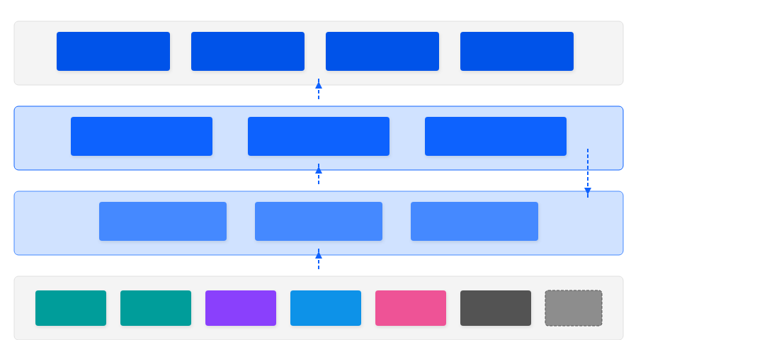
SIEM Architecture
Editable diagram - click text to customize
PRESENTATION TIER
Dashboards
Real-time Views
Alerts
Notifications
Reports
Scheduled
Investigation
Ad-hoc Search
PROCESSING TIER
Indexer Cluster
Index & Store Events
Correlation Engine
Rules & Analytics
Search Cluster
Distributed Search
Data Flow
COLLECTION TIER
Log Collectors
Syslog / Agent / API
Heavy Forwarders
Parse & Transform
Load Balancer
HA Distribution
[X] EPS
DATA SOURCES
Firewall
Palo Alto
EDR
CrowdStrike
Identity
Azure AD
Cloud
AWS/Azure
Email
O365
Apps
Custom
+ More

Slide 12
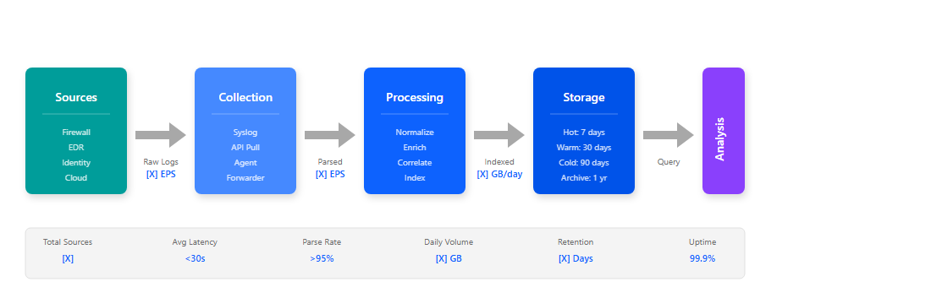
Data Flow Pipeline

Slide 13
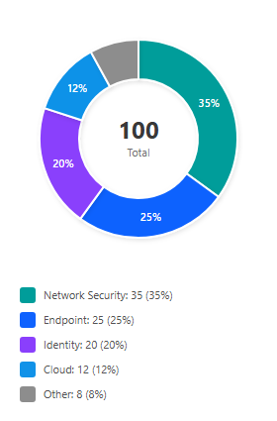
Log Source Summary
Category | Sources | Est. EPS | Priority
Network Security | Firewall, IDS/IPS, Proxy | [X] | P1
Endpoint | EDR, AV, OS Logs | [X] | P1
Identity | AD, Azure AD, PAM | [X] | P1
Cloud | AWS/Azure/GCP | [X] | P2
Application | Web Apps, Databases | [X] | P2

Slide 14
04
Implementation Approach

Slide 15
⌂ IMPLEMENTATION APPROACH
METHODOLOGY
Implementation Strategy
Phase 1: Foundation
Infrastructure setup, platform deployment, network configuration, and security hardening. Establishes the core platform capabilities.
Phase 2: Integration
Log source connectivity, parser development, data normalization, and quality validation. Ensures comprehensive data collection.
Phased Delivery Model
Our implementation follows a structured phased approach. Each phase builds upon the previous, ensuring stable foundations before adding complexity. This approach minimizes risk while maximizing value delivery at each milestone.
Phase 3: Operationalize
Detection rules deployment, dashboard creation, playbook development, and team training. Delivers operational capabilities.

Slide 16
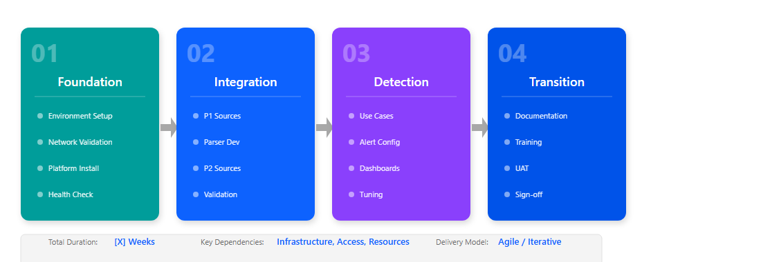
Implementation Methodology

Slide 17
05
Timeline & Milestones

Slide 18
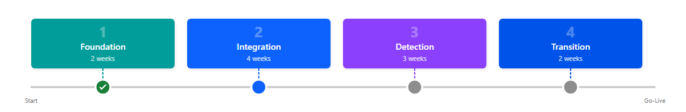
Project Timeline
Phase | Start | End | Duration
Phase 1: Foundation | [DATE] | [DATE] | [X] weeks
Phase 2: Integration | [DATE] | [DATE] | [X] weeks
Phase 3: Detection | [DATE] | [DATE] | [X] weeks
Phase 4: Transition | [DATE] | [DATE] | [X] weeks

Slide 19
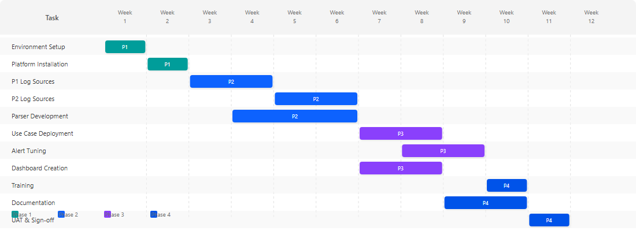
Detailed Schedule

Slide 20
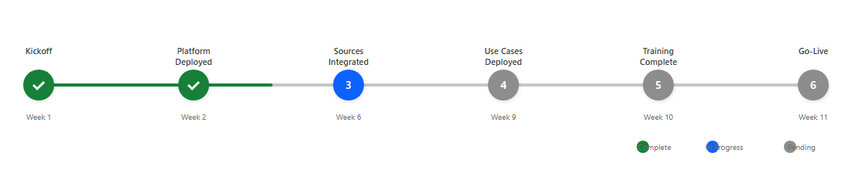
Key Milestones

Slide 21
06
Governance & Communication

Slide 22
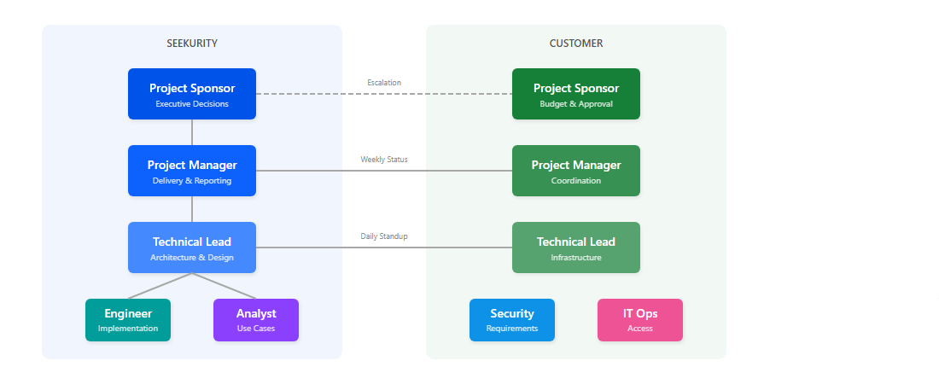
Governance Model

Slide 23
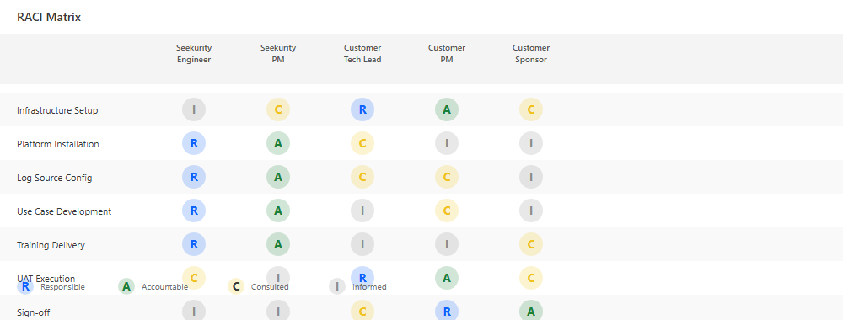
RACI Matrix

Slide 24
07
Risks & Mitigation

Slide 25
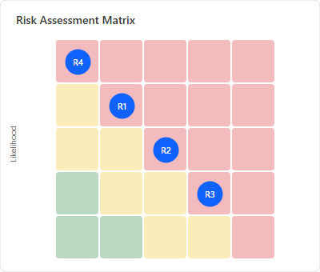
Risk Assessment
Identified risks and mitigation strategies
High Priority Risks
• R1: Infrastructure delays - Early vendor engagement
• R4: Scope creep - Strict change control process
Medium Priority Risks
• R2: Resource unavailability - Cross-trained backups
• R3: Log source access - Pre-validation checklist
• R5: Integration complexity - Technical POC phase
Risk Monitoring
• Weekly risk review meetings
• Automated health checks
• Escalation within 24 hours

Slide 26
Risk Register
# | Risk | Probability | Impact | Mitigation
R1 | Infrastructure delays | Medium | High | Early engagement
R2 | Resource unavailability | Medium | Medium | Backup resources
R3 | Log source access issues | High | Medium | Pre-validation
R4 | Scope creep | Medium | High | Change control
R5 | Integration complexity | Medium | Medium | Technical POC

Slide 27
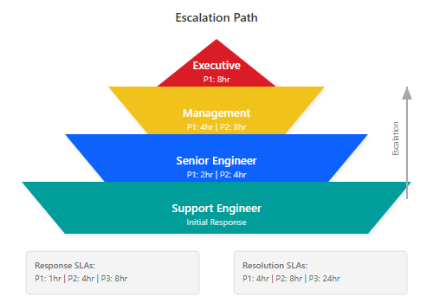
Escalation Path

Slide 28
08
Next Steps & Q&A

Slide 29
⌂ NEXT STEPS
ACTION ITEMS
KEY ACTIONS MOVING FORWARD
Infrastructure Setup
Access & Credentials
Finalize hardware requirements and submit procurement requests. Ensure network connectivity and firewall rules are in place.
Prepare log source access credentials. Set up service accounts and API keys for automated collection.
Team Coordination
Documentation
Schedule Phase 1 kickoff meeting. Assign team members and confirm availability for training sessions.
Distribute meeting minutes and project charter. Review and sign off on scope document.

Slide 30
Immediate Next Steps
# | Action | Owner | Due Date
1 | Distribute meeting minutes | Seekurity PM | [DATE]
2 | Finalize infrastructure requirements | [CUSTOMER_NAME] | [DATE]
3 | Submit firewall change requests | [CUSTOMER_NAME] | [DATE]
4 | Provide log source credentials | [CUSTOMER_NAME] | [DATE]
5 | Schedule Phase 1 kickoff | Both PMs | [DATE]

Slide 31
Thank You
Seekurity
Enterprise Security Solutions
contact@seekurity.com
+1 (555) 123-4567
www.seekurity.com

