Slide 1
Parrot & FLASH
Jackson Clark, Ziqi Yuan, Haocheng Xia
Notes:
From my side, Parrot and FLASH do not have many commons and they a highly different in both research problem and methodology. Fortunately, both of them have simple intuition are easy to understand. We will first introduce you ParrotServe.

Slide 2
Parrot: Efficient Serving of LLM-based Applications with Semantic Variable
Chaofan Lin, Zhenhua Han, Chengruidong Zhang,
Yuqing Yang, Fan Yang, Chen Chen, Lili Qiu
OSDI ‘24
Presented by Ziqi Yuan, Haocheng Xia

Slide 3
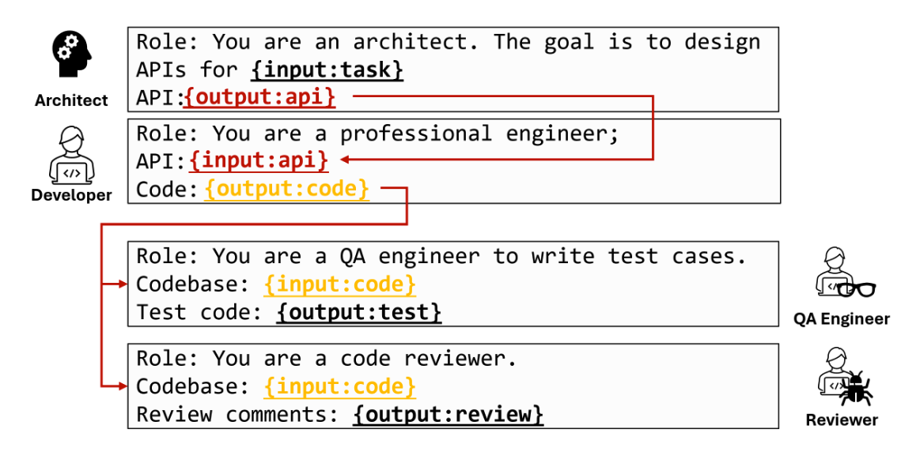

Background
LLM Applications can involve multiple LLM requests to accomplish one task.

Slide 4
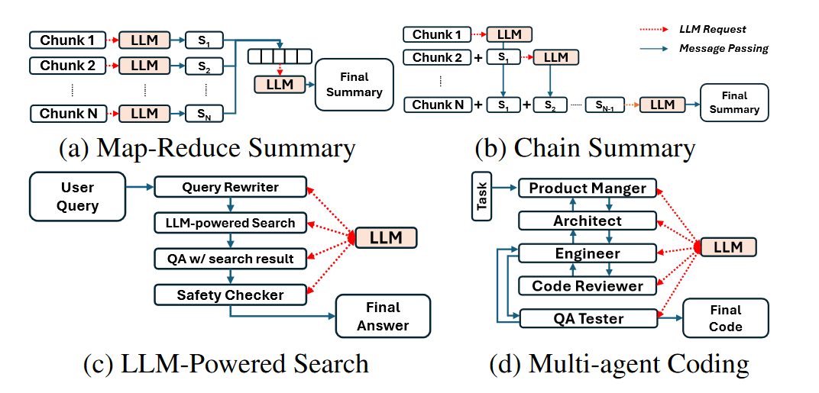
Introduction and Contribution
There are some traditional way how different LLM applications impl multiple requests.
Long context summarization
~
Searching
Coding

Slide 5
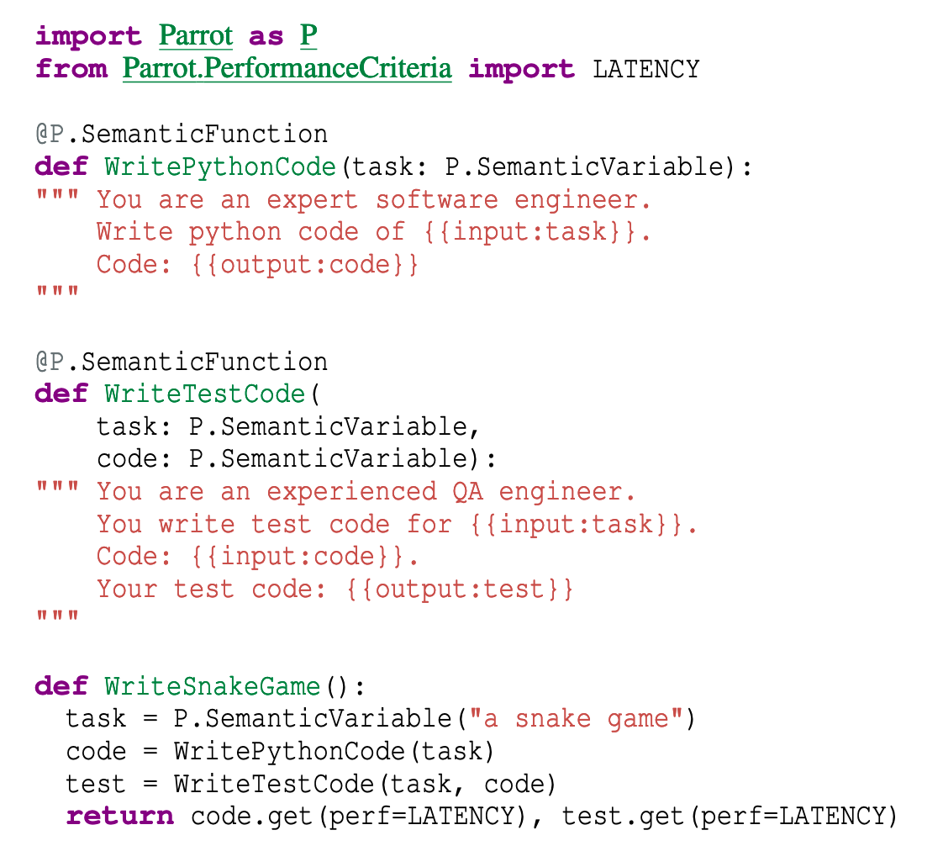
Contribution - Parrot
Similar to ray.
Each request can generate a
Future (Semantice Var), then
Server gets the DAG for better
scheduling.

Slide 6
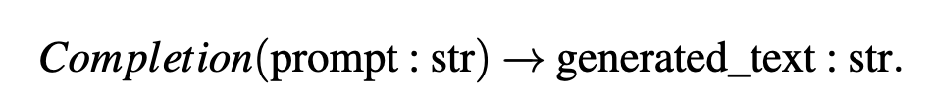
Shortage
Over-simplified API:
All the requests accept explicit prompt as the context.
All the requests are individual, even though we know the structure of different requests for one task.

Slide 7
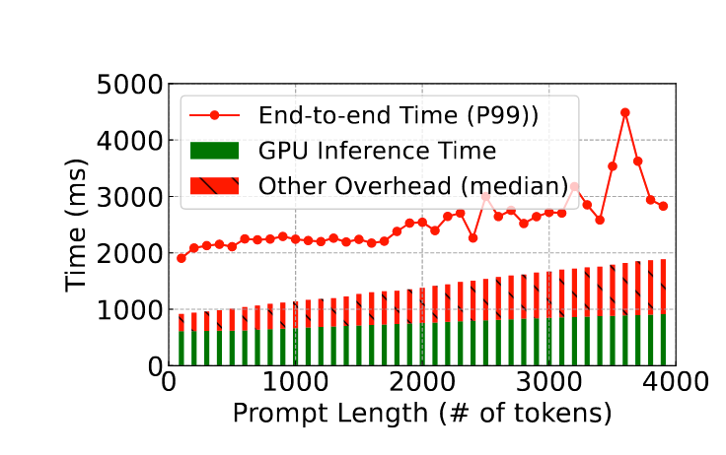
Shortage 1
Recall the example, Arch and Dev are both LLM and serve in the same cluster, however, current workflow requires user (Client) receive the api (network latency) then send it back (network latency).

Slide 8
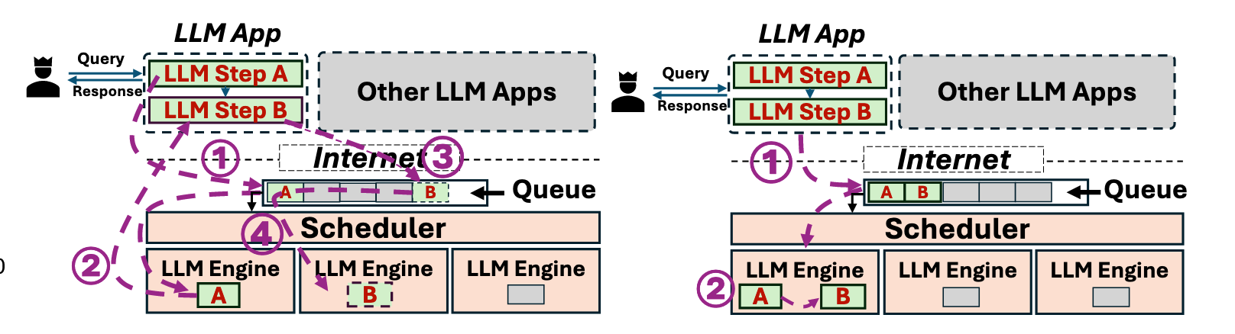
Shortage 1

Slide 9
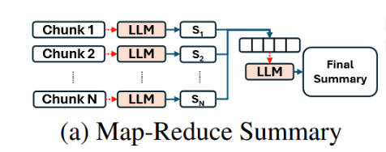
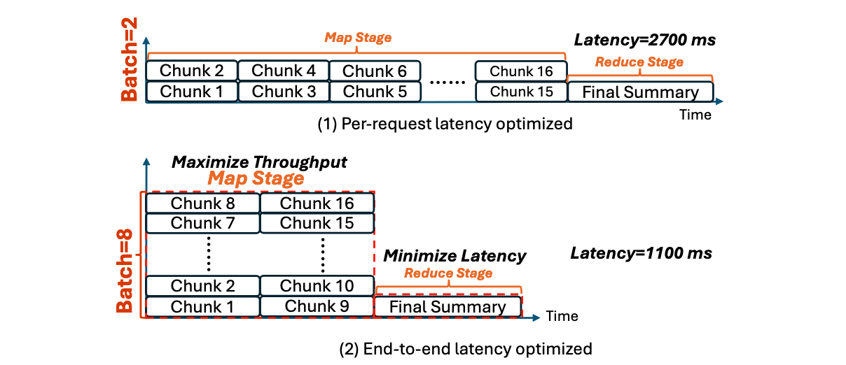
Shortage 2
Some requests need higher throughput.

Slide 10
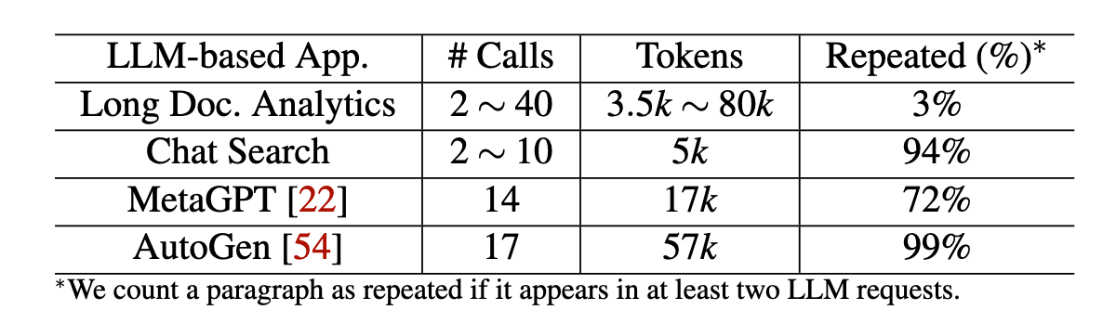
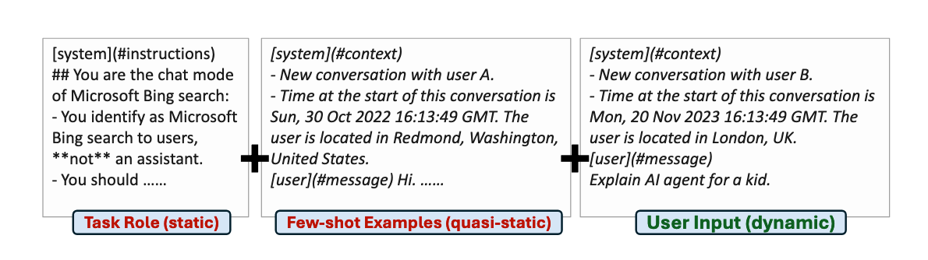
Shortage 3
Commonality across LLM requests.

Slide 11
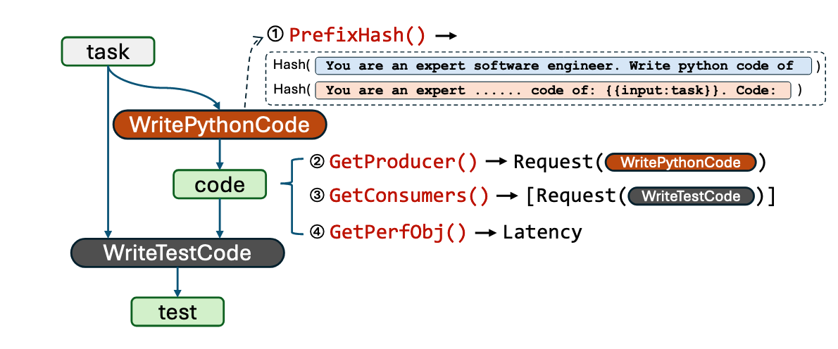
Parrot

Slide 12
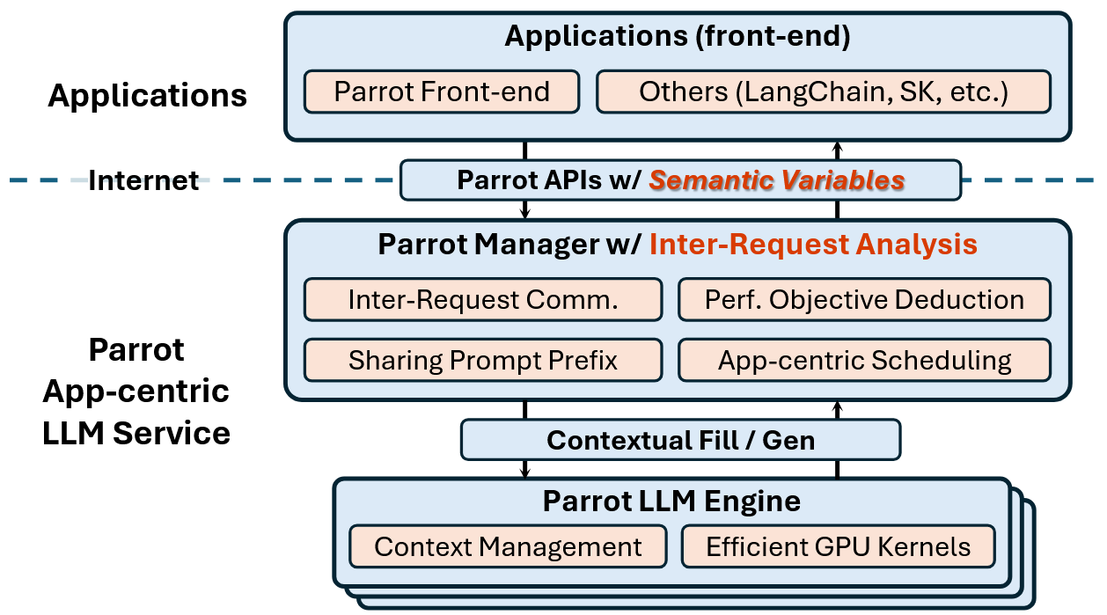
Parrot System Overview
Applications
Insert annotations into source code
Parrot Manager
Identify inter-request dependencies
Performance objectives deduction for LLM applications
Detect shared prompts
Schedule requests across different LLM engines
Parrot LLM Engine
Manage contexts for several requests
Efficient GPU kernels for shared prompts

Slide 13
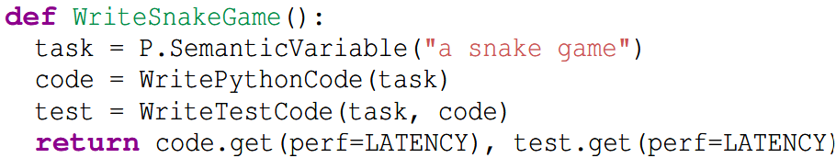
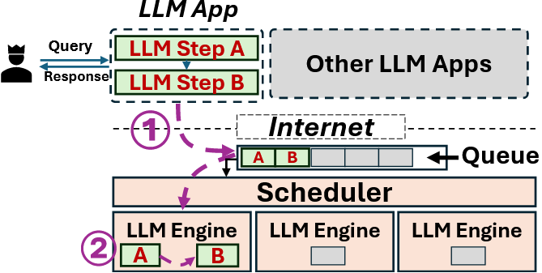
Optimizing Dependent Requests via Semantic Variables
To avoid unnecessary chatty communication between clients and LLM services, Parrot manager directly passes the output of one request as the input to the next.
How does Parrot identify dependent requests?
By analyzing the data-flow graph.
How does Parrot transfer semantic variables between dependent requests?
Using existing message queue systems with built-in string transformation.
Step A
Step B

Slide 14
Optimizing Dependent Requests via Semantic Variables
To avoid unnecessary chatty communication between clients and LLM services, Parrot manager directly passes the output of one request as the input to the next.
How does Parrot identify dependent requests?
By analyzing the data-flow graph.
How does Parrot transfer semantic variables between dependent requests?
Using existing message queue systems with built-in string transformation.
Step A
Step B

Slide 15
Optimizing Performance Objectives via Semantic Variables
To reduce end-to-end latency in LLM applications, Parrot constructs a DAG to represent the application workflow and to determine performance objectives for requests within the workflow.
How does Parrot determine the scheduling objectives for each request?
By following reverse topological order.
Parallel LLM requests are grouped together.

Slide 16
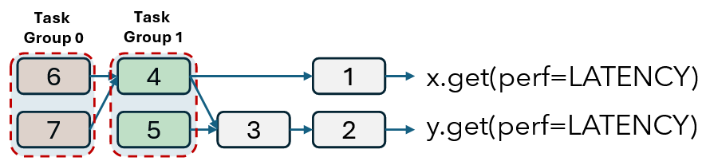
Optimizing Performance Objectives via Semantic Variables
To reduce end-to-end latency in LLM applications, Parrot constructs a DAG to represent the application workflow and to determine performance objectives for requests within the workflow.
How does Parrot determine the scheduling objectives for each request?
By following reverse topological order.
Parallel LLM requests are grouped together.

Slide 17
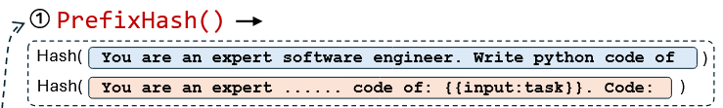
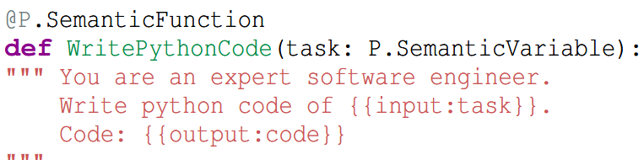
Optimizing Shared Prompt Prefixes via Semantic Variables
Parrot leverages shared prompt prefixes to speed up token generation.
How does Parrot identify shared prefix?
Comparing strings of different requests is too slow.
Prefix hash + map
How does Parrot accelerate token generation? Page attention + no need to load

Slide 18
Application-Centric Scheduling
The primary goal of Parrot’s scheduler is to meet the varied performance goals of LLM applications while optimizing GPU cluster utilization.
Challenge: Balance the concurrent token (throughput) and latency tradeoff
How does Parrot schedule requests?
Schedule requests belonging to the same application together
Group LLM requests with similar performance requirements.
Maximize opportunities for sharing across requests.

Slide 19
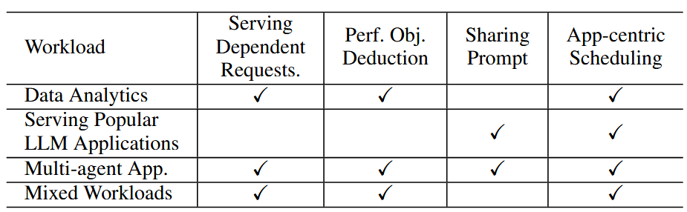
Evaluation Setup
Hardware - one NVIDIA A100 (80GB) GPU / four NVIDIA A6000 (48GB) GPUs
Baseline - FastChat (OpenAI-style) LLM serving system + vLLM / Huggingface Transformers Library as LLM engines + prioritize latency over throughput
Applications -

Slide 20
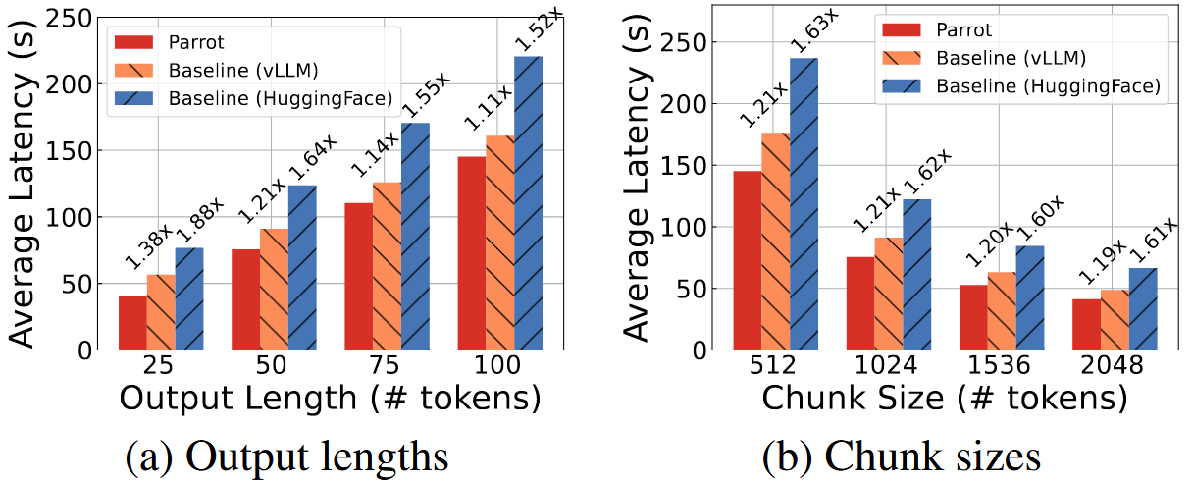
Data Analytics on Long Documents
10 documents, each having over 20,000 tokens.
Chain-based summary [Dependent requests]
Reduce network latency through direct message passing
They tested different output lengths and chunk sizes
Token generation dominates latency, reducing Parrot's benefit when the output is long.

Slide 21
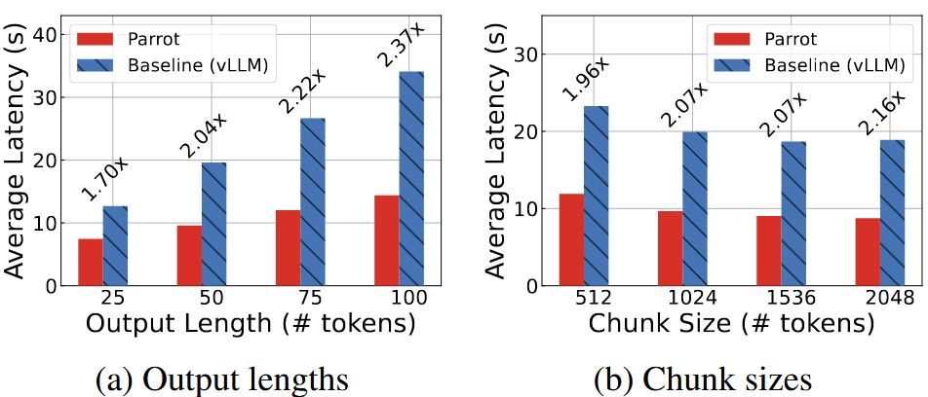
Data Analytics on Long Documents
Summarize 10 documents, each having over 20,000 tokens.
Map-reduce summary [Performance objectives for different requests]
Improve throughput of parallel map stages to reduce end-to-end latency.

Slide 22
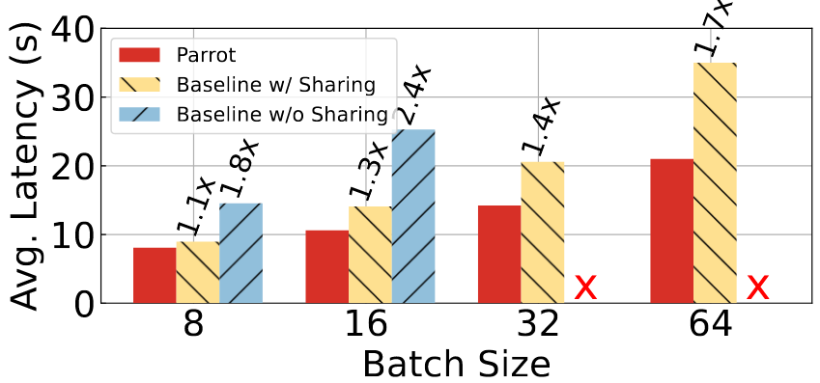
Serving Popular LLM Applications
LLM applications with many shared prefixes (Bing Copilot):
The LLM service in the baseline system is unaware of the prompt structure.
Parrot achieves a 1.1× to 1.7× speedup over Baseline w/ Sharing (vLLM) due to improved GPU kernels.

Slide 23
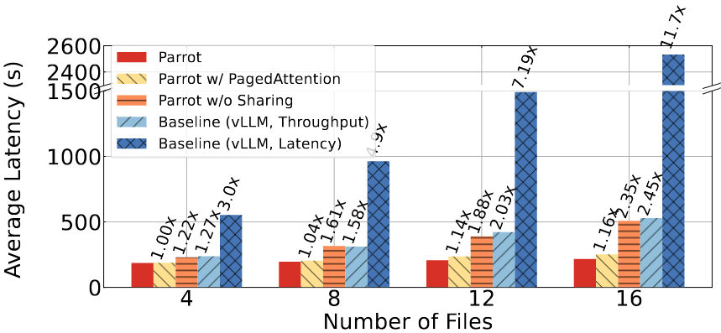
Multi-Agent Applications
Multi-agent system with 3 roles based on MetaGPT [Dependent requests + Performance objectives for different requests + many shared prefixes]
The Architect defines the file structure and APIs → Coders implement the project, each focusing on a specific file → Reviewers assess and comment on individual files → Coders revise the code based on feedback.

Slide 24
Pros and Cons
Pros
Consider the semantic knowledge (dependencies, scheduling objectives, shared prompt prefixes) of different LLM application requests.
Propose a comprehensive system optimization that leverages this semantic knowledge for improved results.
Cons
Increasing scheduler complexity raises scalability concerns.
Lack of support for complex semantic variable transformation limits handling of more complex LLM applications.
Evaluation on limited GPU resources raises questions about the validity of the throughput-latency tradeoff.

Slide 25
FLASH: Fast Model Adaptation in
ML-Centric Cloud Platforms
Haoran Qiu, Weichao Mao, Archit Patke, Shengkun Cui, Chen Wang, Hubertus Franke, Zbigniew Kalbarczyk, Tamer Basar, Ravishankar Iyer
MLSys ‘24
Presented by Jackson Clark

Slide 26
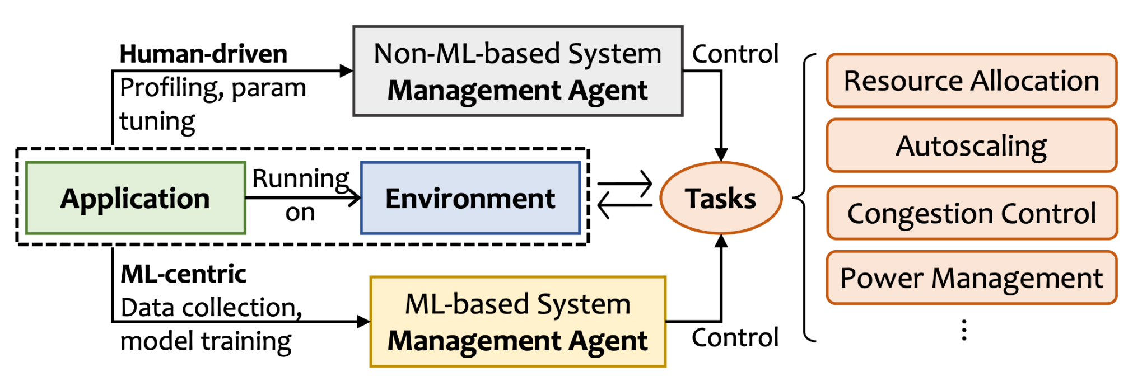
Background
The vision of an ML-Centric cloud platform. (Bianchini et al., 2020)

Slide 27
Core Challenges
There are many different pairings of application and environment (A, E)
Large cloud systems change rapidly
Training a model for each (A, E) pair is expensive
Models need to be retrained to adapt to changes in workload, applications, and environments

Slide 28
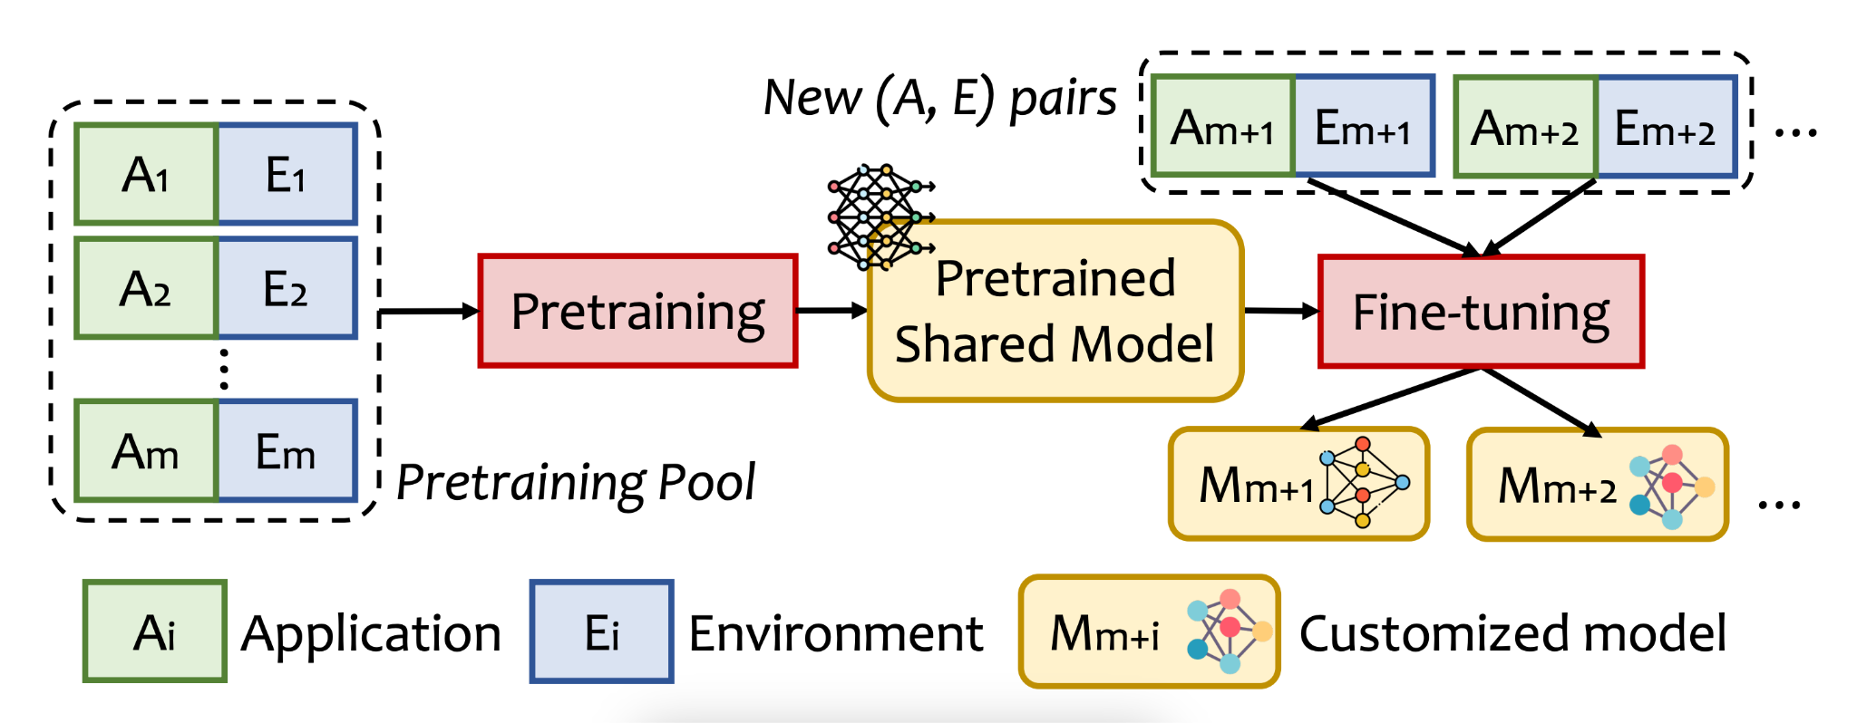
FLASH’s Approach

Slide 29
Phase 1: Pre-training
GOAL: To establish a shared adaptable model that captures the general patterns across (A, E) pairs
Collect data from the base learner across known (A, E) pairs
Train a meta learner to capture generalizable characteristics across (A, E) pairs
Generate embeddings that reflect unique spatial-temporal characteristics for each (A, E) pair

Slide 30
Meta-learning Background
Goal of Meta-learning:
Train a model that learns to generalize across various environments
Training Process:
Unlike traditional training on a single data distribution, meta-learning involves training on diverse distributions to capture shared patterns across environments
Adaptability to New Environments:
Even if a model hasn’t encountered a specific environment before, it can still adapt if the new environment has characteristics similar to those it has learned from
“Learning to learn”:
Meta-learning can be thought of this way, we’re focused on teaching the model to quickly adjust to new tasks with minimal additional training

Slide 31
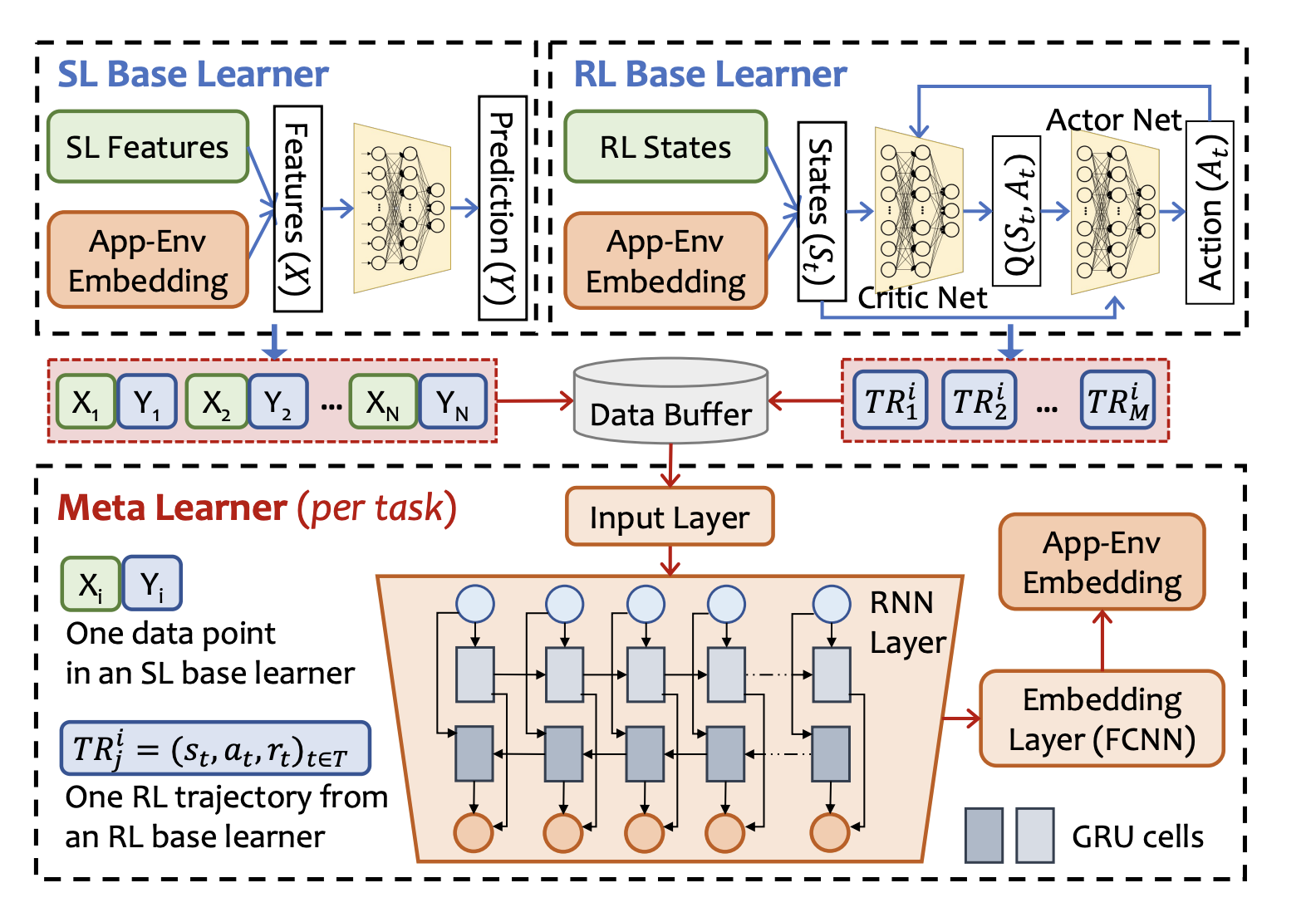
Meta-learner Design

Slide 32
Phase Two: Fine-tuning
Embedding Generation for New Pair:
The meta learner generates an embedding for the new (A, E) pair using representative data (e.g., a few labeled samples or RL trajectories) to capture the unique spatial-temporal patterns of the new environment.
Conditioning the Base Learner:
The embedding is combined with input features (in SL) or state vectors (in RL) in the base learner, enabling it to distinguish the new pair’s characteristics from previously encountered pairs.
Limited Fine-Tuning:
Only the base learner’s parameters are adjusted while the meta learner remains fixed, allowing quick adaptation with minimal retraining data (just a few samples or trajectories).

Slide 33
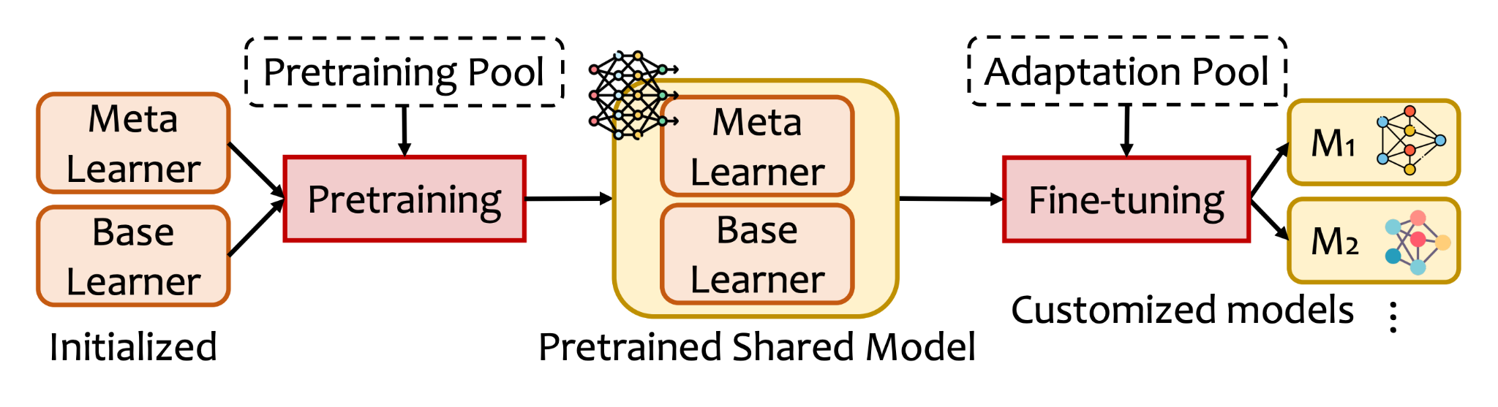
The Workflow
The resultant shared model in Flash is analogous to a pre-trained “foundation model” for a given cloud system management task.

Slide 34
Results
5.5x Faster Adaptation in autoscaling tasks compared to state-of-the-art transfer learning techniques
71.6% Less Performance Drop in reward for the RL-based autoscaler when tested on new applications (from 37% to 10.5%)
Resource Configuration Search: 87% lower prediction error (MAPE) with FLASH
75% of pre-training cost is offset by using only a single shared model with minimal fine-tuning per new pair.

Slide 35
Discussion and Limitations
Model Size and Complexity: FLASH uses a relatively lightweight model, tradeoff between performance and model complexity
Pre-Training Overhead: The initial pre-training phase requires substantial resources (e.g., 5.2 hours for 200 (Ai, Ej) pairs), though this cost is amortized over later adaptations
Fixed Meta Learner: The meta learner’s parameters remain fixed after pre-training. Major feature changes in applications/environments would require re-training the meta learner from scratch
Cross-Task Adaptability: FLASH’s embeddings are optimized for specific tasks (e.g., autoscaling or resource allocation) and may not generalize across entirely different tasks.

Slide 36
Related Works
Meta-Learning in Systems:
ResTune (Zhang et al., 2021): Uses meta-learning for database tuning, optimizing hyperparameters that enhance query performance.
Xue et al. (2022):
Uses neural processes in meta-learning to predict workload CPU utilization but lacks FLASH’s adaptability features for diverse cloud applications.
Curriculum learning (Narvekar et al., 2020):
Uses progressive training sequence based on task difficulty but is designed to maximize final task performance rather than fast adaptation across tasks.

Slide 37
Thank you!

