Slide 1
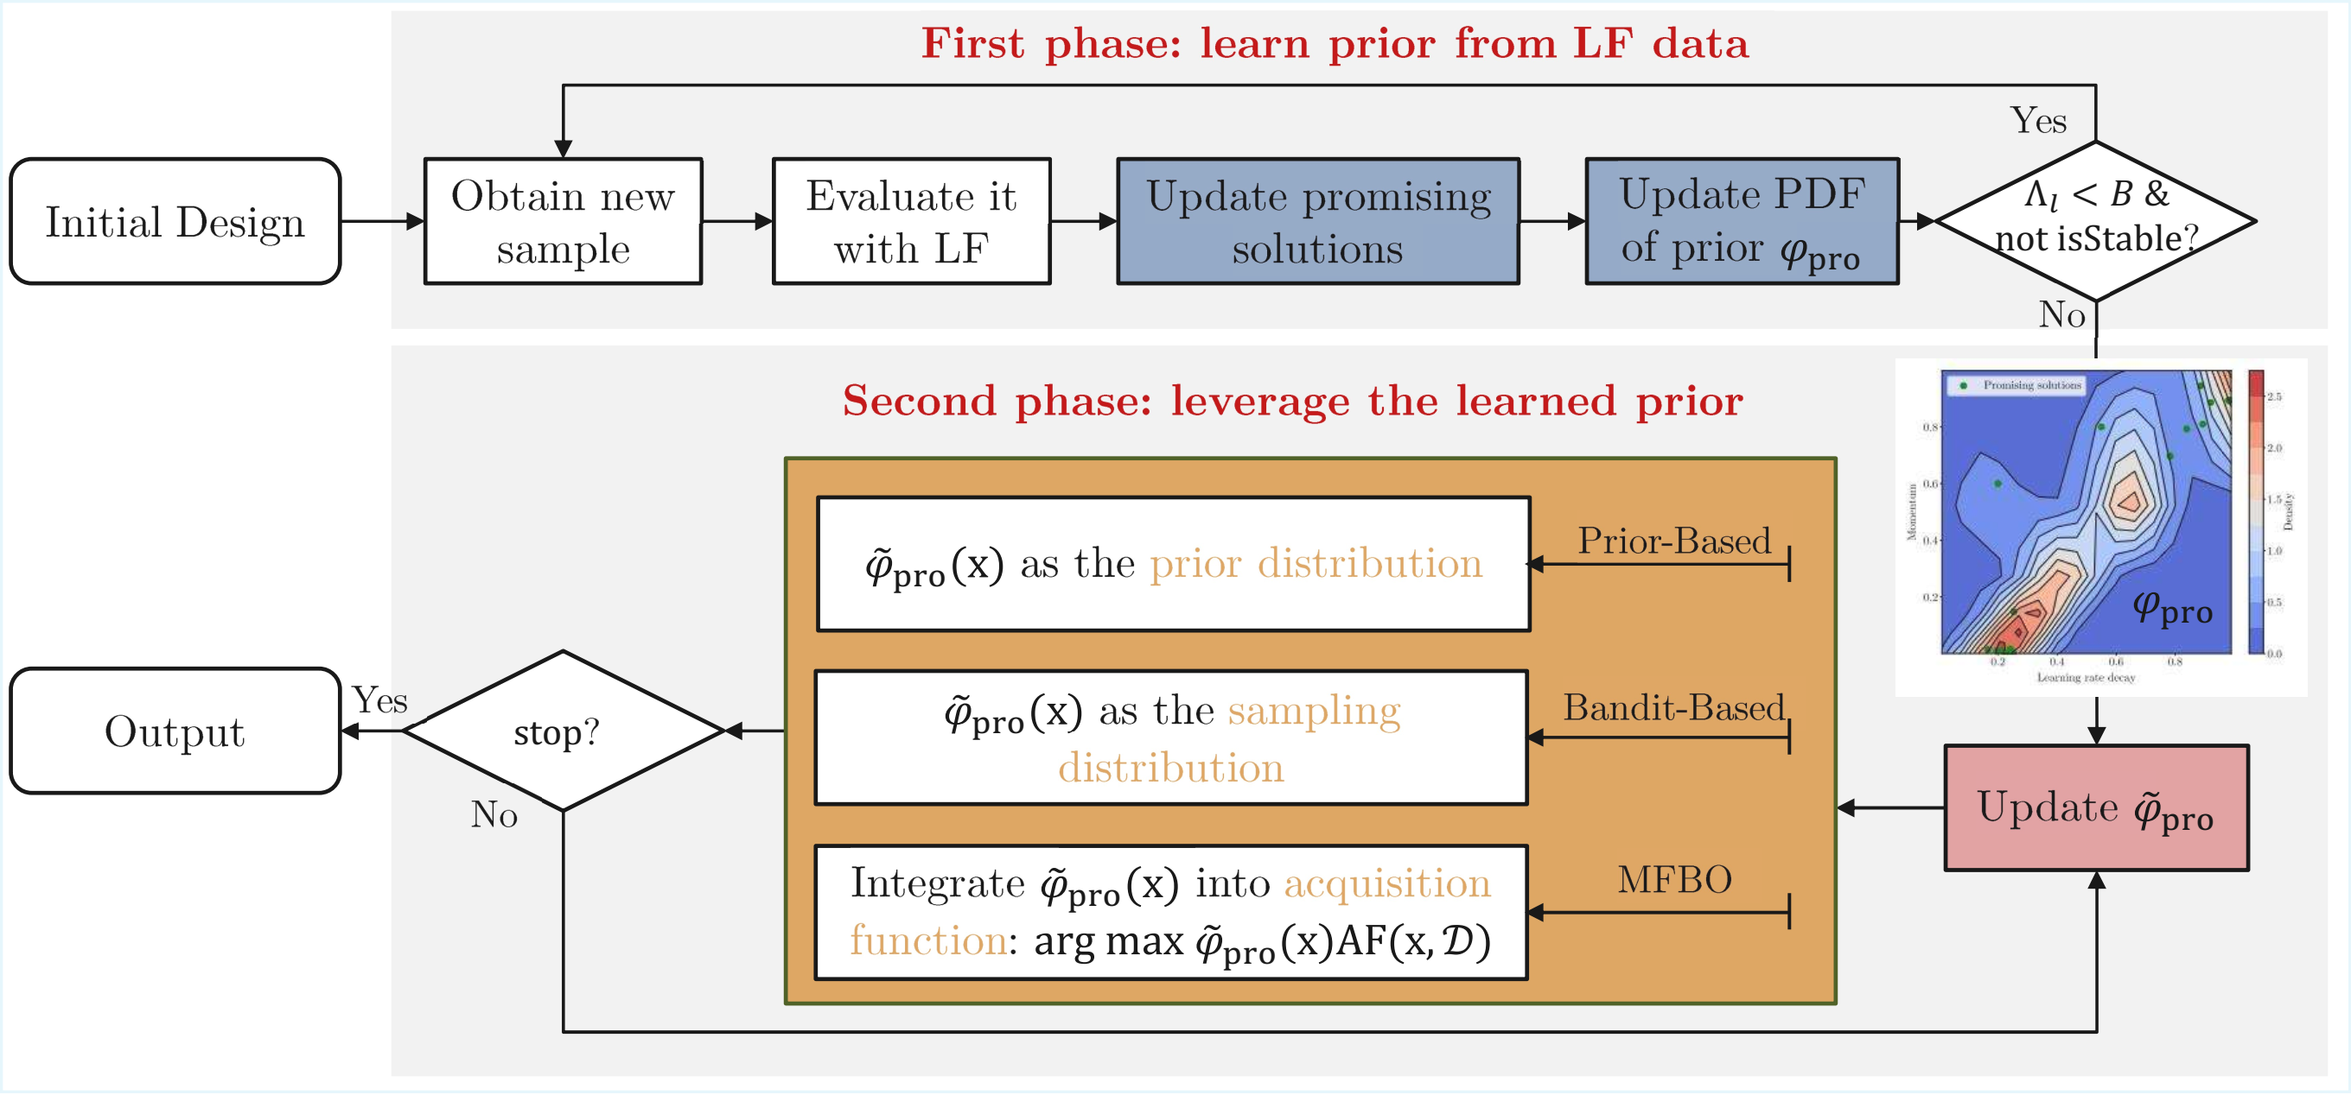

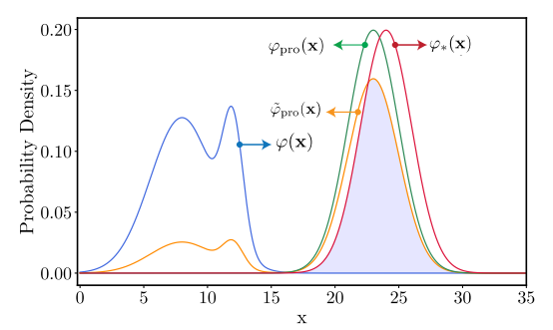
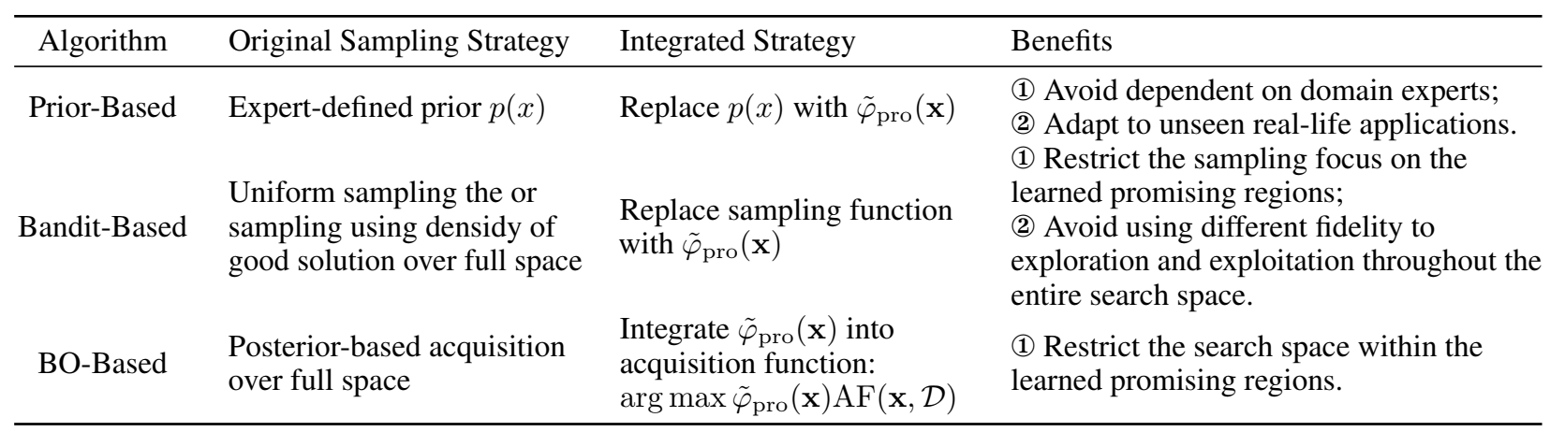
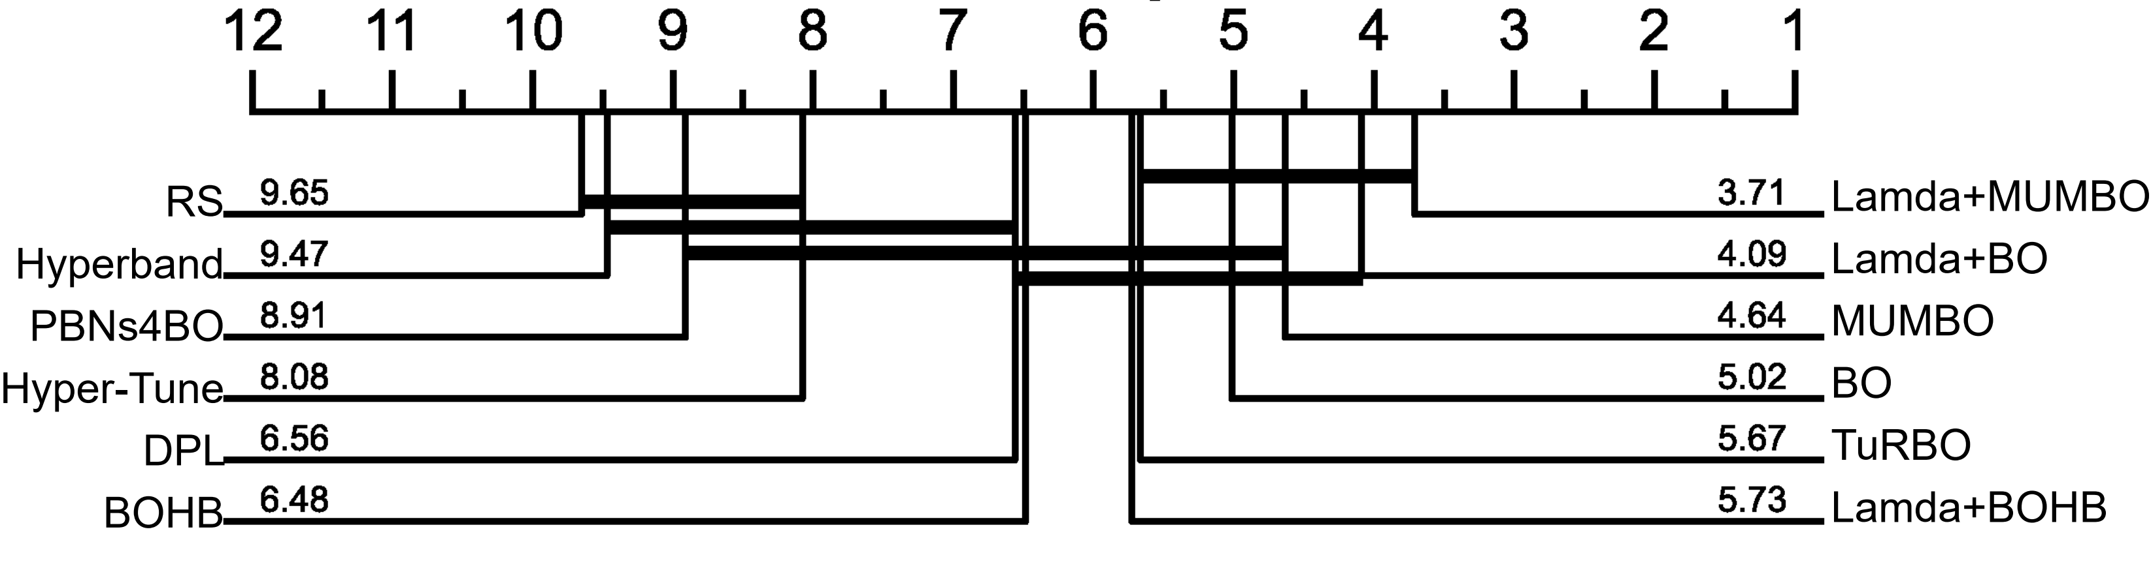


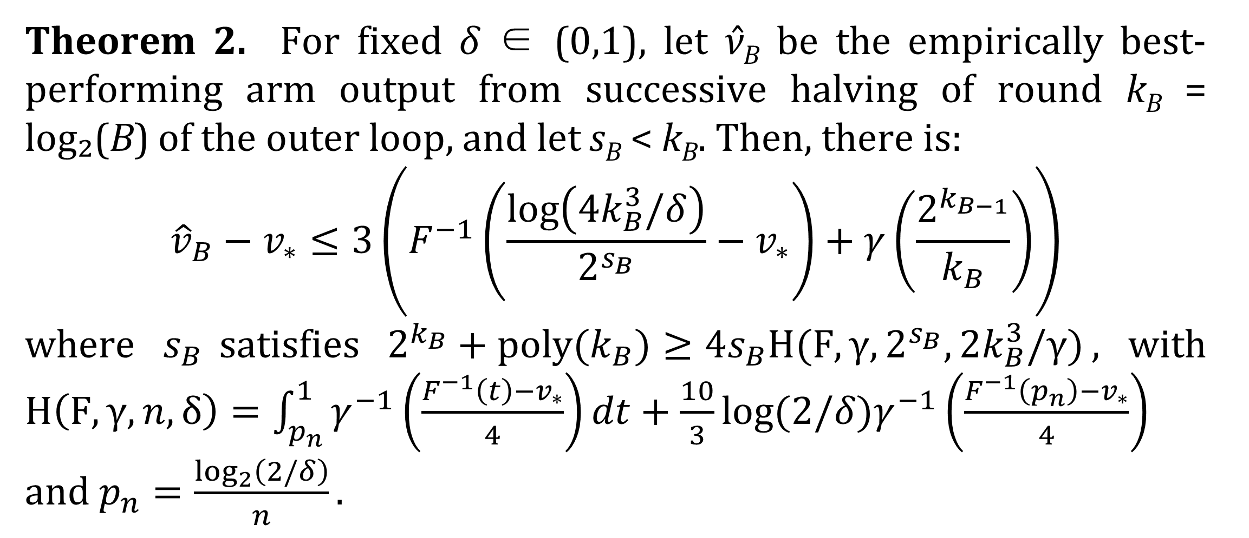
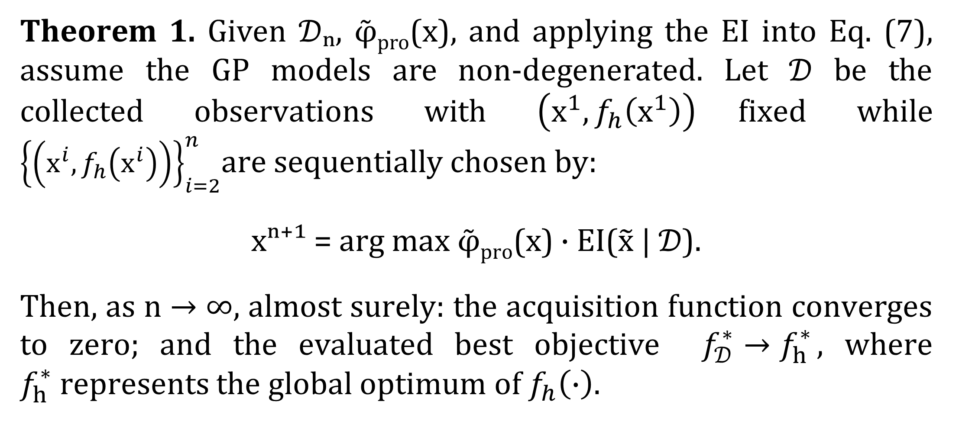
LAMDA: Two-Phase HPO via Learning Prior from Low-Fidelity Data
Fan Li¹ , Shengbo Wang² and Ke Li³
¹College of Mechanical and Electrical Engineering, Central South University, Changsha, China
²School of Computer Science and Engineering, University of Electronic Science and Technology of China, Chengdu, China
³Department of Computer Science, University of Exeter, UK
fanli0525@csu.edu.cn, shnbo.wang@foxmail.com, k.li@exeter.ac.uk
Abstract
Abstract
Hyperparameter Optimization (HPO) is crucial in machine learning, aiming to optimize hyperparameters to enhance model performance. Although existing methods that leverage prior knowledge—drawn from either previous experiments or expert insights—can accelerate optimization, acquiring a correct prior for a specific HPO task is non-trivial. In this work, we propose to relieve the reliance on external knowledge by learning a reliable prior directly from low-fidelity (LF) problems. We introduce Lamda, an algorithm-agnostic framework designed to boost any baseline HPO algorithm. Specifically, Lamda operates in two phases: (1) it learns a reliable prior by exploring the LF landscape under limited computational budgets, and (2) it leverages this learned prior to guide the HPO process. We showcase how the Lamda framework can be integrated with various HPO algorithms to boost their performance, and further conduct theoretical analysis towards the integrated Bayesian optimization and bandit-based Hyperband. We conduct experiments on 56 HPO problems spanning diverse domains and model scales. Results show that Lamda consistently enhances its baseline algorithms. Compared to nine state-of-the-art HPO algorithms, our Lamda variant achieves the best performance in 51 out of 56 HPO tasks while it is the second best algorithm in the other 5 cases.
Proposed Method
Proposed Method
① First-Phase Search
  Sample configurations from LF landscape
  Classify into S_{pro} / S_{inf} using TPE
  Estimate PDFs (φpro, φinf) with KDE
  Assess stability via OVL metric
  Determine if Phase 1 search ends
② Leverage the Learned Prior
$${\overset{˜}{φ}}_{pro}(x)=(1−w)⋅φ(x)+w⋅φ_{pro}(x)$$
③ Integration and Comparison with Current HPO Methods
Theoretical Analysis
Theoretical Analysis
Prior-based Bayesian optimization framework
Bandit-based Hyperband framework
Theorem 1. Given 𝒟ₙ, φ̃_{pro}(x), and applying the EI into Eq. (7), assume the GP models are non-degenerated. Let 𝒟 be the collected observations with $\left(x^{1},f_{h}\left(x^{1}\right)\right)$fixed while ${\left\{\left(x^{i},f_{h}\left(x^{i}\right)\right)\right\}}_{i=2}^{n}$are sequentially chosen by:
xⁿ⁺¹ = arg max φ̃_{pro}(x) · EI($\tilde{x}$ | 𝒟).
Then, as n → ∞, almost surely: the acquisition function converges to zero; and the evaluated best objective $f_{𝒟}^{∗}→f_{h}^{∗}$, where $f_{h}^{∗}$represents the global optimum of $f_{h}\left(∙\right)$.
Theorem 2. For fixed δ ∈ (0,1), let ν̂_{B} be the empirically best-performing arm output from successive halving of round k_{B} = log₂(B) of the outer loop, and let s_{B} < k_{B}. Then, there is:
$${\hat{v}}_{B}−v_{∗}≤3\left(F^{−1}\left(\frac{\log\left(4k_{B}^{3}/δ\right)}{2^{s_{B}}}−v_{∗}\right)+γ\left(\frac{2^{k_{B−1}}}{k_{B}}\right)\right)$$
where $s_{B}$satisfies $2^{k_{B}}+poly(k_{B})≥4s_{B}H(F,γ,2^{s_{B}},{2k}_{B}^{3}/γ)$, with $H\left(F,γ,n,δ\right)=\int_{p_{n}}^{1}{γ^{−1}\left(\frac{F^{−1}\left(t\right)−v_{∗}}{4}\right)dt+\frac{10}{3}log⁡(2/δ)γ^{−1}\left(\frac{F^{−1}\left(p_{n}\right)−v_{∗}}{4}\right)}$ and $p_{n}=\frac{\log_{2}\left(2/δ\right)}{n}.$
Results
56 HPO problems
📊 Tabular (24): FCNet(4×6D) + NAS(4) + ML(16)
🤖 Surrogate (7): PD1(4×4D) + JAHS(3×14D)
🧠 DNN (3): LeNet + ResNet×2
⚙️ Synthetic (2): Hartmann(3D/6D)
🔄 Fine-tune (20): 20×69D
PAPER
Figure: Comparing average relative ranks of peer algorithms across 33 HPO tasks. Lamda+BO and Lamda+MUMBO consistently maintain top positions throughout the evaluations. (Figure 4).
CODE

