Slide 1
ES6
Generators
Asynchronous Flow Control

Slide 2
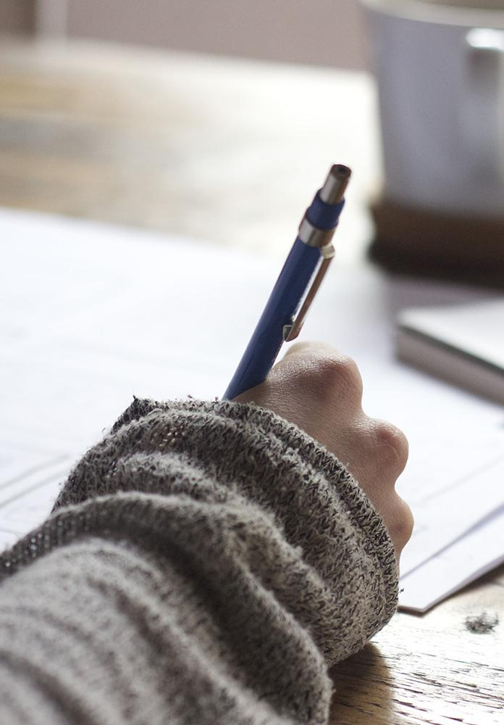
Hello!
I am Jayden Smith
I am here because I love to give presentations.
You can find me at @username

Slide 3
1.
What are
generators?

Slide 4
2.
How can they help me write asynchronously?

Slide 5
Quotations are commonly printed as a means of inspiration and to invoke philosophical thoughts from the reader.

Slide 6
This is a slide title
Here you have a list of items
And some text
But remember not to overload your slides with content
You audience will listen to you or read the content, but won’t do both.

Slide 7
Current Asynchronous Programming
Callbacks
Promises

Slide 8
Callback Functions
Pros
Perform functions asynchronously in single-threaded JS environment
Cons
Callback Hell
Loss of fundamental keywords (return and throw)
Loss of the stack
Functions operate on side effects

Slide 9
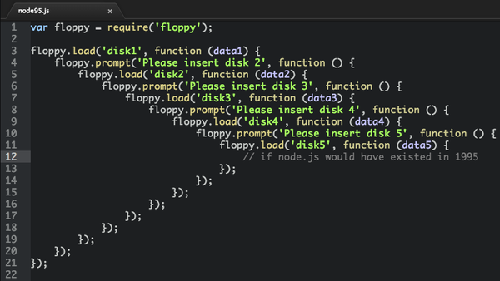
Callback
Hell

Slide 10
Promises
Pros
No more Callback Hell!
Return and throw
More readable code
Return of the stack
Cons
Can be confusing to understand and implement
Difficult to implement with complex logic

Slide 11
ES6
Generators

Slide 12
A generator is a special function that you can pause and resume at many points.

Slide 13
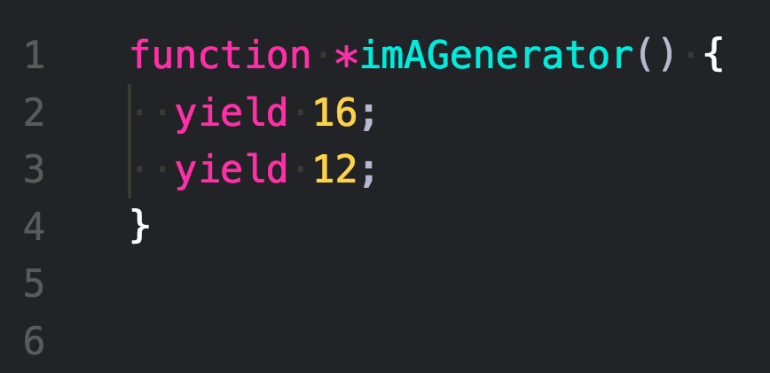
Anatomy
of a Generator

Slide 14
Anatomy
of a Generator

Slide 15
In two or three columns
Yellow
Is the color of gold, butter and ripe lemons. In the spectrum of visible light, yellow is found between green and orange.
Blue
Is the colour of the clear sky and the deep sea. It is located between violet and green on the optical spectrum.
Red
Is the color of blood, and because of this it has historically been associated with sacrifice, danger and courage.

Slide 16

A picture is worth a thousand words

Slide 17
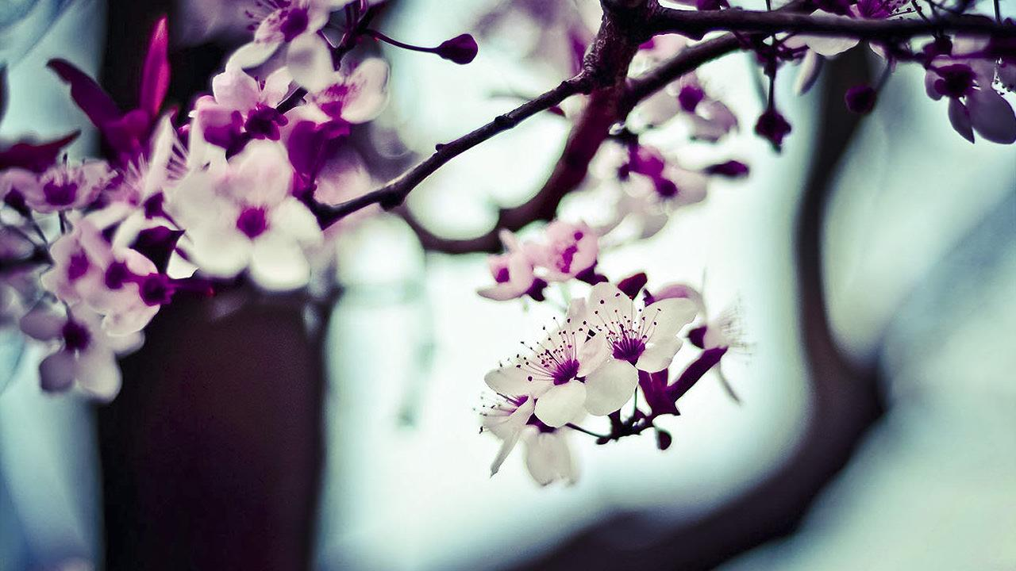
Want big impact?
Use big image.

Slide 18
Use charts to explain your ideas
White
Black
Gray

Slide 19
And tables to compare data
 | A | B | C
Yellow | 10 | 20 | 7
Blue | 30 | 15 | 10
Orange | 5 | 24 | 16

Slide 20
Maps
our office

Slide 21
89,526,124
Whoa! That’s a big number, aren’t you proud?

Slide 22
89,526,124$
185,244 users
100%
That’s a lot of money
And a lot of users
Total success!

Slide 23
Our process is easy
first
second
last

Slide 24
Let’s review some concepts
Yellow
Is the color of gold, butter and ripe lemons. In the spectrum of visible light, yellow is found between green and orange.
Blue
Is the colour of the clear sky and the deep sea. It is located between violet and green on the optical spectrum.
Red
Is the color of blood, and because of this it has historically been associated with sacrifice, danger and courage.
Yellow
Is the color of gold, butter and ripe lemons. In the spectrum of visible light, yellow is found between green and orange.
Blue
Is the colour of the clear sky and the deep sea. It is located between violet and green on the optical spectrum.
Red
Is the color of blood, and because of this it has historically been associated with sacrifice, danger and courage.

Slide 25
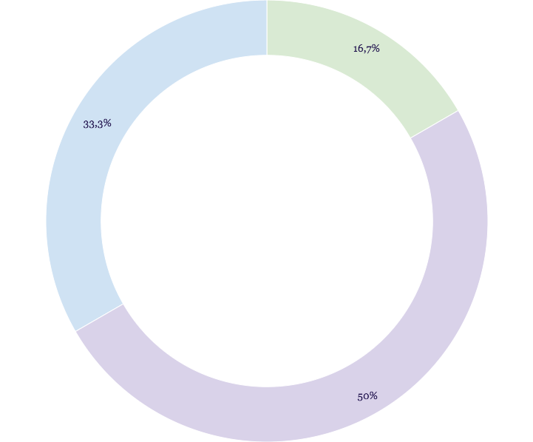
You can insert graphs from Google Sheets

Slide 26
Android project
Show and explain your web, app or software projects using these gadget templates.
Place your screenshot here

Slide 27
iPhone project
Show and explain your web, app or software projects using these gadget templates.
Place your screenshot here

Slide 28
Tablet project
Show and explain your web, app or software projects using these gadget templates.
Place your screenshot here

Slide 29
Desktop project
Show and explain your web, app or software projects using these gadget templates.
Place your screenshot here

Slide 30
Thanks!
Any questions?
You can find me at @username and user@mail.me

Slide 31
Credits
Special thanks to all the people who made and released these awesome resources for free:
Presentation template by SlidesCarnival
Photographs by Unsplash

Slide 32
Presentation design
This presentation uses the following typographies and colors:
Titles: Abril Fatface
Body copy: Raleway
You can download the fonts on this page:
https://www.fontsquirrel.com/fonts/abril-fatface
https://www.fontsquirrel.com/fonts/raleway
Pastel green #bdece5
Pastel blue #afcfec
Violet #c0cafc
You don’t need to keep this slide in your presentation. It’s only here to serve you as a design guide if you need to create new slides or download the fonts to edit the presentation in PowerPoint®

Slide 33
SlidesCarnival icons are editable shapes.
This means that you can:
Resize them without losing quality.
Change fill color and opacity.
Change line color, width and style.
Isn’t that nice? :)
Examples:

Slide 34
😉
Now you can use any emoji as an icon!
And of course it resizes without losing quality and you can change the color.
How? Follow Google instructions https://twitter.com/googledocs/status/730087240156643328
✋👆👉👍👤👦👧👨👩👪💃🏃💑❤😂😉😋😒😭👶😸🐟🍒🍔💣📌📖🔨🎃🎈🎨🏈🏰🌏🔌🔑 and many more...

