Slide 1
LightTrap Simulation — Analysis Summary
Two-layer WLS light trap · Geant4 optical photon transport
Run: output_apexltsim0.root · 10,000,000 primary photons
Source: analysis/analyze_lighttrap.ipynb (PyROOT + RDataFrame)

Slide 2
OVERVIEW
Device & simulation data model
• Two-layer light trap converts UV → blue, guides light to edge SiPMs
  – First layer: thin pTP film on UV-transparent acrylic carrier — absorbs incident UV, re-emits near-UV/blue
  – Second layer: blue-WLS acrylic slab — re-emits blue, transports by TIR
  – SiPMs sit flush to the ±y edges of the slab; Vikuiti ESR foil backs it
  – 15 cm × 15 cm module; pTP 2 µm / UV-acrylic 3 mm / LAr gap 3 mm / blue slab 6 mm
• 9 TTrees record every stage of the photon chain
  – Primary, WLSPhoton (births), SiPMPhotons/SiPMHits (pre/post-PDE)
  – Leak counters: FirstLayerBackplane / FirstLayerEdges / SecondLayerBackplane
  – OpticalValidation: Fresnel refl/ transmit at first surface
10.0 M
primary photons
14.1 M
WLS births
558 k
reach SiPM
333 k
detected p.e.

Slide 3
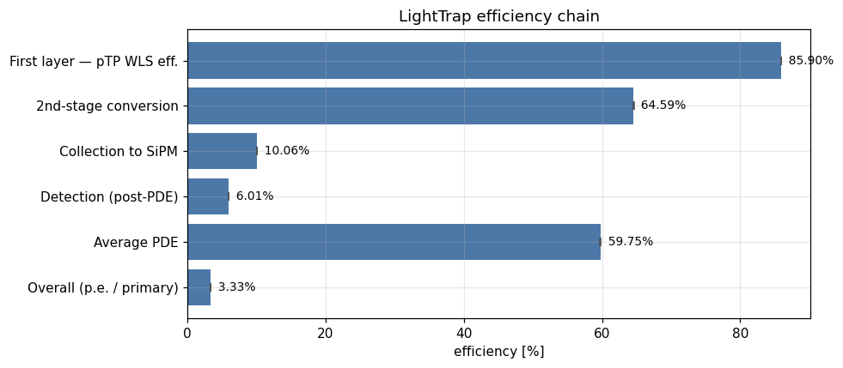
KEY RESULT
Efficiency chain
85.90%
pTP WLS eff. (N_pTP / N_primary)
10.06%
collection (SiPM / blue)
6.01%
detection (hits / blue)
3.34%
overall (p.e. / primary)

Slide 4
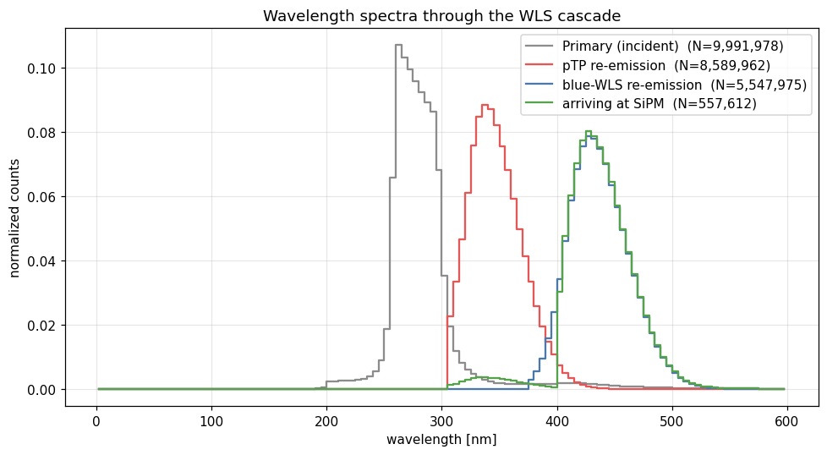
SPECTRA
Wavelength spectra — the WLS cascade
• Each stage shifts redward
  – Incident primary UV is absorbed by pTP
  – pTP re-emits in the near-UV/blue
  – Blue-WLS slab re-emits deeper blue
  – Spectrum arriving at SiPM matches the blue-WLS emission, folded with transport
• Confirms the two-stage down-conversion works as designed

Slide 5
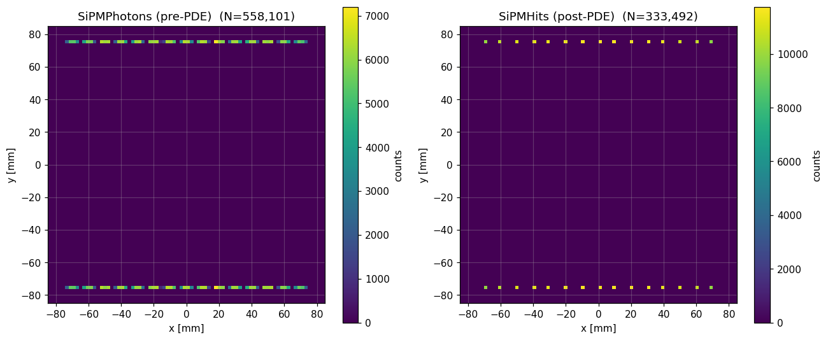
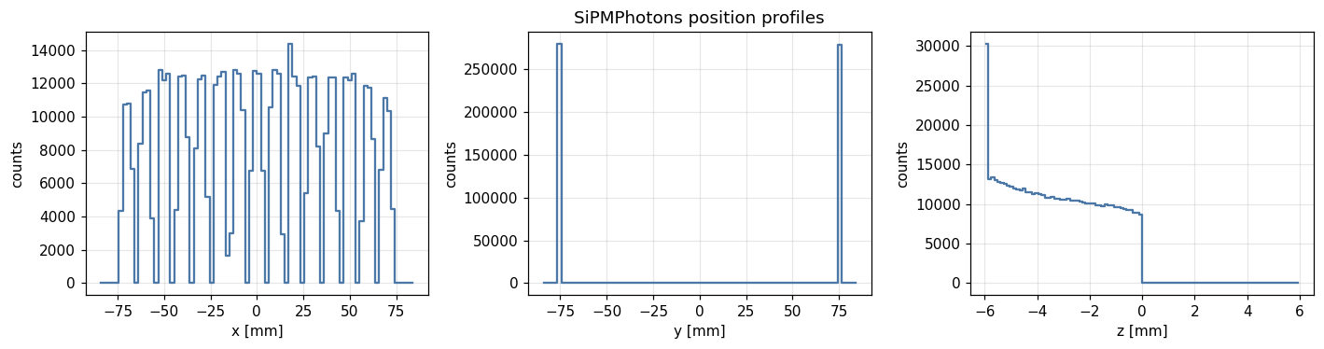
GEOMETRY CHECK
SiPM spatial hit maps
• Two bands at y ≈ ±75 mm
  – Confirms SiPMs on the ±y slab edges
  – Pre-PDE vs post-PDE shows detection thinning (≈60% PDE)
  – z-profile clusters at the blue-slab depth
• 558 k reach SiPM → 333 k detected

Slide 6
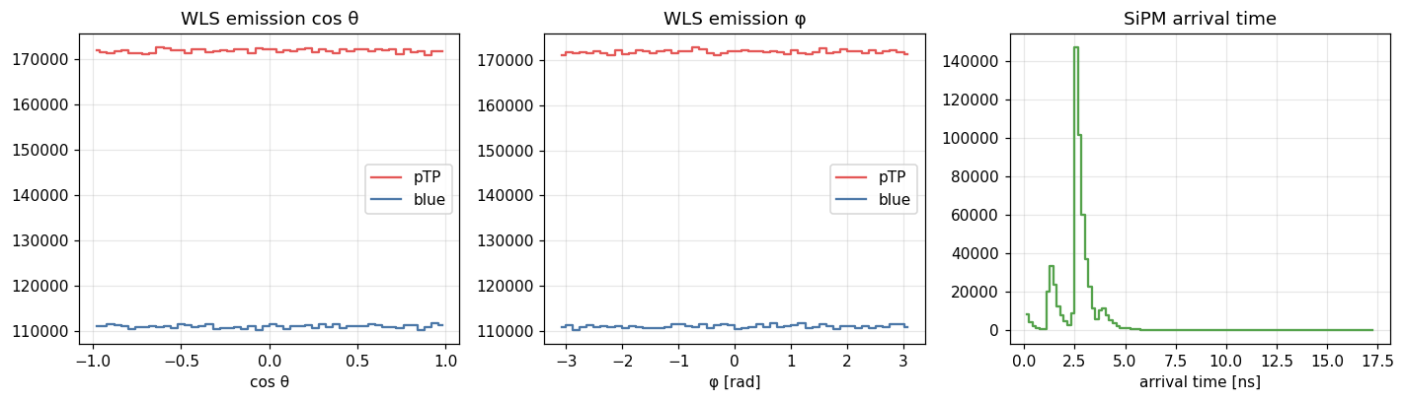
DIAGNOSTICS
Angular & timing distributions
WLS emission cos θ and φ (isotropy check) · photon arrival time at the SiPMs
• cos θ and φ are flat → isotropic re-emission for both pTP and blue emitters; arrival-time spread reflects TIR path-length variation

Slide 7
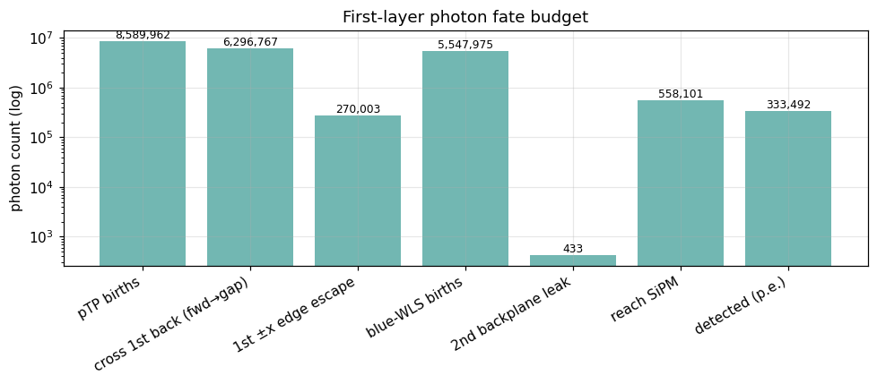
LOSS ANALYSIS
Photon fate budget & leak accounting
• Where first-layer light goes
  – 8.59 M pTP births
  – 11.3 M cross the 1st back face into the gap
  – 270 k escape laterally at ±x edges (loss)
  – 5.55 M blue-WLS births downstream
  – Only 433 leak through the 2nd backplane (Vikuiti works)
• Dominant loss is optical transport, not backplane leakage

Slide 8
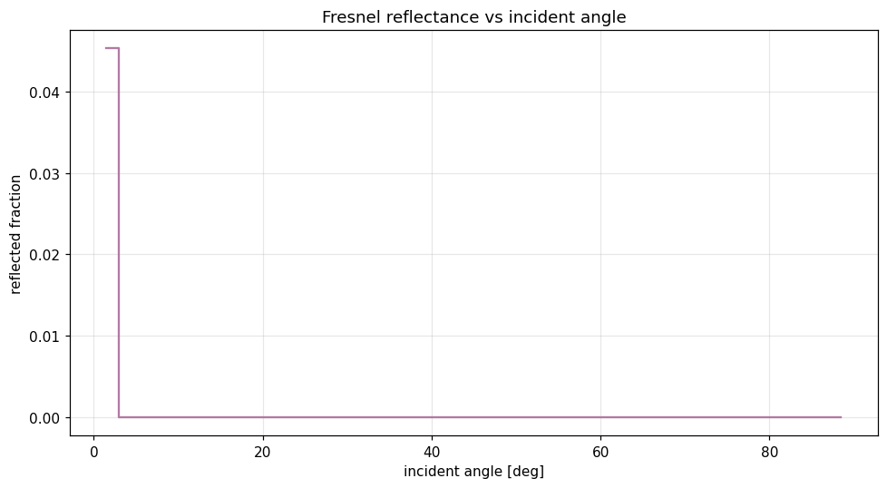
SANITY CHECK
Optical validation — Fresnel reflectance
• Reflected fraction rises with incident angle
  – Expected Fresnel behaviour at the first surface
  – 4.53% of 10 M primaries reflected overall
  – 95.47% transmitted into the stack
• Confirms surface optics are modelled correctly

Slide 9
TAKEAWAYS
Summary & conclusions
85.90%
pTP WLS efficiency
64.59%
2nd-stage conversion
10.06%
collection to SiPM
59.76%
average PDE
3.34%
detected photoelectrons per incident primary
• pTP first-layer conversion is highly efficient (86%)
• End-to-end yield is transport-limited: collection to the SiPMs is the bottleneck (~10%)
• Backplane leakage is negligible (433 of millions) — Vikuiti foil performs
• Lateral ±x edge escape (270 k) is a recoverable loss channel
• Reproducible: re-point ROOT_FILE in the notebook to analyze any run

Slide 10
The new scripts run the simulation with and without PTFE or Vikuiti foils at the backplane.
An analysis script comparing those results needs to be written.

