Slide 1
LightTrap Detector — Geometry
A two-stage wavelength-shifting light trap immersed in liquid argon
VUV LAr scintillation (128 nm) → pTP film → UV acrylic carrier →
LAr gap → blue WLS slab → edge SiPMs (Broadcom PDE)
Geometry as built in src/construction.cc · default parameters

Slide 2
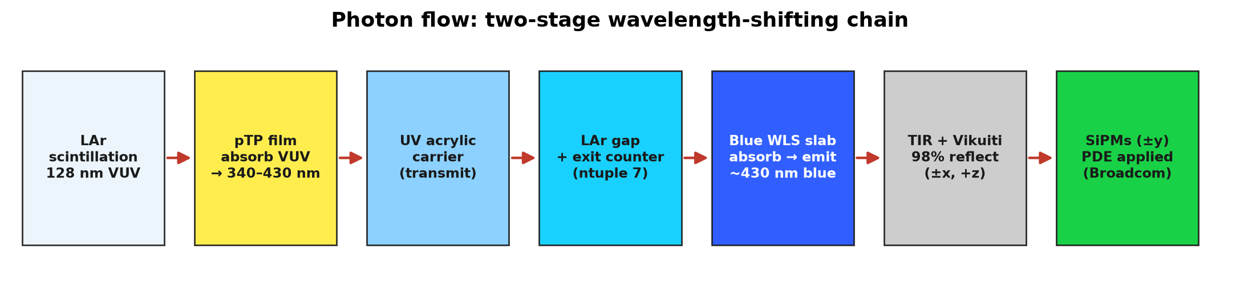
OVERVIEW
Concept & photon flow
▸ Purpose: efficiently convert 128 nm VUV argon scintillation into blue light that SiPMs can detect, over a large-area, thin module.
▸ Two wavelength-shifting (WLS) stages in series:
  – Stage 1 — p-terphenyl (pTP) film absorbs VUV and re-emits at 340–430 nm.
  – Stage 2 — blue-shifting acrylic slab absorbs 340–430 nm and re-emits at ~430 nm.
▸ Blue photons are guided inside the 6 mm slab by total internal reflection and 98% Vikuiti (3M ESR) reflectors, then read out by 30 SiPMs on the ±y edges.
▸ Everything sits inside a liquid-argon world that is both the scintillator and the optical propagation medium.
LightTrap detector geometry · source: src/construction.cc
2

Slide 3
FRAME OF REFERENCE
Coordinate system & module envelope
▸ Right-handed x–y–z; photons of interest propagate in +z.
▸ z reference: the back (+z) face of the blue WLS slab is z = 0.
▸ All component z-positions are derived from the layer thicknesses, so changing any thickness shifts everything downstream consistently.
▸ Lateral size (x, y): 150 × 150 mm square module (lightTrapSize = 15 cm).
▸ World volume: liquid-argon box, 60% larger on each side → 180 × 180 × 180 mm; rendered invisible so daughters show.
▸ Full stack spans z ≈ −12.0 mm (pTP front face) to +0.165 mm (back of leak detector).
Key envelope numbers
Quantity | Value
Module x, y | 150 × 150 mm
World box | 180³ mm (LAr)
Stack depth (z) | ≈ 12.2 mm
z = 0 datum | blue-WLS back face
Photon axis | +z
LightTrap detector geometry · source: src/construction.cc
3

Slide 4
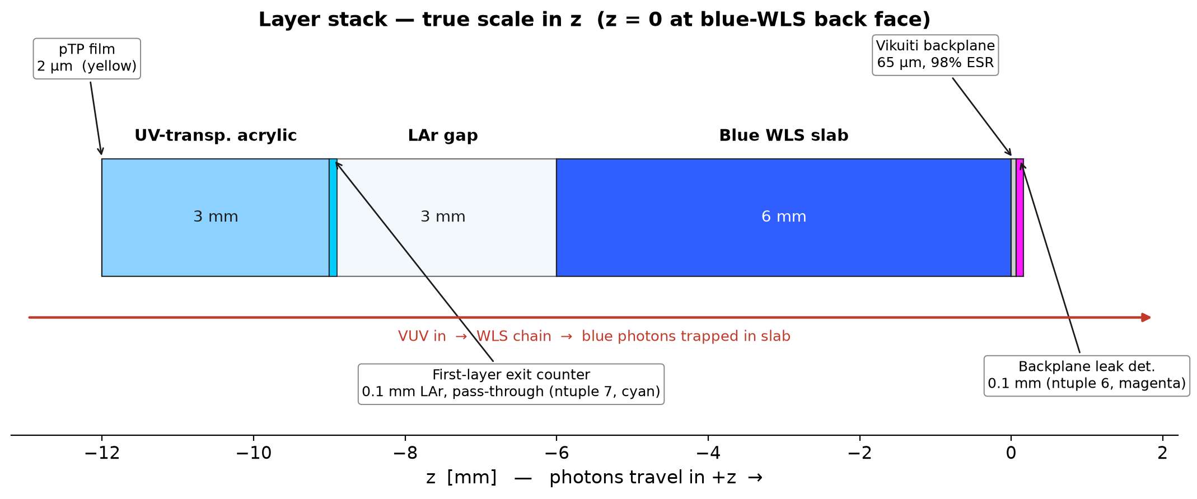
THE STACK
Layer stack (side view, true scale in z)
Sub-millimetre features (pTP 2 µm, Vikuiti 65 µm, the two 0.1 mm counter slabs) are called out; the mm-scale acrylic carrier, LAr gap and WLS slab are drawn to scale.
LightTrap detector geometry · source: src/construction.cc
4

Slide 5
GEOMETRY DETAIL
Layer-by-layer breakdown
Component | z-range [mm] | Thick. | Material | Role
pTP WLS film | −12.002 … −12.000 | 2 µm | pTP (C₁₈H₁₄) | 1st WLS: VUV → 340–430 nm
UV-transp. acrylic | −12.000 … −9.000 | 3 mm | PMMA UVT | Carrier; transmits near-UV, absorbs residual VUV
First-layer backplane counter | −8.990 … −8.890 | 0.1 mm | LAr (worldMat) | Pass-through counter → ntuple 7 (FirstLayerBackplane); 0.01 mm behind back face (TIR-aware)
LAr gap | −9.000 … −6.000 | 3 mm | liquid argon | Optical gap, first layer → blue slab
Blue WLS slab | −6.000 … 0.000 | 6 mm | blue WLS acrylic (C₉H₁₀) | 2nd WLS: → ~430 nm; light guide
Vikuiti backplane foil | 0.000 … 0.065 | 65 µm | PMMA + ESR skin | 98% back reflector (+z face)
Backplane leak detector | 0.065 … 0.165 | 0.1 mm | LAr (worldMat) | Terminal counter → ntuple 6 (SecondLayerBackplane)
SiPMs (±y edges) | at z-centre −3 | 6×6 mm face | LAr + PDE | 30 total, 15 per edge; readout
Vikuiti edge foils (±x) | at z-centre −3 | 65 µm | PMMA + ESR skin | Lateral reflectors (no SiPMs on ±x)
First-layer edge counters (±x) | spans first layer (−12.0 … −9.0) | 0.1 mm | LAr (worldMat) | Pass-through counter → ntuple 8 (FirstLayerEdges)
LightTrap detector geometry · source: src/construction.cc
5

Slide 6
MATERIALS
Materials & optical properties
Material | Composition | ρ [g/cm³] | n | Key optical role
pTP | C₁₈H₁₄ | 1.23 | 1.65 | WLS abs 106–305 nm, emit 340–430 nm; τ = 1.136 ns
UV-transp. acrylic | C₅H₈O₂ (PMMA) | 1.19 | 1.49–1.55 | UV-transparent carrier; strong VUV absorption
Blue WLS acrylic | C₉H₁₀ (EJ-280-type) | 1.023 | 1.58 | WLS abs 340–430 nm, emit ~430 nm; τ = 1.26 ns
acrylic (McMaster) | C₅H₈O₂ (PMMA) | 1.19 | 1.50 | Body material for Vikuiti foils
Liquid argon (world) | G4_lAr | 1.40 | 1.23–5.45 | Scint. peak 128 nm, 24000 γ/MeV, τ 7 / 1400 ns; Rayleigh 90 cm
▸ Refractive index of LAr is strongly dispersive in the VUV (n rises from 1.23 in the visible to 5.45 at 106 nm) — all tables are defined on 13 wavelength points (530 → 106 nm), densified across 115–145 nm to bracket the 128 nm scintillation peak.
▸ LAr also carries SCINTILLATIONYIELD1/2 = 0.75 / 0.25 (fast/slow), RESOLUTIONSCALE = 1.0, Birks constant 0.694 mm/MeV.
▸ Any of these tables can be overridden from sim_config.yaml (materials: section); otherwise the hard-coded defaults above apply.
LightTrap detector geometry · source: src/construction.cc
6

Slide 7
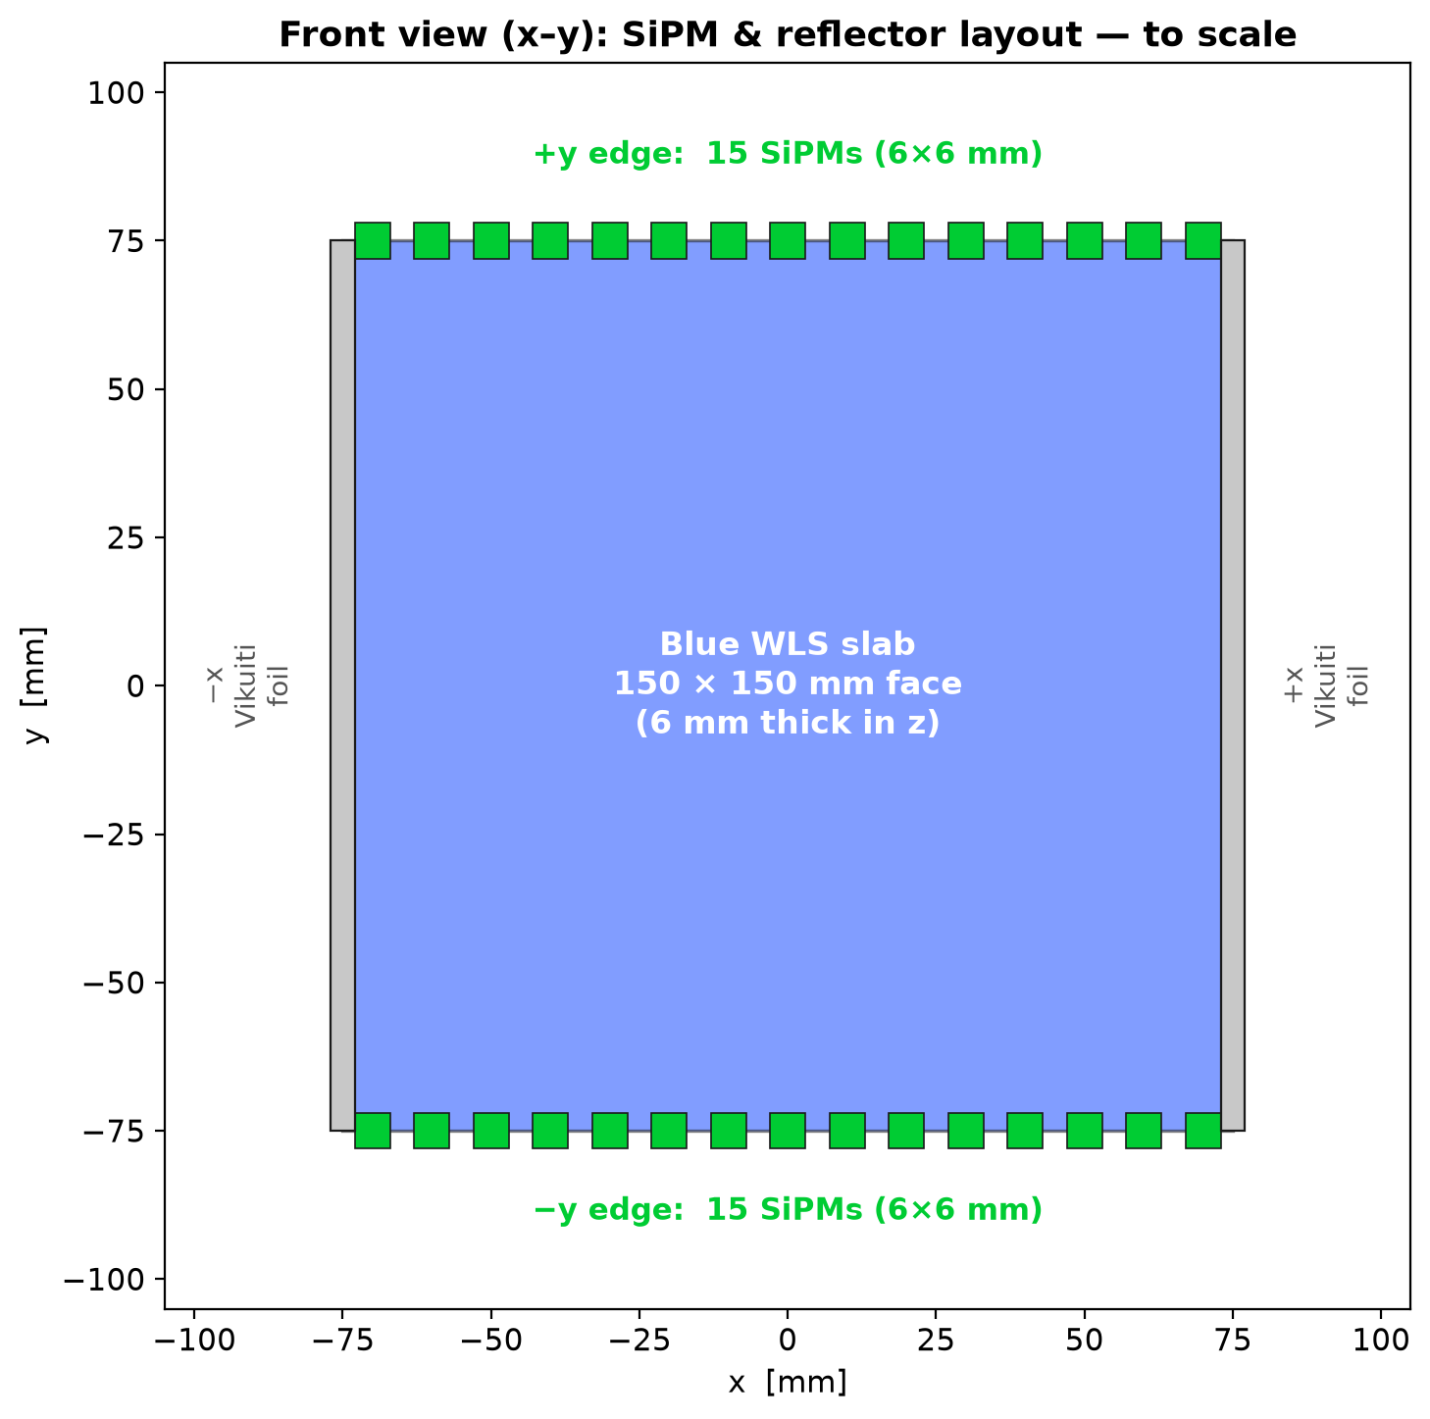
READOUT
SiPM array & readout
▸ 30 SiPMs total, split 15 / 15 across the +y and −y edges of the blue WLS slab.
▸ Each SiPM presents a 6 × 6 mm sensitive face against the slab edge; 1 mm depth extends outward in ±y.
▸ SiPM z half-size = slab half-thickness (3 mm) → the face spans the full 6 mm slab edge.
▸ Uniform x-pitch = 150 / 15 = 10 mm; centres at x = −70 … +70 mm.
▸ Copy numbers: 0–14 = +y edge, 15–29 = −y edge.
▸ Sensitive detector 'SensitiveDetector' applies the Broadcom PDE table (pde_broadcom.dat) per photon.
▸ The ±x edges carry no SiPMs — they are covered by Vikuiti reflectors instead.
LightTrap detector geometry · source: src/construction.cc
7

Slide 8
LIGHT CONTAINMENT
Reflectors — 3M Vikuiti / ESR
▸ Vikuiti Enhanced Specular Reflector (ESR): dielectric-metal optical surface, ground/unified finish, 98% reflectivity (flat across all 13 wavelengths).
▸ Implemented as G4LogicalSkinSurfaces on thin PMMA foil volumes (65 µm), so both faces reflect.
Reflector | Location | Size | Function
Backplane foil | +z face of slab (z: 0 … 0.065) | 150 × 150 mm | Reflects ~98% forward-leaking light back to SiPMs; ~2% transmits to leak detector
Edge foil +x | +x face of slab | 150 (y) × 6 (z) mm | Lateral reflector — recycles photons toward ±y SiPM edges
Edge foil −x | −x face of slab | 150 (y) × 6 (z) mm | Lateral reflector — recycles photons toward ±y SiPM edges
LightTrap detector geometry · source: src/construction.cc
8

Slide 9
DIGITISATION
Sensitive detectors & output ntuples
Detector | Volume | Class / mode | Output | Records
SiPM readout | logicSiPMs (×30) | MySensitiveDetector (PDE) | SiPMPhotons (0), SiPMHits (1) | All photons at SiPM face (0); Broadcom-PDE-detected subset (1)
First-layer backplane counter | logicFirstLayerExitDet | MyLeakDetector, pass-through (killTrack = false) | ntuple 7 'FirstLayerBackplane' | eventID, x, y, z, t, wavelength, cosθz, forward — track continues
Backplane leak detector | logicBackplaneLeakDet | MyLeakDetector, terminal (killTrack = true) | ntuple 6 'SecondLayerBackplane' | Same fields incl. forward flag; track killed on entry
First-layer edge counters (±x) | logicFirstLayerEdgeDet (×2) | MyLeakDetector, pass-through (killTrack = false) | ntuple 8 'FirstLayerEdges' | Same fields incl. forward flag; track continues
▸ The first-layer backplane counter is a 0.1 mm LAr slab set 0.01 mm behind the first-layer back (+z) face, so photons total-internally-reflected at that face are not counted — only light that escapes the first layer is recorded. Built from world material (same n), it adds no optical boundary and does not kill the photon.
▸ Direction is tagged two ways: cosθz (momentum-z cosine) and an explicit forward flag (1 = +z, out of layer 1; 0 = back-going). This separates first-layer light from photons reflected by the second-layer Vikuiti backplane foil that escape back toward the counter (forward = 0).
▸ Pairing WLSPhoton (birth) with FirstLayerBackplane[forward = 1] gives the first-layer transport / collection efficiency.
LightTrap detector geometry · source: src/construction.cc
9

Slide 10
SURFACE PHYSICS
Optical surfaces
▸ pTP interface surface — both faces of the pTP film (outer LAr-facing and inner acrylic-facing) share one ground/unified dielectric-dielectric surface, applied as G4LogicalBorderSurfaces in both directions on pTP↔LAr and pTP↔UV-acrylic.
▸ Its facet-slope RMS is pTPsigmaAlpha (radians), configurable via geometry.pTPsigmaAlpha_rad or /detector/pTPsigmaAlpha. Default = 0 → perfectly smooth, specular Fresnel.
▸ Physics note: a perfectly smooth 2 µm film total-internal-reflects ~55% of WLS photons and traps them. Raising sigmaAlpha (e.g. 0.1 rad ≈ 6°) models evaporated-film roughness so guided modes scatter out within a few bounces.
▸ Vikuiti skin surfaces — dielectric-metal, ground/unified, 98% reflectivity, on the backplane and both ±x edge foils.
LightTrap detector geometry · source: src/construction.cc
10

Slide 11
TUNABILITY
Configurable parameters
▸ Geometry is driven by the /detector/ messenger; sim_config.yaml (geometry: section) sets these at startup, else constructor defaults apply.
YAML key | Messenger | Default | Meaning
lightTrapSize_cm | /detector/lighttrapsize | 15 cm | Square module side (x, y)
pTPLayerThickness_mm | /detector/pTPlayerthickness | 2 µm | pTP WLS film thickness
uvAcrylicThickness_mm | /detector/uvAcrylicThick | 3 mm | UV-transparent carrier thickness
LArThickness_mm | /detector/LArthickness | 3 mm | LAr gap, first layer → blue slab
pTPSubstrateThickness_mm | /detector/pTPsubstratethickness | 6 mm | Blue WLS slab thickness
nSiPMs | /detector/nSiPMs | 30 | Total SiPMs (split across ±y)
pTPsigmaAlpha_rad | /detector/pTPsigmaAlpha | 0.0 | pTP surface facet-slope RMS [rad]
LightTrap detector geometry · source: src/construction.cc
11

