Slide 1
SAP BDC AUTHORIZATION WIZARD
Row-Level Security, Simplified
A guided platform for building, testing, and synchronizing role-based data access in SAP BDC
Presales Overview | 2026

Slide 2
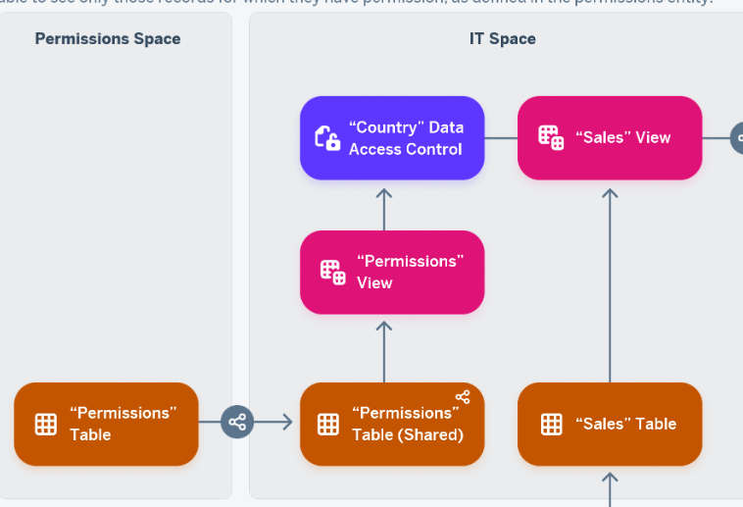
Data Access Control
Row-level security to your objects in SAP BDC
Data Access Controls enable row-level security by controlling which data users can access.
When applied to a data layer view or business layer object, access is dynamically filtered based on predefined security criteria.
The foundation of this approach is the Permission Table/View — it stores the access rules and restriction criteria that determine what data each user can see.
Key Question:
How do we effectively maintain and manage the records in permission tables/views to ensure accurate and governed data access?
SAP BDC Authorization Wizard
10

Slide 3



Strategies to Populate Permission Tables
Three paths to keep row-level authorizations current — trade-offs at a glance
Manual Maintenance
Role Synchronization
Role name split
Data Builder / CSV Upload
S/4HANA or SAP BW Role Sync
Haribo - Way
PROS
PROS
PROS
No integration build required
Full manual control for one-off or ad-hoc changes
Works even without a live source-system connection
Reuses existing S/4 or BW role investments
Familiar governance model for SAP security teams
Good fit where org already standardized on PFCG/BW roles
No separate mapping table needed
Leverages the approvement process in GRC
Clear visibility about data access restriction
CONS
CONS
CONS
Labor-intensive at scale; slow to update
Prone to human error and inconsistent formatting
No automatic link to source-of-truth ownership data
Coarser granularity — not built for row-level filters
Two systems to keep aligned; drift risk over time
Extra mapping layer needed to translate roles into restrictions
Not applicable for cloud-only or Non-SAP dimensions
Coarser granularity — not built for row-level filters (e.g. cost center authorization)
High dependency on perfect naming conventions
Another procedure for a complex rules (e.g. DEHO)
SAP BDC Authorization Wizard
10

Slide 4



The Business Challenge
Manual, database-level row security doesn't scale with the enterprise
Slow & Error-Prone
Difficult to Audit
Central IT Bottleneck
Fragmented Sync
Editing row-level permissions directly in the database is manual, hard to repeat, and easy to get wrong.
Without a structured trail, proving who changed what — and why — becomes a compliance risk.
Every new plant, region, or customer segment needs a new role, queued behind a central security team.
Keeping SAP HANA and Datasphere authorizations aligned with source systems is a constant, brittle chore.
SAP BDC Authorization Wizard
2

Slide 5
Authorization Governance Center
The true paths to handle row-level authorizations
Centralized, self-service governance platform that replaces complex database script queues with a guided interface to create, validate, and synchronize row-level raw-level restriction in SAP BDC
🛡️ Decentralized Self-Service: Enables local business administrators to safely build and assign localized access rules (derived child roles) under template structures maintained by central IT.
⚡ High-Performance Query Isolation: Segregates permissions into stream-specific namespaced database tables. This prevents single-table database bottlenecks and isolates different access scopes (such as Sales Reporting vs. Planning).
🤖 DRAGE Automation: Auto-generates roles and maps user assignments directly from ownership fields in master data assets .
🔍 Audit: Automatic Activity Tracking Every time a role is modified, created, or assigned to an employee, the system logs the activity automatically. No spreadsheets or manual records are needed.
SAP BDC Authorization Wizard
10

Slide 6
One Platform, Three Layers
A guided front end, a governed engine, and native replication into your SAP BDC Landscape
EXPERIENCE
Dashboard
Authorization Wizard
Organization Manager
Audit Tracker
CORE LOGIC
Auth Guard
Effective Restriction Resolver
Org Role Generator
DRAGE Sync Engine
TARGET SYSTEMS
SAP HANA
SAP Datasphere / BDC Cloud
SAP BDC Authorization Wizard
3

Slide 7





Application Modules
Six connected modules cover the full lifecycle, from modeling to audit
Dashboard
Organization Manager
Authorization Wizard
Health Center view of risk flags, active roles, users, and org coverage at a glance.
Model the Global → Region → Plant hierarchy and map attributes to each node.
Guided four-step flow to define, simulate, and deploy role restrictions.
Role Assignments
Audit Tracker
Administration
Assign derived roles to users and teams, with inheritance enforced automatically.
Append-only log of every create, update, and delete, with full before/after diffs.
Manage BDC connections, restriction fields, and DRAGE sync rules centrally.
SAP BDC Authorization Wizard
5

Slide 8

What the Wizard Delivers
Four capabilities that turn row-level security into a governed, self-service process
Visualize the Org Tree
Guided Role Wizard
Model Global → Region → Plant hierarchies and auto-generate roles from mapped attributes.
A four-step flow to define restrictions, simulate access, and route for approval before deploy.
Decentralized Self-Service
Automated Replication
Central IT owns global templates; local admins create and assign derived roles autonomously.
Nested rules expand into flat rows and sync natively to SAP HANA and Datasphere.
SAP BDC Authorization Wizard
4

Slide 9
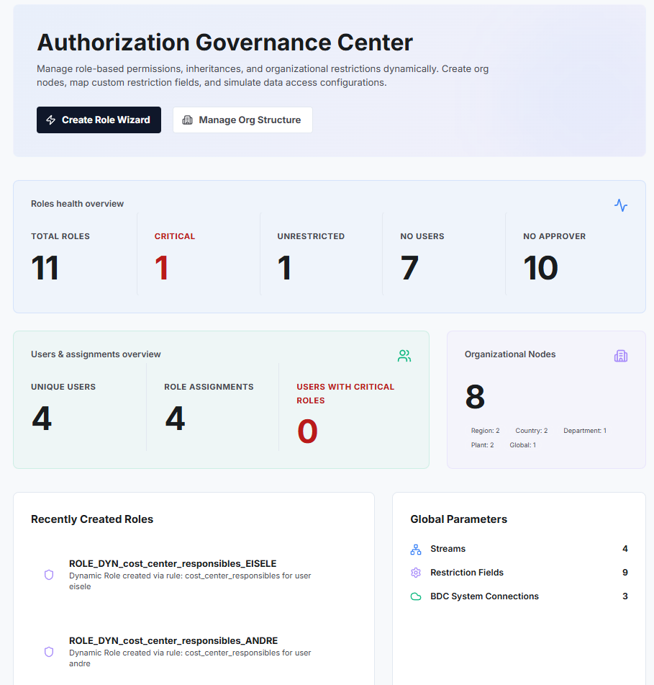
Health Center: Know Your Risk at a Glance
The dashboard surfaces exactly where authorization risk is hiding
Critical
High-risk roles granting sensitive access
Unrestricted
Roles with no restrictions, exposing excess data
No Users
Active roles assigned to nobody
No Approver
Roles lacking a designated owner
Plus at-a-glance totals for users, active assignments, and organizational nodes across every environment.
SAP BDC Authorization Wizard
5

Slide 10
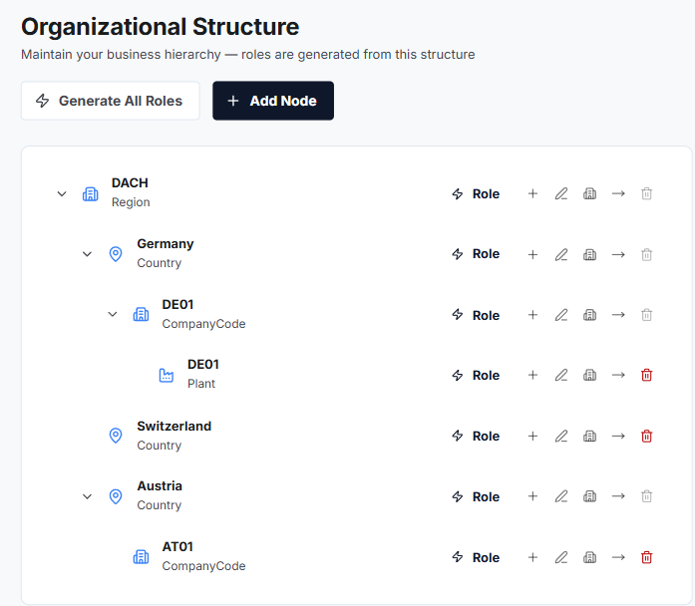
Model the Org, Generate the Roles
Build a hierarchy once; the system does the role engineering
1
Add nodes for regions, plants, or segments — build the tree once.
2
Map key-value attributes (e.g. Country, Plant) to each node.
3
Generate a role for one node, or click Generate All Roles to sync the entire hierarchy.
Attributes (e.g. Country = FR) map to each node and become role restrictions automatically.
SAP BDC Authorization Wizard
6

Slide 11
The Authorization Wizard: Four Guided Steps
From origin to deployment with impact analysis before anything goes live
1
2
3
4
Origin & Parent
Restrictions
Approvers
Review & Deploy
→
→
→
Choose Single or Organizational role type; optionally inherit from an approved parent template.
Define filters (single, range, hierarchy, wildcard)
Search and assign approvers via SCIM lookup.
Confirm downstream impact on child roles and users, then deploy.
SAP BDC Authorization Wizard
7

Slide 12
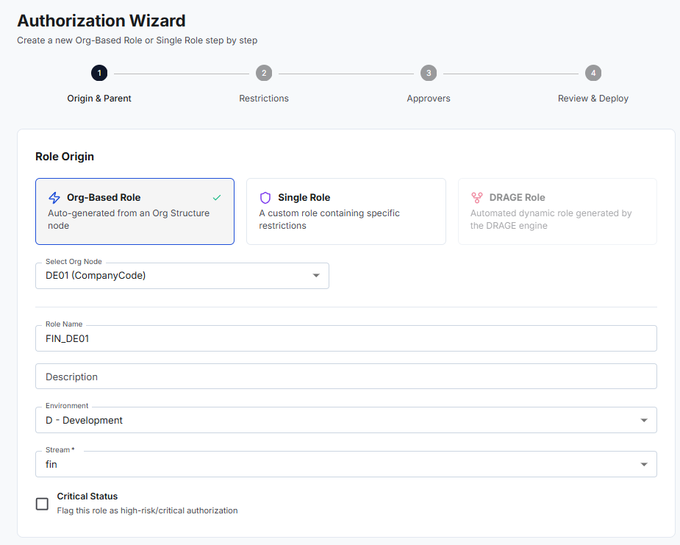
The Authorization Wizard: Four Guided Steps
From origin to deployment with impact analysis before anything goes live
SAP BDC Authorization Wizard
7

Slide 13
The Authorization Wizard: Four Guided Steps
From origin to deployment with impact analysis before anything goes live
1
2
3
4
Origin & Parent
Restrictions
Approvers
Review & Deploy
→
→
→
Choose Single or Organizational role type; optionally inherit from an approved parent template.
Define filters (single, range, hierarchy, wildcard)
Search and assign approvers via SCIM lookup.
Confirm downstream impact on child roles and users, then deploy.
SAP BDC Authorization Wizard
7

Slide 14
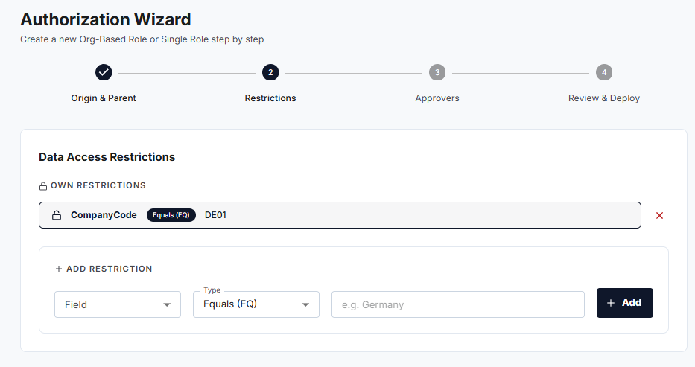
The Authorization Wizard: Four Guided Steps
From origin to deployment with impact analysis before anything goes live
SAP BDC Authorization Wizard
7

Slide 15
The Authorization Wizard: Four Guided Steps
From origin to deployment with impact analysis before anything goes live
1
2
3
4
Origin & Parent
Restrictions
Approvers
Review & Deploy
→
→
→
Choose Single or Organizational role type; optionally inherit from an approved parent template.
Define filters (single, range, hierarchy, wildcard)
Search and assign approvers via SCIM lookup.
Confirm downstream impact on child roles and users, then deploy.
SAP BDC Authorization Wizard
7

Slide 16
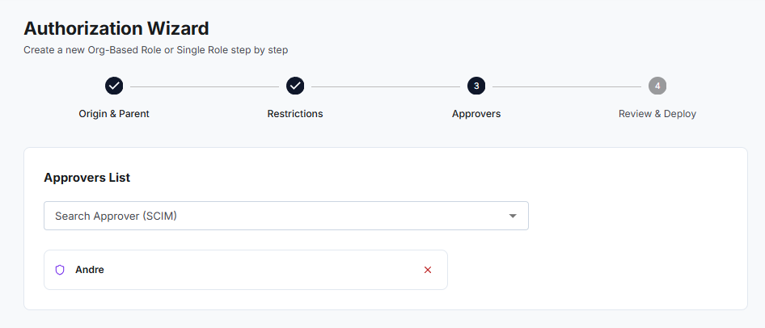
The Authorization Wizard: Four Guided Steps
From origin to deployment with impact analysis before anything goes live
SAP BDC Authorization Wizard
7

Slide 17
The Authorization Wizard: Four Guided Steps
From origin to deployment with impact analysis before anything goes live
1
2
3
4
Origin & Parent
Restrictions
Approvers
Review & Deploy
→
→
→
Choose Single or Organizational role type; optionally inherit from an approved parent template.
Define filters (single, range, hierarchy, wildcard)
Search and assign approvers via SCIM lookup.
Confirm downstream impact on child roles and users, then deploy.
SAP BDC Authorization Wizard
7

Slide 18
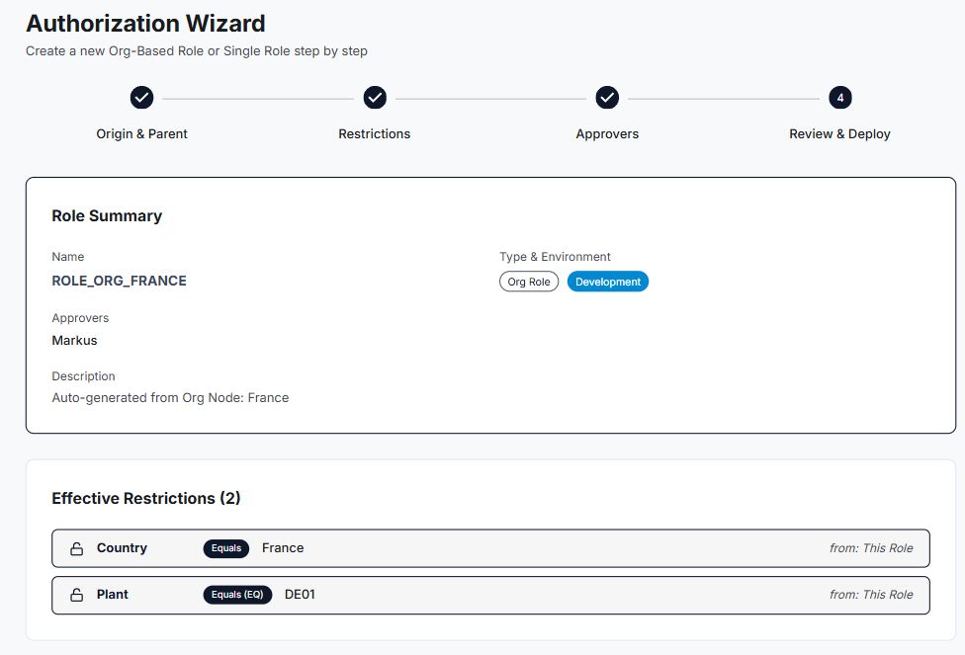
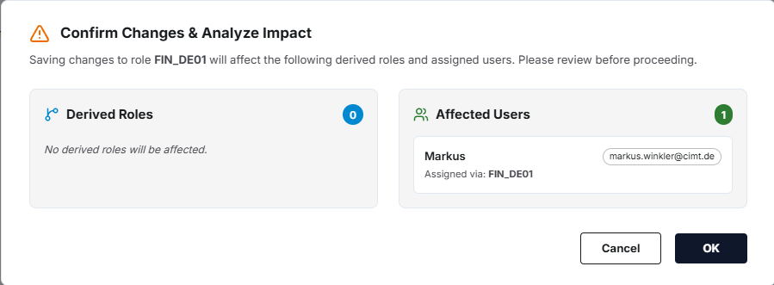
The Authorization Wizard: Four Guided Steps
From origin to deployment with impact analysis before anything goes live
SAP BDC Authorization Wizard
7

Slide 19
Central Control, Local Autonomy
Remove Central IT as the bottleneck for every regional role request
Central IT Security
Local Business Admins
Owns Parent (Single) Roles — global, structural templates
Holds the canManageSingleRoles permission exclusively
Defines approved restriction fields and structural logic (e.g. "must restrict by Company Code")
Create Derived (Child) Roles for their own region or plant
Inherit parent restrictions automatically — read-only, cannot weaken them
Add local parameters (e.g. Cost Center = FR01DE) and assign roles to their team, all without Central IT
SAP BDC Authorization Wizard
8

Slide 20

Streams: Built for Scale
Namespaced tables keep millions of row-level rules fast and organized
Isolated Performance
Simplified Organization
Targeted Data Push
Context-Based Splitting
Each stream gets its own flat table (e.g. finance_flat_authorizations) — small, index-friendly, fast.
Roles are grouped and filterable by business domain instead of one global list.
Datasphere sync pushes only the relevant stream's rows, not a full enterprise bulk sync.
The same user can hold different access scopes for the same field across streams — e.g. broader view in Sales Reporting, narrower in Sales Planning.
SAP BDC Authorization Wizard
9

Slide 21
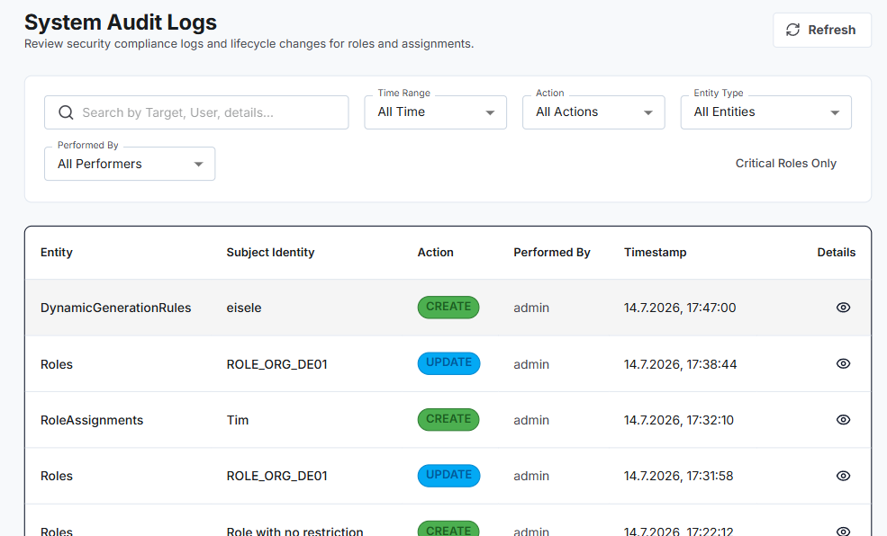
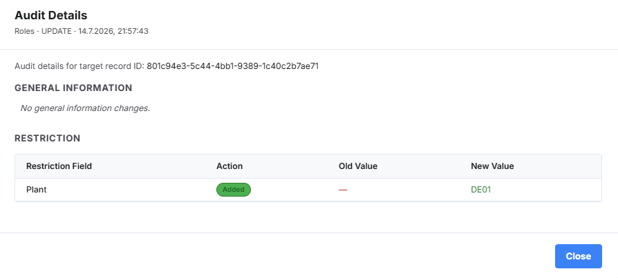
A Complete, Append-Only Audit Trail
Every change to roles, restrictions, and assignments is captured and reviewable
Filter by time range, action (Create / Update / Delete), entity type, or performer
Isolate Critical Roles Only for high-risk review
Drill into any entry for a full before/after diff of restriction changes
SAP BDC Authorization Wizard
11

Slide 22
Why SAP BDC Authorization Wizard
From Weeks to Minutes
Guided role creation and org-driven generation replace manual database edits.
Decentralized, Not Uncontrolled
Local autonomy for regional teams, global governance for Central IT.
Let's scope a pilot for your landscape.
Audit-Ready by Design
Next step: a working-session demo against one of your business streams.
Append-only trail with full before/after diffs, out of the box.
Built to Scale
Namespaced streams keep millions of row-level rules fast across

