Slide 1
SAP BDC AUTHORIZATION WIZARD
Enterprise Access Governance for SAP HANA & SAP Datasphere
Transforming manual database tables into a governed, scalable, self-service authorization platform.

Slide 2
Agenda & Discussion Points
1. The Access Governance Challenge (IT Bottlenecks & Query Slowdowns)
2. Platform Solution & Guided 4-Step Role Creation Wizard
3. Decentralized Self-Service (Delegating Child Roles safely)
4. Stream-Namespaced Architecture (Isolated HANA Table Performance)
5. Master Data Integration & DRAGE Automation Engine
6. Audit trail & ROI Value Realization

Slide 3
The Access Governance Challenge
THE MAINTENANCE BOTTLENECK
• Central IT dependency limits business unit speed.
• Manual SQL scripts to provision permission tables are error-prone.
• Deploying changes takes days or weeks, causing business workarounds.
THE PERFORMANCE BOTTLENECK
• Storing all permissions in a single, massive table degrades query execution speeds.
• High complexity when managing different access contexts (e.g. Sales Reporting vs Sales Planning) for the same user.

Slide 4
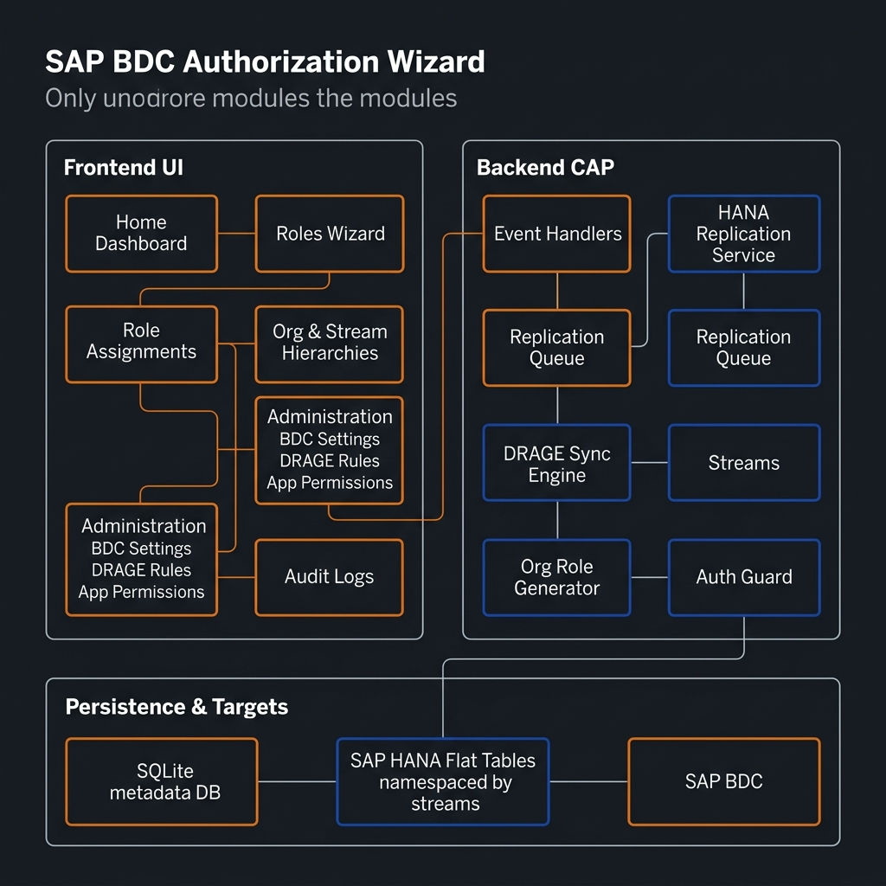
Application Module Architecture
INTEGRATED PLATFORM
✔ Structured React UI for fast rule configuration & access simulation.
✔ Thin CAP backend services handling caching, replication queues, and sync mappings.
✔ Target system deployment directly to custom SAP HANA tables.

Slide 5
Decentralized Self-Service & Role Inheritance
DELEGATING LOCAL CONTROL WITHOUT SECURITY RISK
• IT Core Management: Central IT Security controls the global Parent (Single) Roles defining standard dimensions.
• Local Autonomy: Regional admins are granted only the 'manage derived roles' permission. They cannot modify structural templates but can autonomously create sub-roles and assign permissions to their local teams.
• Automatic Cascade: Any updates made to the parent template dynamically propagate down to all derived child roles, preserving security integrity.

Slide 6
Classification Streams & Dedicated Tables
ISOLATING DATABASES BY BUSINESS DOMAIN
• Namespaced HANA Tables: Every Stream (e.g. Sales, Finance) dynamically provisions a separate, small database table: [stream_name]_flat_authorizations.
• Performance Boost: Segregating rules into isolated tables keeps indices small and ensures database queries remain near-instantaneous.
• Split Access Contexts: A user can hold a reporting role in the 'sales-reporting' stream and a planning role in the 'sales-planning' stream. Since the tables are separate, their scopes never collide or blend.

Slide 7
Predefined View Reuse
ELIMINATING SCHEMA AND VIEW DUPLICATION
• Standard Modeling Integration: The wizard links directly to the existing predefined views already used for general data modeling in SAP BDC.
• Zero Extra Overhead: Eliminates the requirement to build and maintain separate database views just to feed security restriction dropdowns.
• In-Sync Lookups: Since it reads the live master data views, all available values are always current and consistent.

Slide 8
DRAGE: Automated Role Generation Engine
DYNAMIC SECURITY IN SYNC WITH MASTER DATA
• Automated Lifecycle: Automatically creates roles and assigns users based on ownership information in BDC Assets.
• Idempotent Rule Sync: DRAGE scans, groups, and maps users. It updates active assignments and cleans up obsolete permissions automatically on sync.
• The Ignore Option: Allows mapping key columns as 'Ignore'—validating their presence on records while skipping restriction building to avoid cluttered target roles.

Slide 9
Guided Wizard & Access Simulation
PREVENTING ERRORS WITH A GUIDED FLOW
• 4-Step Flow: Walk administrators through Origin, Restrictions, Approver assignment, and Final review.
• Access Simulation: Run test checks during step 2. Enter hypothetical records in JSON to visualize what data the user can view before saving rules.
• Downstream Impact Analysis: Displays warnings detailing exactly how editing a parent role will alter inherited permissions for child roles and active users.

Slide 10
Why SAP BDC Authorization Wizard?
DELIVERING COMPLIANCE, AGILITY, AND DATABASE PERFORMANCE
✔ Agility: Access setup drops from days to minutes through secure self-service role derivation.
✔ Database Speed: Stream-isolated namespaced flat tables avoid single-table database bottlenecks.
✔ Compliance Ready: Automatic field-level diff logging provides clean, immutable compliance audit trails.
✔ IT Cost Reduction: Automated dynamic generation via DRAGE eliminates manual ticket resolution costs.

