Slide 1
Diverter
Manish and Yuliya

Slide 2
Idea
To divert packets coming from a port to different port depending upon protocol
Our case
  Listen packets in nf0
  If ICMP packets received bounce back
  If TCP and UDP packets received send to nf1

Slide 3
Implementation
Implemented in verilog and P4
LISTEN
!ICMP/TCP/UDP || !nf0
ICMP/TCP/UDP && nf0
After Last packet
DISCARD
FORWARD

Slide 4
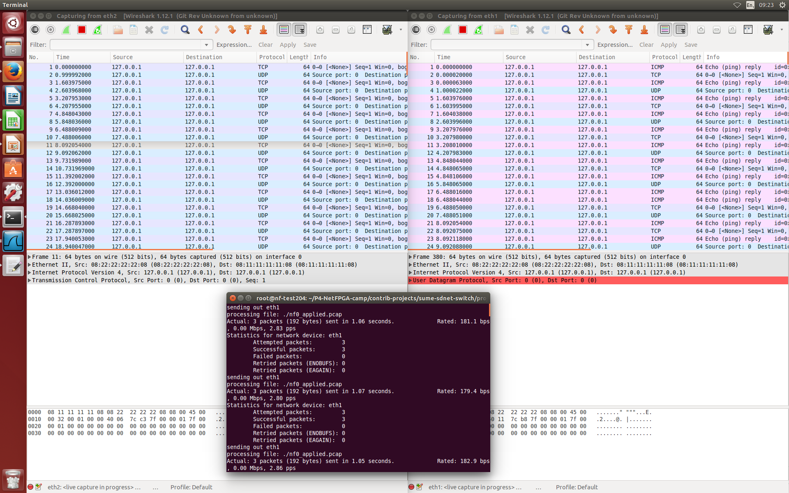
Output

