Slide 1

Airline System
Done by using Ado.net and MSSQL server

Slide 2
UML
Tables
UI
NUnit

Slide 3
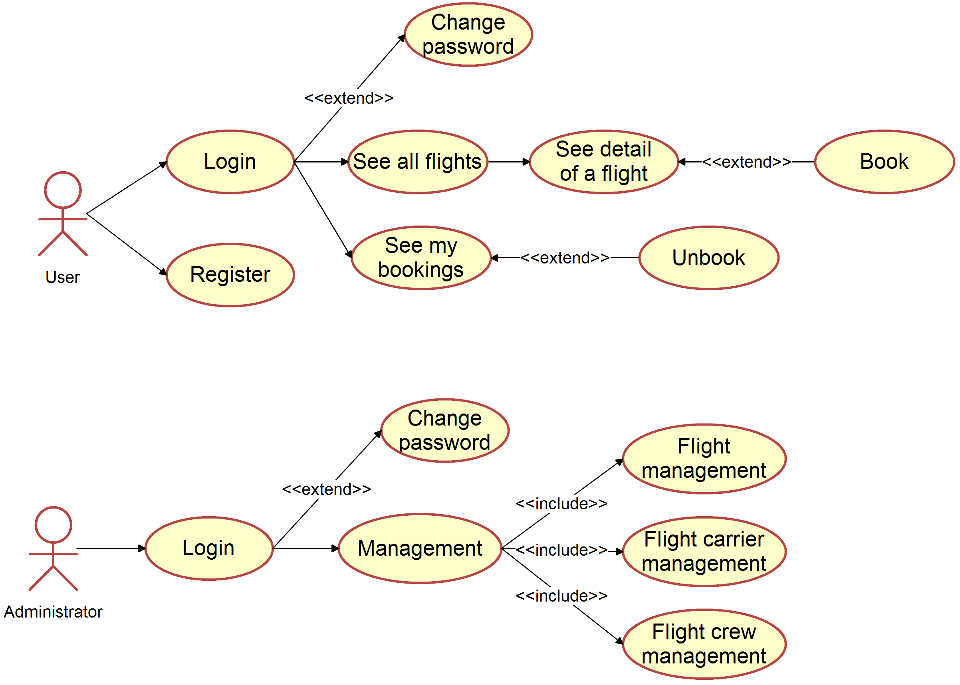
UML

Slide 4
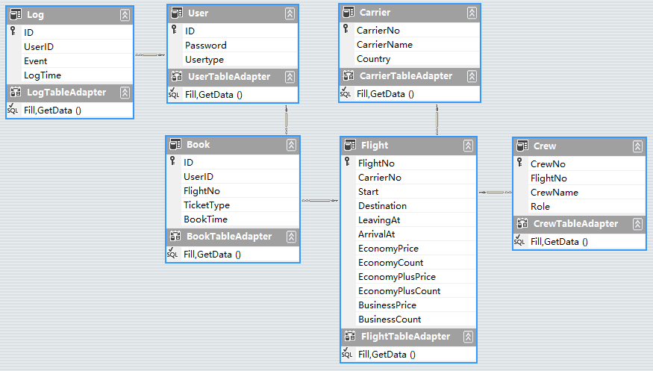
Tables

Slide 5
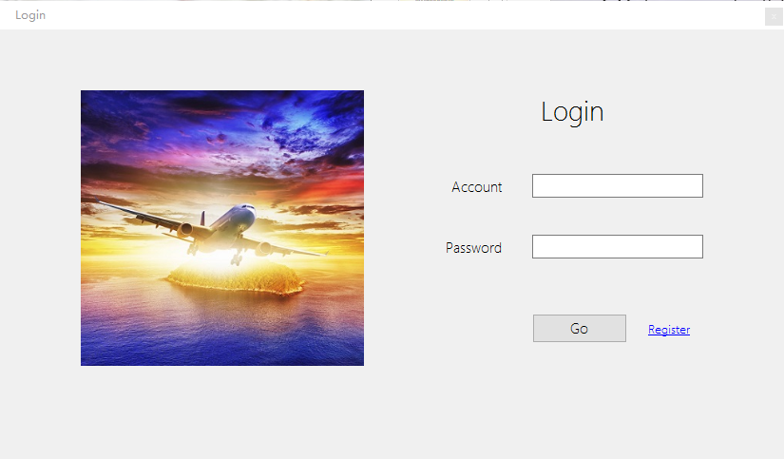
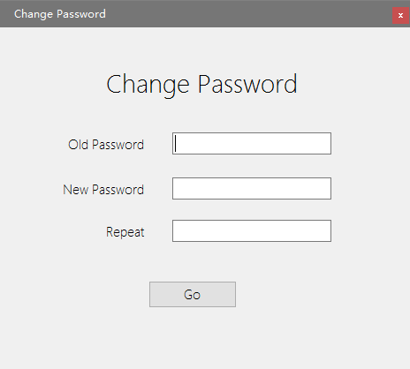
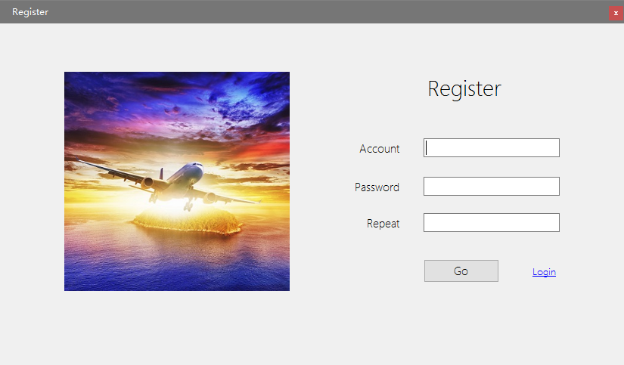
UI login, register & Change Password

Slide 6
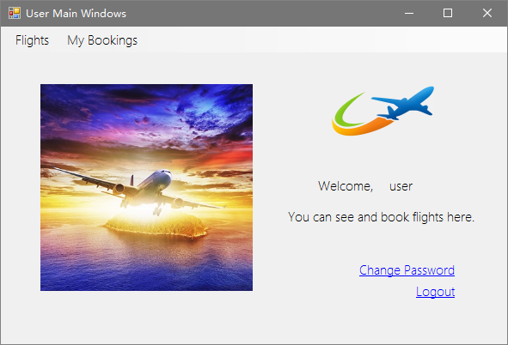
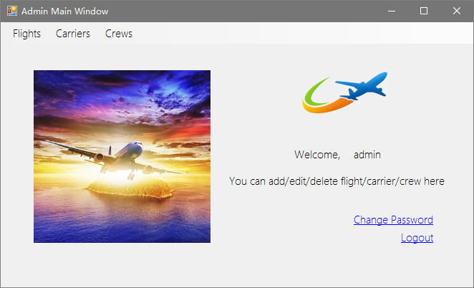
UI User/Admin main window

Slide 7
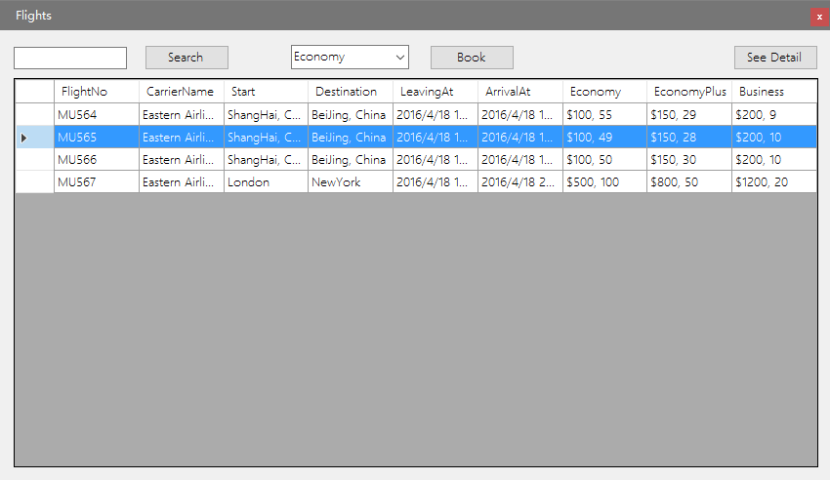
UI flights list
User can see all flights here.
User can chose and book a flight.

Slide 8
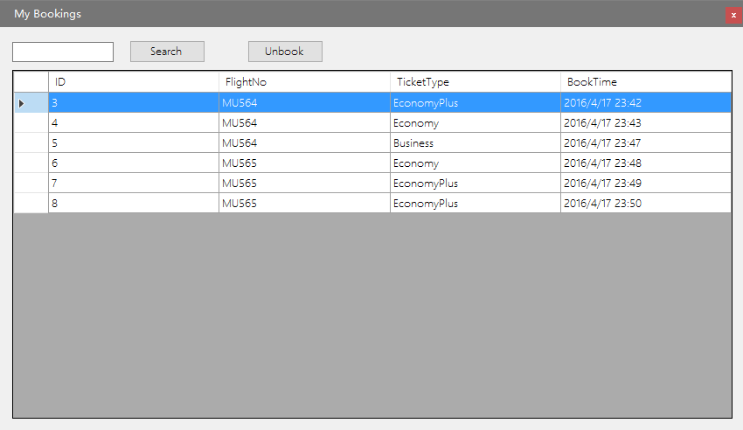
UI my bookings list
User can see all his bookings here.
User can chose and unbook a flight.

Slide 9
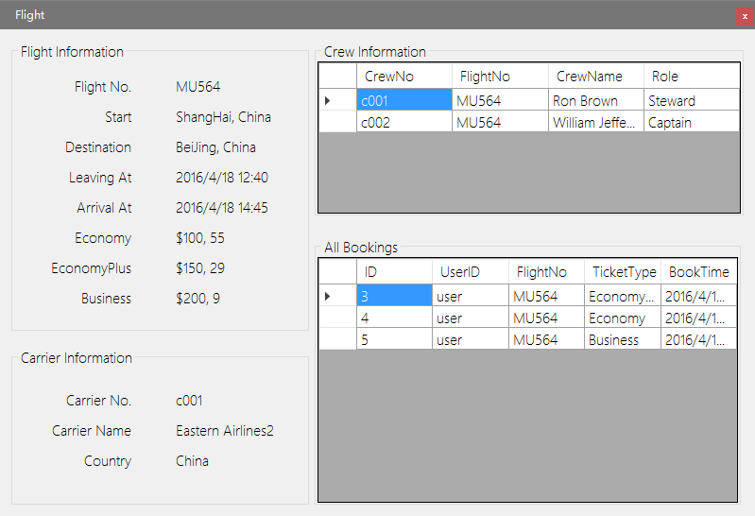
UI flight information
User can see all information of a flight here.

Slide 10
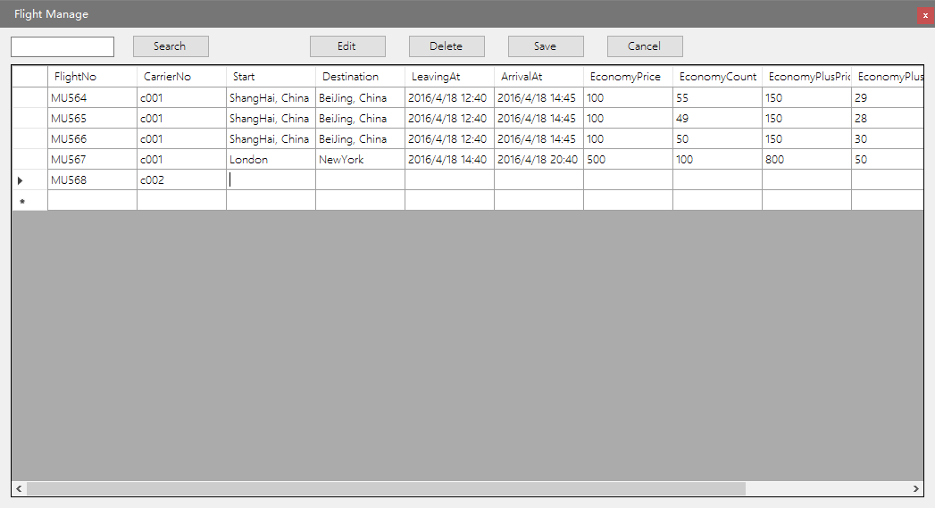
UI flight management
Admin can introduce/update/delete a flight here.
Carriers and crew management are the same with flights management.

Slide 11
Achieve logs
Logging , simply content to be recorded into the database of the Log table . Since the logging operation is very independent , so we created a class of documents, stored logging function .

Slide 12
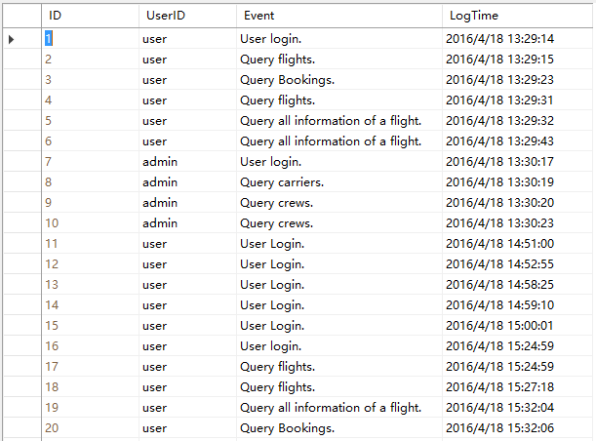
Logging a table in a DB
We create a table in our DB and log all events such as “login”, “update”, “delete” …

Slide 13
Thank You!

