Slide 1


The prediction for the bank loans
Group: 6
Members:
      Chang Liu (20632304)
      Xiyue Zhang (20601564)
      Su Wang (20625858)

Slide 2

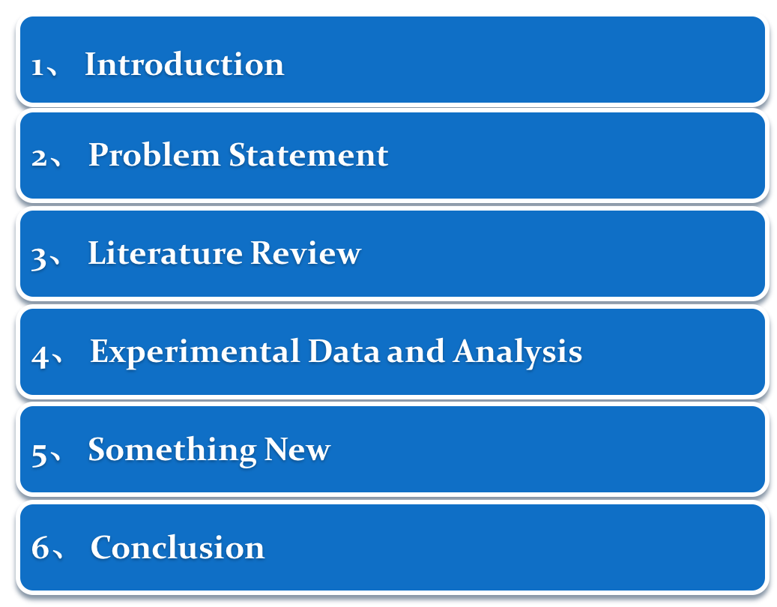
The prediction for the bank loans

Slide 3
1、Introduction
Important!
Commercial bank to offer loans
P2P lending
Get an accurate prediction of loans
Uncertainty
Creditors
Customers

Slide 4
2、Problem Statement
Detect and Fix
Classfication
Project Goal
Construct and Compare
Prediction
Predict
gender education employment
applicant income co-applicant income
loan amount loans termcredit history
final results of loans status
Project Dataset
Feature
Training Algorithm
K-fold cross-validation
Logistic Regression
Project Method
Model
Decision Tree
Random Forest
Python
Classfication
Pandas, Sklearn package

Slide 5
3、Literature Review
Paper [1]
employed Random Forest, Logistic Regression to predict bad loans.
how imbalanced data effect their classification accuracy,
how ROC curve and recall better than accuracy to detect loan risk
important feature for different loan to detect loan risk
Traditional loan : credit history
P2P lending : loan interest rate
Paper [2]
employed Bayesian classifier, Random Forest to predict loan distress
Multi-class classification for financial distress prediction(4 level)
IG algorithm can eliminate weak-related attributes for preprocessing
Bayesian classifier is bad due to hypothesis of class independency
[1] Jiayu Wu. Loans Default Prediction Using Lending Club Data.
[2] Sun, Jie, and Hui Li. "Data mining method for listed companies’ financial distress prediction.

Slide 6
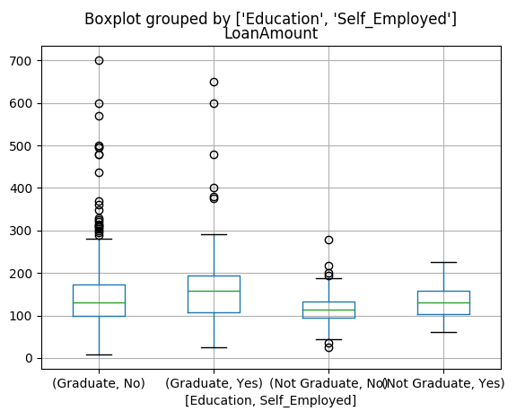
4、Experimental Data and Analysis
Data Preprocessing – missing value
Median value
Most likely value
Loan Amount, Loan Term ---- Median value
For example: Loan Amount
1. Detect how Educated and Self_employed influence loan amount using Box figure
2. Divide applications into 4 groups by Educated and Self_employed.
3. Replace the missing value with the median value in each group.

Slide 7





4、Experimental Data and Analysis
Data Preprocessing – missing value
Credit History, Self Employed, Gender, Dependents, Married --- Most likely value
Replace the missing value with the most likely value of each feature.

Slide 8
4、Experimental Data and Analysis
Data Preprocessing – extreme value
New
Method: Log transformation
Loan Amount
Some applicants may apply for high value loans due to specific need,
so use log transformation to nullify their effect instead of treating as outliers.
Application Income
Some applicants have lower income but strong support Co-applicants,
so combine both incomes as total income for Application Income.
Then use log transformation to process the Application Income.

Slide 9
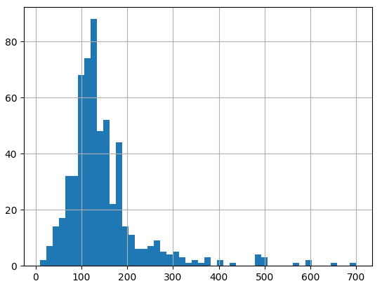
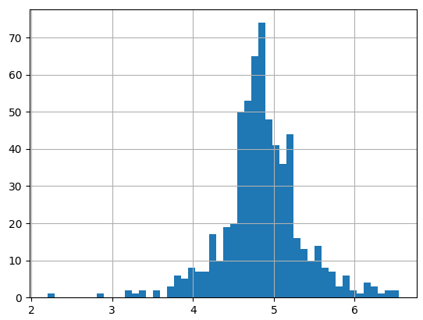
4、Experimental Data and Analysis
Data Preprocessing – extreme value
Histogram of loan amount
Loan amount before log transformation
Loan amount after log transformation
Log transformation can help to spread the points more uniformly
rather than tight cluster in the graph.
The loan amount will be more interpretable within an range than in the point.

Slide 10
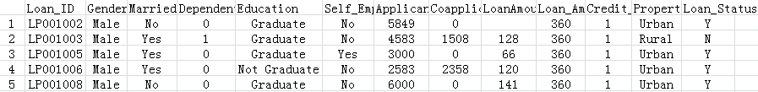
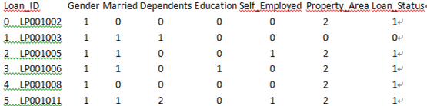
4、Experimental Data and Analysis
Classification – encoding
Data before encoding
Because model process requires all inputs to be numeric, convert all categorical variables into numeric by encoding.
Data after encoding

Slide 11
4、Experimental Data and Analysis
Classification– Logical Regression
Method :
1.Choosing ‘Credit_History’ as the common variable
2.Selecting other 3 variables for combination
predictor1 = ['Credit_History']
predictor2= [' Credit_History','Education','Married','Self_Employed','Property_Area ']
predictor3= [' Credit_History','Gender','Married','Education','Dependents '] .
Result:
 | Accuracy | Cross-Validation Score
predictor1 | 80.946% | 80.946%
predictor2 | 80.946% | 80.946%
predictor3 | 80.946% | 80.946%
Conclusion:
Credit_History is dominating the mode.

Slide 12
4、Experimental Data and Analysis
Classification– Decision Tree
Method :
1.Choosing ‘Credit_History’ as the common variable
2.Selecting other 2 variables for combination
predictor1 = ['Credit_History','Gender','Married','Education','Dependents']
predictor2= ['Credit_History','Loan_Amount_Term','LoanAmount_log']
Result:
 | Accuracy | Cross-Validation Score
predictor1 | 81.107% | 78.342%
predictor2 | 88.925% | 68.886%
Overfitting !

Slide 13
4、Experimental Data and Analysis
Classification– Random Forest
First Model :
use by all features and default parameters
n_estimators=100
predictor1 = ['Gender', 'Married', 'Dependents', 'Education', 'Self_Employed', 'Loan_Amount_Term', 'Credit_History', 'Property_Area', 'LoanAmount_log','TotalIncome_log']
Result:
 | Accuracy | Cross-Validation Score
predictor | 100.000% | 78.014%
Overfitting !

Slide 14
4、Experimental Data and Analysis
Classification– Random Forest
Second Model :
use top 5 important features and optimized model parameter
Top 5 features | Importance
Credit_History | 0.269401
TotalIncome_log | 0.260916
LoanAmount_log | 0.226960
Dependents | 0.055359
Property_Area | 0.050728
n_estimators=25, min_samples_split=20, max_depth=7, max_features=1
predictor2= ['TotalIncome_log','LoanAmount_log','Credit_History','
Dependents','Property_Area']
Result:
 | Accuracy | Cross-Validation Score
predictor | 82.248% | 80.620%
Best !

Slide 15
4、Experimental Data and Analysis
Results Validation– Random Forest
Original Data:
Loan_ID : LP001003 ApplicantIncome: 4583 CoapplicantIncome: 1508
LoanAmount: 128 Credit_History: 1 Dependents: 1 Property_Area: Rural LoanStatus : Y
Predictions:(Using the Random Forest)
n_estimators=25, min_samples_split=20,max_depth=7, max_features=1
predictor_var= [‘8.7146’,‘4.8520’,’1‘,’1’,’1’]
predictions = model.predict(predictor_var)
Result:
predictions = 1
Y
LoanStatus : Y

Slide 16


5、Conclusion
Summary
Fix the missing value by median, mean or most likely value
Fix the extreme value by log transformation
Compare Logistic Regression, Decision tree and Random Forest
Select the important feature for Random Forest model
Select the proper parameter to avoid overfitting but higher accuracy
Improvement
Imbalanced data: undersampling, oversampling, SMOTE
ROC curve: the recall and accuracy meaning for investor’s

Slide 17

Thanks！
“…Science never solved one problem
without creating ten more…”
George Bernard Shaw

Slide 18

5、Conclusion
Imbalanced Data
Undersampling the majority class:
Model sensitivity Increase
Poor results, few sample, throwing away useful information
Oversampling the minority class
Oversample inside cross-validating to avoid overfitting
Oversample by duplicating entries
Oversample by SMOTE technique

Slide 19
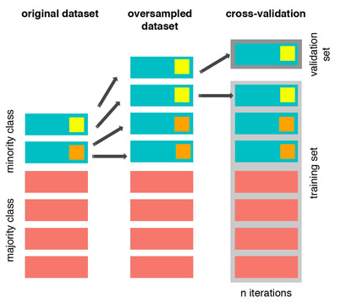
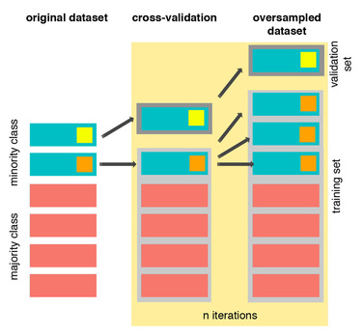
5、Conclusion
Imbalanced Data
oversampling outside cross validation loop
oversampling in cross validation loop

Slide 20
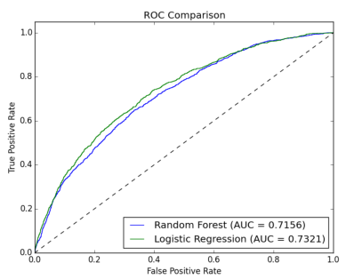
5、Conclusion
ROC curve
1 miss an investment opportunity to avoid bad loans.
2 take more risk to get every possible opportunity

Slide 21
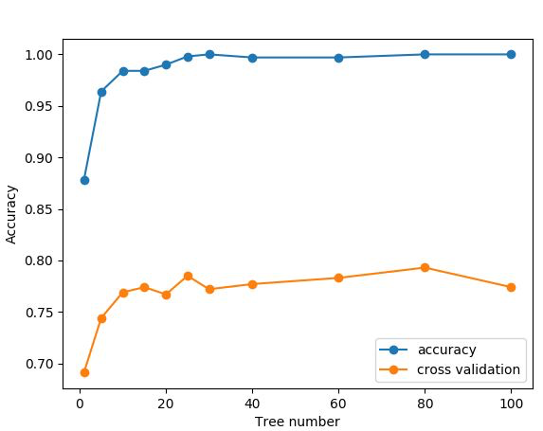
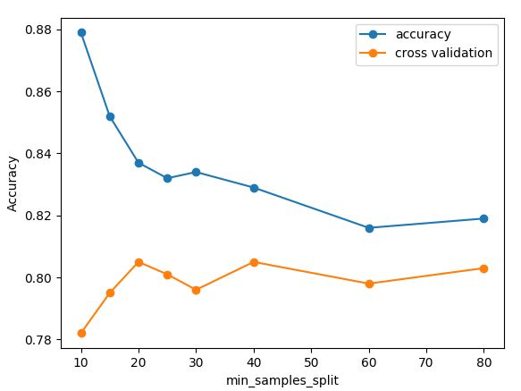
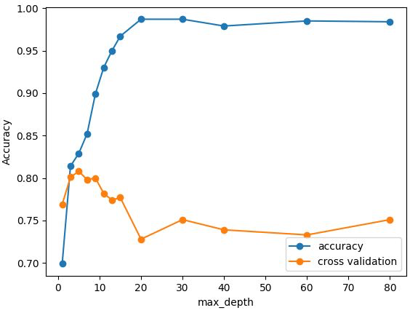
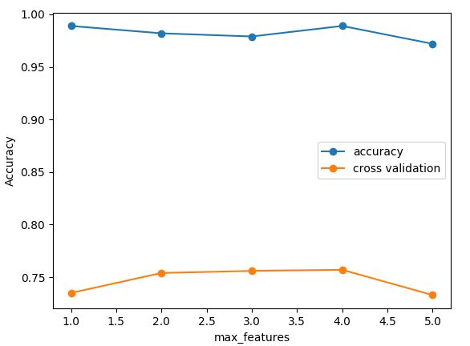
Optimized Model Parameter for Random Forest

