Slide 1
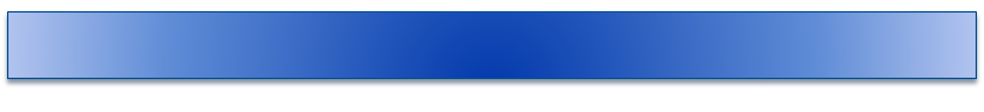
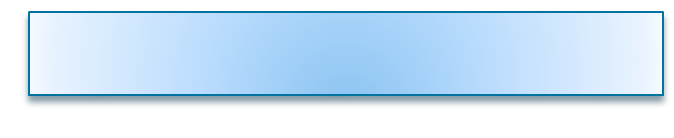
Movie Review Sentiment Analysis
Xiyue Zhang (20601564)

Slide 2
1、Introduction
We can find people’s opinions and experiences though internet. Because more and more people prefer to show their opinions to strangers on the platform. These review is useful because customer can identify product quality based on review, meanwhile company can detect the customer preference.
Important!
Mining useful information based on sentiment analysis for company and customer

Slide 3
2、Project Goal
Multi-class Classification Problem: movie review into 5 class
0---negative
1---somewhat negative
2---neutral
3---somewhat positive
4---positive
Why Multi-class [2]: Hard to explain by two class
most reviews are neutral, rarely extreme opinions
stronger sentiment →longer phrases
neutral sentiment → shorter phrases
Data Preprocessing : Noise, extract Feature
Classification: KNN, SGD, Random Forest classifier
Coding tool: nltk for phrase, sklearn for model
[1] Seeing stars: Exploiting class relationships for sentiment categorization with respect to rating scales.
[2] Recursive deep models for semantic compositionality over a sentiment treebank
[3] https://nlp.stanford.edu/sentiment/]

Slide 4
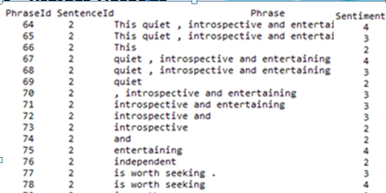
3、Project DataSet
Why?
Sentence into phrases
train.tsv: SentenceId, phraseId, phrase, labels
test.tsv. SentenceId, phraseId, phrase
[1] Seeing stars: Exploiting class relationships for sentiment categorization with respect to rating scales.
[2] Recursive deep models for semantic compositionality over a sentiment treebank
[3] https://nlp.stanford.edu/sentiment/]

Slide 5
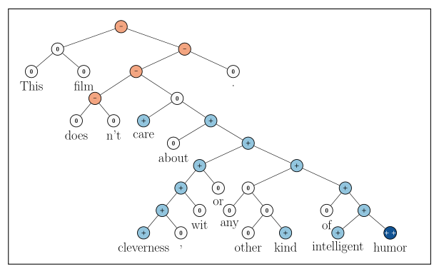
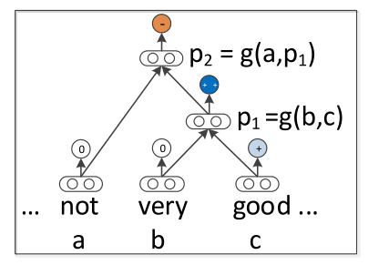
3、Project DataSet
Recursive Neural Network compute parent vectors
Leaf node: word (phrases)
Parent node: phrases
Tree bank represent sentences structure
Movie is neither funny nor witty → negative
[1] Seeing stars: Exploiting class relationships for sentiment categorization with respect to rating scales.
[2] Recursive deep models for semantic compositionality over a sentiment treebank
[3] https://nlp.stanford.edu/sentiment/]

Slide 6
4、 Data Preprocessing
Noise
Remove useless information like time or web link
Translate the emoticons into sentiment words
Transform capital letters into lowercase
Detect spelling mistake

Slide 7
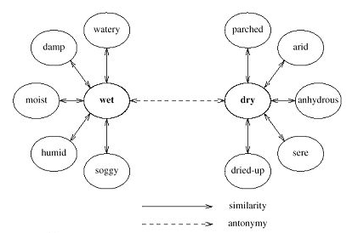
4、 Data Preprocessing
Feature Extraction -- Wordnet
WordNet is a lexical database for the English language. It groups English words into sets of synonyms called synsets.
  replace similar words with the same synsets.
  removes useless feature like (“the”, “a”, “is”)
  combine the sentence with same meaning.
[1] http://wordnetweb.princeton.edu/perl/webwn

Slide 8

4、 Data Preprocessing
Feature Extraction -- Wordnet
70 | Synset('introspective.a.01') Synset('entertain.v.01') Synset('entertain.v.02') Synset('harbor.v.01') ynset('entertaining.s.01')
71 | Synset('introspective.a.01') Synset('entertain.v.01') Synset('entertain.v.02') Synset('harbor.v.01') Synset('entertaining.s.01')
72 | Synset('introspective.a.01')
73 | Synset('introspective.a.01')
[1] http://wordnetweb.princeton.edu/perl/webwn

Slide 9
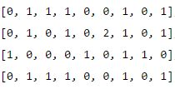
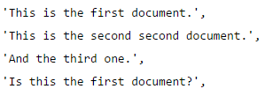
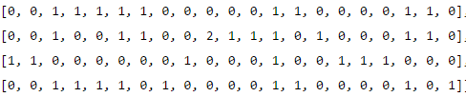
4、 Data Preprocessing
Feature Vectors -- Bag-of-words as feature
Convert text documents to a matrix of token counts(feature vectors)
1-grams
Feature:
Words, Phrases, Synsets
2-grams(relative position)

Slide 10
4、 Data Preprocessing
Feature Vectors -- Score as feature
SGDClassifier produce a vector of decision functions separating target classes in a one-versus-rest fashion. There are five scores generated by each classifier can used as feature of the each sentence
SGDClassifier select part of data to train classifier, take less time for analyze the dataset that sample and feature is very large
One-versus-rest reduce multi-class problem into multiple binary problems. Train a classifier for each class, sample in class → positive, other class → negative
70 | [2.3716, 47.9750, 48.2221, 27.7105, 116.8539]
71 | [2.3716, 47.9750, 48.2221, 27.7105, 116.8539]
72 | [ 2.3716, 10.3810, 9.7235, -1.6149, -2.6382]
73 | [ 2.3716, 10.3810, 9.7235, -1.6149, -2.6382]

Slide 11
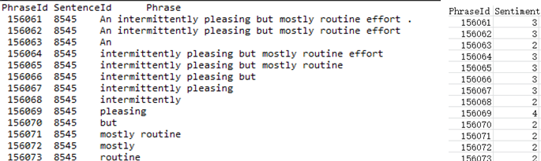
5、Classification
Classifier | Accuracy
Random Forest (trees=100) | 0.65920
Random Forest (trees=20) | 0.65656
KNN | 0.63255
SGD | 0.63619
Low Accuracy?

Slide 12
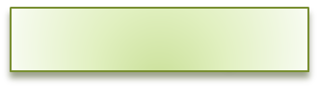
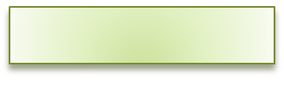
6、Conclusion
Summary
Noise Reduction
Feature Extraction: WordNet,
Feature Vectors: Bag-of-words, Classification Score
Compare KNN, SGD and Random Forest classifier
Select the proper parameter and classifier to predict sentiment label
Improvement
Try oversample training set
Try other data preprocessing method
Try other classifier: SVM, Naive Bayes, Neural Network

Slide 13

Thanks！
“…Science never solved one problem
without creating ten more…”
George Bernard Shaw

