Slide 1
Test Automation Tools for Mobile Apps
Zhang, Xiyue
ID: 20601564

Slide 2
Organization
Introduction for existing tools
Problem for GUI Testing
Solution-Android Ripper
Solution-GUI-Model Generation
Conclusion

Slide 3
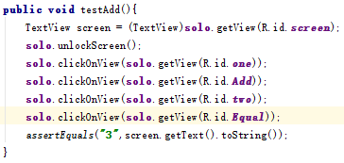

Introduction
Automated testing tools can offer fast, repeatable and comprehensive test execution. There are some common testing tools strategies as below:
Write script code to test (Robotium)
Convert recorded action into script (MonkeyTalk)
研究背景
研究方案
研究总结
Robotium testscript
MonkeyTalk workspace

Slide 4
Problem
GUI has many operations that need to be tested and some test scenarios may be left out.
Most of testing tools generate test case by writing script or converting action into script for certain UI/logic, So developer may have to rewrite test case just because the UI/logic changes.
So this research pick up some strategy for GUI Automation Testing and GUI test case.

Slide 5
Solution
GUI testing is the process of testing graphical user interface to ensure it meets its specifications[1]. For example selecting menu or clicking button. Here we pick up some techniques to support GUI testing
Android Ripper
GUI-Model Generation
[1] https://en.wikipedia.org/wiki/Graphical_user_interface_testing

Slide 6
Solution
AndroidRipper is an automated GUI testing tool. It extends previous work on ripping to automatically and systematically traverse user interface, generating and executing test cases
During its operation, it maintains a state machine model of the GUI, which we call a GUI Tree. The GUI Tree model contains the set of GUI states and state transitions encountered during the ripping process.[1]
[1] “Using GUI ripping for automated testing of Android applications."

Slide 7
Solution
Grey-Box Approach for GUI-Model Generation is a technique of Model based testing. Model based testing is an approach that operates on a model of an app’s behavior. The model is used to construct a suite of test cases to test the application.
The step to extract model by this approach:
Step1: Static analysis
Step2: Dynamic crawling
[1] “A grey-box approach for automated GUI-model generation of mobile applications."

Slide 8
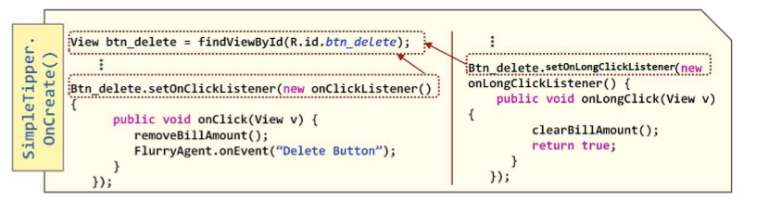
Solution
Step1: Static analysis
First, we use static analysis of the app’s source code to extracts the set of. The user action is defined by
registering event listener for it
inheriting event handling method.
[1] “A grey-box approach for automated GUI-model generation of mobile applications."

Slide 9
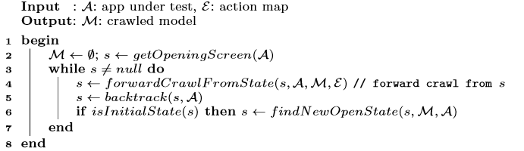
Solution
Step2: Dynamic crawling
Next, a dynamic crawler is used to reverse-engineer a model of the app, by systematically exercising extracted actions on the live app.
[1] “A grey-box approach for automated GUI-model generation of mobile applications.“

Slide 10
Conclusion
This research picks up some strategy for GUI Automation Testing and GUI test case. To generate a set of test case, developer attempt to cover all the functionality of the system.
There are still issues about GUI automation testing, for example some tools may too complex to implement and these are future work to analyze.

