Slide 1
ITS Trip Logger
Shu-Wei Hsu
University of California, Davis

Slide 2


Project Overview
Using Bluetooth 4.0 (Bluetooth Low Energy, BLE) Beacon for driver identification
Household based driving dataset
Database – MySQL
Backend – Node.js with forever
Webpage – HTML + CSS + Javascript with jQuery and Ajax
Mobile app – iOS and Android

Slide 3
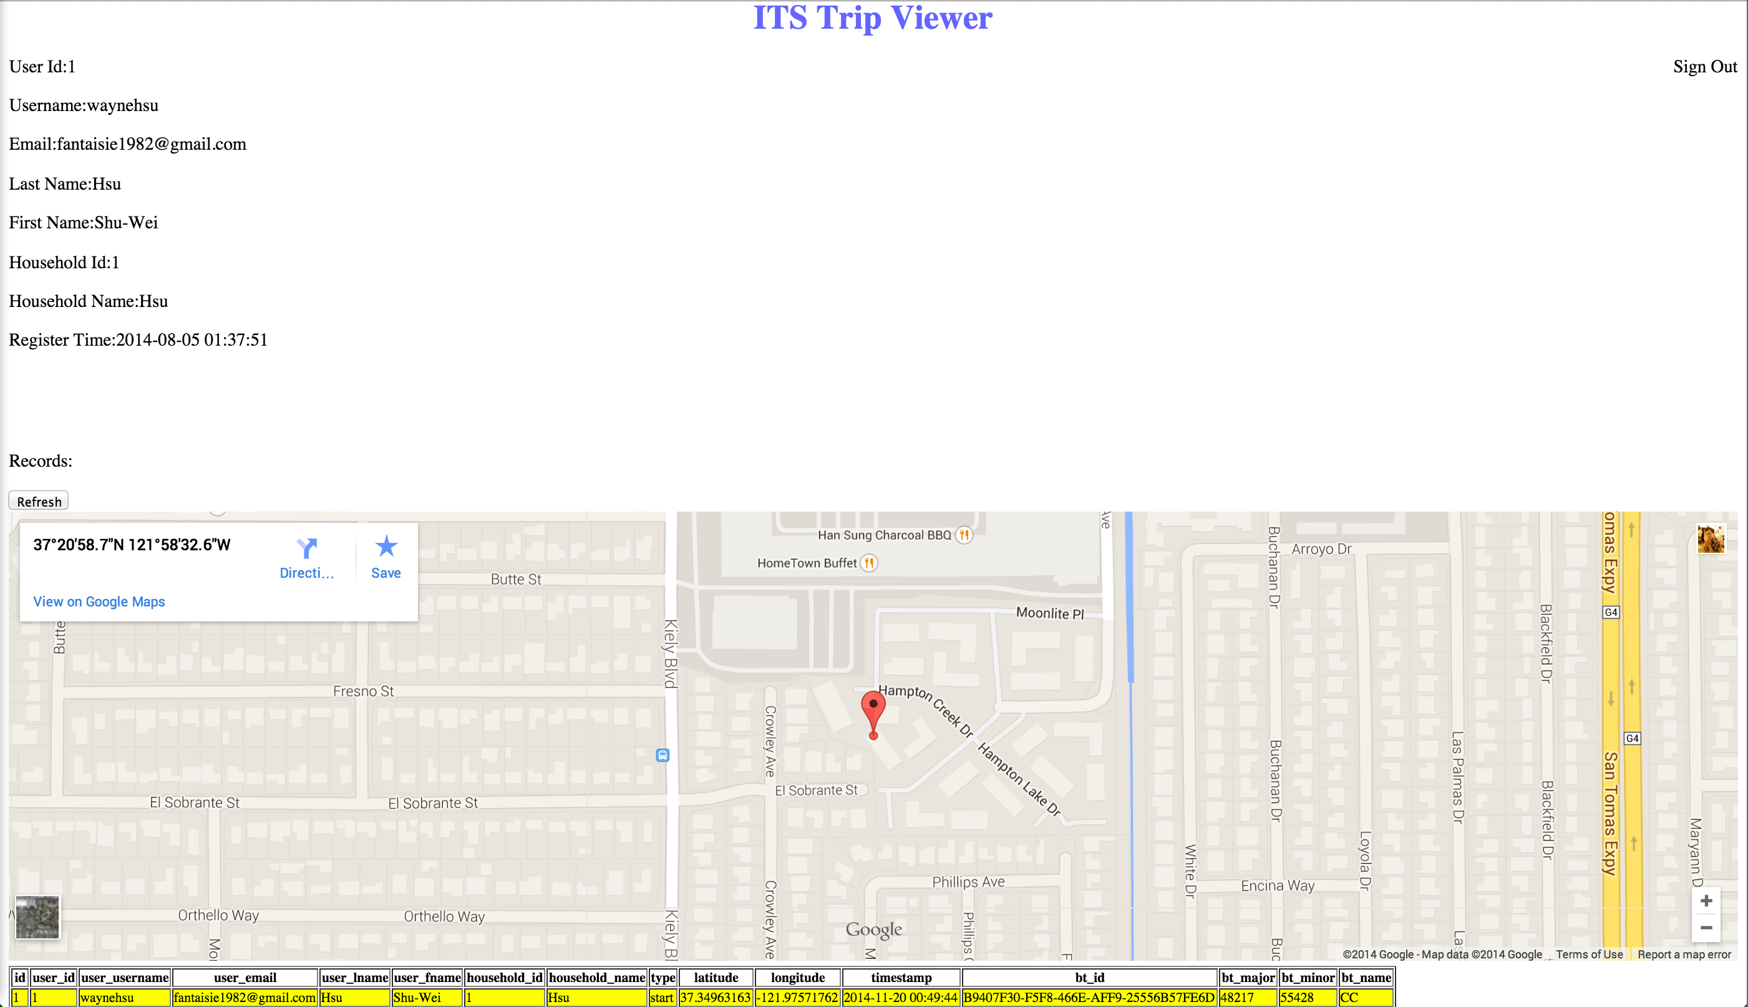
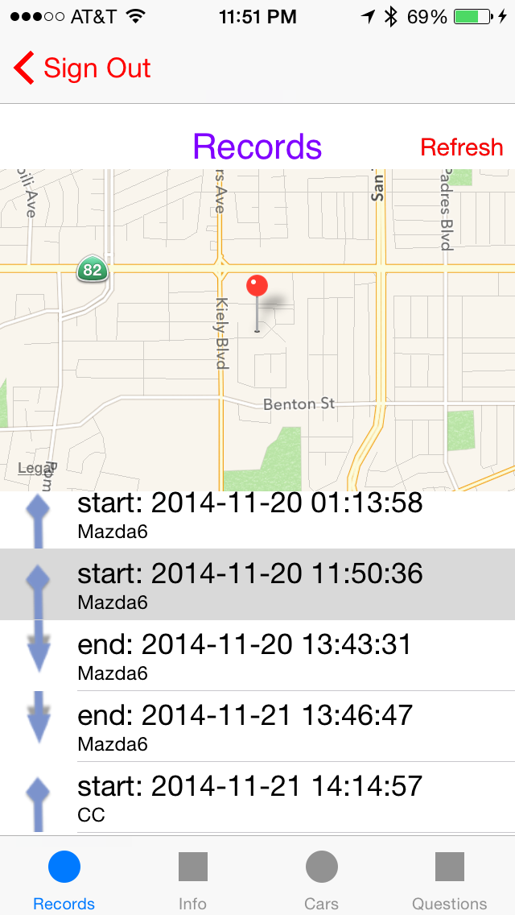
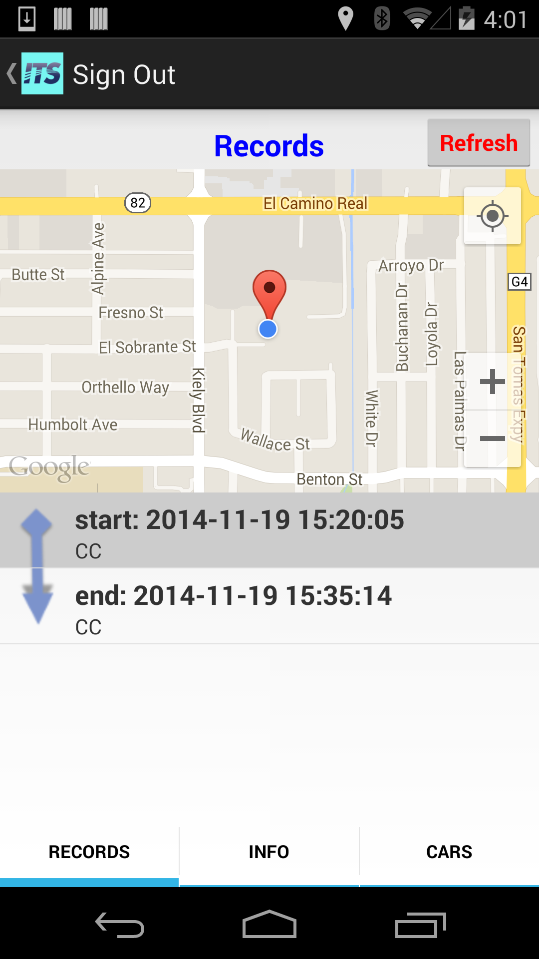
System Architecture
Web Page
Server
MySQL
express
http request with json
Ajax
iOS
Android

Slide 4
ITS Trip Logger Server
Node.js
Mysql framework for database access
Express web framework for http request and response using post and get
Json format with three major elements:
Mode: sign in/out, insert/get records
Message: success, fail, errors
Data: data requested

Slide 5
ITS Trip Logger Server
handleDisconnect(): handle MySQL disconnection (Probably due to process’s being killed and recreated)
encryptArray, getToken and verifyToken: verify global token and semi-session token
Web_*: for web page access
Mobile_*: designed for mobile device accesses
process.on('uncaughtException', function (err): for possible exception crash

Slide 6

ITS Trip Logger Webpage
Sign out
User information
Record location
Records

Slide 7
ITS Trip Logger Webpage
Main view with sign-in page
User information
Records and locations
sign-up page
New user information
New/existing household creation/selection
HTML + CSS + Javascript
jQuery for element accesses
Ajax for http request and response

Slide 8
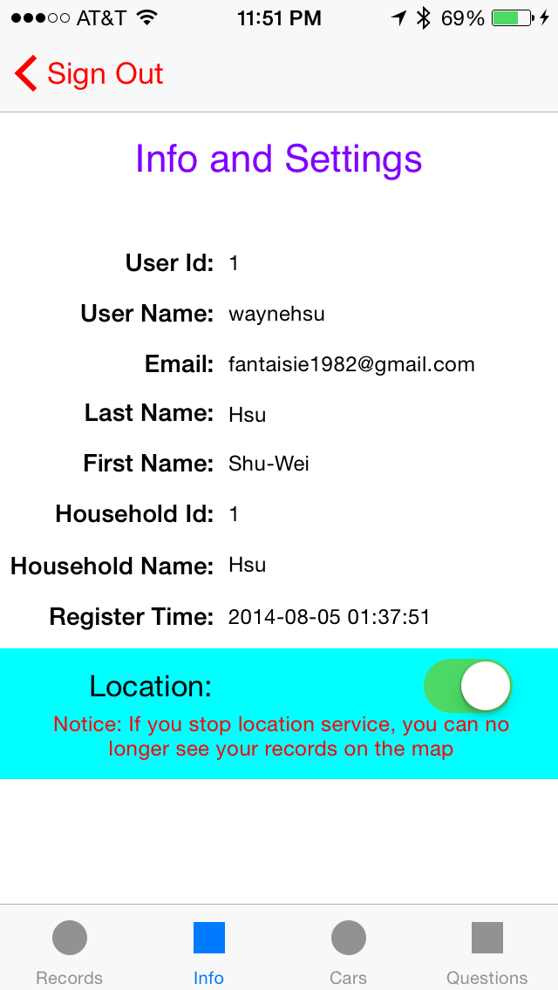
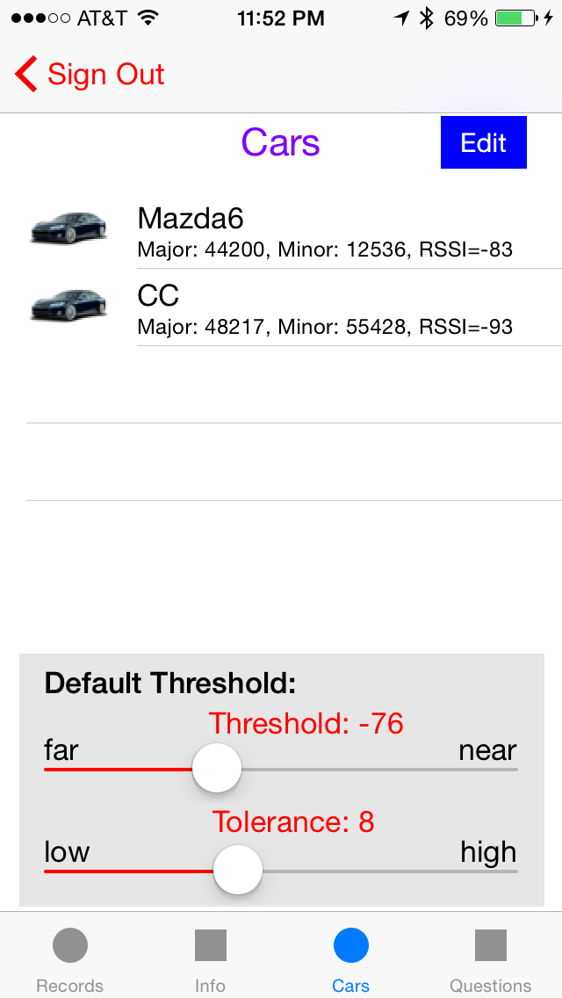
ITS Trip Logger Mobile - iOS

Slide 9
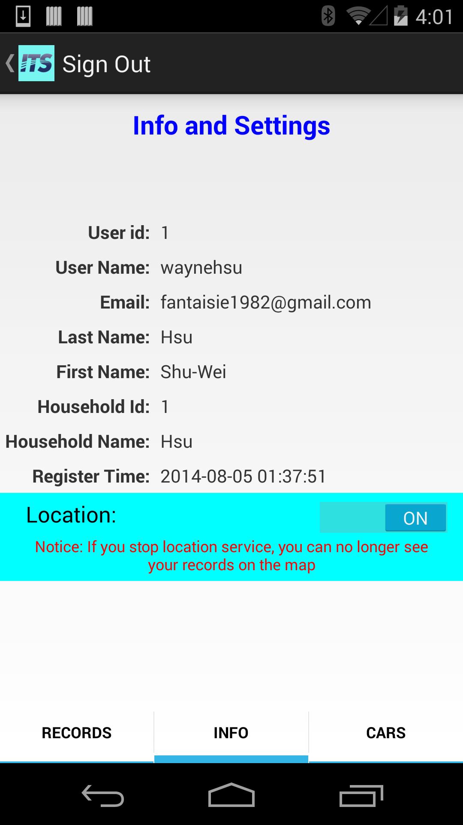
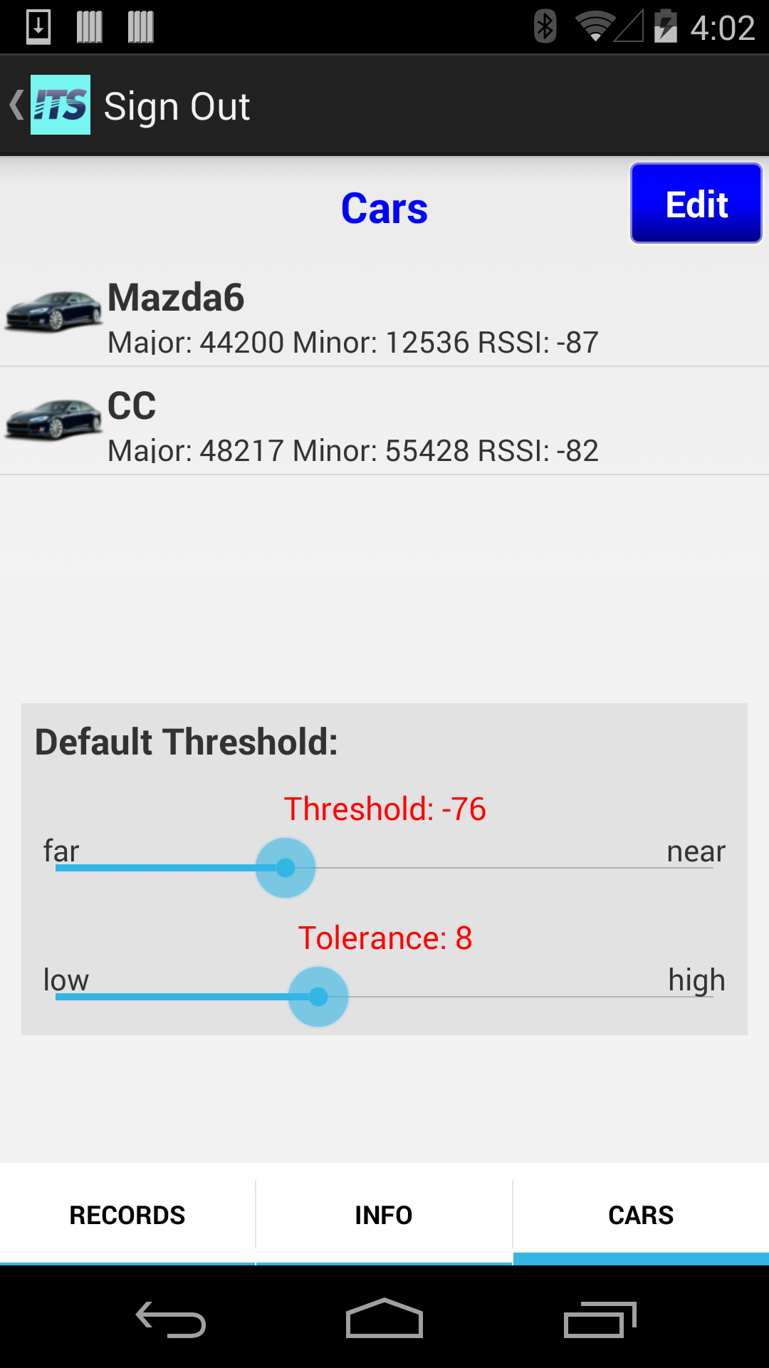
ITS Trip Logger Mobile - Android

Slide 10
ITS Trip Logger Mobile - Features
Records
Records and locations
Information and Settings
User information
Location service on/off (not global)
Cars
Cars (Beacons) information and signal strength
Global threshold settings
Single beacon threshold settings / calibration
Questionnaire
To be done …

Slide 11
ITS Trip Logger Mobile - iOS
ConnectionManager
Http request response
BeaconManager
Sensing Multiple Beacons
SignInViewController
Sign In
Auto/Offline Sign In
Upload New Records
Get/Update Beacon Info/Parameters
Trip type (start/end)
Default Parameters
Beacon Info/Parameters
User Verification
Get User Info
User Data
Uploading Data
Login Data & Token
Sign In/Out
Get Records
Get Info
Get/Update Beacon Info/Parameters
Get Beacons
Threshold Settings
Calibration
Location Service on/off
RecordViewController
Get Records
Show Locations
InfoViewController
Show User Information
Location Service on/off
BeaconViewController
Car/Beacon Information
Threshold Settings
Calibration
Tab Switch
Tab Switch

Slide 12
ITS Trip Logger Mobile - iOS
Beacon awaking (even process killed)
Singleton Managers
Plist for storing data (with Dictionary, Array, etc.)
ITSRecordData class for uploading data
User Interface for iPhone 6, iPhone 6 + to be done

Slide 13
ITS Trip Logger Mobile - Android
ConnectionManager
Http request response
BeaconManager
Sensing Multiple Beacons
Upload New Records
Get/Update Beacon Info/Parameters
Trip type (start/end)
Default Parameters
Beacon Info/Parameters
User Verification
Get User Info
User Data
Uploading Data
Service
Keep both manager running
Communication
Start service
SignInViewActivity
BootReceiver
Start Service when boot
Login Data & Token
Sign In/Out
TabBarActivity
RecordViewController
InfoViewController
BeaconViewController
Tab Switch
Communicate with ConnectionManager and BeaconManager directly
Tab Switch
BeaconListAdapter
Show Beacon List

Slide 14
ITS Trip Logger Mobile - Android
Service is awaken by boot receiver
Add Service for keeping both manager alive
Service handles most communication
SharedPreference for storing data (ITSJSONSharedPreferences)
Responsive User Interface design for most larger screen devices

Slide 15
What is Missing
User Interface (.storyboard) for iPhone 6 and iPhone 6 +
Questionnaire (page ready)

