Slide 1
High performance controllers in automotive

Slide 2
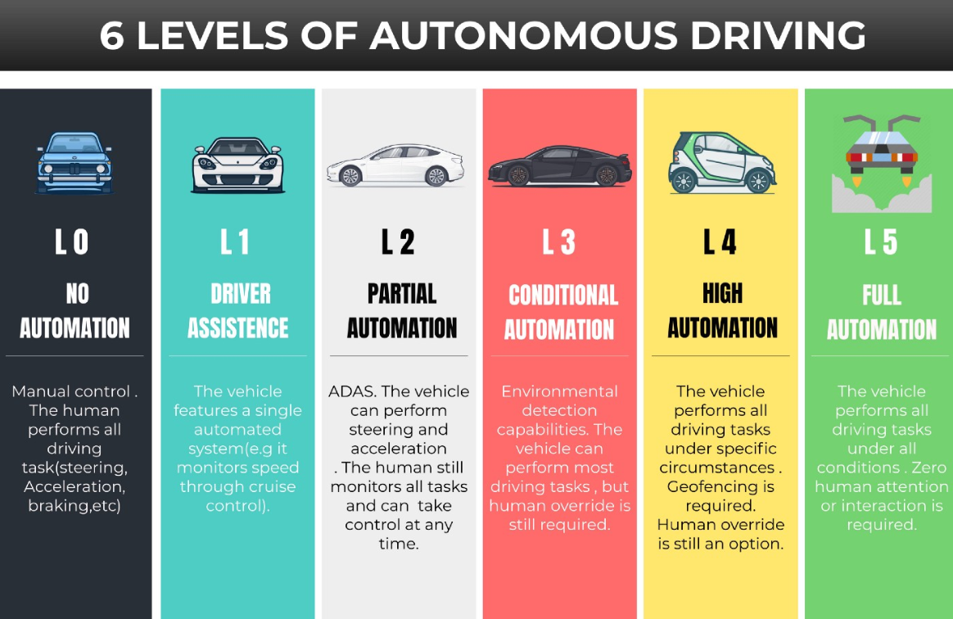
Business case

Slide 3


Slide 4


Slide 5
Requirements
Functional safety
Interoperability
Reliability
Security

Slide 6
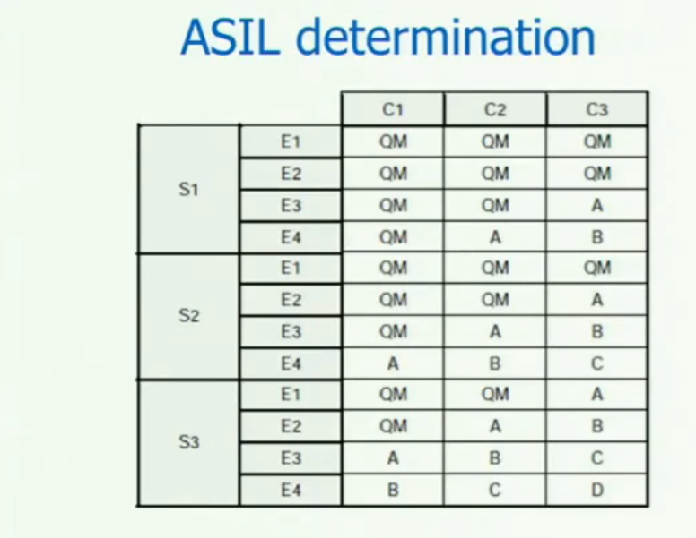

Slide 7
Architecture
HW architecture before
HW architecture of the future
2C architecture
SW architecture
  Hypervisor
  Safety OS
  Performance OS

Slide 8
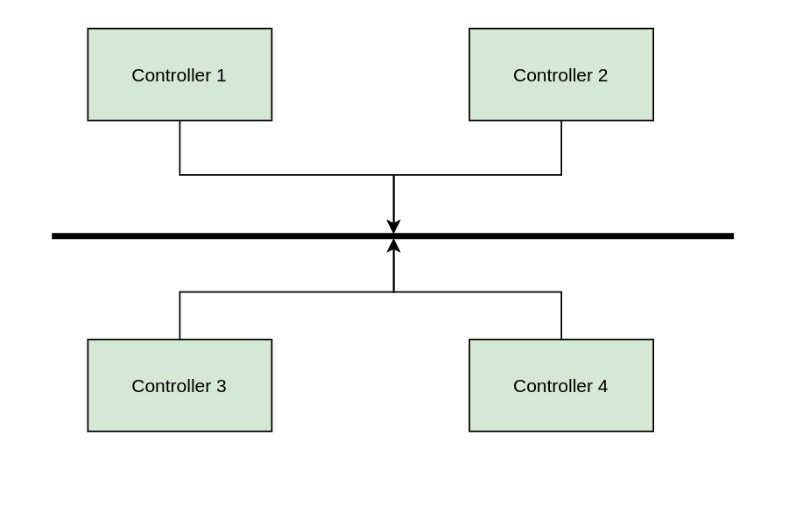

Slide 9
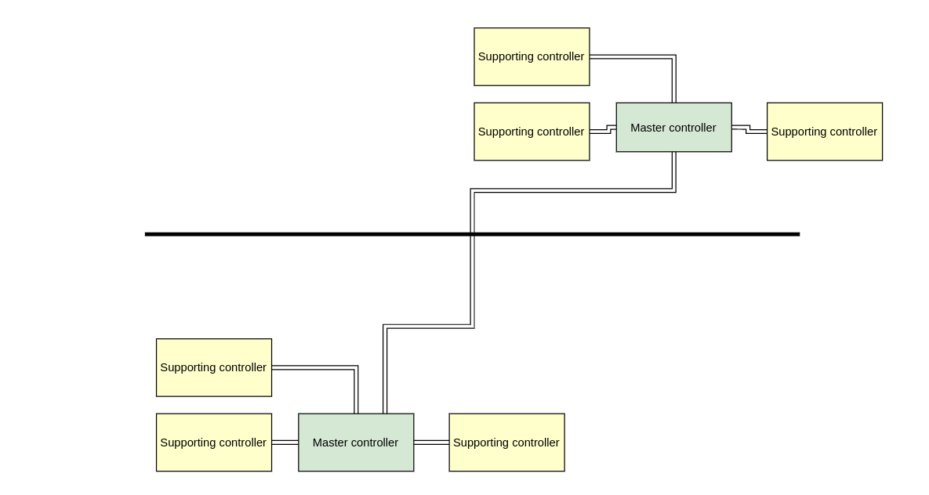

Slide 10
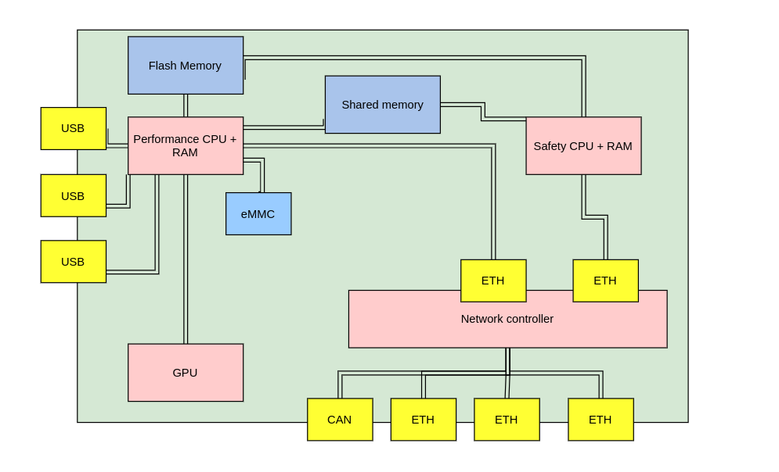

Slide 11
Networking
CAN bus
Ethernet
PCIe

Slide 12
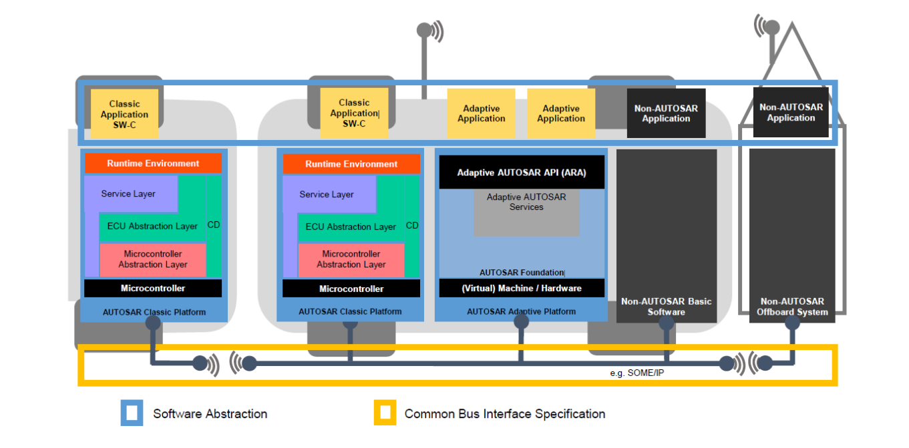

Slide 13
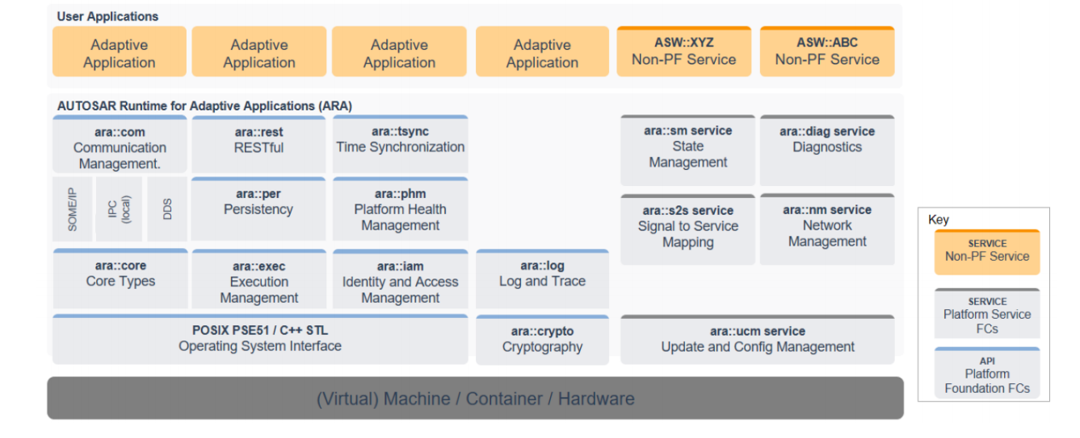

Slide 14
High performance chips
GPU architecture
Network routing acceleration
FPGAs
Accessing chips from Linux – OpenCL

Slide 15
TBD
How to easily integrate components from different vendors?
Common API on all layers
Improving safety for L4-L5
Overcoming HW shortages
Vehicle communication
Security

