Slide 1
VOTE.io
A Blockchain based E-Voting System

Slide 2
Introducing Fantastic007
Chaincode Developing Team => Shuhan & Jenny
Backend => Samyo, Humaun & Farhan
Testing and documentation => Tihami & Tipu

Slide 3
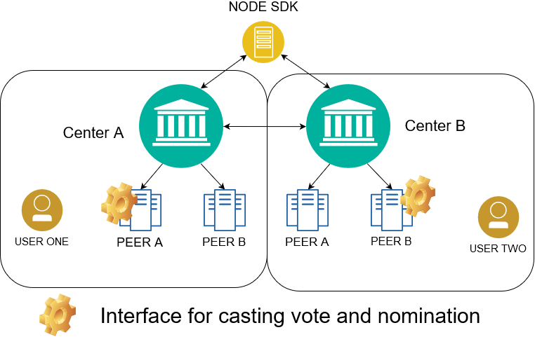
Architecture

Slide 4
Chain Code Functions
createUser( nid, username, password )
queryUser( nid)
------- return user[nid]
Nominate/vote(voterNid, NominatedNid, Position)
------- return TransactionID
getNomination/VoteList()
--------- return nomination/voteList
initLedger() [only admin has the power]

Slide 5
Why blockchain was needed ?

Slide 6

Work flow

Slide 7
THANK YOU

