Slide 2
Introduction
An Abstraction on top of MapReduce
Allows users to query data in the Hadoop cluster without knowing Java or MapReduce
Structured Data in HDFS logically into Tables
Uses the HiveQL Language
Very similar to SQL
Turns HiveQL into MapReduce Jobs

Slide 3
Installation
Download http://hive.apache.org
tar -xvf hive-x.y.z-dev.tar.gz
export HADOOP_HOME=/<HADOOP DIR>
bin/hive

Slide 4
Create database
bin/hive
show databases;
create database training;
show databases;
use training;
show tables;

Slide 5
Hive Shell - Examples
bin/hive
•show tables;
•create table patient(pid INT, pname STRING, drug STRING,gender STRING, tot_amt INT) row format delimited fields terminated by ',' stored as textfile;
•load data inpath ‘/home/sasken/pfile.txt‘ into table patient;
•select count(*) from patient;
•select sum(tot_amt) from patient where drug = ‘paracetamol’;
•select max(tot_amt) from patient group by drug;
•show tables;
•desc patient;
•desc extended patient;
•show functions;
•insert overwrite local directory ‘/home/sasken/results’ select * from patient;
•select * from patient where drug in (‘avil’,’metacin’);
01,sasken,paracetamol,male,12
02,saravanan,avil,male,44
03,rajesh,metacin,male,26
04,usha,paracetamol,female,20
05,alex,paracetamol,male,48
06,nasir,metacin,male,37
07,singh,paracetamol,male,15

Slide 6
Some more..
create table drug(drugname STRING) row format delimited fields terminated by ‘,’ stored as textfile;
load data local inpath ‘/home/sasken/drug_file.txt‘ into table drug;
select * from patient join drug on patient.drug=drug.drug;
select patient.* from patient left outer join drug on patient.drug = drug.drug where drug.drug is NULL;
create table drug_ new(drug STRING) row format delimited fields terminated by ‘,’ stored as textfile;
insert overwrite table drug_new select * from drug;
select * from drug_new;
insert into table drug_new select * from drug;
select * from drug_new;
paracetamol
avil
Metacin

Slide 7
External Table
create EXTERNAL table patient_external(pid INT, pname STRING, drug STRING,gender STRING,tot_amt INT) row format delimited fields terminated by ',' stored as textfile LOCATION '/patient_external';
LOAD DATA INPATH '/data10.txt' INTO table patient_external;
drop table patient_external;
check the table in hdfs path

Slide 8
Partitions
A way of dividing table into multiple parts based upon a column value such as Date
defined at table creation time using the PARTITIONED BY clause
create table patient (pid INT, pname STRING, drug STRING, tot_amt INT) partitioned by (dt STRING, country STRING)row format delimited fields terminated by ‘,’ stored as textfile;
LOAD DATA LOCAL INPATH ‘/tmp/file_ind.txt‘ INTO TABLE logs PARTITION (dt='2012-11-01', country=‘IND');
Above code creates a sub partition called country in date
Please look at the directory structure in the HDFS
Our data in the files should not contain the columns used for partitioning

Slide 9
Partition querys
create table patient_partition_1(pid INT, pname STRING, drug STRING,gender STRING,tot_amt INT)partitioned by(country STRING)row format delimited fields terminated by ',' stored as textfile;
LOAD DATA LOCAL INPATH '/home/username/Desktop/patient_file.txt' INTO TABLE patient_partition_1 PARTITION (country='IND');
Check the /user/hive/warehouse/patient_partition_1 directory in HDFS
create table patient_partition_2 (pid INT, pname STRING, drug STRING,gender STRING,tot_amt INT) partitioned by (dt STRING, country STRING)row formatdelimited fields terminated by ',' stored as textfile;
desc patient_partition_2;
LOAD DATA LOCAL INPATH '/home/username/Desktop/patient_file.txt' INTO TABLE patient_partition_2 PARTITION (dt='2012-11-01', country='IND');
Check the /user/hive/warehouse/ patient_partition_2
Select * from patient_partition_1;
Select * from patient_partition_2;

Slide 10
Buckets
To enable map side join effectively
To do sampling
CREATE TABLE bucketed_patient (pid INT, pname STRING, drug STRING,genter STRING, tot_amt INT) CLUSTERED BY (pid) INTO 4 BUCKETS;
hive.enforce.bucketing = true;
INSERT OVERWRITE TABLE bucketed_patient SELECT * FROM patient;
Can contain multiple fields for bucketing.

Slide 11
Partition with Bucket
CREATE TABLE partition_bucketed(pid INT, pname STRING, drug STRING, gender STRING, tot_amt STRING)PARTITIONED BY(country STRING)CLUSTERED BY(pid) INTO 4 BUCKETS;
set hive.enforce.bucketing = true;
LOAD DATA LOCAL INPATH '/home/saravanan/Desktop/datagen_10.txt' INTO TABLE partition_bucketed PARTITION (country='IND');
INSERT OVERWRITE TABLE partition_bucketed PARTITION (country='us') SELECT * FROM patient;
select * from partition_bucketed where country= 'IND';
select * from partition_bucketed where country= 'us';
Alter Table patient RENAME TO patient_new;
ALTER TABLE patient_new ADD COLUMNS (extra STRING);
Sub Queries
Views

Slide 12
Data Types
Primitive types
Integers: TINYINT, SMALLINT, INT, BIGINT.
Boolean: BOOLEAN.
Floating point numbers: FLOAT, DOUBLE .
String: STRING.
Complex types
Structs: {a INT; b INT}.
Maps: M['group'].
Arrays: ['a', 'b', 'c'], A[1] returns 'b'.

Slide 14
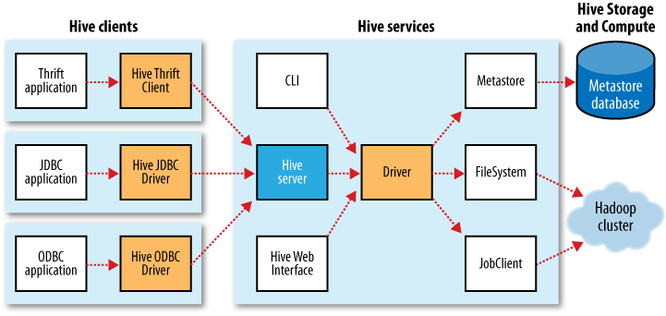
Hive clients

Slide 15
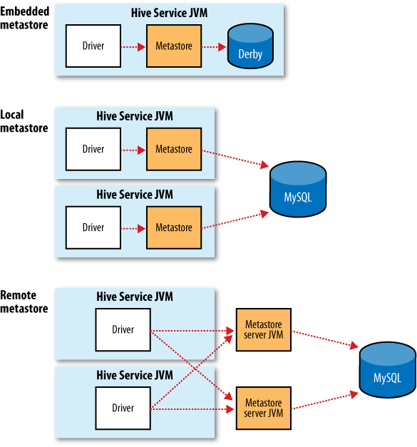
Configuration option - Metastore

Slide 16
SQL Vs HiveQL
Features | SQL | HiveQL
Updates | UPDATE, INSERT, DELETE | INSERT OVERWRITE TABLE (populates whole table or parition)
Indexes, Transactions | Supported | Not Supported
Latency | Sub-second | Minutes
Multitable inserts | Not supported | Supported
Subqueries | In any clause.Correlated or noncorrelated | Only in the FROM clause. (Correlated queries not supported)
Views | Updatable. Materialized views | Read-only. Not supported

Slide 17
JOINS
SELECT a.* FROM a JOIN b ON (a.id = b.id)
•Join on multiple columns
•SELECT a.* FROM a JOIN b ON (a.id = b.id AND a.department = b.department)
•Join on Multiple tables
•SELECT a.val, b.val, c.val FROM a JOIN b ON (a.key = b.key1) JOIN c ON (c.key = b.key1)
•SELECT a.val, b.val, c.val FROM a JOIN b ON (a.key = b.key1) JOIN c ON (c.key = b.key2)
•LEFT, RIGHT, and FULL OUTER joins – available in HiveQL
•SELECT a.val, b.val FROM a LEFT OUTER JOIN b ON (a.key=b.key)
• provides more control over ON clauses for which there is no match
•WHERE clause available using JOIN
•SELECT a.val, b.val FROM a LEFT OUTER JOIN b ON (a.key=b.key) WHERE a.ds='2009-07-07' AND b.ds='2009-07-07'

Slide 18
Built in operators
Arithmetic Operators
•+, -, *, /,%, |,^,~
•Relational Operators
•= , <=> , !=, <>, < , >, <=, =>, IS NULL, IS NOT NULL, LIKE, RLIKE, REGEXP, BETWEEN , NOT BETWEEN
•Logical Operators
•AND, OR, &&, ||, NOT, !

Slide 19
Built-in Functions
Mathematical: round, floor, ceil, rand, exp...
•Collection: size, map_keys, map_values, array_contains.
•Type Conversion: cast.
•Date: from_unixtime, to_date, year, datediff...
•Conditional: if, case, coalesce.
•String: length, reverse, upper, trim...

Slide 20
Hive Web Interface
Configuration - hive-site.xml
•hive.hwi.listen.port -- 0.0.0.0
•hive.hwi.listen.host -- 9999
•hive.hwi.war.file -- /lib/hive_hwi.war
•bin/hive --service hwi
•Features
•Schema Browsing
•Detached query execution
•No local installation
•Results are stored locally in hive server machine

Slide 21
Custom User Defined Functions
package com.example.hive.udf;
import org.apache.hadoop.hive.ql.exec.UDF;
import org.apache.hadoop.io.Text;
public final class Lower extends UDF
{
public Text evaluate(final Text s){
if (s == null)
{ return null; }
return new Text(s.toString().toLowerCase());
}
}
UDF operates on a single row and produces a single row as its output.

Slide 22
UDAF
works on multiple input rows
•It may either creates a single output row or create a multiple output rows
•Methods to override
•init, iterate, terminatePartial, merge, terminate

Slide 23
Storage Formats
Default
•delimited - Control-A character with a row per line
•Two dimensions – row format & file formats
•Use ROW FORMAT or STORED AS for the above two
•ROW format uses Serde
•Serde – serializers and deserializers
•Binary FileFormats
•SequenceFile
•RCFILE
•Default in industry
•CREATE TABLE ... ROW FORMAT SERDE 'org.apache.hadoop.hive.serde2.columnar.ColumnarSerDe‘ STORED AS RCFILE;

Slide 24
RC file format
create table patient_new(pid INT, pname STRING, drug STRING,gender STRING,tot_amt INT) row format delimited fields terminated by ',' stored as textfile;
•load data local inpath '/home/saravanan/Desktop/data_30l.txt' into table patient_new;
•create table patient_rc(pid INT, pname STRING, drug STRING,gender STRING,tot_amt INT) ROW FORMAT SERDE'org.apache.hadoop.hive.serde2.columnar.ColumnarSerDe' STORED AS RCFILE;
•insert overwrite table patient_rc select * from patient_new;
•select pid from patient_new where tot_amt =110;
•select pid from patient_rc where tot_amt =110;
•Look at the time differrence betweeen two.

Slide 25
Hive – Hbase integration
Create a Hbase table “testtable” with column family “data” and column Qualifies “name”
•Replace the hbase-*.jar , zookeeper-*.jar,guava-*.jar in hive-*/lib from hbase-*/lib
•Copy the all the jars from hbase-*/lib folder to HADOOP_HOME/lib folder
•bin/hive
•set hbase.zookeeper.quorum=localhost;
•create external TABLE hbase_table(key int, value string) STORED BY 'org.apache.hadoop.hive.hbase.HBaseStorageHandler' WITH SERDEPROPERTIES ("hbase.columns.mapping" = ":key,data:name") TBLPROPERTIES ("hbase.table.name" = “testtable");
•insert overwrite table hbase_table select pid, pname from patient;
•select * from hbase_table;

