Slide 1
https://sqoop.apache.org/docs/1.4.2/
Apache Sqoop
Notes:
m_
https://docs.cloudera.com/HDPDocuments/HDP3/HDP-3.1.5/migrating-data/content/hive_import_rdbms_data_into_hive.html

Slide 2
Introduction – Rdbms to Hadoop
Like Hadoop, Sqoop is written in java
Sqoop version
Bulk data transfer tool
• To import and export data from a relational database into Hadoop for processing
• Map only job.
• command-line tool
• Integrates with Hive & Hbase
• Support plugins via connector based architecture

Slide 3
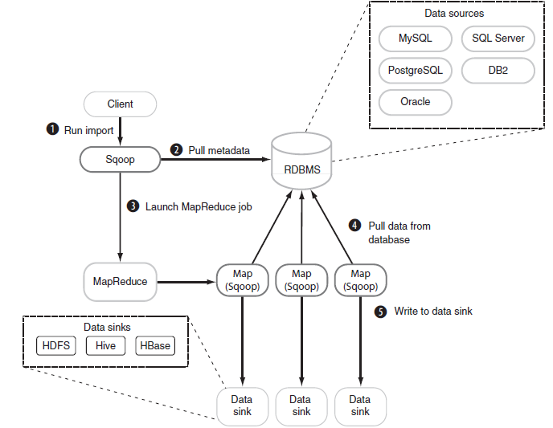
Sqoop Architecture
Notes:
3

Slide 4
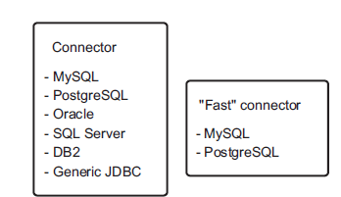
Supported databases
Need to add vendor specific drivers in $SQOOP_HOME/lib
Sqoop connectors are used to read and write to external systems
Sqoop comes with 2 classes of connectors
Common connector - for regular reads and writes
Fast connector – Uses database-proprietary batch mechanisms for efficient imports

Slide 5
File Formats
Two file formats:
• Delimited text
• SequenceFiles
•Delimited Text File
• Default import format, explicitly as --as-textfile
• Default delimiters are comma(,) for fields , a newline (\n) for records.
• Sequence File --as-sequencefile

Slide 6
Installation
• Download Sqoop-*.tar.gz
• tar –xvfsqoop-*.*.tar.gz
• export HADOOP_HOME=/some/path/hadoop-dir
• Please add the vendor Specific JDBC jar to $SQOOP_HOME/lib
• Change to Sqoop Bin folder
• ./sqoophelp

Slide 7
Sqoop – Commands
sqoop help
Or We can use: sqoop COMMAND [ARGS]
Available commands:
•codegen
•Generate code to interact with database records
•create-hive-table
•Import a table definition into Hive
•eval
•Evaluate a SQL statement and display the results
•export
•Export an HDFS directory to a database table help List available commands
•import
•Import a table from a database to HDFS
•import-all-tables
•Import tables from a database to HDFS
•list-databases
•List available databases on a server
•list-tables
•List available tables in a database version Display version information

Slide 8
Mysql - Connectivity
mysql–u root –p
•Enter password:root
•show databases;
•use test;
•mysql>CREATE TABLE patient( pid INT(10),name VARCHAR(20),drug VARCHAR(20),tot_amt INT(10));
•mysql>insert into patient values(1,'saravanan','avil',100);
•mysql>insert into patient values(2,'senthil','metacin',200);
•mysql>insert into patient values(3,'Gowtham','paracetamol',300);
•mysql>select * from patient;

Slide 9
Sqoop Evaluate
Evaluate a SQL statement
• bin/sqoop eval--connect jdbc:mysql://localhost/test -username root -password root –query "SELECT * FROM patient"
• bin/sqoop eval--connect jdbc:mysql://localhost/test -username root -password root --query "SELECT * FROM patient LIMIT 2"
• bin/sqoop eval--connect jdbc:mysql://localhost/test -username root -password root --query "INSERT INTO patient VALUES(4, ‘amudhan’,'avil',400)”

Slide 10
Sqoop List
Sqoop-list-databases
• bin/sqoop list-databases --connect jdbc:mysql://localhost/
information_schema-username root -password root
• Sqoop-list-tables
bin/sqoop list-tables --connect jdbc:mysql://localhost/test username root -password root

Slide 11
Sqoop Import: mysql to hdfs
bin/sqoop import --connect jdbc:mysql://localhost/test -username root –password root --table patient -m 1
Imports “patient” table into HDFS directory
•Data imported as text or SequenceFiles
• Sqoop generates java file(patient.java) for our use
•Instead we can use codegen
• bin/hadoop dfs –cat /user/username/patient/part-00000
•All values re displayed
•These files can be used as input to MR jobs.

Slide 12
Sqoop Export
Exports a set of files from HDFS back to an RDBMS
• The target table must already exist in the database
• The input files are read and parsed into a set of records according to the user-specified delimiters.
• Does not export from HBase

Slide 13
hdfs to mysql
• bin/sqoop export --connect jdbc:mysql://localhost/test -username root -password root --table patient --export-dir /user/sasken/patient
•hive to mysql:
• bin/sqoop export --connect jdbc:mysql://localhost/test --table patient --export-dir /user/hive/warehouse/patient --username root --password root -m 1

Slide 14
Job Creation
Creating a job and store it in metastore
sqoop job --create stock_increment -- import \
--append \
--check-column "quote_date" \
--incremental "lastmodified" \
--last-value "2005-01-01" \
--connect jdbc:mysql://localhost/sqoop_test \
--username hip_sqoop_user \
--table stocks
List all jobs in the metastore
$ sqoop job --list
Available jobs:
stock_increment
To Execute your job
- $ sqoop job --exec stock_increment
To show the job’s meta data information
$ sqoop job --show stock_increment
incremental.last.value = 2011-11-24 15:09:38.0
Notes:
14

Slide 15
Fast connectors
To enable use of the fast connector you must specify the --direct argument:
$ hadoop fs -rmr stocks
$ sqoop --options-file ~/.sqoop_import_options.txt --direct
--connect jdbc:mysql://localhost/sqoop_test --table stocks
What are the disadvantages of fast connectors?
First, only MySQL and PostgreSQL are currently supported. Fast connectors also only work with text output files—specifying Avro or SequenceFile as the output format of the import won’t work.
Notes:
By default sqoop run with 4 mappers
15

Slide 16
Incremental Imports
Import data that’s newer than 01 Jan, 2005
$ sqoop --options-file ~/.sqoop_import_options.txt --check-column "quote_date" \
--incremental "lastmodified“ --last-value "2005-01-01" \
--connect jdbc:mysql://localhost/sqoop_test --table patient
...
tool.ImportTool: --incremental lastmodified

Slide 17
Lab Exercises
Use case 1 – export an entire table
sqoop import \
--connect jdbc:mysql://localhost/test \
--username u1\
--password p1 \
--table cities
Use Case 2 – Specify a target directory
sqoop import \
--connect jdbc:mysql://localhost/test \
--username u1 \
--password p1 \
--table cities \
--target-dir /etl/input/cities

Slide 18
Lab Exercises – Contd..
Use case 3 – Use different file formats
sqoop import --connect jdbc:mysql://foo.com/db
--table orders
--fields-terminated-by '\t'
--lines-terminated-by '\n
sqoop import \
--connect jdbc:mysql://mysql.example.com/test \
--username u1 \
--password p1 \
--table cities \
--as-sequencefile
Avro can be enabled by specifying the --as-avrodatafile parameter:
sqoop import \
--connect jdbc:mysql://mysql.example.com/test \
--username u1 \
--password p1 \
--table cities \
--as-avrodatafile
Use case 4 – Import only a subset of the dataset
Sqoop import \
--connect jdbc:mysql://localhost/test \
--username u1\
--password p1\
--table patient \
--where “amount > 1000'“

Slide 19
Lab Exercises – Contd..
Use case 5 –import all the tables
sqoop import-all-tables \
--connect jdbc:mysql://mysql.example.com/test \
--username u1 \
--password p1
Use case 6 – Run the import process in parallel
sqoop import \
--connect jdbc:mysql://mysql.example.com/test\
--username u1 \
--password p1 \
--table cities \
--num-mappers 10

Slide 20
Lab Exercises – Contd..
Use case 7 – Incrementally load data
sqoop import \
--connect jdbc:mysql://localhost/test \
--username u1 \
-- password p1 \
--table visits \
--incremental lastmodified \
--check-column last_update_date \
--last-value "2014-06-22 01:01:01“
The import process will have 2 different MR jobs . It will first import the delta records into a temporary folder and the other MR job will pick up these delta and merge it together with the final data set.

Slide 21
Lab Exercises – Contd..
Use case 8 – Import data by joining more than one table
sqoop import \
--connect jdbc:mysql://localhost/test \
--username u1 \
--password p1 \
--query 'SELECT emp.id, \
dept.deptid, \
emp.salary \
FROM emp \
JOIN dept USING(dept_id) \
WHERE $CONDITIONS' \
--split-by id \
--target-dir cities

Slide 22
Lab Exercises – Contd..
Use case 9 – Tranport the portion of data from Hadoop
sqoop export \
--connect jdbc:mysql://localhost/test \
--username u1\
--password p1 \
--table patient \
--columns pid,drug,amount
Use case 10 – Tranport the data from Hadoop
sqoop export \
--connect jdbc:mysql://localhost/test \
--username u1 \
--password p1\
--table patient \
--export-dir patient

Slide 23
Lab Exercises – Contd..
Use case 11 – Using a non csv file format
sqoop import \
--connect jdbc:mysql://localhost/test \
--username u1 \
--password p1 \
--table patient \
--as-sequencefile
sqoop import \
--connect jdbc:mysql://localhost/test \
--username u1 \
--password p1 \
--table cities \
--as-avrodatafile
Use case 12 – Importing data into hbase
sqoop import \
--connect jdbc:mysql://localhost/test \
--username u1 \
--password p1\
--table patient \
--hbase-table patient\
--column-family patient

Slide 24
Lab Exercises – Contd..
Use case 13 – Store the jobs in metastore
sqoop job \
--create mypatientjob \
import \
--connect jdbc:mysql://localhost/test \
--username u1 \
--password p1 \
--table patient \
--incremental append \
--check-column pid \
To check the job which is in the metastore
sqoop job –list
sqoop job –exec mypatientjob
sqoop job –exec mypatientjob -- --verbose
sqoop job –show mypatientjob /* To display the parameters of the saved job
sqoop job –delete mypatientjob
Use case 14 – Bulk transfer
sqoop import \
--connect jdbc:mysql://localhost/test \
--username u1 \
--table cities \
--direct
Bypassing the JDBC interface and uses the native utilities while transferring the data

Slide 25
sqoop export \
--connect jdbc:mysql://mysql.example.com/sqoop \
--username sqoop \
--password sqoop \
--table cities \
--input-null-string '\\N' \
--input-null-non-string '\\N
sqoop export \
--connect jdbc:mysql://mysql.example.com/sqoop \
--username sqoop \
--password sqoop \
--table cities \
--update-key id \
--update-mode allowinsert

