Slide 1
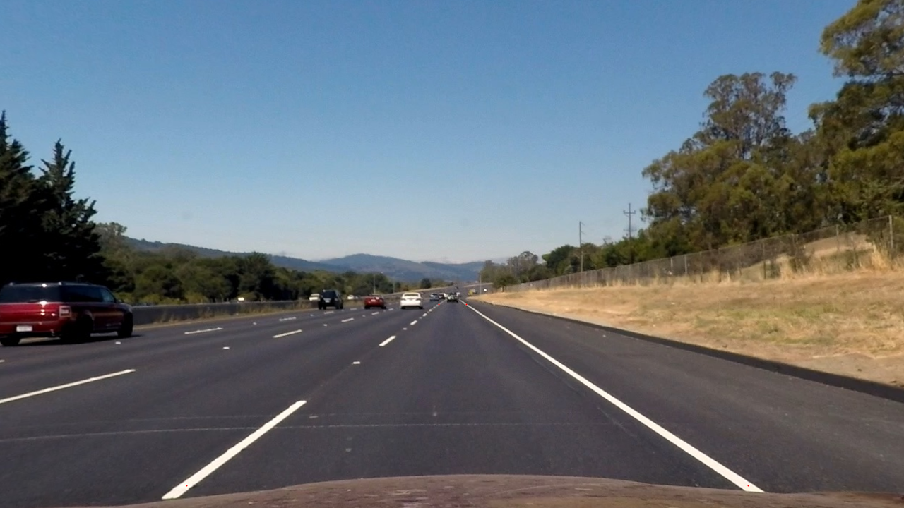
V
D
C
A
B

