Slide 1

Imperceptible Misclassification Attack on Deep Learning Accelerator by Glitch Injection
Wenye Liu¹, Chip-Hong Chang¹, Fan Zhang² and Xiaoxuan Lou²
¹School of Electrical and Electronic Engineering, Nanyang Technological University, Singapore
²College of Computer Science and Technology, Zhejiang University, China

Slide 2
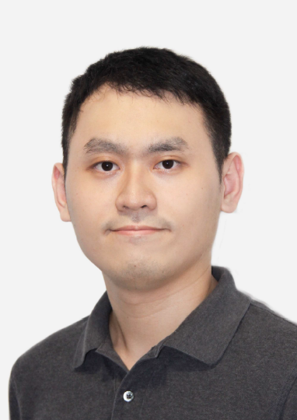
Speaker
Wenye Liu
wliu015@e.ntu.edu.sg
I am currently pursuing a Ph.D. degree with the School of Electrical and Electronic Engineering, Nanyang Technological University, Singapore.
My research interests include machine learning accelerator, hardware security, and fault injection attack.

Slide 3
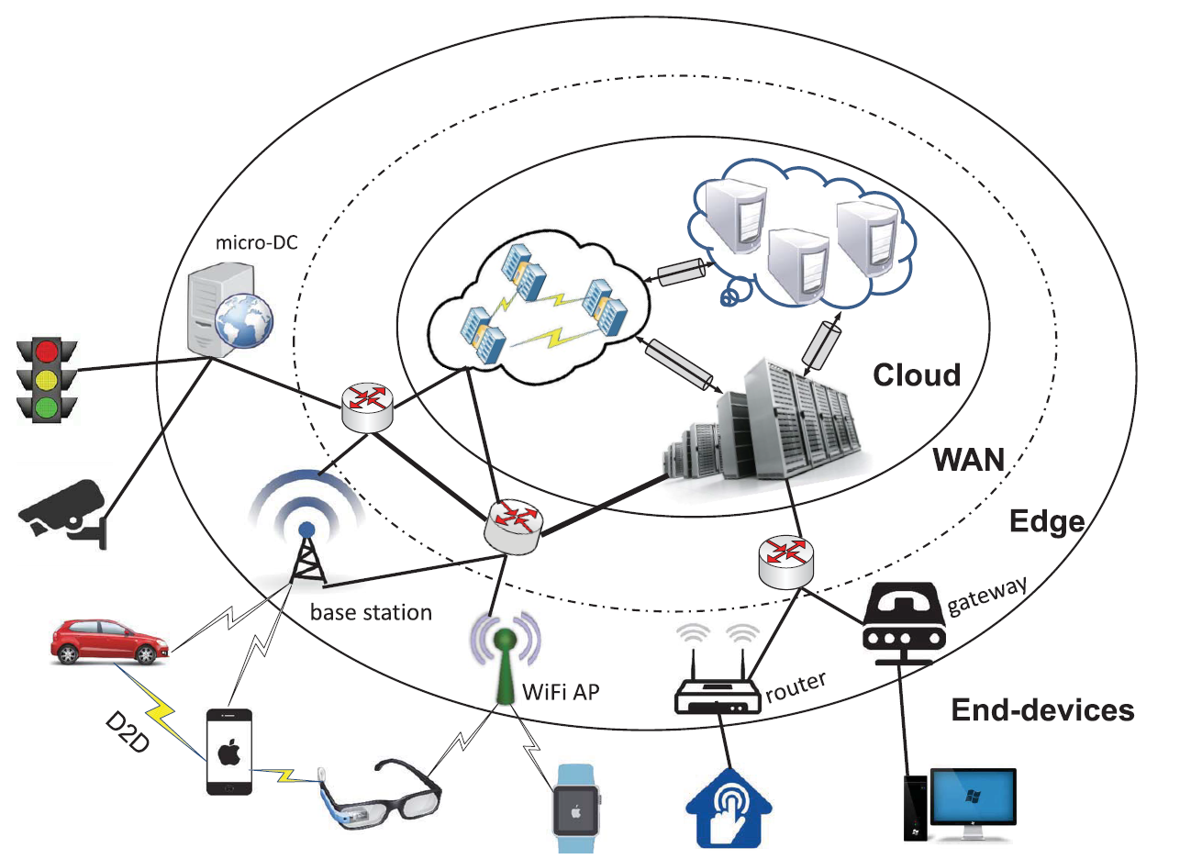
Edge Intelligence - AIoT
Deep learning algorithm on endpoint device
Unlock edge applications
Efficient hardware accelerator
Security and robustness considerations
Existing vulnerabilities
New potential attack vectors
Zhou et al. Proceedings of the IEEE 2019

Slide 4
Existing Security flaws (1)
Input of adversarial examples
Add carefully crafted perturbations on original sample
Subvert correct prediction on well-trained classifier
Restrictions
All the pixels should be shifted
Any pixel can be altered to arbitrary value
Szegedy et al. ICLR 2014

Slide 5
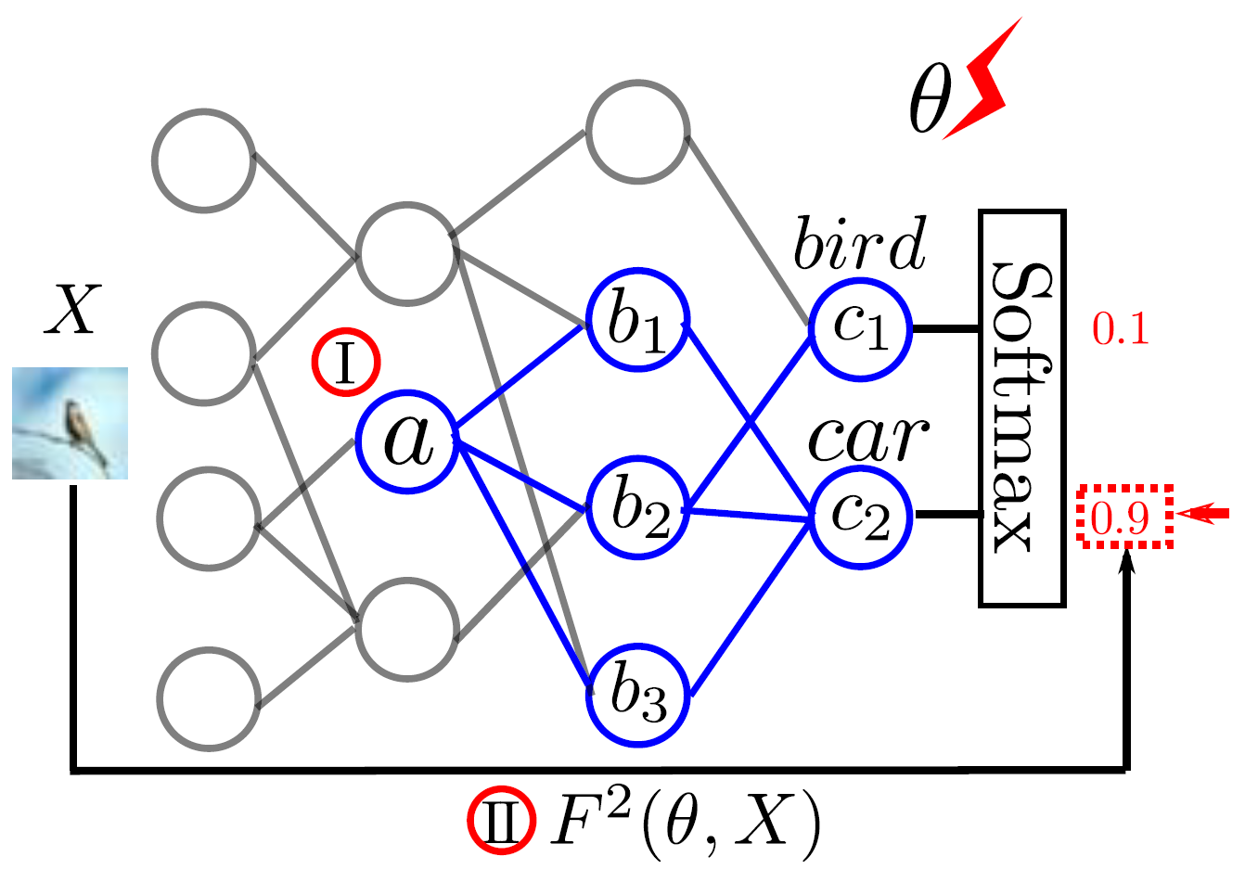
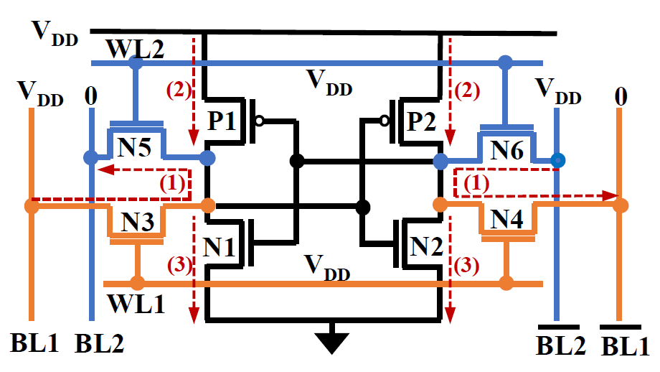
Existing Security flaws (2)
Model parameters interpolation
Saturating last layer’s bias (ICCAD’17)
Fault sneaking attack (DAC’19)
Leave non-erasable traces in memory
Physical fault attack on edge DNN device
Instruction skip faults by laser beam (CCS’18)
Memory collision on dual-port RAM (FDTC’19)
Evaluate on MCU or small-scale problem
Liu et al. ICCAD 2017
Alam et al. FDTC 2019
We introduce a stealthy misclassification attack on DNN accelerator for ImageNet applications

Slide 6
General DNN Accelerator
Highly parallel and energy-efficient PE array
Host processor and peripherals
On-chip buffer and controller
PE array has a separate clock/voltage domain from other modules, which become an exploitable source of vulnerability

Slide 7
Threat Model
Delude a physically deployed deep learning accelerator without leaving trace for detection
Rule out invasive and tamper-evident probing attacks.
No low-level implementation details
Black-box and gray-box penetrations
No knowledge of DNN model
Know model architecture and image

Slide 8

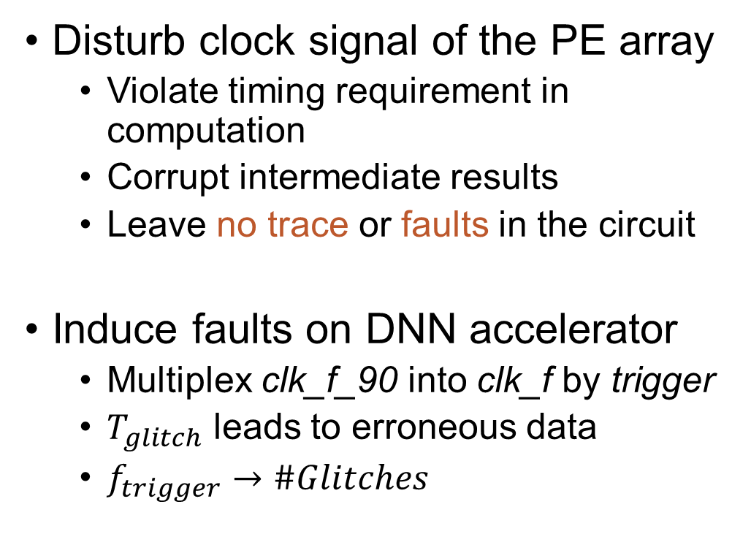
Imperceptible Misclassification Attack
Disturb clock signal of the PE array
Violate timing requirement in computation
Corrupt intermediate results
Leave no trace or faults in the circuit
Induce faults on DNN accelerator
Multiplex clk_f_90 into clk_f by trigger
$T_{glitch}$ leads to erroneous data
$f_{trigger}→\#Glitches$
$$T_{clk}≥ t_{pcq}+t_{pd}+t_{setup}+t_{skew}$$
Timing Diagrams of Glitch Injection into Deep Learning Accelerator

Slide 9
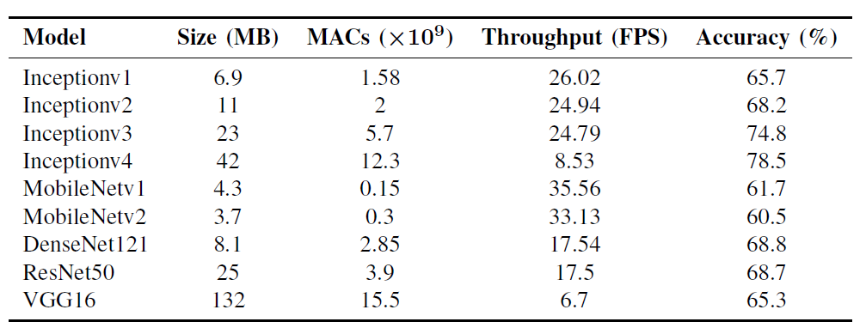
Black Box and Gray Box Attack
Black box setting
Directly apply clk_mux to PE array
Image and model independent attack
Gray box setting
Induce faults on internal layer
Minimize glitch injections
Evaluation platform on Xilinx ZCU102 board
Nine ImageNet models under evaluation

Slide 10
Results of Black Box Attack
Black-box Attack on Nine ImageNet Models
ImageNet - entire validation set
50000 images
A set of glitch Intensity
0.01% - 10%
> 98% misclassification on 8 models
40% on VGG16
No clear distinctive relationship
Vulnerability among Model Architectures

Slide 11
Results of Gray Box Attack
Effective Attack Pattern on ResNet50 of IMG44 and IMG154
Glitch injection on selected layer
IMG44 is highly vulnerable
IMG154 can only be misclassified on 5 layers
Misclassify 256 images
by glitch injection into one layer
< 1.7% actual glitch intensity

Slide 12
Potential Countermeasures
Improve the robustness of DNN models
Defensive quantization (ICLR’19)
Employ one single domain of the accelerator
Reduce energy efficiency
Double DSP usage and 33.7% overhead of LUTs

Slide 13
Conclusion
Inconspicuous attack on dedicated deep learning accelerator
Perturb clock signal to the PE array infrequently
Leave no sign after the attack
Demonstrate the attack on FPGA platform
> 98% misclassification on 8 models in black box attack
5.9x less glitch intensity to fool the classifier in gray box attack

Slide 14
Questions

