Slide 2


Terminator on SkyNet: A Practical DVFS Attack on DNN Hardware IP for UAV Object Detection
Junge Xu, Bohan Xuan, Anlin Liu,
Mo Sun, Fan Zhang and Kui Ren
Zhejiang University, China
This work is partly supported by Alibaba-Zhejiang University Joint Institute of Frontier Technologies
Notes:
Hello, everyone.
This is junge xu from Zhejiang university, china
on behalf of my superviser, doctor fan zhang
im going to present our work Terminator on SkyNet: A Practical DVFS Attack on DNN Hardware IP for UAV Object Detection
This work is supported by Alibaba-Zhejiang University Joint Institute of Frontier Technologies

Slide 3


Team SkrSkr
The second place in the DAC-SDC 2020
The championship in the DAC-SDC 2021
Special thanks to Dr. Weixiong Jiang and Prof. Yajun Ha for assistance and discussion
Prof. Yajun Ha
Dr. Weixiong Jiang
Notes:
Team SkrSkr won the second place in the DAC-SDC 2020 and the championship in the DAC-SDC 2021
Our work is based on their outstanding achievements.
Thanks to Dr. Weixiong Jiang and Prof. Yajun Ha for assistance and discussion

Slide 4

Fan (Terry) Zhang
Professor
School of Cyberscience and Technology
College of Computer Science and Technology
Zhejiang University, China
Research:
Hardware Security
AI Security
Network Security
https://person.zju.edu.cn/en/fanzhang
Notes:
doctor fanzhang is a professer coming from College of Computer Science and Technology, Zhejiang University, China
His main research areas include Hardware Security , AI Security and Network Security.

Slide 5
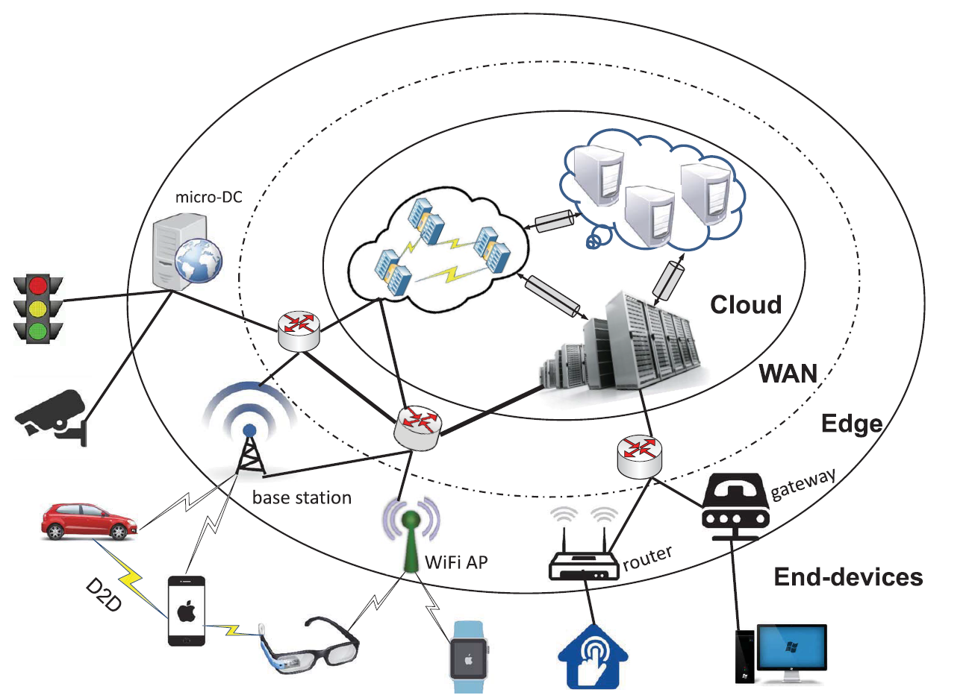
FPGAs in AIoT
Promising edge computing platforms
A great diversity of edge intelligence applications
Efficient hardware accelerator
Security and robustness considerations
Existing vulnerabilities
New attack vectors
Zhou et al. Proceedings of the IEEE 2019
Notes:
Now lets get down to our presentation
Given their high flexibility and energy efficiency, FPGAs have become
one of the most promising edge computing platforms.
Deep learning empowers a great diversity of edge applications on FPGAs, like self-driving car and intelligent home.
Due to the energy and resource constraints on endpoint device, efficient hardware accelerators have been developed in recent years.
However, the raising concerns on its robustness and security have
not been fully summarized and fully addressed, which include Existing vulnerabilities and New attack vectors.

Slide 6

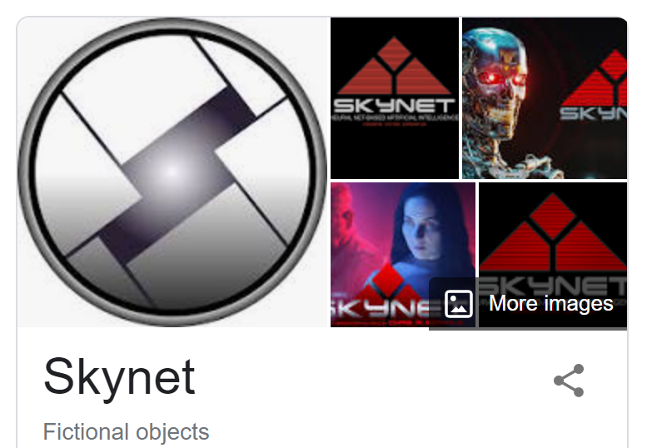




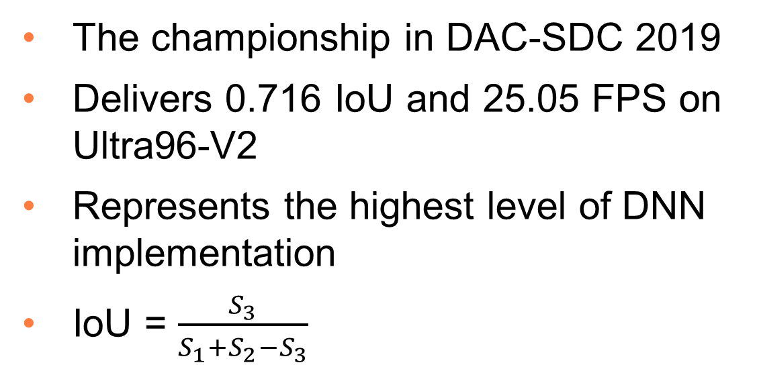
SkyNet Accelerator
The championship in DAC-SDC 2019
Delivers 0.716 IoU and 25.05 FPS on Ultra96-V2
Represents the highest level of DNN implementation
IoU = $\frac{S_{3}}{S_{1}+S_{2}−S_{3}}$
SkyNet detection box$S_{2}$
Ground truth detection box ${ S}_{1}$
$${intersection S}_{3}$$
Notes:
In our work, we evaluate our proposed attack on the Skynet accelerator,
which won the championship in DAC-SDC 2019. SkyNet delivers 0.716 IoU and 25.05 FPS on an Ultra96-V2.
SkyNet is a highly-advanced computer system possessing artificial intelligence in the movie the terminator. And the SkyNet accelerator Represents the highest level of DNN implementation in FPGA. Our attack, like a terminator on the detection accuracy of SkyNet, aims at inducing temporal faults into the intermediate results of the network.
Lets take a look on the definition of IoU.
We set the area of the Ground truth detection box as S1, and the area of the SkyNet detection box as S2, then IoU is equal to the intersection area S3 divided by the union area S1 plus S2 minus S3.

Slide 7

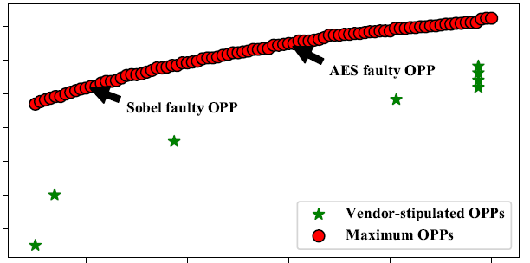
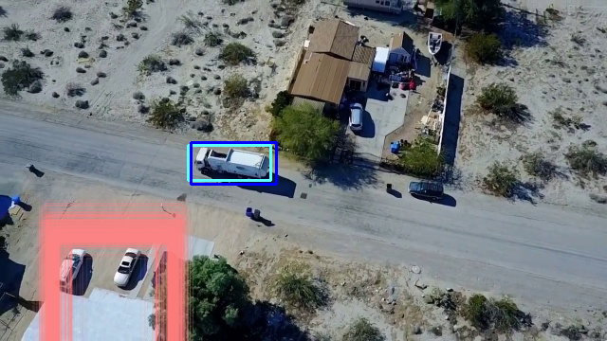

Dynamic Voltage and Frequency Scaling (DVFS)
Widely deployed on GPU, CPU and FPGA
Regulates frequency and voltage
Real time scheduling
Reduces power consumption
Security considerations
Out-of-specification voltage and frequency combinations
DVFS
Majid et al. Design Automation Conference 2020
Notes:
The need for better performance and energy-efficiency
drives the development of the DVFS mechanism, which is widely deployed on GPU, CPU and FPGA.
It regulates the frequency and voltage of processors to reduce energy consumption according to their real-time computation requirements.
However, designers of DVFS may do not fully consider the security of it. Out-of-specification voltage and frequency combinations may lead to erroneous results.

Slide 8
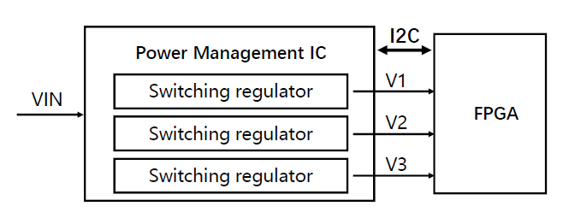
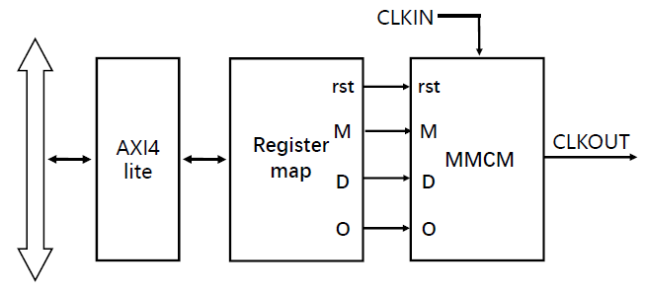
DVFS Framework
Dynamic voltage and frequency scaling
Dynamic voltage scaling (DVS)
Power management IC (PMIC)
Accessed via I2C interface
Dynamic frequency scaling (DFS)
Mixed-Mode Clock Manager (MMCM)
Accessed via AXI4-Lite interface
Notes:
Our DVFS framework is implemented with the PMIC and the MMCM.
PMIC controls and monitors the switching regulators to provide different voltage to various components on FPGA,
It can be Accessed via I2C interface. MMCM can generate all the desired clock signals of the SkyNet accelerators. It can be Accessed via AXI4-Lite interface

Slide 9
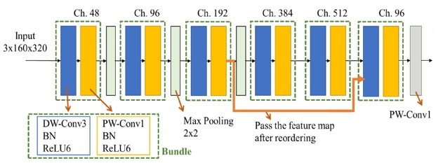
Threat Model
DVFS faults
Black box scenario
Global fault injection
No low-level implementation and DNN details
Image independent attack
Local fault injection
Consideration of the attack cost and stealthiness
Short fault injection duration
DVFS faults
Notes:
Here is our Threat model. Black box scenario is considered, including Global fault injection and Local fault injection.
For Global fault injection, the attacker has No low-level implementation and DNN model details.
And we Faults into the whole inference procedure, which is an image and model independent attack. For local fault injection,
Due to the consideration of the attack cost and stealthiness, we induce faults in a short fault injection duration.

Slide 10

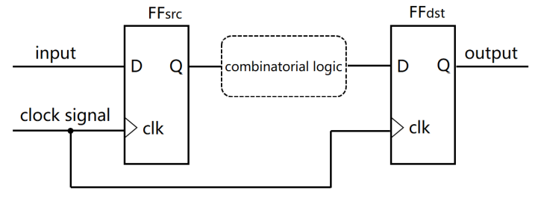
Timing Constraints and Violations
Timing constraints of flip-flops (FFs)
Timing constraints can be violated by overclocking or undervolting
Intermediate results corruption
Leave no trace or faults in the circuit
Notes:
Under normal operations, the PE array should fulfill the timing Constraints showing here. overclocking or undervolting will result in Intermediate results corruptions. This disturbance will be overwritten by the correct data after each prediction. So no trace or faults will be left in the memory or the circuit to affect another prediction.

Slide 11
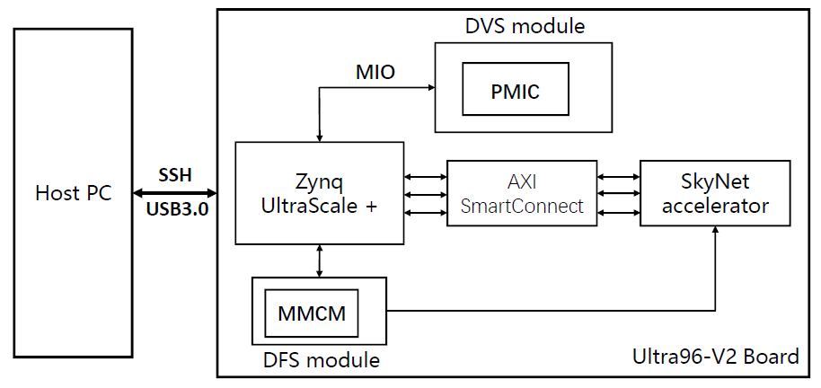
The Experiment Setup
The DVS and DFS module are utilized to scale voltage and frequency
The SkyNet is written in high-level synthesis (HLS) C++
The Ultra96-V2 is chosen as the test platform
Notes:
The attack is mounted on Xilinx Ultra96-V2 evaluation board. The seup consists of a SkyNet accelerator,
DVS module, DFS module, an ARM processor and some peripheral circuits.
The DVS and DFS module are utilized to scale voltage and frequency
And The SkyNet is written in high-level synthesis (HLS) C++

Slide 12
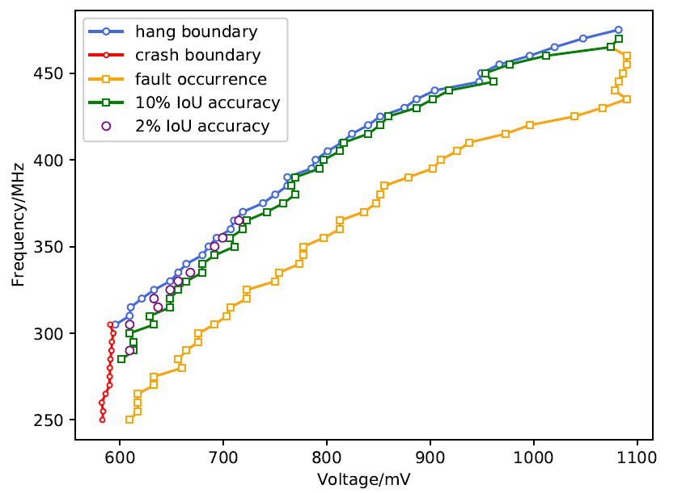
Characterization of Regulator Limits
Validation set of DAC-SDC 2019
1000 images
Operating Point Pairs (OPPs)
Scan range：voltage 580mV ~ 1100mV；frequency 250MHz ~ 480MHz
Scan step：voltage 10mV；frequency 5MHz
Determines the OPPs’ range where the accelerator will not crash or hang
Notes:
Here is the result of Characterization of Regulator Limits. We evaluate our attack on the public Validation set of DAC-SDC 2019 which has 1000 images.
We call the combination of voltage and frequency as OPPs. We scan the OPPs by incrementally increase the voltage from
about 580 millivolt to 1100 millivolt at a certain frequency from 250 megahertz
to 480 megahertz. the step size of voltage and frequency is 10millivolt and 5megahertz, respectively.
The hang-crash boundary Determines the OPPs’ range where the accelerator will not crash or hang.

Slide 13
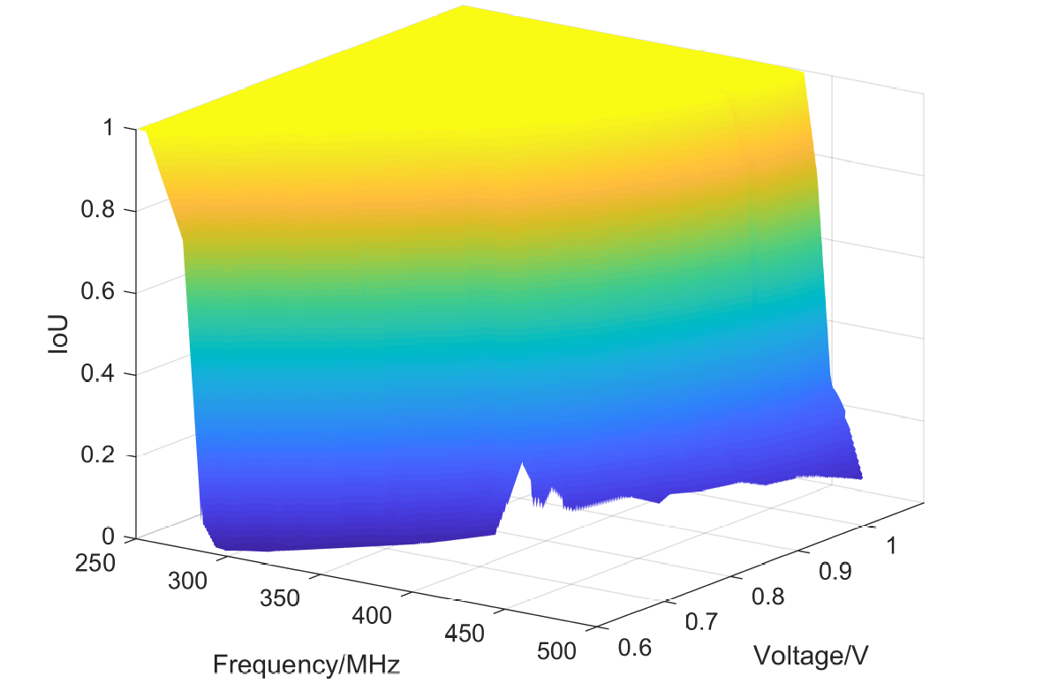
Global Fault Injection
Accuracy loss threshold
Average IoU will drop from 1
> 98% accuracy loss on the SkyNet
Without hang or crash
Notes:
Here is the result of Global Fault Injection
For every frequency from 250 megahertz to 480 megahertz, there is always a voltage threshold below which the average IoU will drop from 1.
We can find different degree of accuracy loss under different OPPs. And we can achieve more than 98% detection accuracy loss on the SkyNet.
Through the Characterization of Regulator Limits, the Global Fault Injection and the subsequent attack can be mounted without hang or crash.

Slide 14
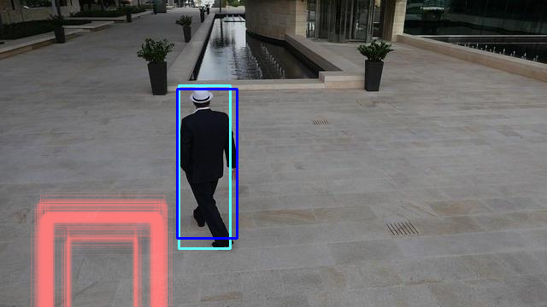
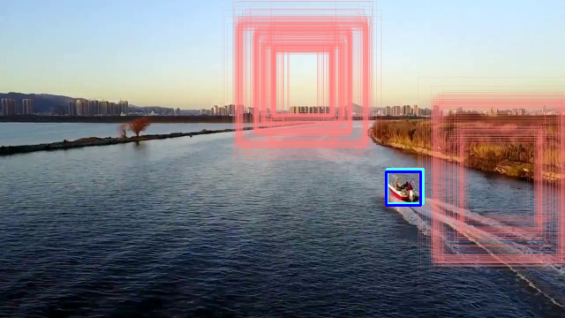
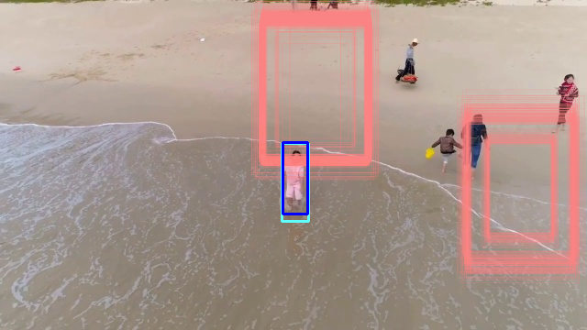
Global Fault Injection
Random faults induced
> 95% accuracy loss on randomly selected images
Notes:
To better illustrate our DVFS attack, we randomly select 4 images to be detected by the SkyNet with and without the global fault injection.
The cyan [ˈsaɪən] bounding boxes represent the ground truth. The red bounding boxes represent the results generated with the global fault injection.
For the blue ones, there is no fault injection. The uncertainty in the red boxex indicates the randomness of induced faults.
More than 95% accuracy loss can be achieved on these randomly selected images.

Slide 15
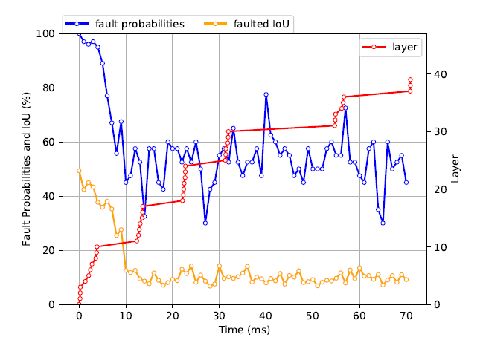
Local Fault Injection
Layers estimated as red dots
First 11 layers of SkyNet are easier to be affected
95.00% accuracy loss probability and 59.20% accuracy loss under 1ms duration
(350MHz, 700mV)
Notes:
For Local Fault Injection, we estimate each layer’s runtime of the SkyNet accelerator. we set the fault injection duration to 1 ms
with different fault injection starting time. The result indicates that the first 11 layers of SkyNet are easier to be affected by proposed attack.
With 1 ms duration injection, the attacker can achieve 95.00% fault probabilities and 59.20 % average accuracy loss.

Slide 16
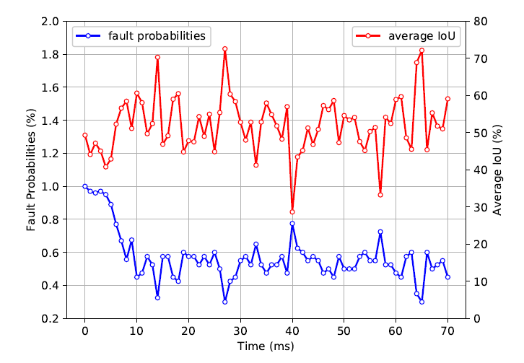
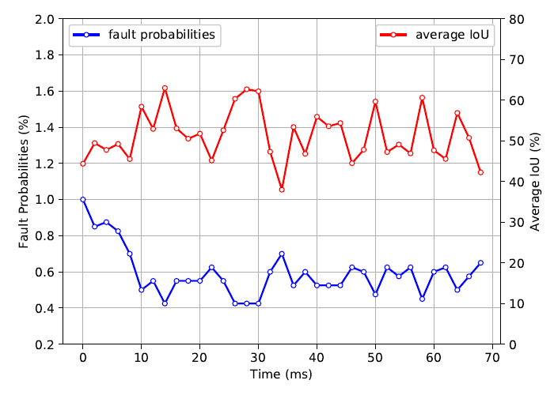
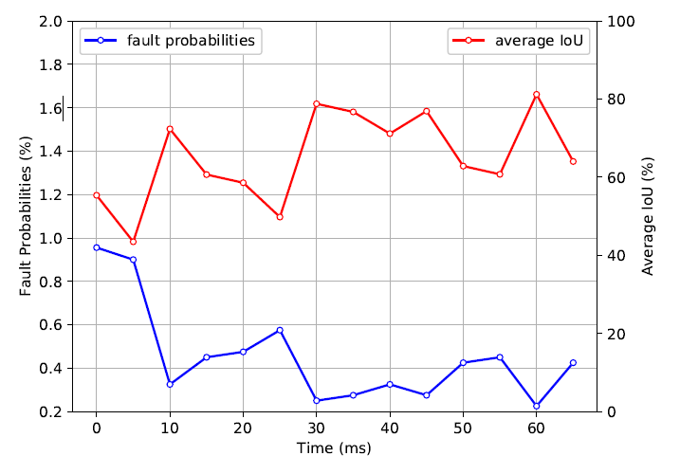
Local Fault Injection
1 ms durations is enough to induce effective faults
95.45% accuracy loss probability and 74.44% accuracy loss through doubling the fault injection density
1ms duration result
2ms duration result
5ms duration result
Notes:
Next, we investigate the influence of injection duration. Increasing the duration will not effectively enhance the attack effect when the duration less than or equal to 5ms. Such finding suggests that 1 ms duration is enough and the best choice to induce effective data corruption. When we doubling the fault injection density, we can achieve 95.45% accuracy loss probability and 74.44% accuracy loss.

Slide 17
Conclusions
Stealthy attack on dedicated deep learning accelerator
Dynamically scale voltage and frequency
Leave no trace after our attack
Demonstrate our attack on the SkyNet on our evaluation system
> 98% accuracy loss in black box scenario
1ms duration can induce effective faults into the SkyNet
Notes:
In summary, we present a Stealthy attack on dedicated deep learning accelerator by Dynamically scaling voltage and frequency.
And the attacker will Leave no trace after the attack.
We Demonstrate our attack targeting at the SkyNet on our evaluation system for both global and local fault injection in black box scenario.
More than 98% accuracy loss can be achieved in the global fault injection.
For local fault injection, 1ms duration can induce effective faults into the SkyNet accelerator.
Thank you!

Slide 18
Thank You!

